Slide 1
Atmospheric evolution: The cosmic shoreline
BPRO 28800: From Fossils to the Fermi Paradox / 29 Jan Lecture
Edwin Kite, Geophysical Sciences
Solar System and Exoplanet Habitability
(physical and chemical controls on habitability on Mars, icy moons, rocky exoplanets)
sseh.uchicago.edu

Slide 2
III. PLANETS AND EXOPLANETS
Jan 29 - Atmospheric evolution: The cosmic shoreline - Edwin Kite
Jan 31 - Diversity of rocky worlds - Leslie Rogers
Feb 5 - Planetary formation - Fred Ciesla
- Evolution of planetary systems - Daniel Fabrycky
Feb 7 - Climate, habitability on exoplanets - Dorian Abbot
Feb 14 - Detecting celestial bodies, biosignatures - Jacob Bean
Notes:
There will be a Q&A period at the end. Questions during lecture are also welcome, but the limit is one question-during-lecture per person.

Slide 3
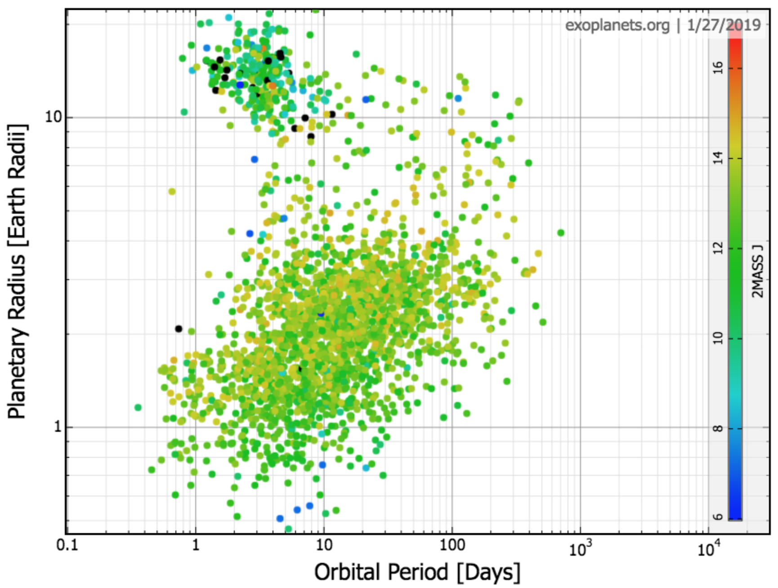
Planets are numerous … and many have atmospheres
Jupiter
planets tidally disrupted
or vaporized
planets hard to detect
Earth
Notes:
This is one of the greatest scientific achievements of humans so far this century

Slide 4
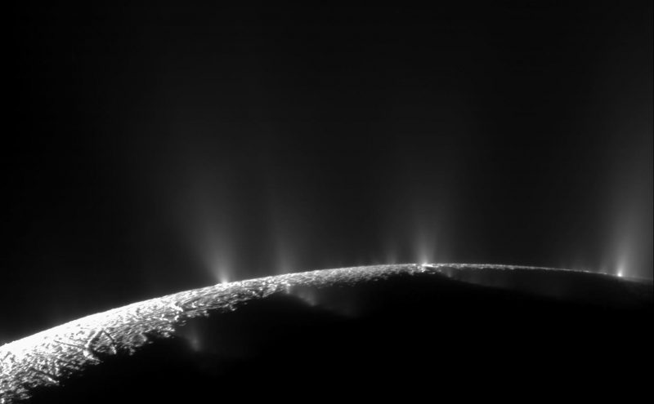
Why care about atmospheres?
(1) Detectability
visible-light image – Enceladus ( r = 252 km ) ice-covered global-ocean world
Zero atmosphere (gas released from cryovolcanoes escapes to Saturn orbit)
Cassini Project / ISS – CICLOPS / NASA / JPL

Slide 5
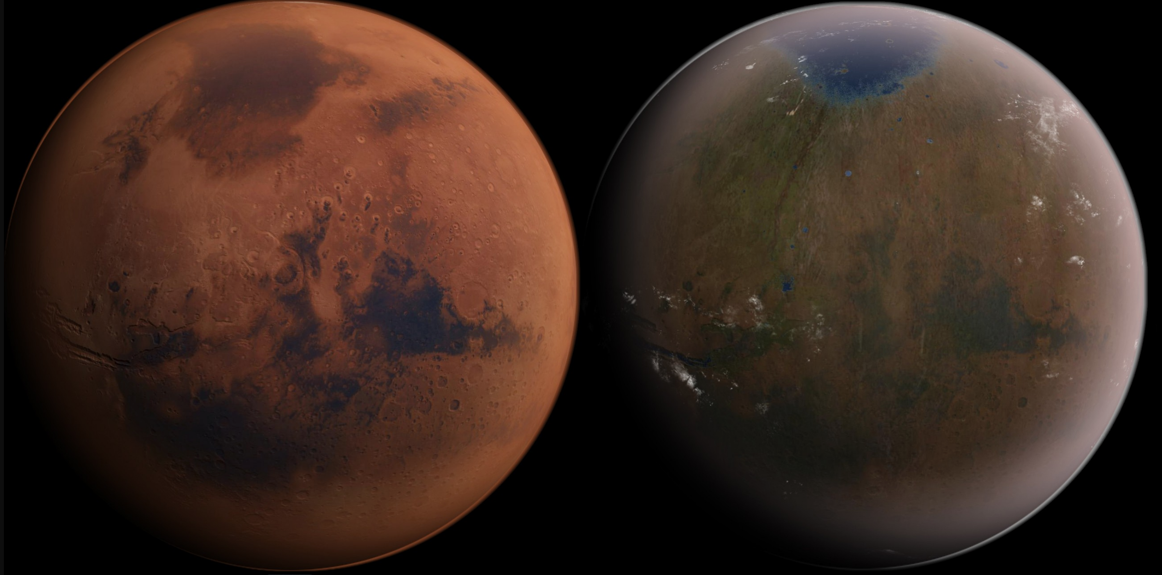
Why care about atmospheres?
(2) Energy (settlement/habitability)
2 x 10¹⁶ W
Mars in 2019
Mars in 3019?
Establish an atmosphere: how long to decay?

Slide 6
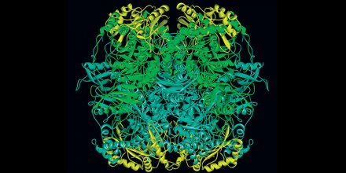
What atmosphere is required?
For us?
For land plants?
ignition
log (pCO₂)
land plants (C₃)
hypercapnia
humans
oxygen toxicity
photosynthesis ceases
log ( pO₂ )
Rubisco (catalyses CO₂->C_{org}) the most abundant enzyme.
Slow (3 reactions/protein/sec)
and apparently self-defeating
(catalyzes back-reaction C_{org} + O₂ → CO₂)
Hypothesis paper: Nisbet & Nisbet, Philosophical Transactions of the Royal Society B, 2008
Notes:
Although many animals can tolerate lower pO2 than humans, there is a minimum O2 level for complex animal life.
An ancient molecule of baroque complexity, that has been arguably an anachronism for gigayears but still dominates our planet. If it were replaced by
a hypothetical synthetic enzyme that the did the same job better, the result would be a significant increase in agricultural yield –
followed in a geologic instant by a new ice age and a rise in atmospheric oxygen to the point where a lit match could set fire to a city.

Slide 7
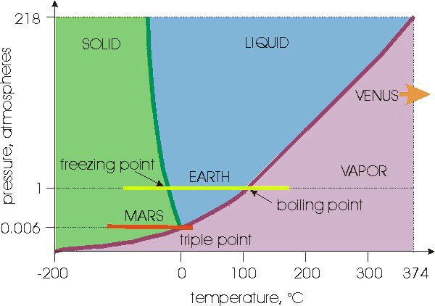
What atmosphere is required?
(3) For surface life?
http://www.iceandclimate.nbi.ku.dk
For discussion of the possibility of non-water-requiring life (e.g., in the methane lakes of Titan):
“The Limits of Organic Life in Planetary Systems,”
National Research Council, 2007. (a.k.a. the “Weird Life Report”)
Notes:
An ancient molecule of baroque complexity, that has been arguably an anachronism for gigayears but still dominates our planet,

Slide 8
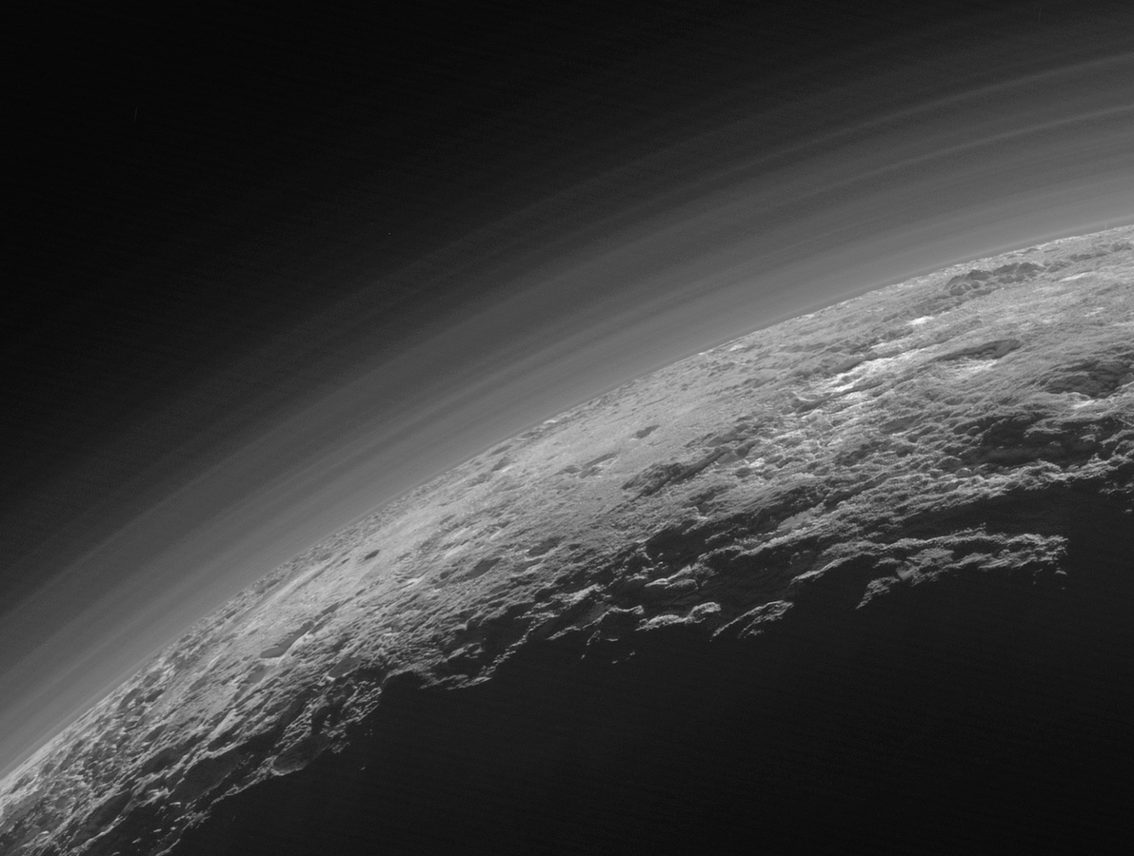
Too thin (Pluto)
Pressure: 10⁻⁵ x Earth
T = 44K
>99% N₂
for more information:
Stern et al., “The Pluto system after New Horizons,”
Annual Reviews of Astronomy & Astrophysics, 2018
NASA/JHUAPL

Slide 9
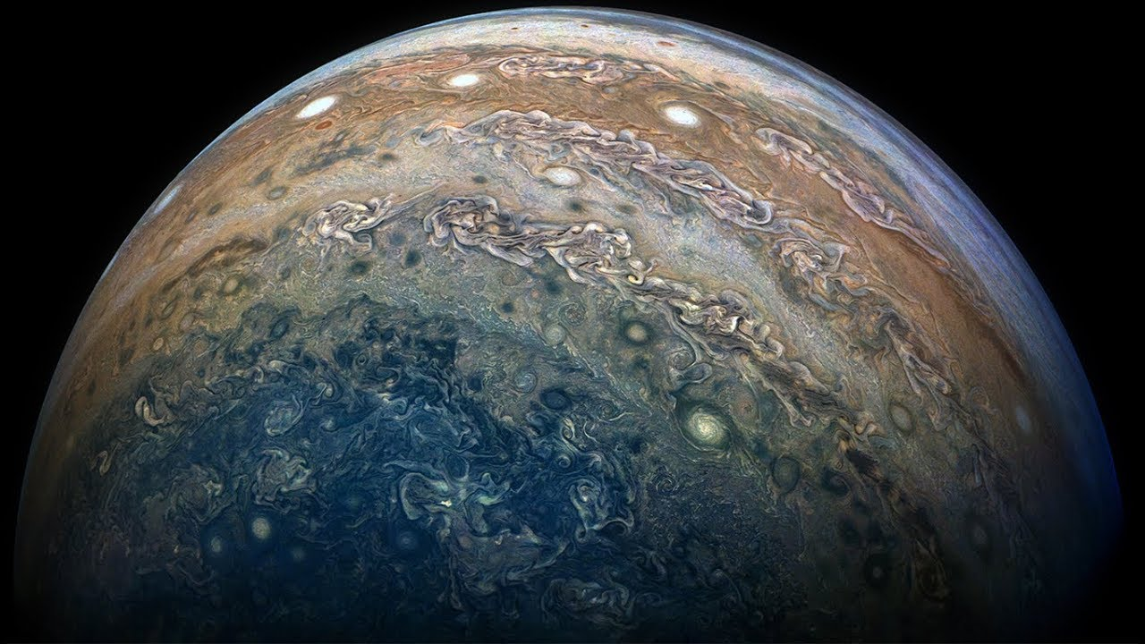
Too thick (Jupiter)
Visible-light image. NASA/JPL/Juno Project
Pressure at the top of the
rock core of Jupiter:
>10⁷ x Earth. T > 30000K
Atmosphere >99% H₂/He
for more information:
Pollack et al., “Formation of the giant planets by concurrent
accretion of solids and gas ,” Icarus, 1996

Slide 10
Why care about surfaces?
Origin of life?
Stability/buffering
T-P profiles (future of Neptune)
For more information: “The Limits of Organic Life in Planetary Systems,” National
Research Council, 2007. (a.k.a. the “Weird Life Report”)

Slide 11
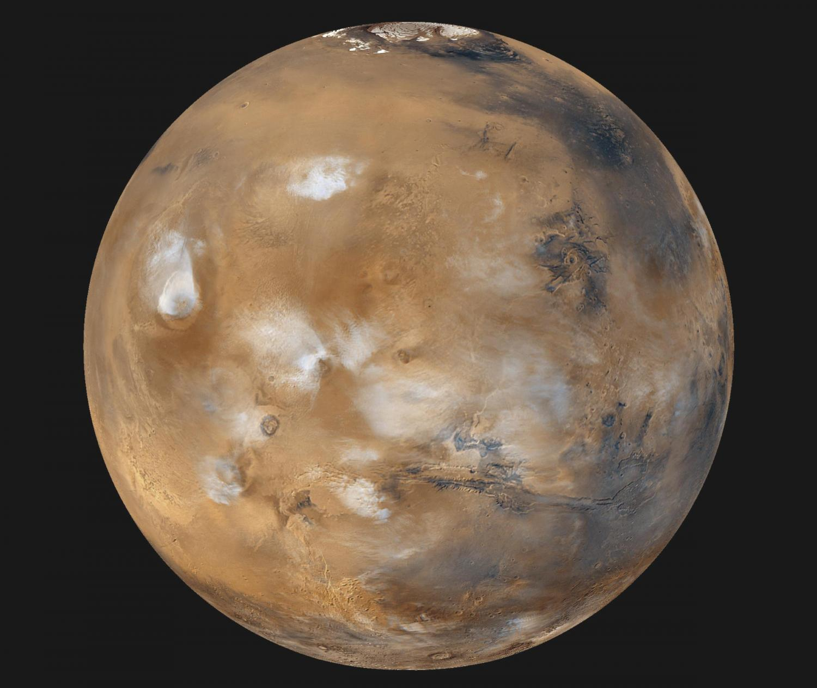
Near miss! (Mars)
Pressure: 10⁻² x Earth
T = 210K
>95% CO₂
Hubble Space Telescope – Aphelion Cloud Belt
for more information:
Forget et al., “Planet Mars: Story of Another World,” full text at
https://catalog.lib.uchicago.edu/vufind/Record/8886884

Slide 12
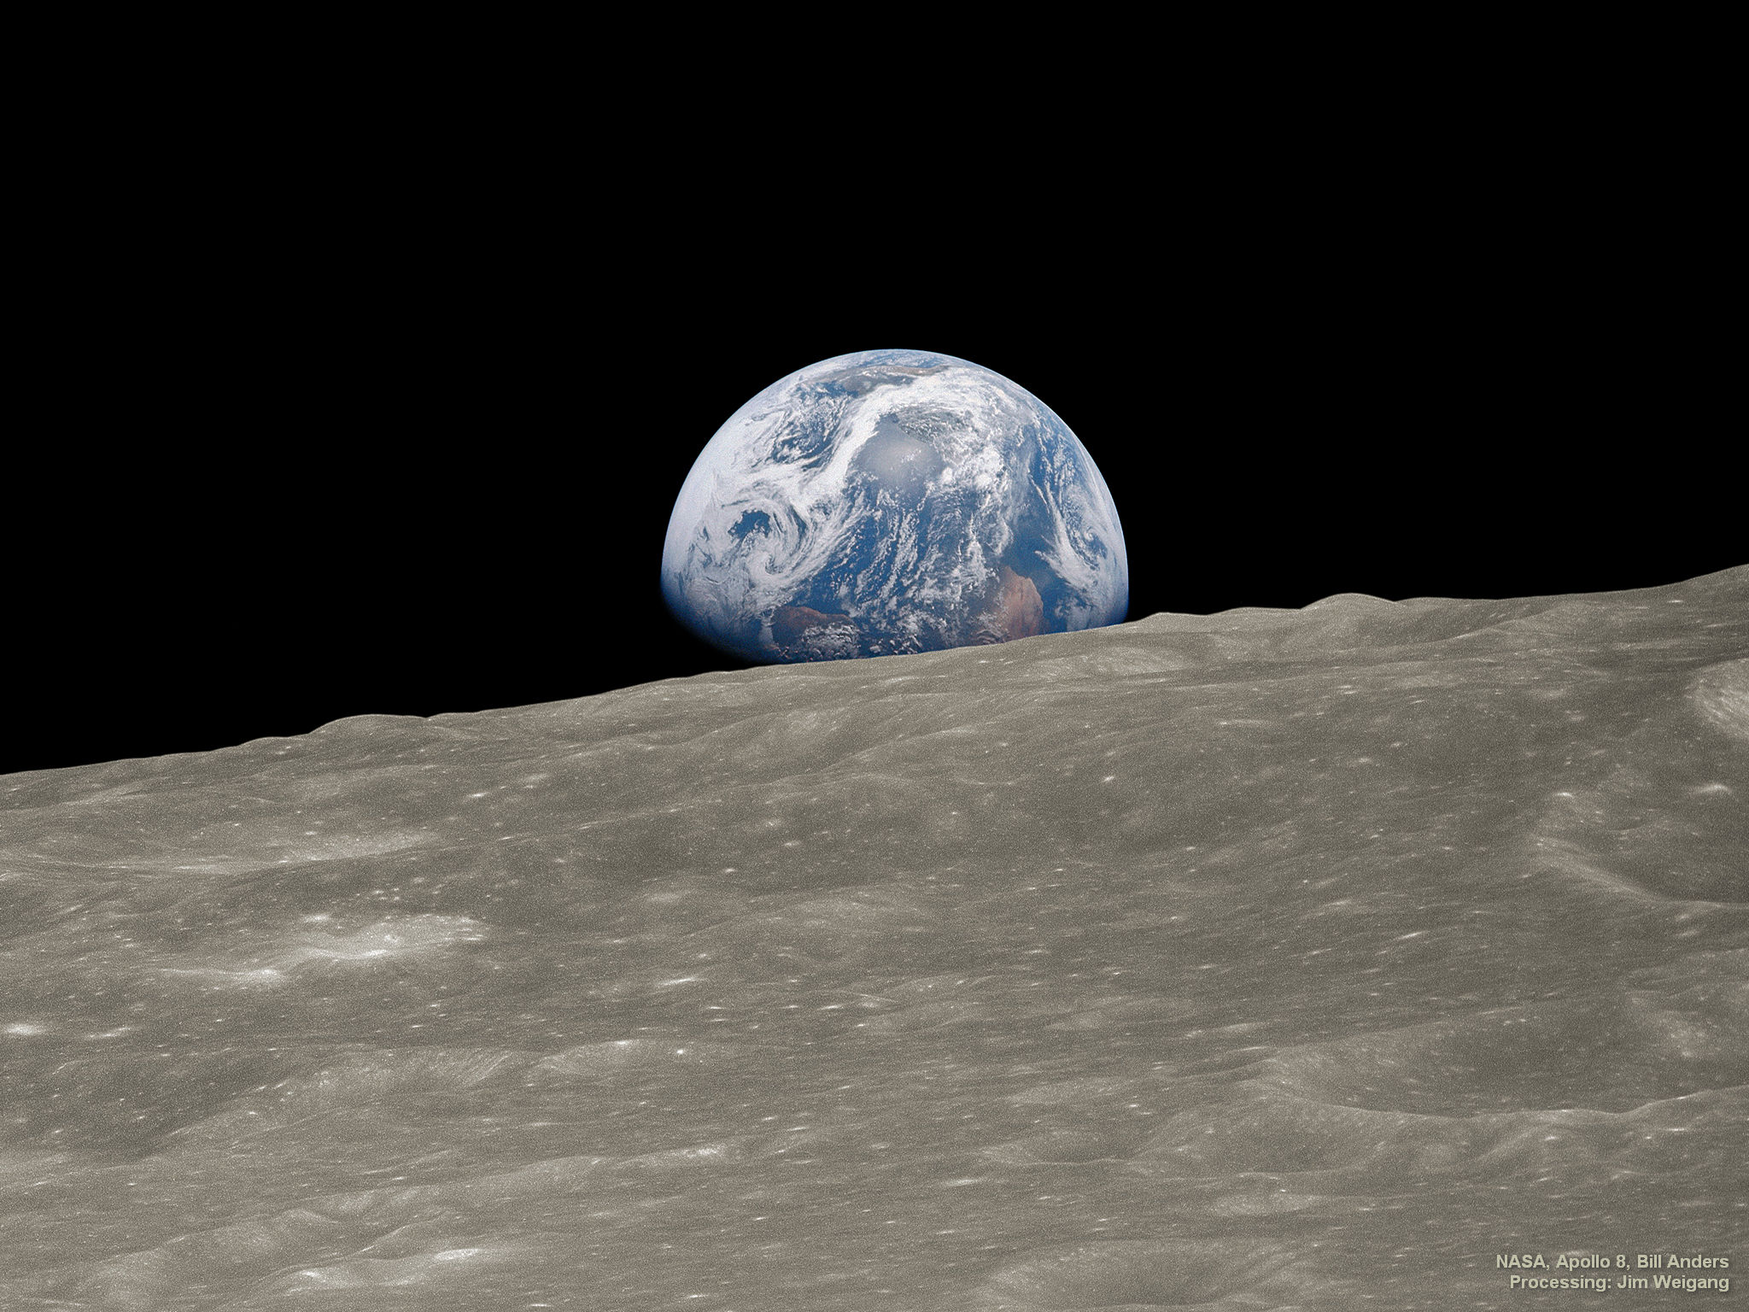
Just right …
NASA / Apollo 8 / Visible-light image.

Slide 13
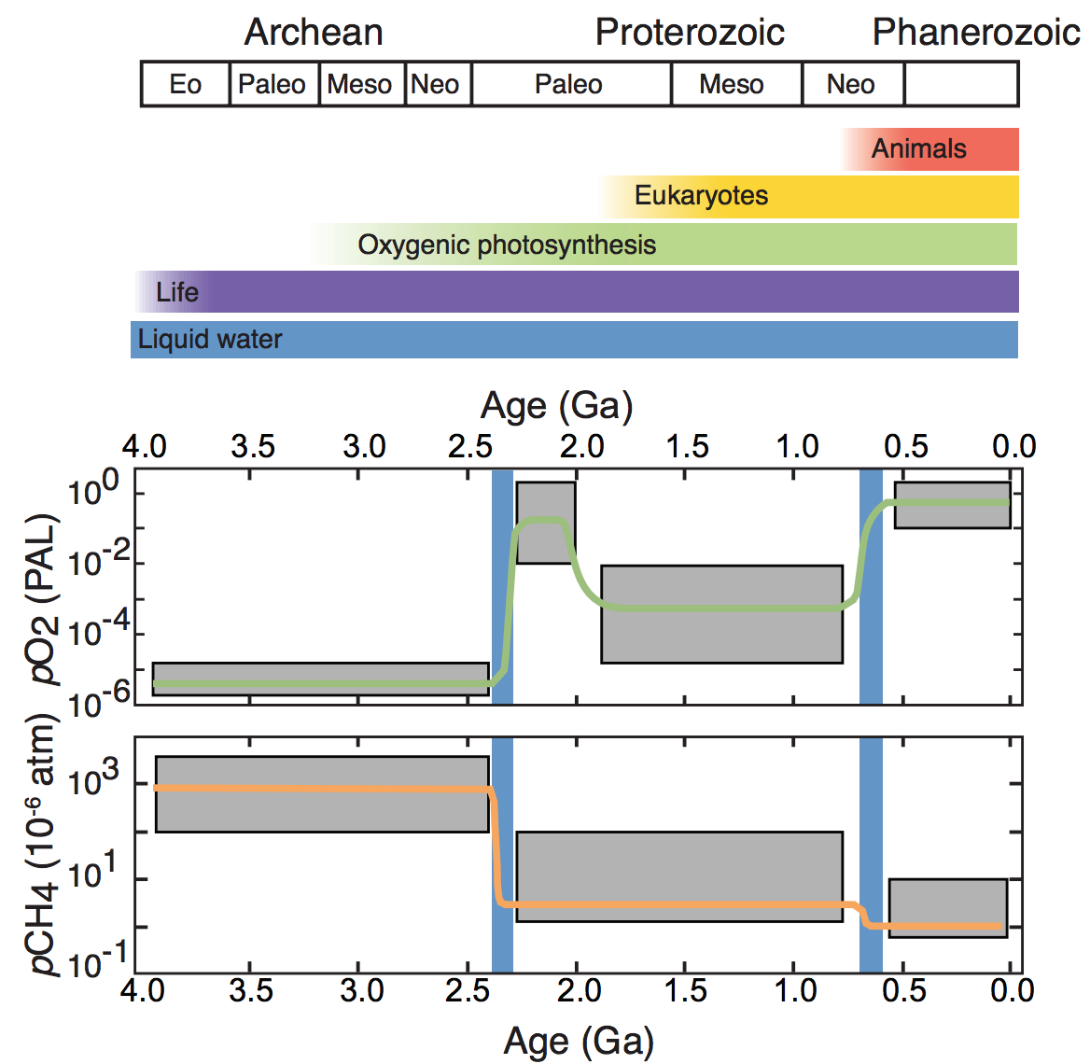
Just right …
(… at least
right now)
For more information: Olson et al., “Earth: Atmospheric Evolution of a Habitable Planet,” in
Deeg & Belmonte, Handbook of Exoplanets, 2018

Slide 14
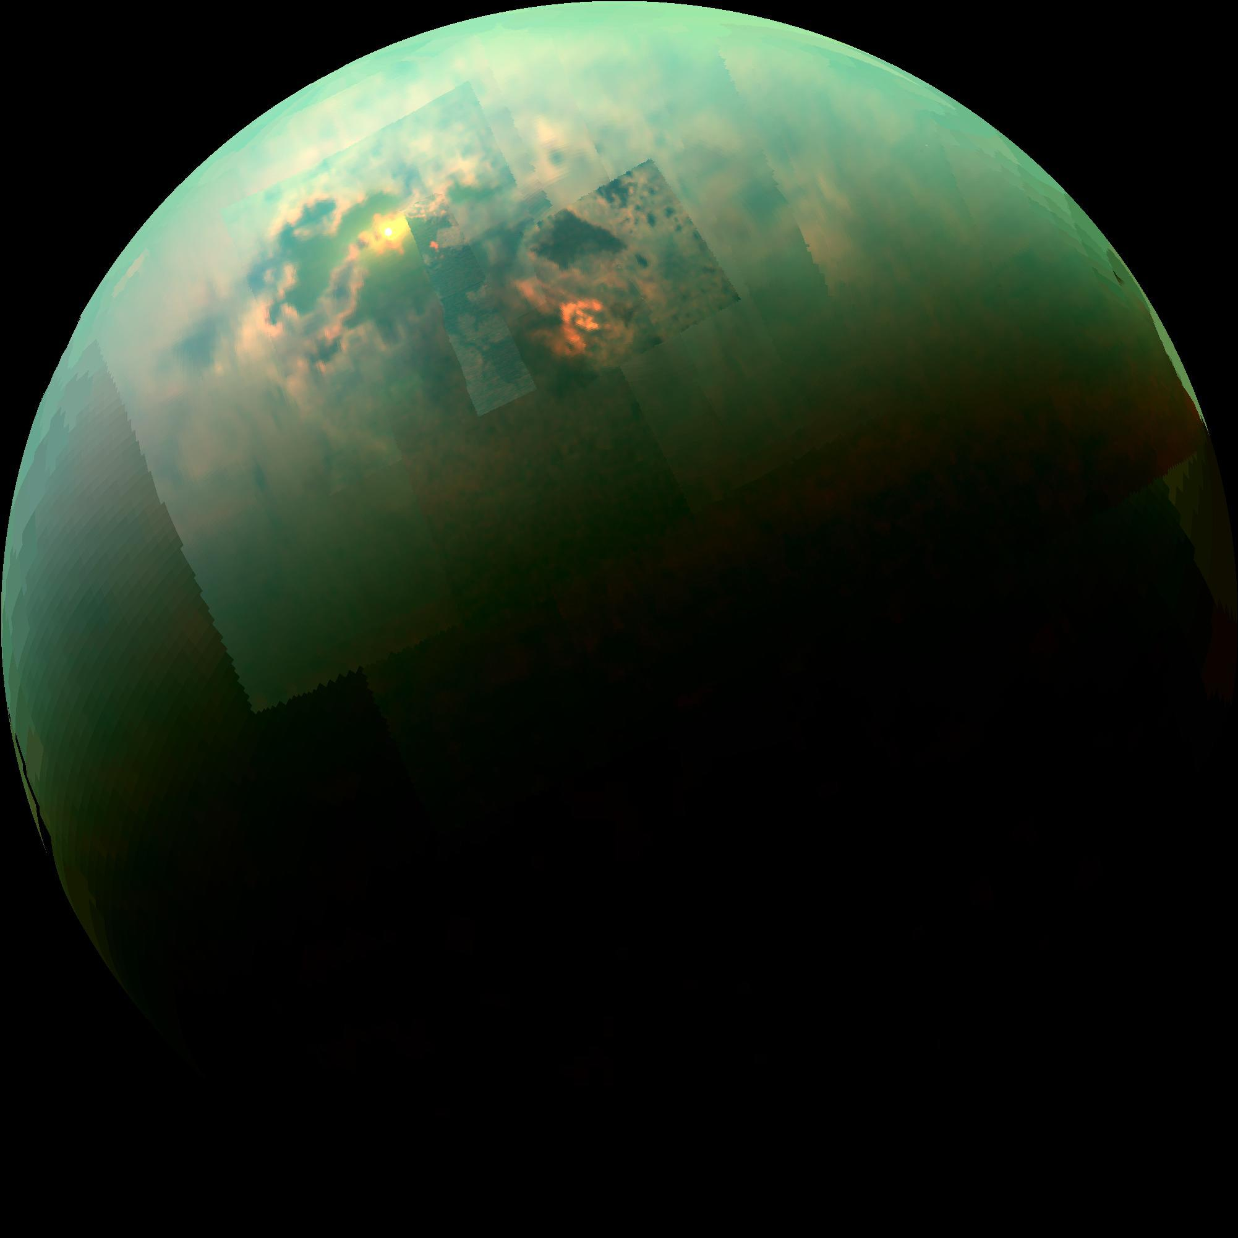
With mbar of CH₄, Early Earth’s atmosphere may have had photon-driven organic haze and soot drizzle, like modern Titan
Pressure: 1.5 x Earth
T = 92K
98.4% N_{2,} 1.4% CH₄
Near-infrared image. NASA / JPL / Cassini Project / VIMS
For more information: Lunine & Atreya, “The methane cycle on Titan”,
Nature Geoscience, 2008.

Slide 15
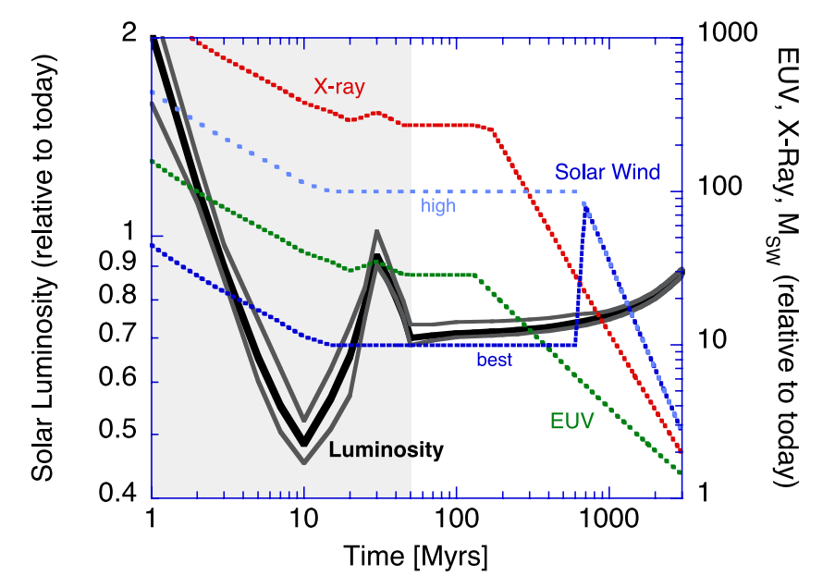
Atmosphere composition is mostly set during the first 1% of a planet’s history
Zahnle et al., “Emergence of a habitable planet,” Space Science Reviews 2007
Notes:
Both gain and loss.

Slide 16
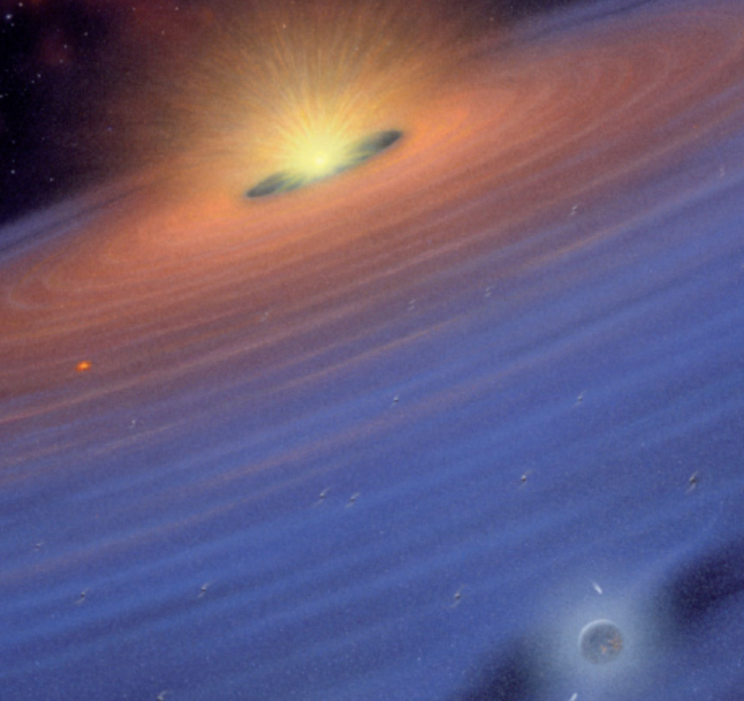
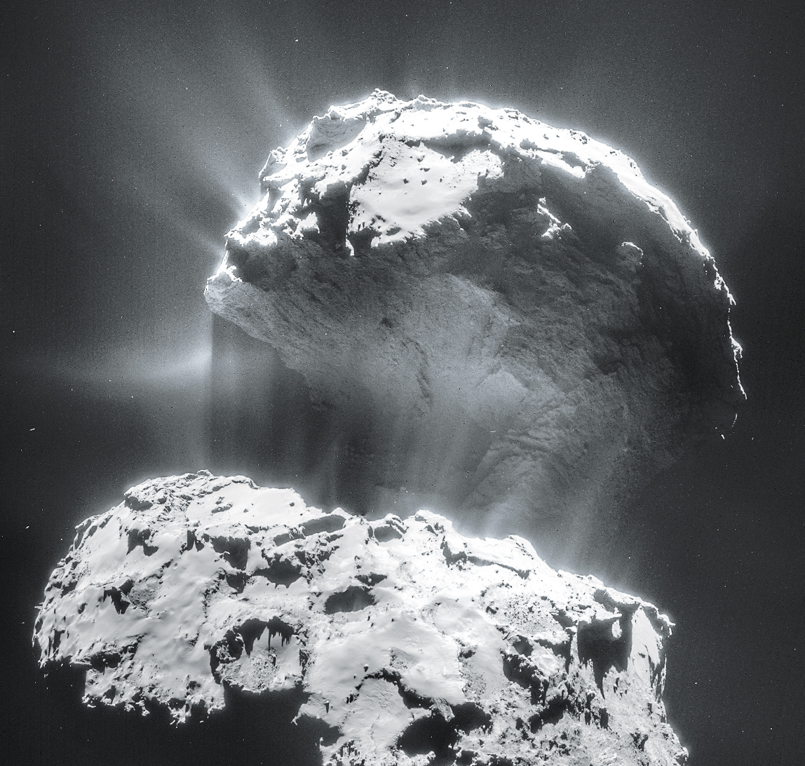
Atmosphere sources: gas from nebula, or volatiles locked up in solids
First 10⁶-10⁷ yr of planetary system history
Mostly <10⁸ yr after planet formation
young
star
Comet 67P from Rosetta/ESA
young planet
de Pater & Lissaeur, Planetary Sciences,
2nd edition, 2010
Top lobe is
2.6 km across
For more information: Raymond et al., “Terrestrial planet formation at home and abroad”,
https://arxiv.org/abs/1312.1689, and Fred Ciesla’s lecture on Tue 5 Feb.

Slide 17
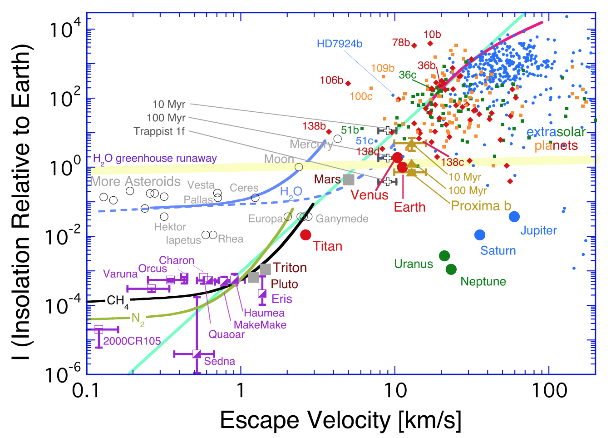
Planet gravity and insolation regulate atmosphere retention
no atmosphere
too thick
cosmic
shoreline
Zahnle & Catling, “The Cosmic Shoreline,” Astrophysical Journal, 2018

Slide 18
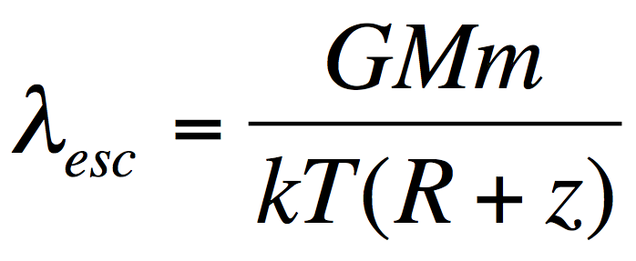
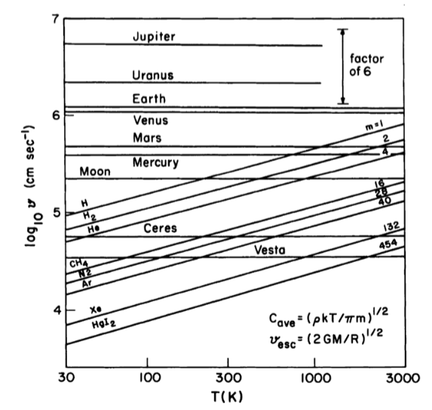
Jeans parameter
(= “escape parameter”)
>> 1: hydrostatic
atmosphere,
Jeans escape (usually
slow)
< 2: hydrodynamic
escape (often fast)
Lewis & Prinn,
“Planets and their
atmospheres,”2nd edition,
2004, p.108
Notes:
The most important parameter in planetary atmospheric evolution:

Slide 19
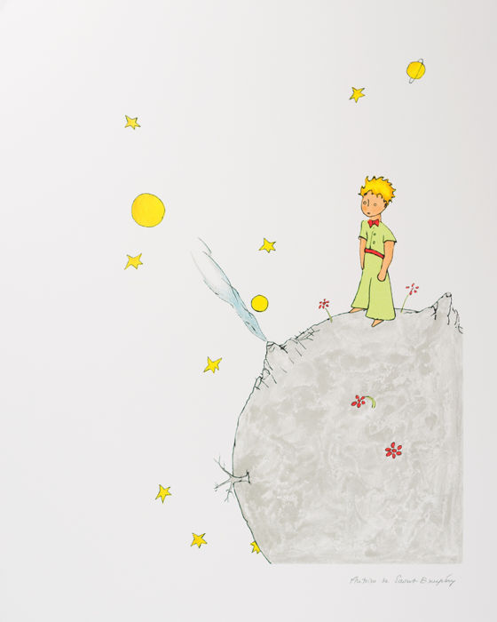
The Little Prince needs a pressure suit
Antoine de Saint-Exupéry
The Little Prince

Slide 20
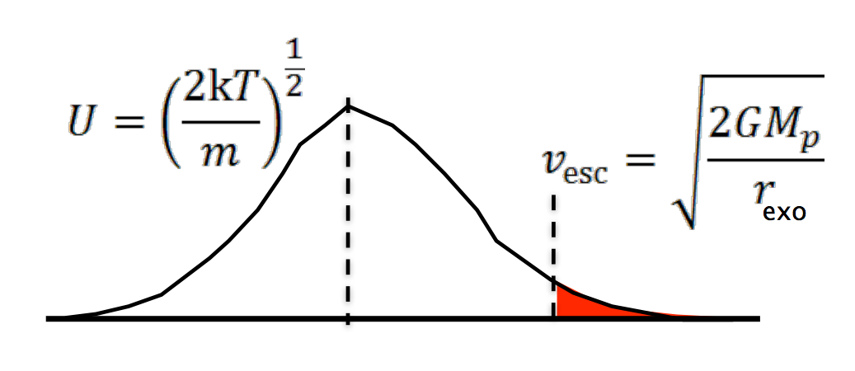
Jeans parameter >> 1 molecule-by-molecule loss of atm. to space
R + z

Slide 21
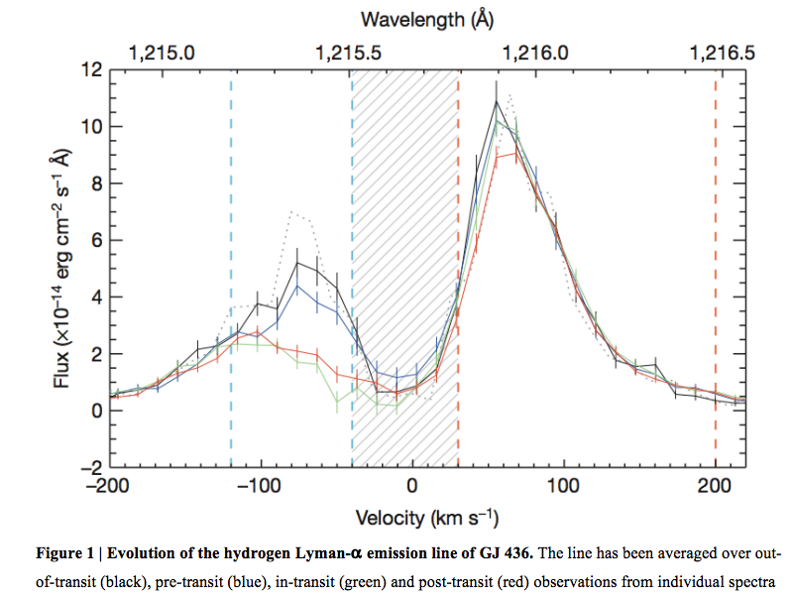
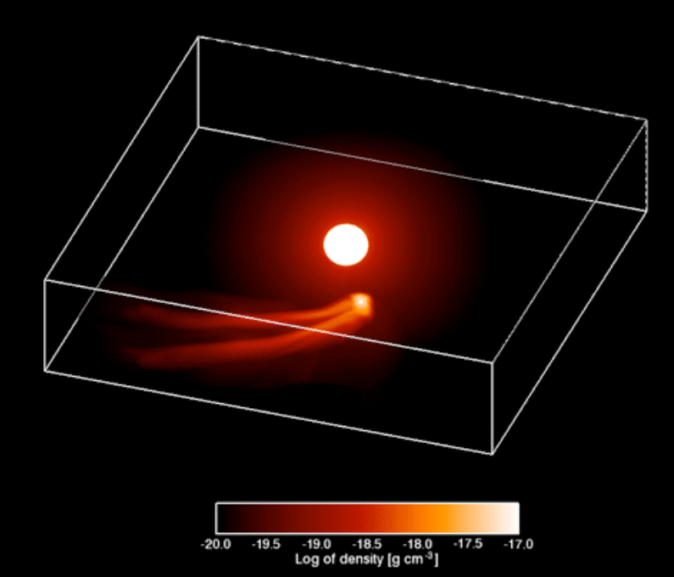
Jeans parameter < 2 hydrodynamic escape – bulk outflow
Example: GJ 436b (Neptune-sized planet in hot orbit around active star)
Model
Data
Ehrenreich et al., “A giant comet-like cloud of hydrogen escaping the warm Neptune-mass
exoplanet GJ 436b,” Nature, 2015

Slide 22
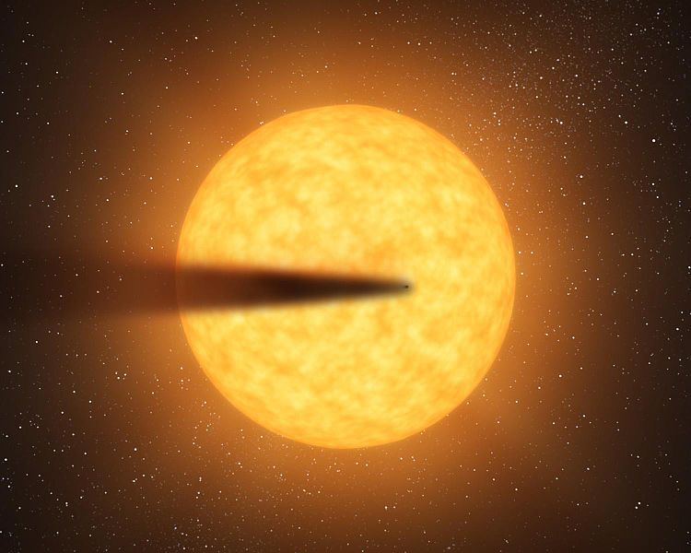
s
Rocky-planet disintegration by hydrodynamic escape
(requires T_{surf}>2000K and g << Earth)
Kepler-1520b
Artist’s impression
For more information: Perez-Becker & Chiang, “Catastrophic destruction of rocky planets,” Astrophysical Journal, 2013
NASA/JPL

Slide 23
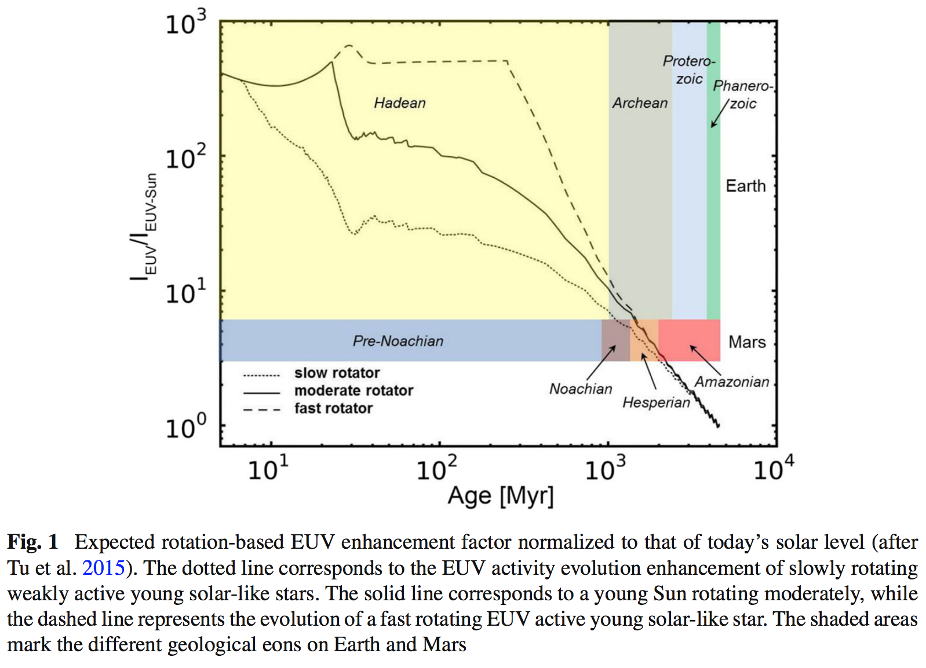
Young star’s EUV drives escape by raising upper-atm. T
Lammer et al. Space Science Reviews 2018

Slide 24
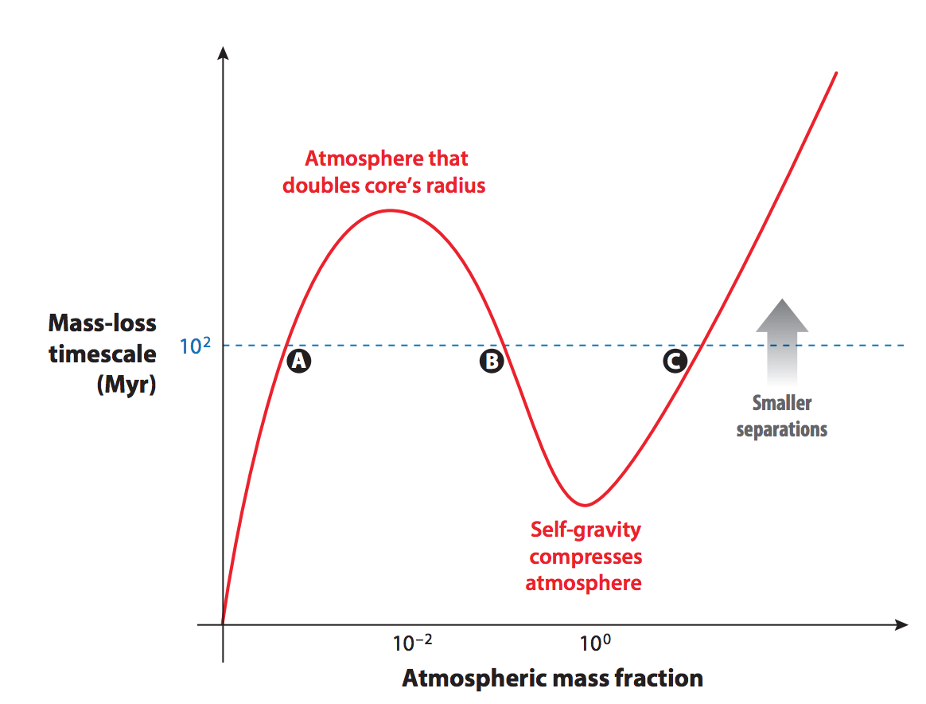
Theory predicts Super-Earths and mini-Neptunes
Owen 2019, “Atmospheric escape and the evolution of
close-in exoplanets,”
Annual Reviews of Astronomy and Astrophysics

Slide 25
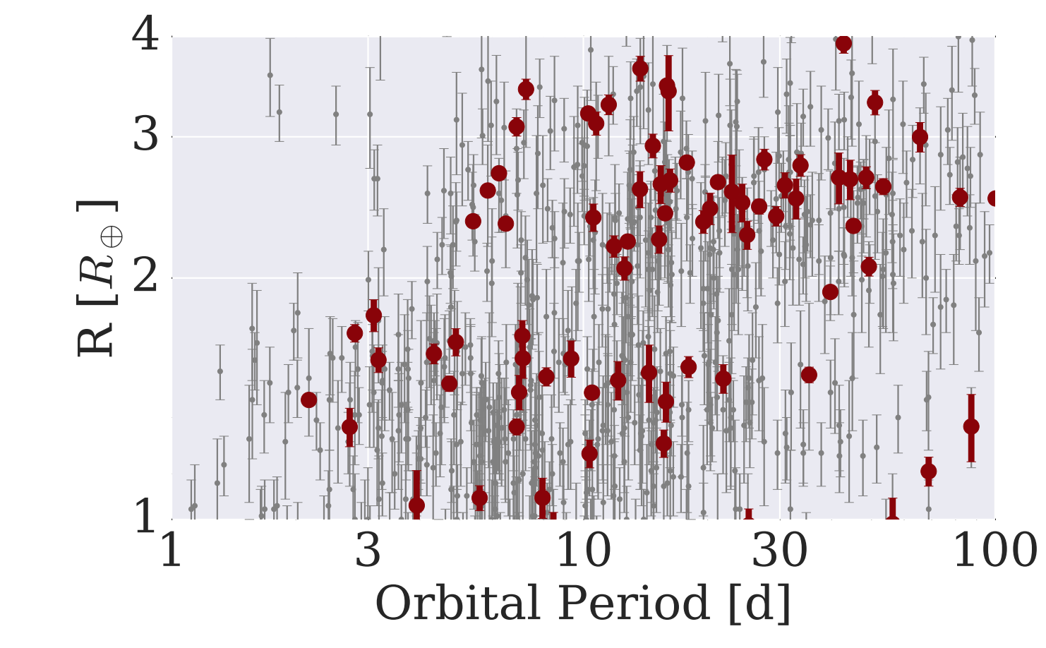
Data indicate many H₂-absent Super-Earths and many ≥1 wt% H₂ mini-Neptunes: not much in between
mostly not rocky
based on density data
(L. Rogers ApJ 2015)
harder to detect
< 1.6 R_Earth
planets
>1.6 R_Earth
planets
van Eylen et al. “An asteroseismic view of the radius valley: stripped cores, not born rocky,”
Astrophysical Journal 2018

Slide 26
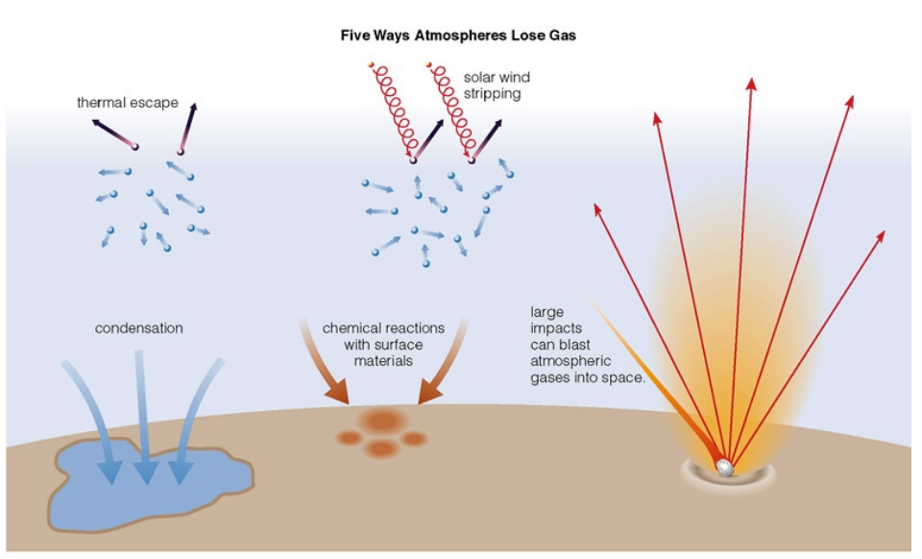
Key processes in atmospheric escape
via James Wray (Georgia Tech)

Slide 27
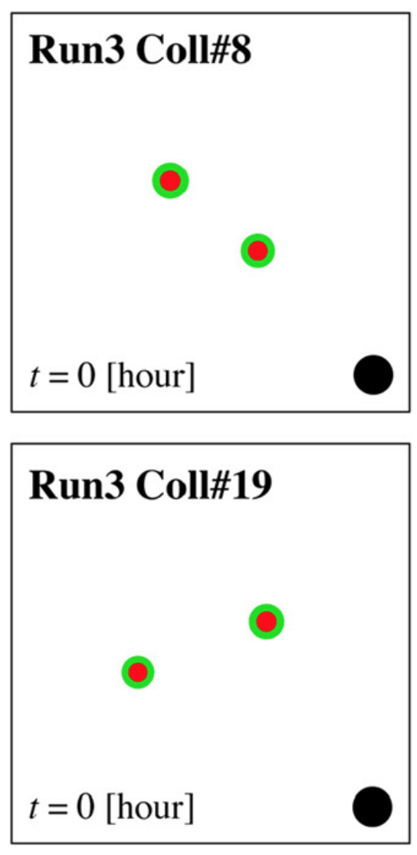
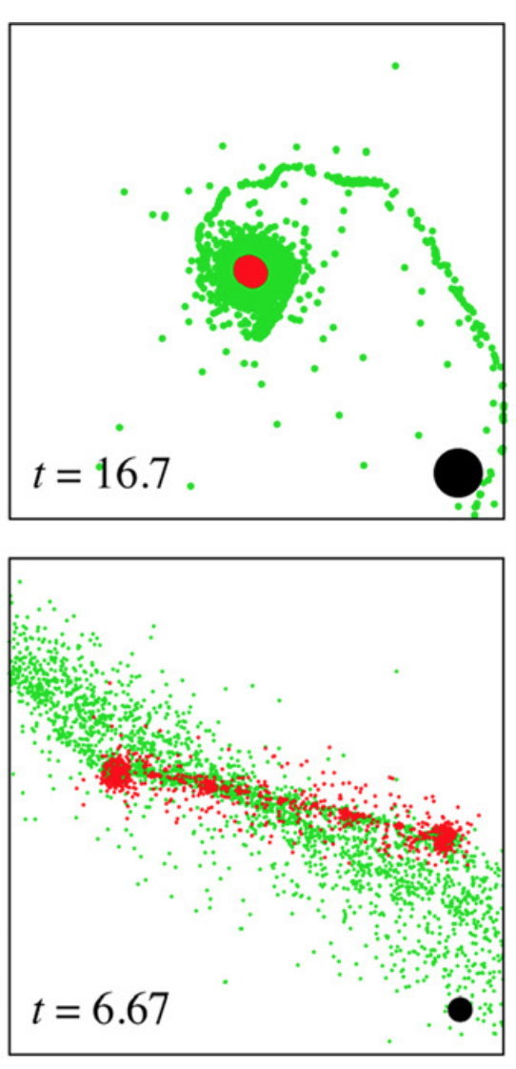
Rocky planets are built by a handful of giant impacts. Giant impacts can remove atmospheres and oceans. Giant impacts are stochastic.
head-on
collision:
atmosphere
retention
favored
red = metal core. green = rock mantle.
black scale-bar discs are 5000km diameter
grazing collision:
atmosphere loss
likely
Genda et al., “Ejection of iron-bearing giant-impact fragments and the dynamical and
geochemical influence of the fragment re-accretion,” Earth and Planetary Science Letters 2017

Slide 28
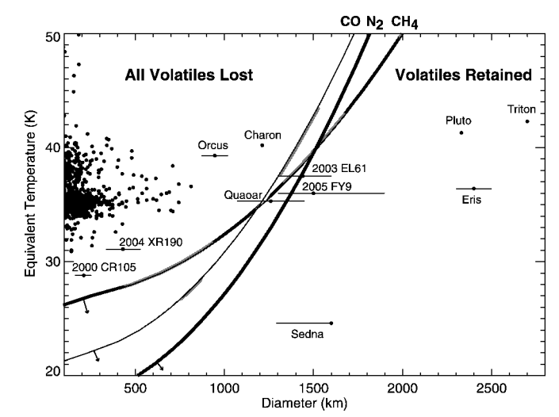
Condensation Aids Volatile Retention
insolation
Brown & Schaller, “Volatile Loss and Retention on Kuiper Belt Objects,” Astrophysical Journal 2007
gravity

Slide 29
Planet gravity
and insolation
regulate
atmosphere
thickness
Zahnle & Catling ApJ 2018

Slide 30
Example:
Establishing an
atmosphere on
the Moon
Illumination/Universal

Slide 31
for more information: Needham & Kring,
“Lunar volcanism produced a transient atmosphere around the ancient Moon”,
Earth & Planetary Science Letters, 2017

Slide 32
Planets are numerous … and many have atmospheres.

Slide 33
Bonus slides

Slide 34
The cosmic
shoreline:
Planet gravity
and insolation
regulate
atmosphere
thickness
no atmosphere
too thick
Zahnle & Catling ApJ 2018

Slide 35
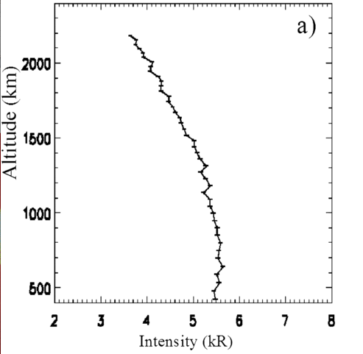
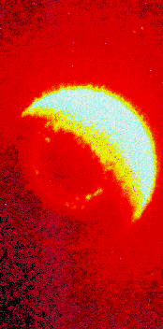
What atmospheric escape looks like (inside the solar system):
Earth hydrogen corona
Mars hydrogen corona (Chauffray et al. 2008)

