Slide 1
GEOS 28600
The science of landscapes:
Earth & Planetary Surface Processes
Lecture 8
Wednesday 5 Feb 2020

Slide 2
The flow of ice
ICE MOVEMENT – GLEN’S LAW
TEMPERATURE STRUCTURE WITHIN ICE SHEETS
EFFECT OF GLACIAL EROSION ON TOPOGRAPHY
(Earth examples)

Slide 3
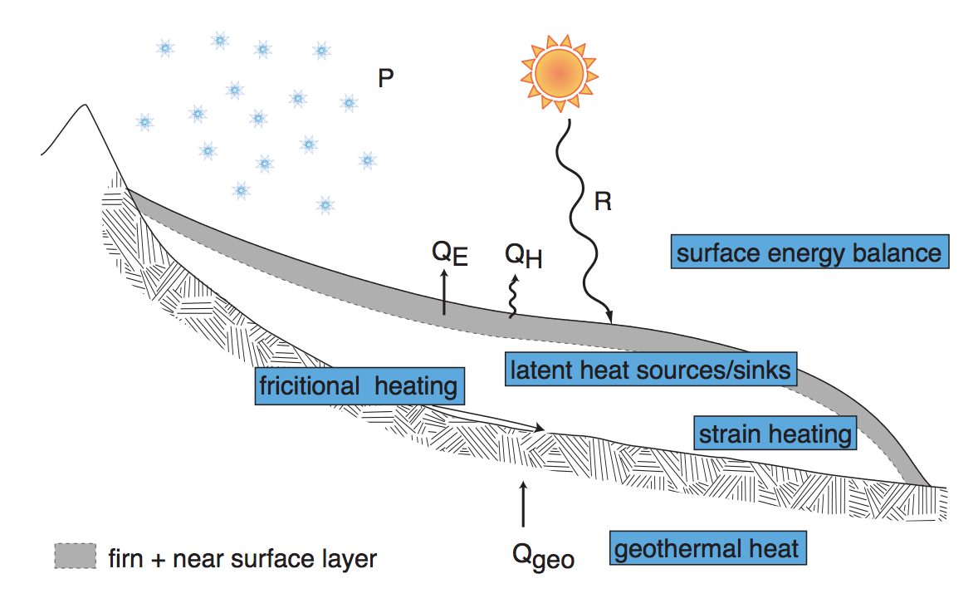
Andy Anschwanden, Glaciology Summer School

Slide 4
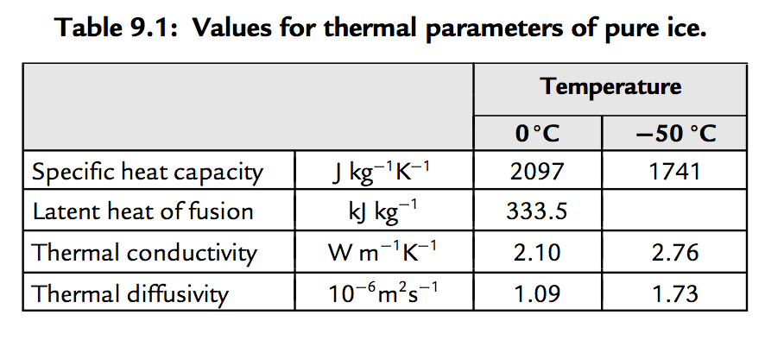
Decay of T signal of climate forcing with depth
a way to quantify
exceptional late-20th
warmth relative to
earlier centuries
Cuffey & Patterson, ch. 9 (supplementary reading)

Slide 5
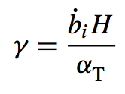
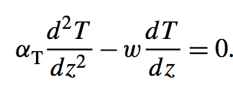
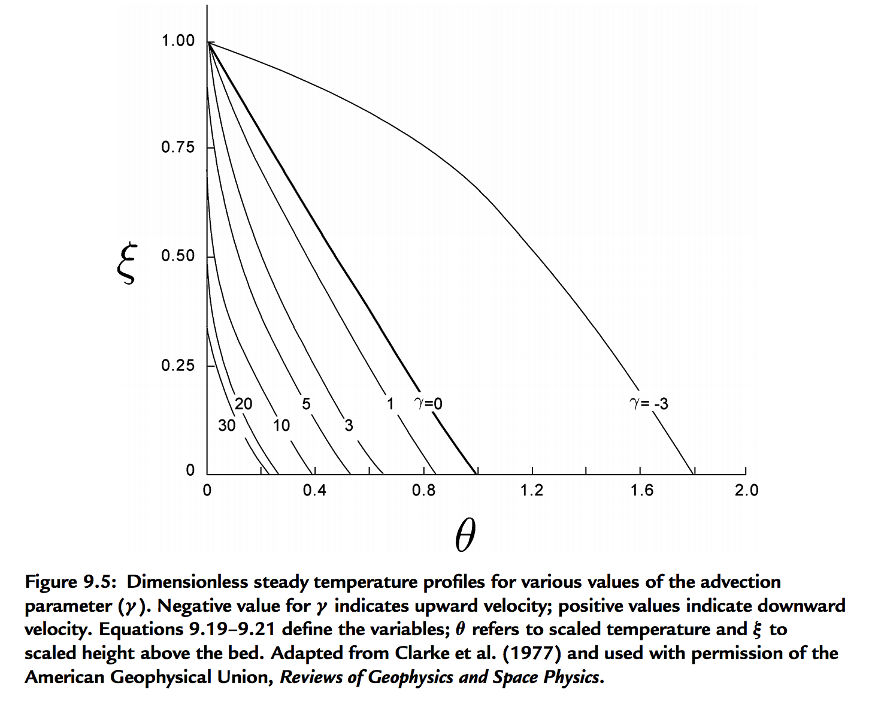
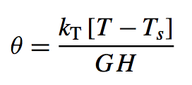
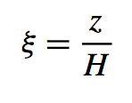
For slow-flowing ice sheets (e.g., Mars) → shear heating unimportant, temperature set by geothermal heat flow modified by advection of cold ice from above
Thermal structure of an ice sheet: neglecting horizontal advection
surface mass
balance:
thickness/time
signed
Peclet
number
Constant heat flow at z = 0
(Geothermal + shear heating)
Mass removed at bed
(e.g., rapid lateral flow)
(Ice divide)
Cuffey & Patterson, ch. 9 (supplementary reading)

Slide 6
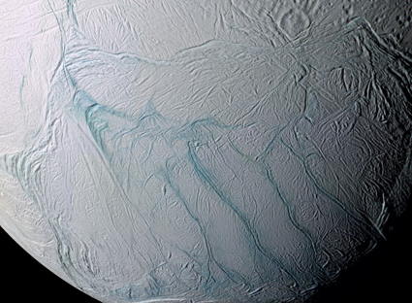
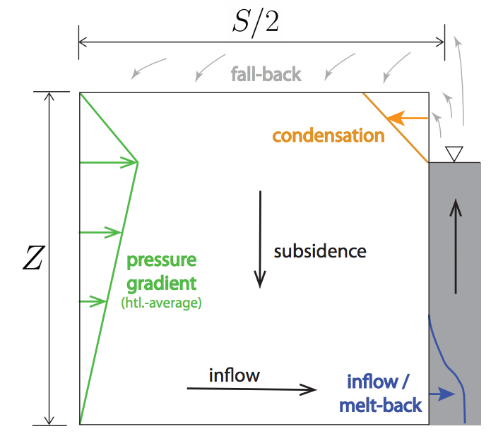
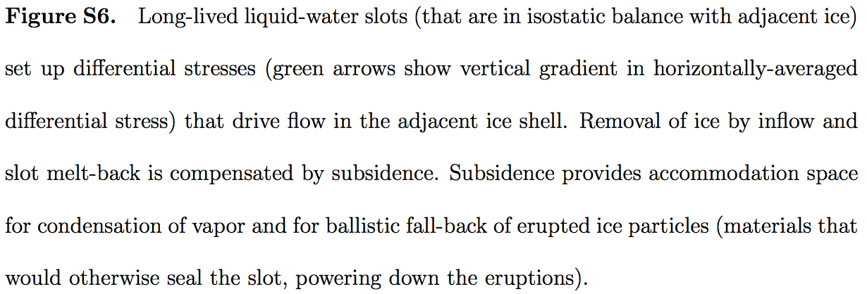
Linking thermal structure and ice flow: crevasse-closure regulation of the rate of volcanism on Enceladus?
Kite & Rubin 2016

Slide 7
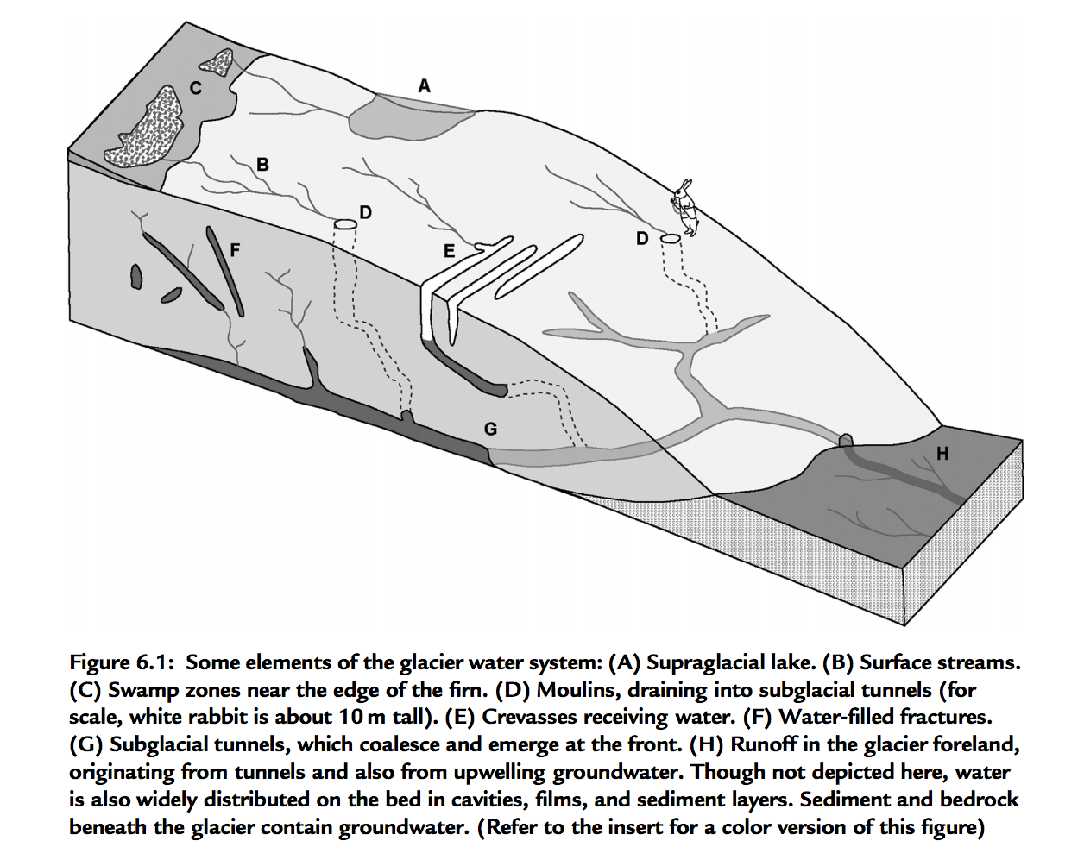
Wet-based ice sheets
Basal melt
Applications: ice streams
will Greenland + Antarctic ice shelf collapse take a few millenia or a few centuries?

Slide 8
The flow of ice
ICE MOVEMENT – GLEN’S LAW
TEMPERATURE STRUCTURE WITHIN ICE SHEETS – ESKERS (Mars examples)
EFFECT OF GLACIAL EROSION ON TOPOGRAPHY
(Earth examples)

Slide 9
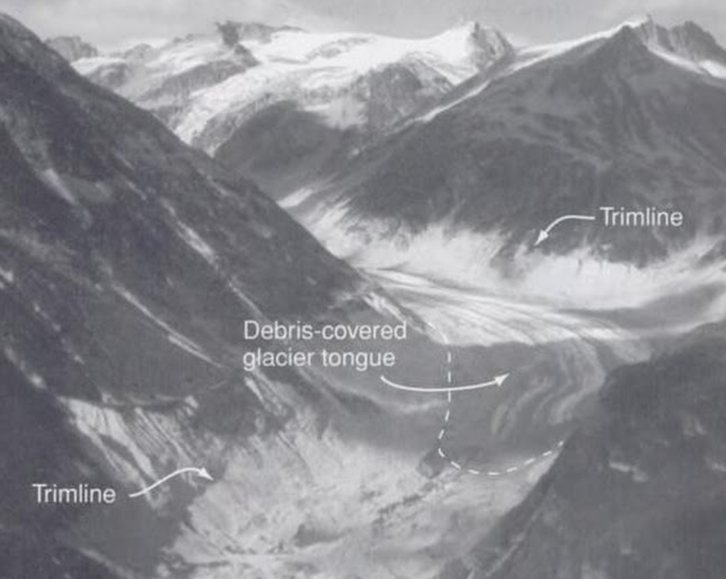
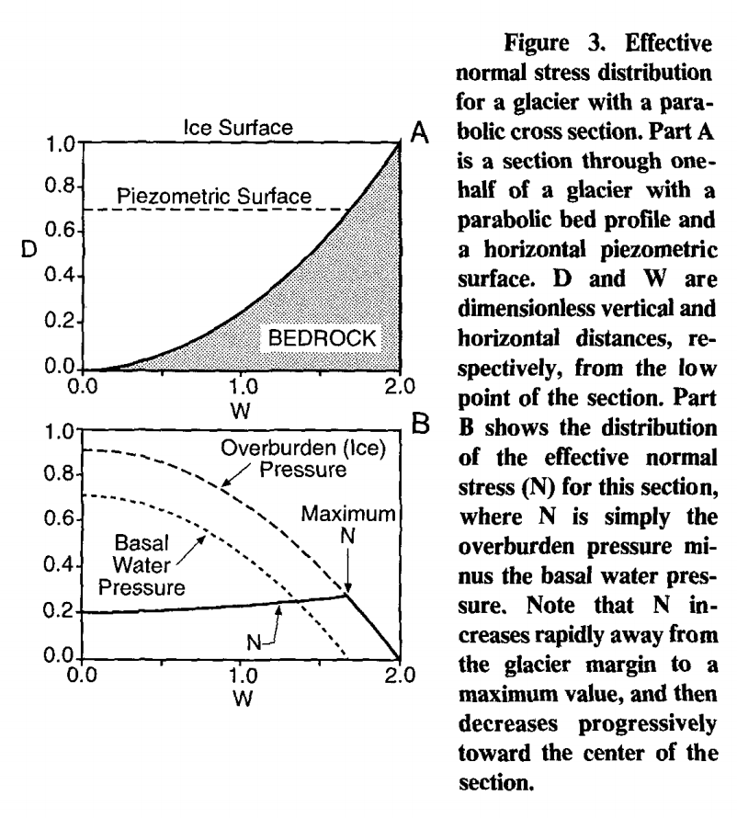
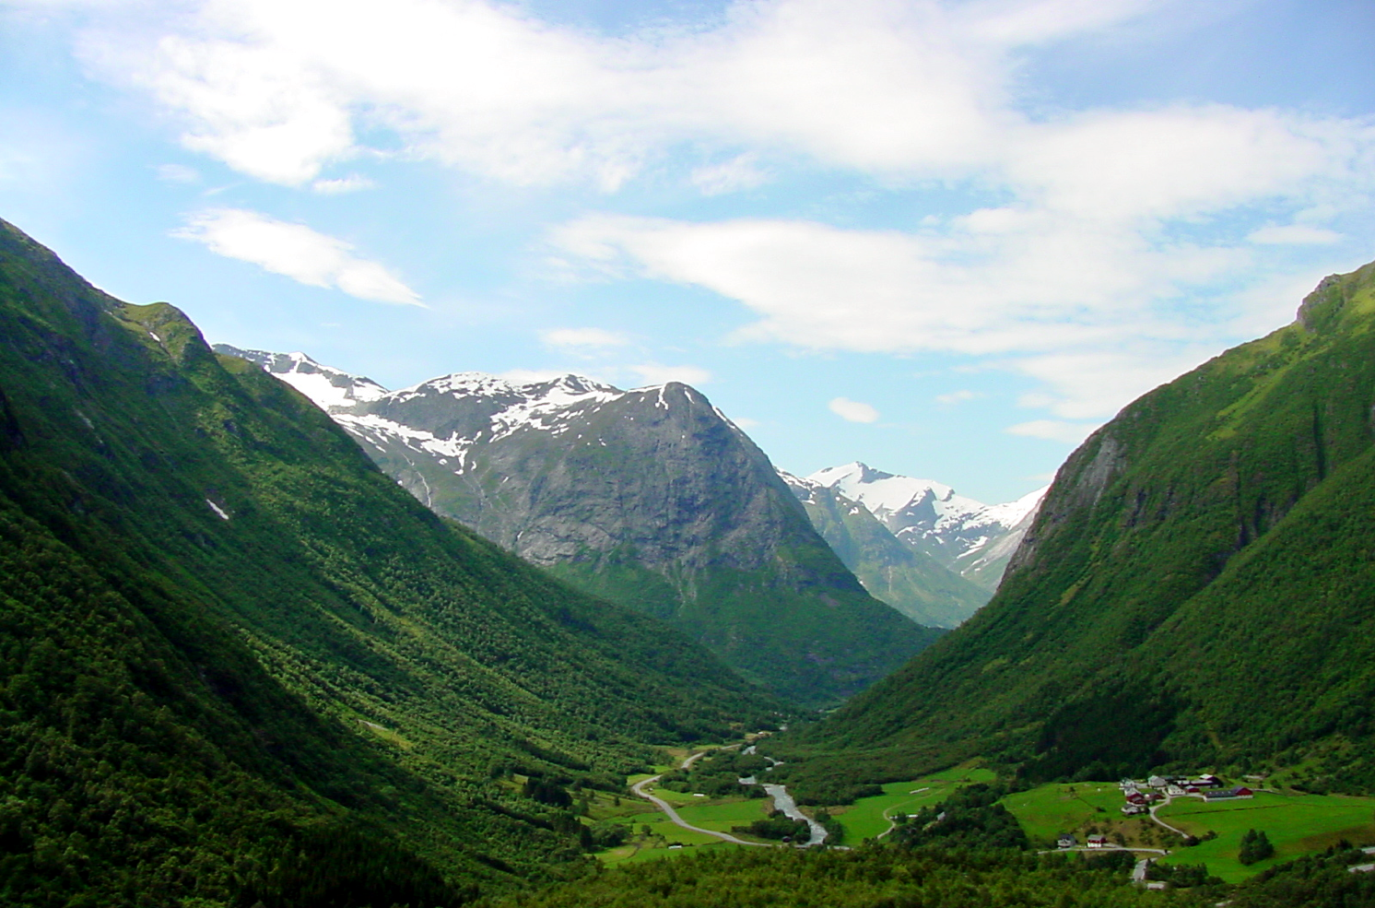
Origin of U-shaped glacial valleys: role of water table
Harbor, 1992, GSA Bulletin

Slide 10
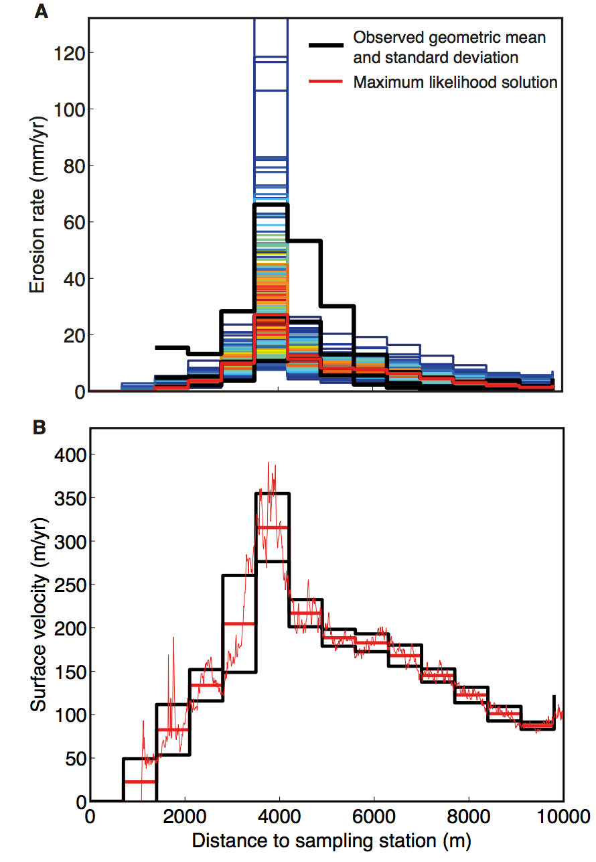
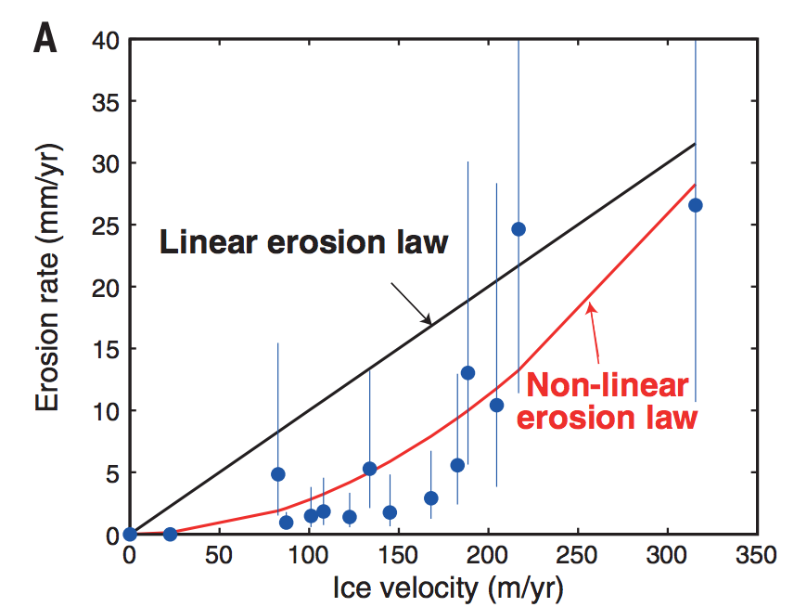
Glacial abrasion and plucking scales as (sliding velocity)²
using metamorphic grade
of eroded rocks as a proxy
for distance upstream
Herman et al. Science 2015
Abrasion, quarrying

Slide 11
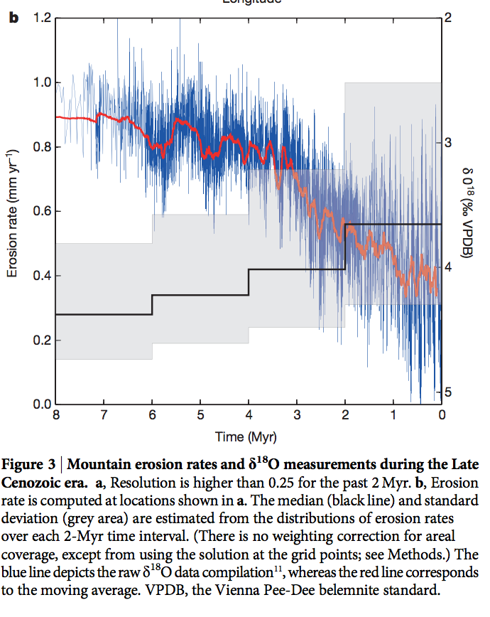
Global increase in erosion rate in the last 2 Myr – possibly due to increase in glaciation
Herman et al. Science 2013
(thermochronology compilation)

Slide 12
Key points from today’s lecture
Mass balance of a glacier or ice sheet
Glen’s Law
Nondimensional T-vs-depth as a function of accumulation rate for fixed basal heat flow
Other points:
Approximations to the full Stokes equation: locations where they are and are not acceptable
Glacial erosion parameterization

Slide 13
Key points from “Introduction to fluvial sediment transport”:
Critical Shields stress
Differences between gravel-bed vs. sand-bed rivers
Discharge-width scaling

Slide 14
Prospectus: fluvial processes
Today: overview, hydraulics.
Next lecture: initiation of motion, channel width adjustment.
Channel long-profile evolution.
Mountain belts.
Looking ahead: landscape evolution (including fluvial processes.)
This section of the course draws on courses by W.E. Dietrich (Berkeley),
D. Mohrig (MIT → U.T. Austin), and J. Southard (MIT).

Slide 15
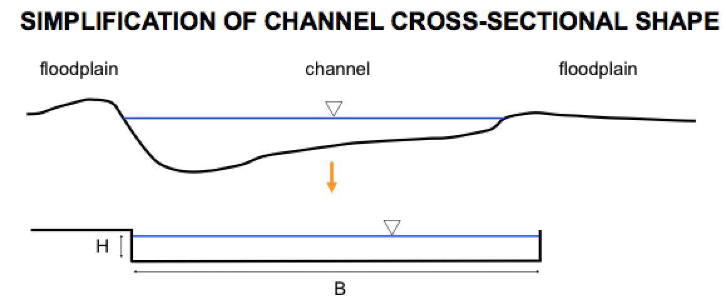
Hydraulics and sediment transport in rivers:
1) Relate flow to frictional resistance so can relate discharge to hydraulic geometry.
2) Calculate the boundary shear stress.
Simplified geometry: average over a reach (12-15 channel widths).
→ we can assume accelerations are zero.
→ this assumption is better for flood flow (when most of the erosion occurs).
riffle
pool
pool
riffle
Parker Morphodynamics e-book

Slide 16
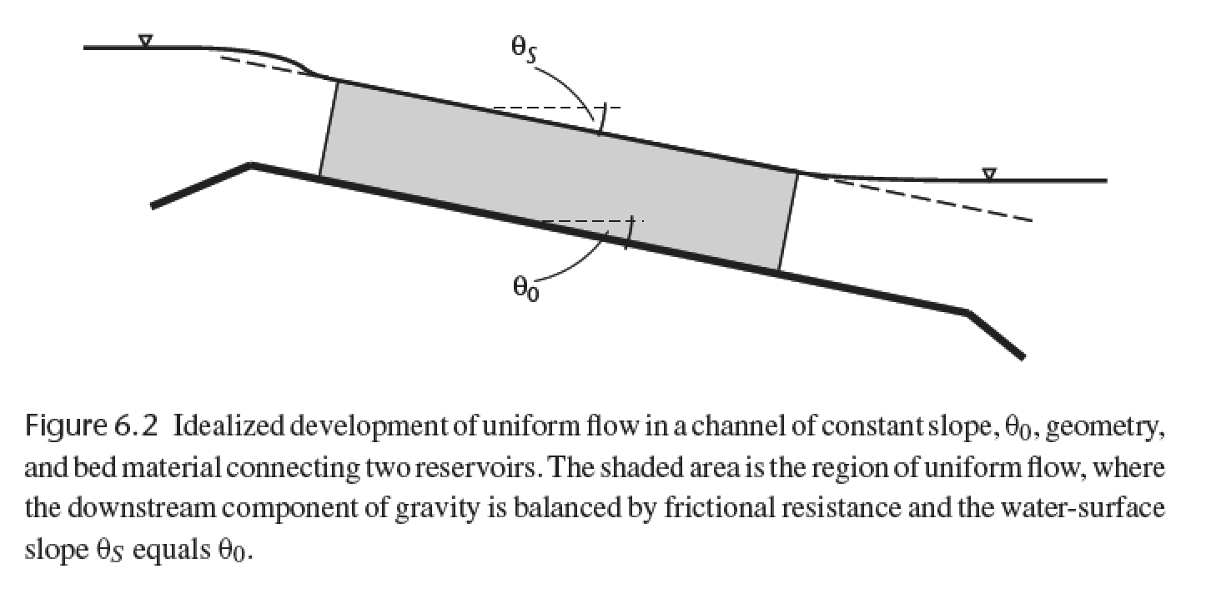
The assumption of no acceleration requires that gravity (resolved downslope) balances bed friction.
τ_{zx} = ρgh sinθ
averaging over 15-20 channel widths
forces the water slope to ~ parallel the
basal slope
Dingman, chapter 6

Slide 17
Basal shear stress, frictional resistance, and hydraulic radius
1
z/h
0
0
τ_{b}
τ_{zx} = ρgh sinθ
At low slope (S, water surface rise/run), θ ~ tan θ ~ sin θ
τ_{b} = ρgh S
Frictional resistance:
Boundary stress = ρgh sinθ L w
Frictional resistance = τ_{b} L (w + 2 h)
ρgh sinθ L w = τ_{b} L (w + 2 h)
τ_{b} = ρgh ( w / (w + 2 h ) ) sinθ
Define hydraulic radius, R = hw / (w + 2 h)
→ τ_{b} = ρgR sinθ
h
w
L
In very wide channels, R → h (w >> h)

Slide 18
Law of the wall:
Rivers ( Re >> 10, and fully turbulent):
Glaciers ( Re << 1):
τ_{zx} = ρ K_{T} (du/dz)
τ_{zx} = μ(T,σ) (du/dz)
eddy viscosity, “diffuses” velocity
Properties of turbulence:
Irregularity
Diffusivity
Vorticity
Dissipation
From empirical & theoretical studies:
K_{T} = (k z )² (du/dz)
(where k = 0.39-0.4 = von Karman’s constant)
→ τ_{B} = ρ(k z)² (du/dz)²
→ (τ_{B} /ρ )^{1/2} = k z (du / dz) = u* = “shear velocity”
Memorize this.
→ (ρ g h S /ρ )^{1/2} = u* = ( g h S )^{1/2}
Now u* = k z (du / dz)
Separate variables: du = (u* / k z ) dz
Integrate: u = (u*/k) (ln z + c). For convenience, set c = -ln(z₀)
Then, u = (u*/k) ln (z/z₀)
“law of the wall”
(explained on next slide)
when z = z₀, u = 0 m/s.

Slide 19
Calculating river discharge, Q (m³s⁻¹), from elementary
observations (bed grain size and river depth).
u = (u*/k) ln (z/z₀)
“law of the wall”
z₀ is a length scale for grain roughness
varies with the size of the bedload. In this class, use
z₀ = 0.12 D₈₄, where D₈₄ is the 84th
percentile size in a pebble-count (100th
percentile is the biggest).
brackets denote vertical
average
Q = <u> w h
h
<u> = u(z) dz (1/(h-z₀))
z₀
<u> = (u*/k) (z0 + h ( ln( h / z₀ ) – 1 ) ) (1/ (h - z₀))
h >> z₀:
Extending the law of the wall
throughout the entire depth of
the flow is a rough
approximation – do not use
this for civil-engineering
applications. This approach
does not work at all when
depth → clast grainsize.
<u> = (u*/k) ( ln( h / z₀ ) – 1 )
<u> = (u*/k) ln ( h / e z₀)
<u> = (u*/k) ln (0.368 h / z₀)
typically rounded to 0.4

Slide 20
Drag coefficient for bed particles:
→ τ_{B} = ρgRS = C_{D} ρ <u>² / 2
<u> = ( 2g R S / C_{D} )^{1/2}
( 2g / C_{D} )^{1/2} = C = Chezy coefficient
<u> = C ( R S )^{1/2}
Chezy equation (1769)
<u> = ( 8 g / f )^{1/2} ( R S )^{1/2}
f = Darcy-Weisbach friction factor
<u> = R^{2/3} S^{1/2} n⁻¹
n = Manning roughness coefficient
3 alternative methods
Most used, because lots of investment in measuring n for different objects
0.025 < n < 0.03 ----- Clean, straight rivers (no debris or wood in channel)
0.033 < n < 0.03 ----- Winding rivers with pools and riffles
0.075 < n < 0.15 ----- Weedy, winding and overgrown rivers
n = 0.031(D₈₄)^{1/6} ---- Straight, gravelled rivers
In sand-bedded rivers (e.g. Mississippi), form drag due to sand dunes is important.
In very steep streams, supercritical flow may occur:
supercritical flow
Froude number
Fr # = <u>/(gh)^{1/2} > 1

Slide 21
Getting from water flow to sediment flux

Slide 22
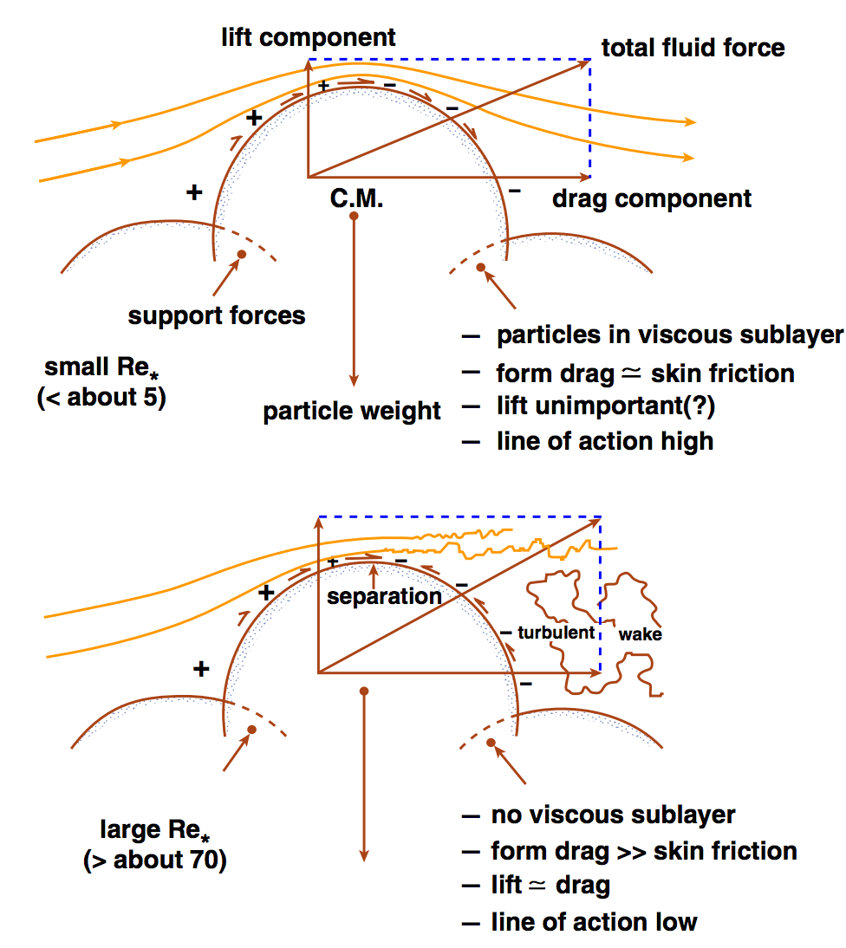
John Southard

Slide 23
Sediment transport in rivers:
(Shields number)
F_{L}
F_{D}
At the initiation of grain motion,
F_{D} = ( F’_{g} – F_{L} ) tan Φ
→ F_{D}/F’_{g} =
Φ
tan Φ
1 + (F_{L}/F_{D}) tan Φ
≈ τ_{c} D²
(ρ_{s} – ρ)gD³
F’_{g} (submerged weight)
= τ_{c} = τ*
(ρ_{s} – ρ)gD
Shields number (“drag/weight ratio”)
Is there a representative particle size for the bedload as a whole?
Yes: it’s D₅₀.

Slide 24
Equal mobility hypothesis
F_{L}
“Hiding” effect
small particles
don’t move significantly
before the D₅₀ moves.
F_{D}
Φ
Φ
D/D₅₀
Trade-off between size and embeddedness
F’_{g} (submerged weight)
Significant controversy over validity of equal mobility hypothesis in the late ’80s – early ’90s.
Parameterise using
τ* = B(D/D₅₀)^{α}
α = -1 would indicate perfect equal mobility (no sorting by grain size with downstream distance)
α = -0.9 found from flume experiments (permitting long-distance sorting by grain size).

Slide 25
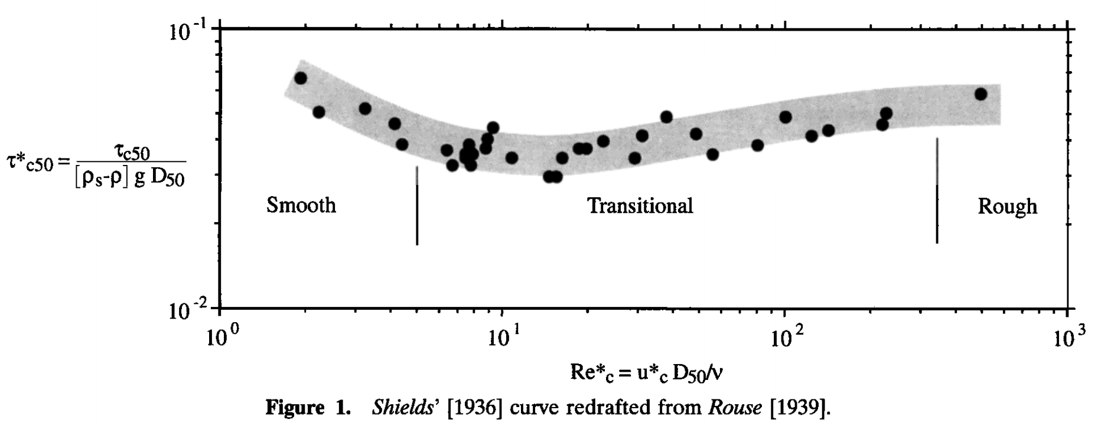
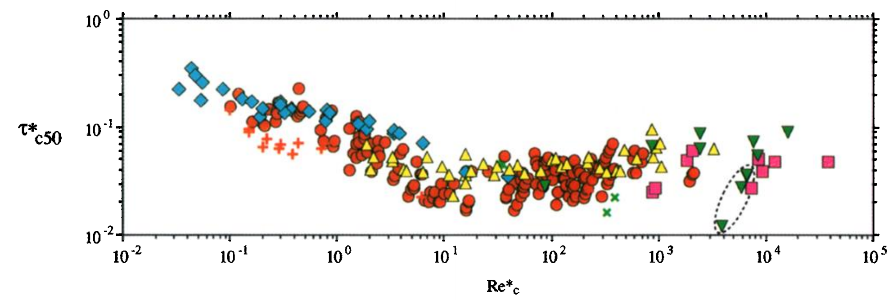
τ_{*c50} ~ 0.04, from experiments (0.045-0.047 for gravel, 0.03 for sand)
1936:
Hydraulically rough:
viscous sublayer is a thin
skin around the particles.
sand
gravel
Re* = “Reynolds roughness number”
1999:
Theory has approximately
reproduced some parts
of this curve.
Causes of scatter:
(1) differing definitions of
initiation of motion (most important).
(2) slope-dependence?
(Lamb et al. JGR 2008)
Buffington & Montgomery, Water Resources Research, 1999

Slide 26
Fluvial sediment transport: introduction
REVIEW OF REQUIRED READING (SCHOOF & HEWITT 2013)
TURBULENT VELOCITY PROFILES, INITIATION OF MOTION
BEDLOAD, RIVER GEOMETRY

Slide 27
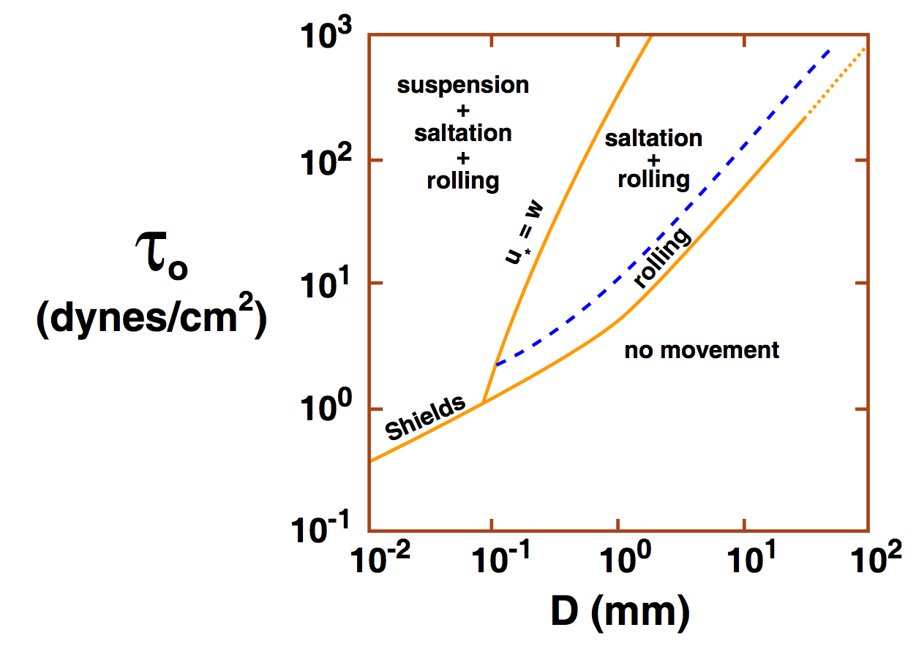
Consequences of increasing shear stress: gravel-bed vs. sand-bed rivers
Suspension: characteristic velocity for
turbulent fluctuations (u*) exceeds
settling velocity (ratio is ~Rouse number).
Typical transport distance
100m/yr in gravel-bedded bedload
Sand: km/day
John Southard
(Experimentally, u* is approximately
equal to rms
fluctuations in vertical
turbulent velocity)
Empirically, rivers are either gravel-bedded or sand-bedded (little in between)
The cause is unsettled: e.g. Jerolmack & Brzinski Geology 2010 vs. Lamb & Venditti GRL 2016

Slide 28
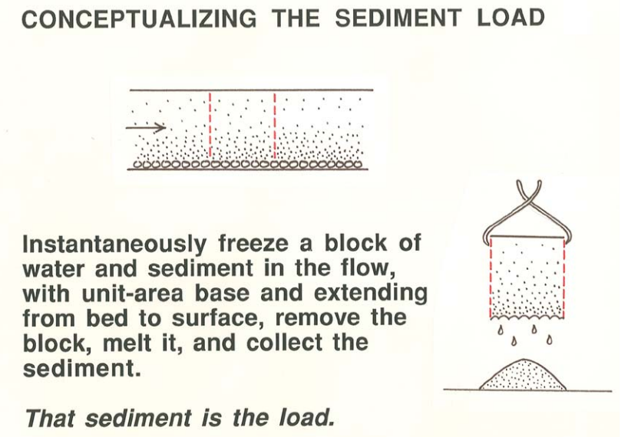
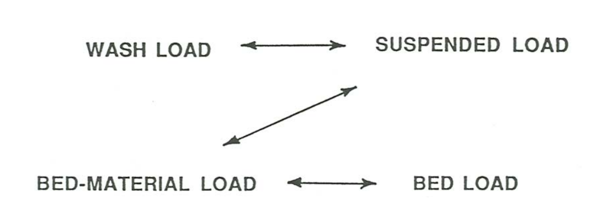
Bedload transport
(Most common:)
Meyer-Peter Muller
Many alternatives, e.g.
Yalin
Einstein
Discrete element modeling
q_{bl} = k_{b}(τ_{b} – τ_{c})^{3/2}
there is no theory for washload:
it is entirely controlled by upstream supply
John Southard

Slide 29
River channel morphology and dynamics
“Rivers are the authors of their own geometry” (L. Leopold)
And of their own bed grain-size distribution.
Rivers have well-defined banks.
Bankfull discharge 5-7 days per year; floodplains inundated every 1-2 years.
Regular geometry also applicable to canyon rivers.
Width scales as Q^{0.5}
River beds are (usually) not flat.
Plane beds are uncommon. Bars and pools, spacing = 5.4x width.
Rivers meander.
Wavelength ~ 11x channel width.
River profiles are concave-up.
Grainsize also decreases downstream.

Slide 30
Slope, grain size, and transport mechanism: strongly correlated
z
>20%; colluvial
8-20%
boulder
cascade
(periodically
swept by
debris
flows)
3-8%
step-pool
gravel
bedload
0.1-3%
bar-pool
gravel
bedload
<0.1%
bar-pool
sand
bedload & suspension
rocks may be
abraded in place;
fine sediment bypasses boulders

Slide 31
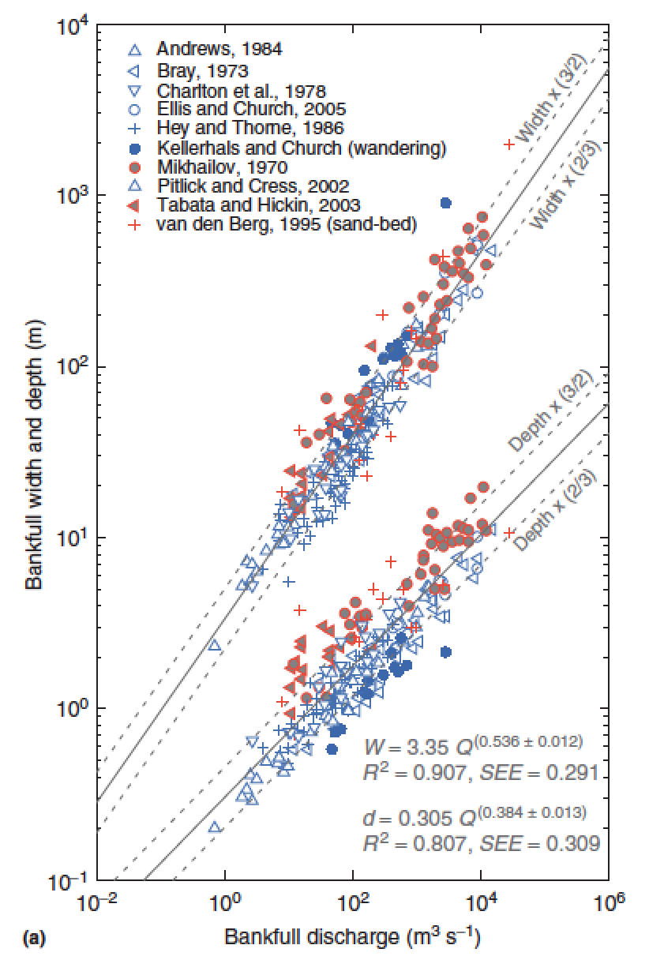
What sets width?
Q = wd<u>
w = aQ^{b}
d = cQ^{f}
<u> = kQ^{m}
b+f+m = 1
Comparing
different points
downstream
b = 0.5
m = 0.1
f = 0.4
Eaton, Treatise on
Geomorphology, 2013

Slide 32
What sets width? Three approaches to this unsolved question:
(1) Posit empirical relationships between hydraulics, sediment supply, and form (Parker et al. 2008 in suggested reading; Ikeda et al. 1988 Water Resources Research).
(2) Extremal hypotheses; posit an optimum channel, minimizing energy (Examples: minimum streampower per unit length; maximum friction; maximum sediment transport rate; minimum total streampower; minimize Froude number)
(3) What is the actual mechanism? What controls what sediment does, how high the bank is, & c.?

Slide 33
Key points from “Introduction to fluvial sediment transport”
Law of the wall – how to calculate river discharge from elementary measurements (bed grain size and river depth).
Critical Shields stress
Differences between gravel-bed vs. sand-bed rivers
Discharge-width scaling

Slide 34
Bonus slides

Slide 35
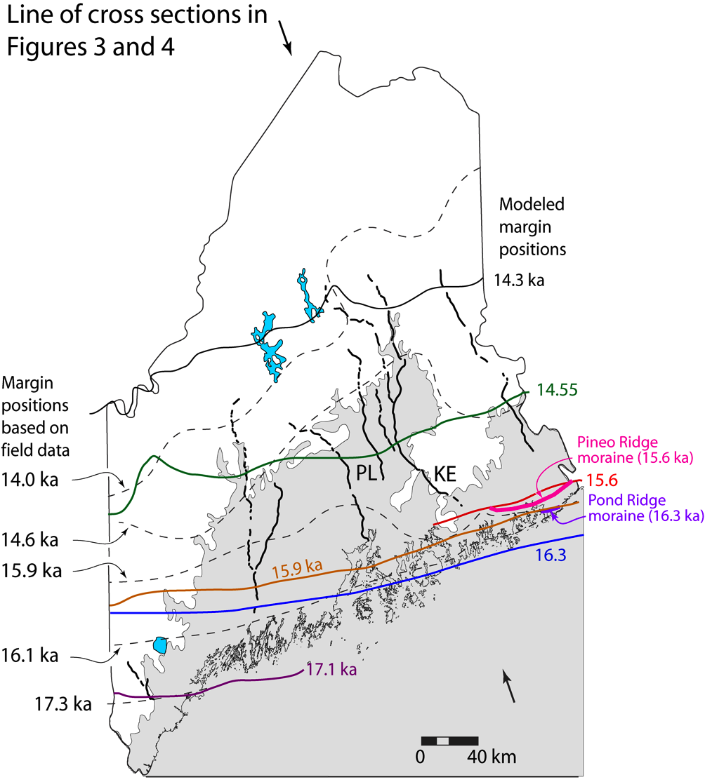
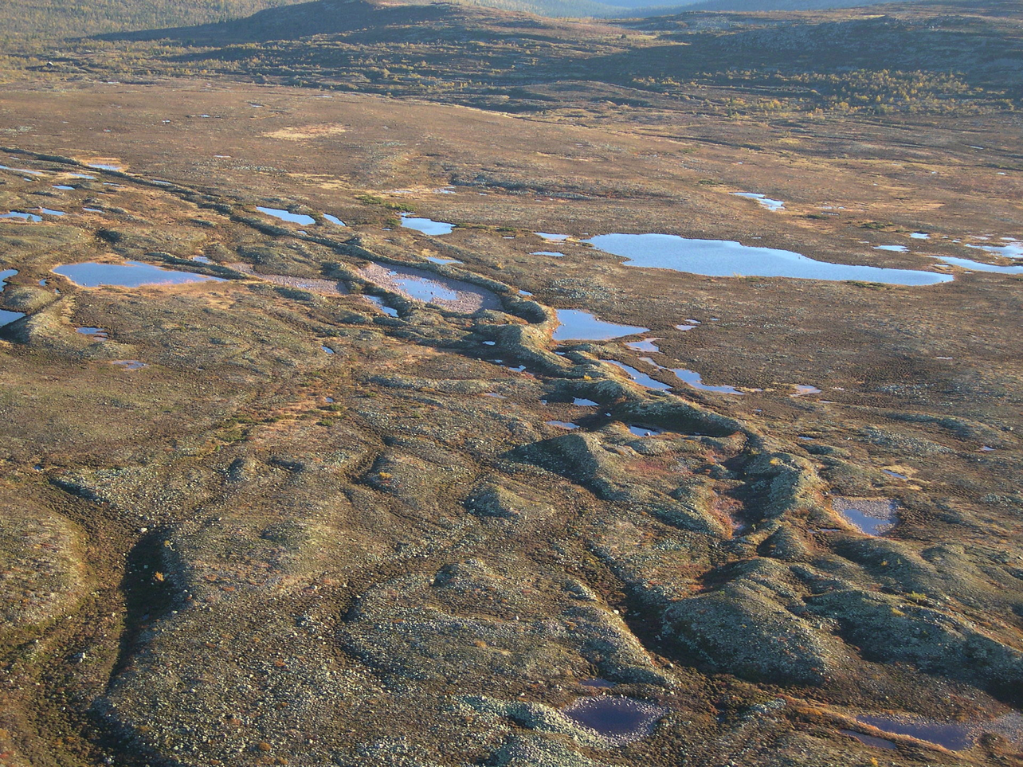
Eskers:
sand+gravel ridges deposited from
subglacial water channels
Katahdin esker system,
Maine
Eskers can flow uphill: why?

Slide 36
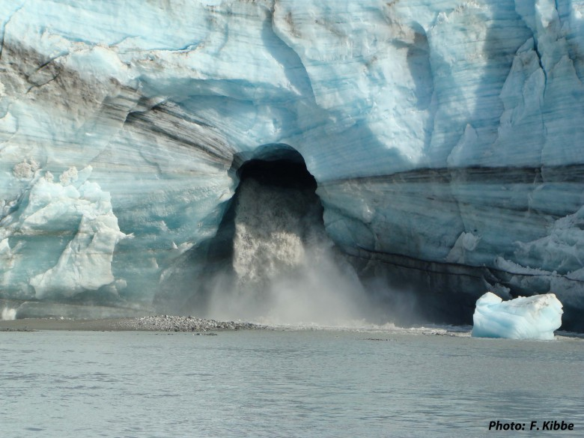
How are subglacial conduits kept open?
Viscous inflow of warm ice will seal conduits near the ocean interface
in decades, unless opposed e.g. Rothlisberger 1972

Slide 37
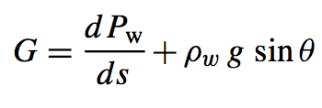
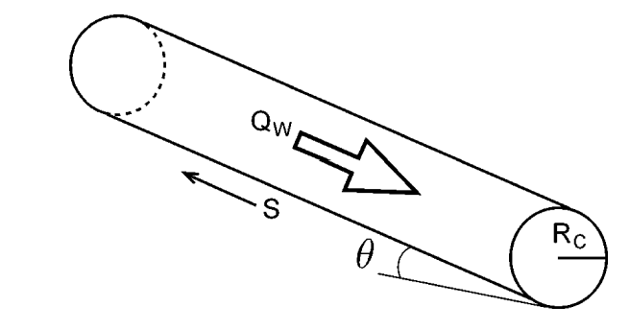
Nye (1953) / Rothlisberger (1972) theory for subglacial conduits
applications: plumbing system of cryovolcanoes on Enceladus and Ceres
Assume: water temperature = ice temperature
work done per unit volume of
water per unit distance along
flow
pressure driving closure
A,n: creep parameters for ice
Energy required to raise water temperature
(pressure dependence of the melting point
of ice):
melt-back rate
warming of
water
heat generated
by flow of water
Following Cuffey, ch. 6., p.198-199
(suggested reading)

Slide 38
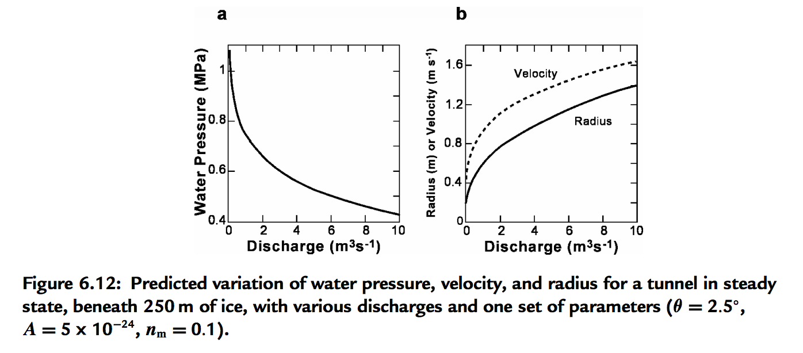
Pressure reduction in big Rothlisberger channels causes them to parasitize flow from smaller channels

Slide 39
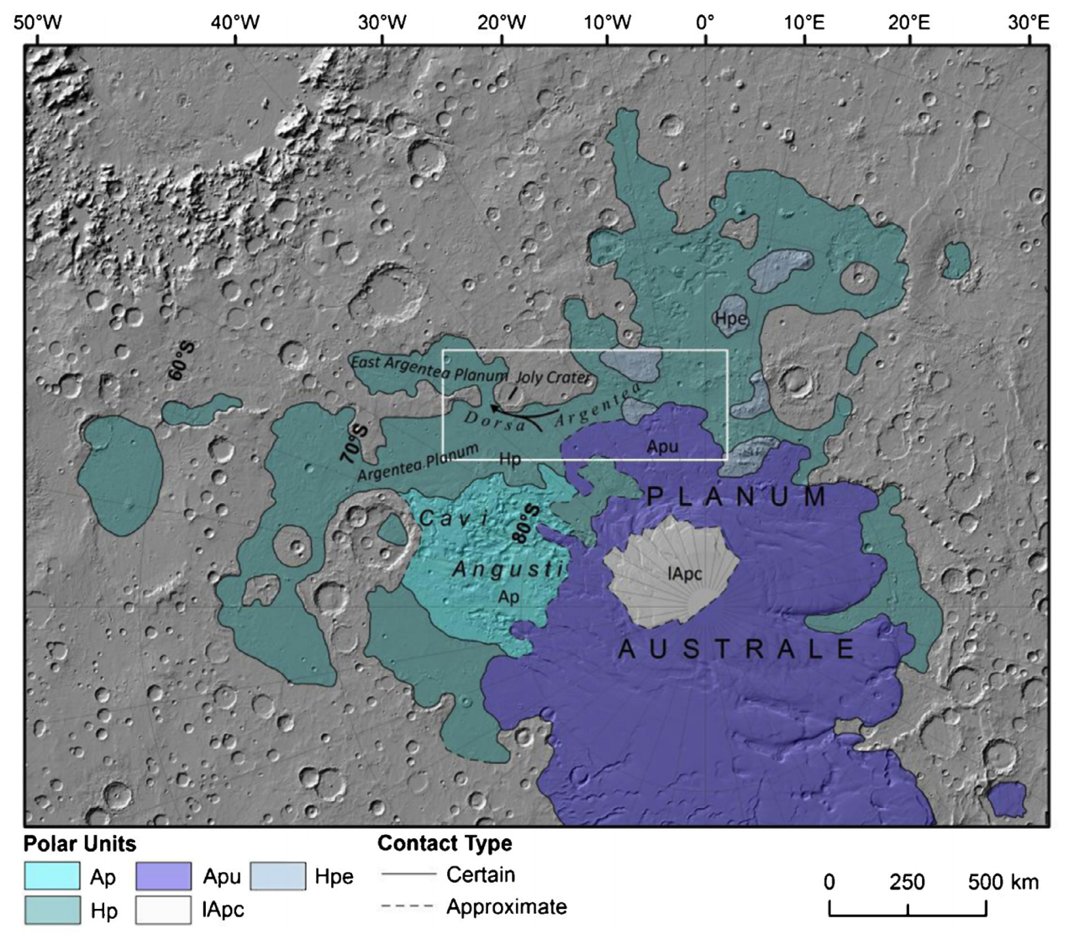
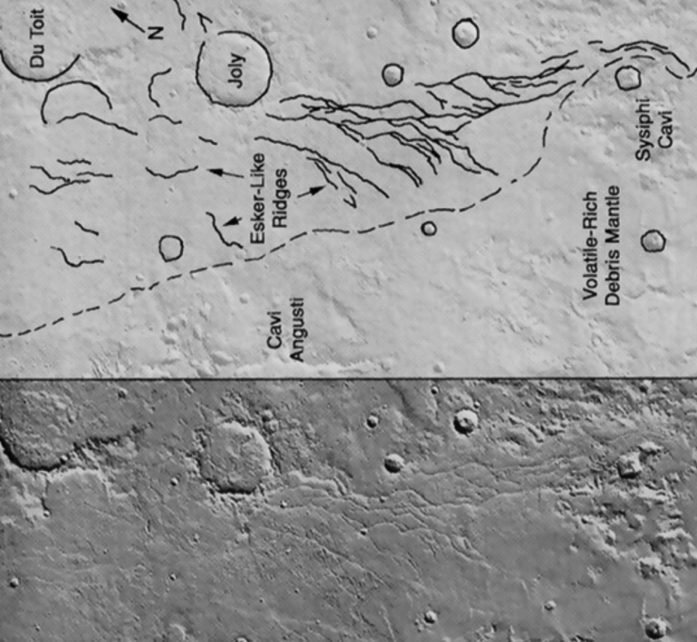
Example: Mars, Dorsa Argentea Formation eskers (~3.5 Ga)
Fastook et al. Icarus 2012
Butcher et al. Icarus 2016 – South Pole of Mars

Slide 40
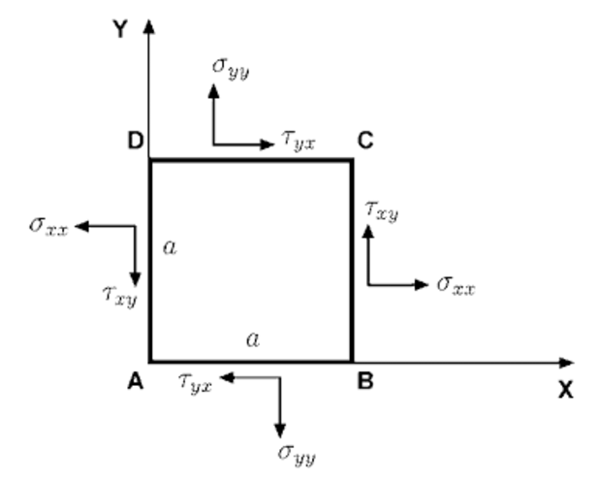
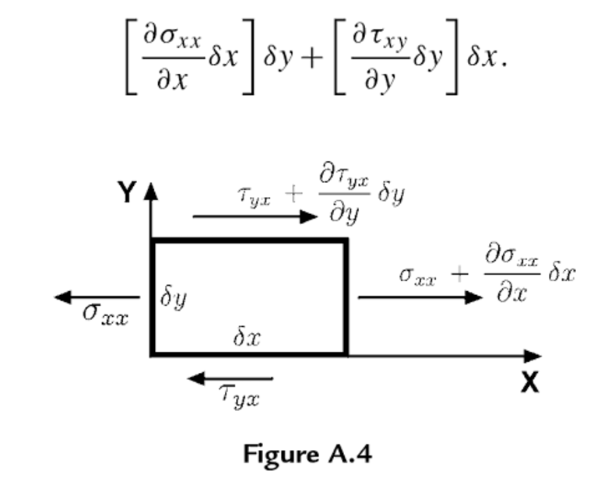
Review of stress and strain
Definitions (2D – real case is 3D):
Assumption: Forces are balanced
(no rotational acceleration nor lateral acceleration)
Infinitesimal strain (invalid for complexly folded ice)
Convention: Extensional stresses defined as +ve
(note: in some engineering contexts, compression is +ve)
Rotate coordinate system to maximize normal
stresses (these are then called the principal stresses)
Subtract off pressure:

Slide 41
Ice is incompressible, so only deviatoric stresses matter for flow
0 - Pressure:
Ice flow is pressure-independent
for pressure within glaciers
Effective stress:

Slide 42
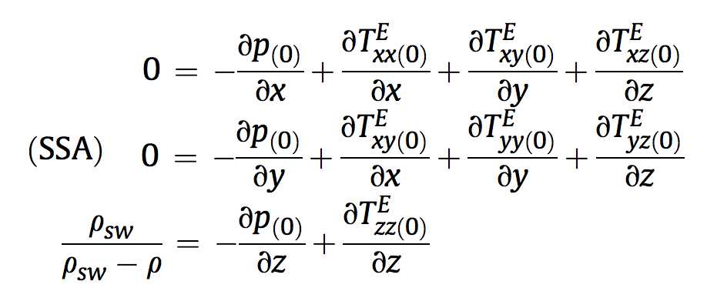
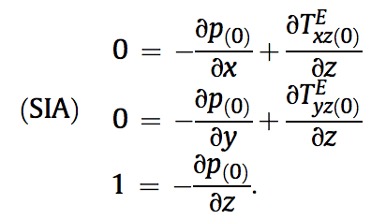
Stress: which components of stress to consider?
non-dimensionalized
SHALLOW SHELF APPROXIMATION
SHALLOW ICE APPROXIMATION
floating

Slide 43
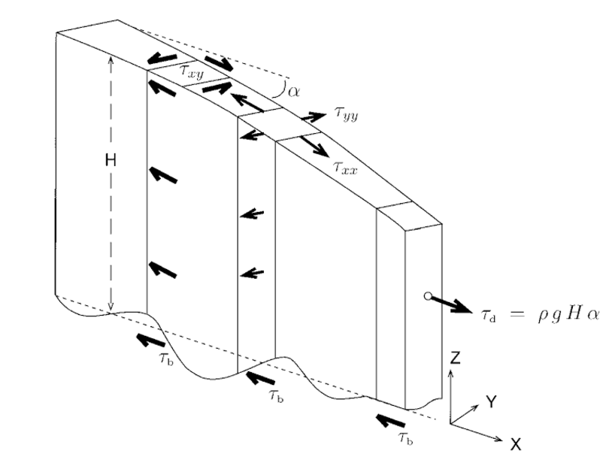
Vertically integrated force balance (map-plane models)
Cuffey & Patterson 2010
e.g. Fastook & Chapman, J. Glaciol., 1989

