Slide 1
GEOS 28600
The science of landscapes:
Earth & Planetary Surface Processes
Lecture 8
Monday 3 Feb 2020

Slide 2
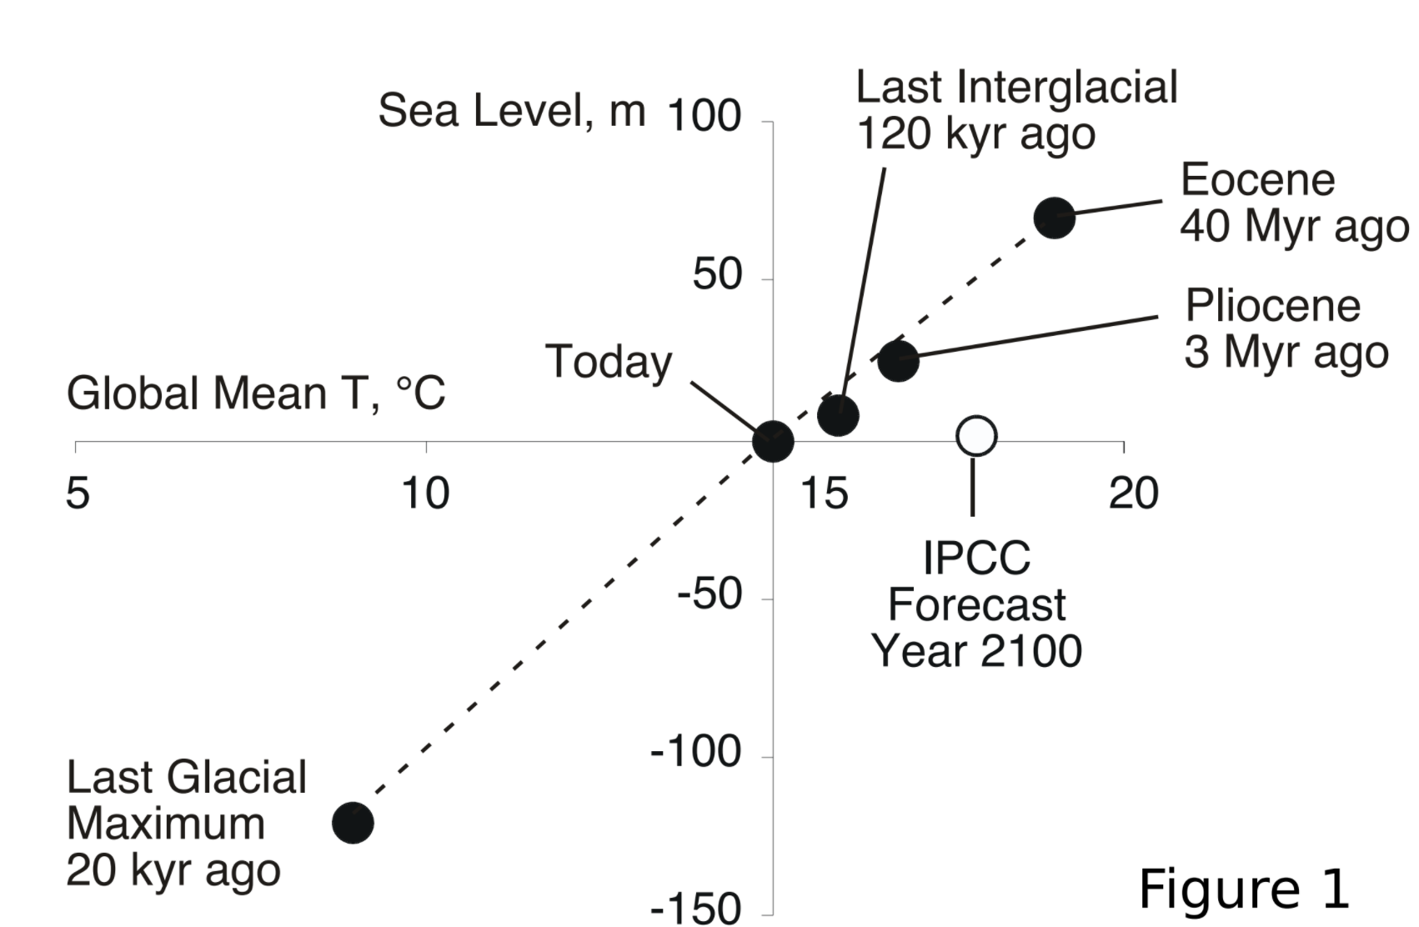
Ice flow physics will determine how fast Antarctica melts
Lifetime of anthropogenic CO2 in atmosphere: 10s of Kyr
Worst case for Antarctic melting (no geoengineering): centuries
Reasonable central guess: a few thousand years.
See Schoof & Hewitt 2013 (required reading)
Archer & Kite, “The ultimate social cost of carbon”, in prep.

Slide 3
Key points from today’s lecture
Mass balance of a glacier or ice sheet
Glen’s Law
Nondimensional T-vs-depth as a function of accumulation rate for fixed basal heat flow

Slide 4
The flow of ice
ICE MOVEMENT – GLEN’S LAW
TEMPERATURE STRUCTURE WITHIN ICE SHEETS – ESKERS (Mars examples)
EFFECT OF GLACIAL EROSION ON TOPOGRAPHY
(Earth examples)

Slide 5
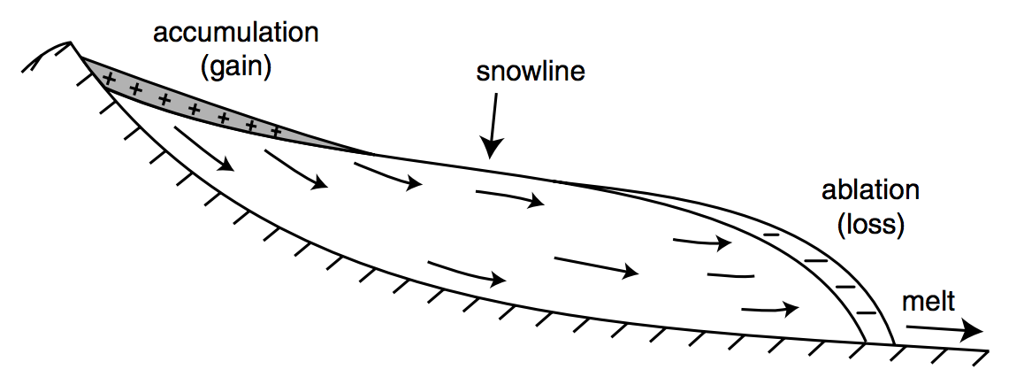
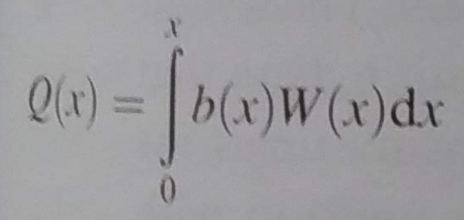
Climate drives accumulation+ablation patterns, which drive glacial flow
Therefore, changes in glacier length (recorded by e.g. moraines, historical photographs)
can be a proxy for changes in climate.
Anderson & Anderson 2010

Slide 6
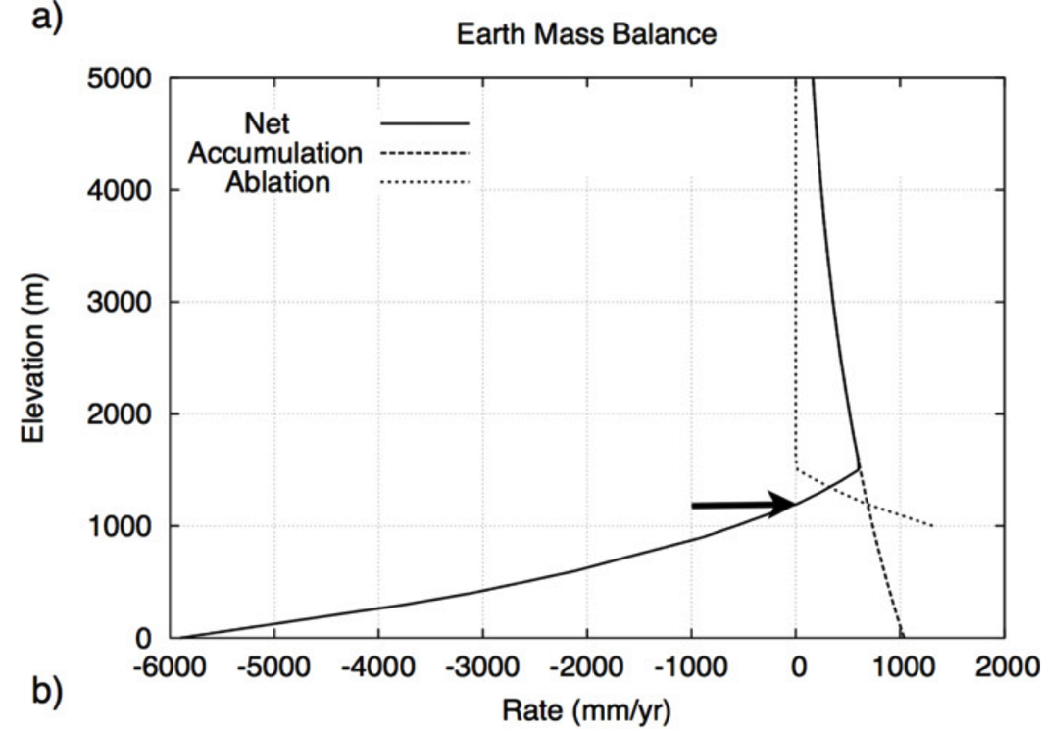
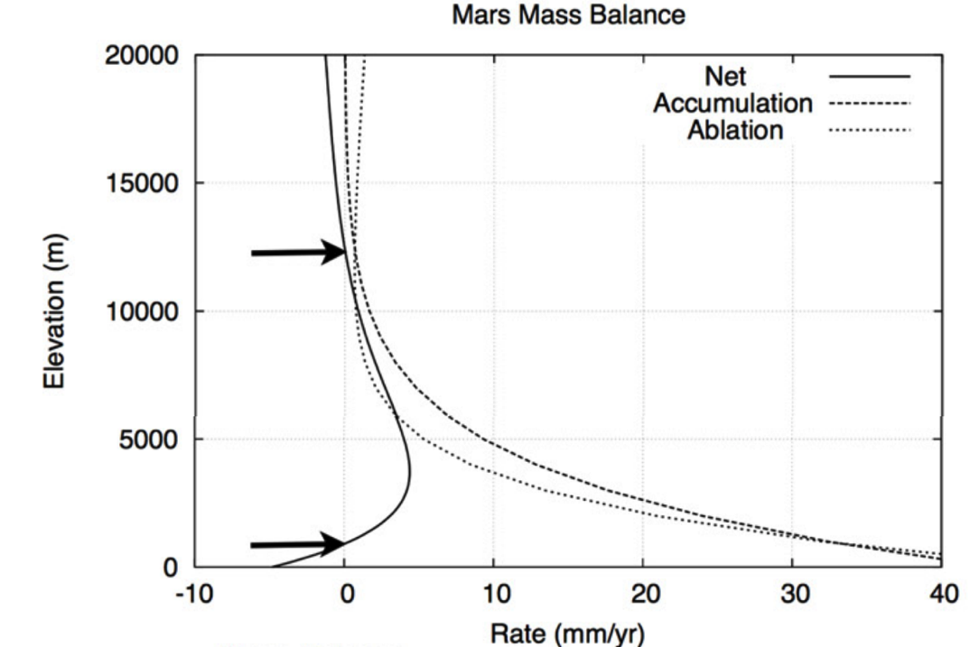
Mass balance on Earth favors ice accumulation at high elevations. Mass balance on Mars may favor ice accumulation at low elevations.
Orographic precipitation; low temperatures disfavor melting + sublimation
Sublimation rate increases as pressure decreases
Fastook et al., Icarus 2008

Slide 7
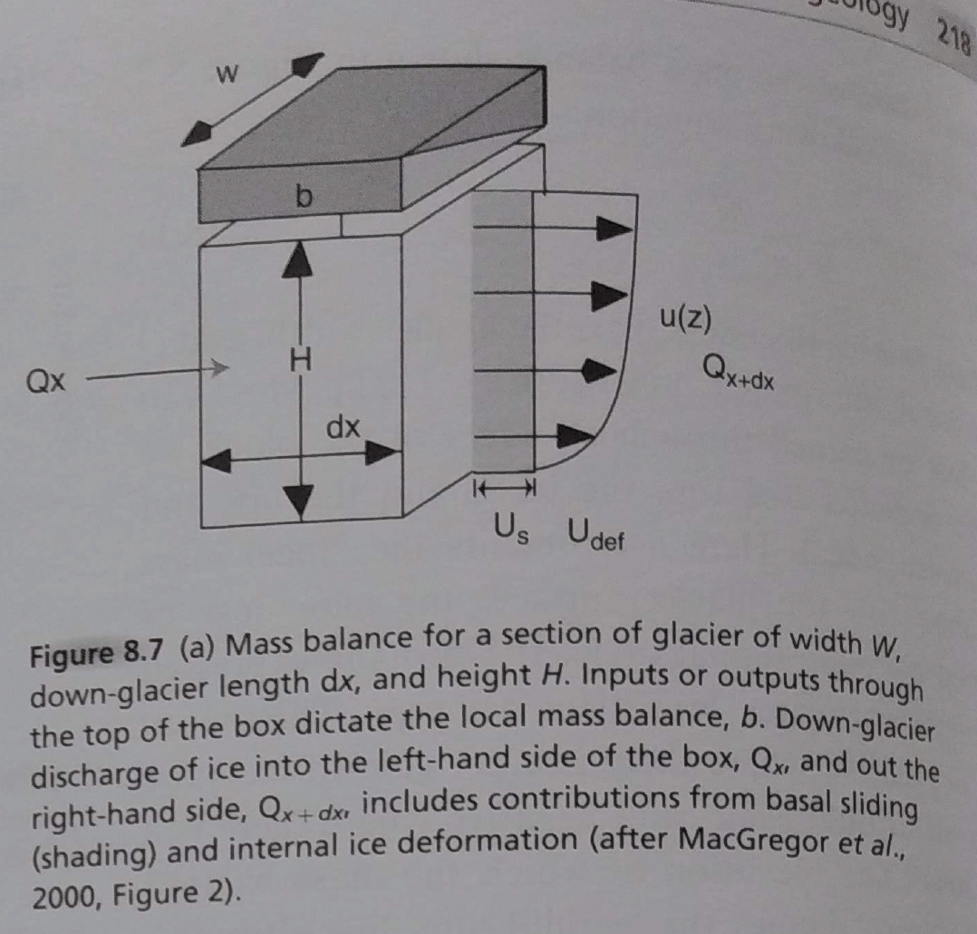
Anderson & Anderson 2010

Slide 8
Develop an expression for the patten of shear stress within the material.
Develop an expression to describe the rheology of the material.
Combine these expressions to get a relationship between the rate of strain and the position within the material.
Integrate the strain rate to obtain the velocity profile.

Slide 9
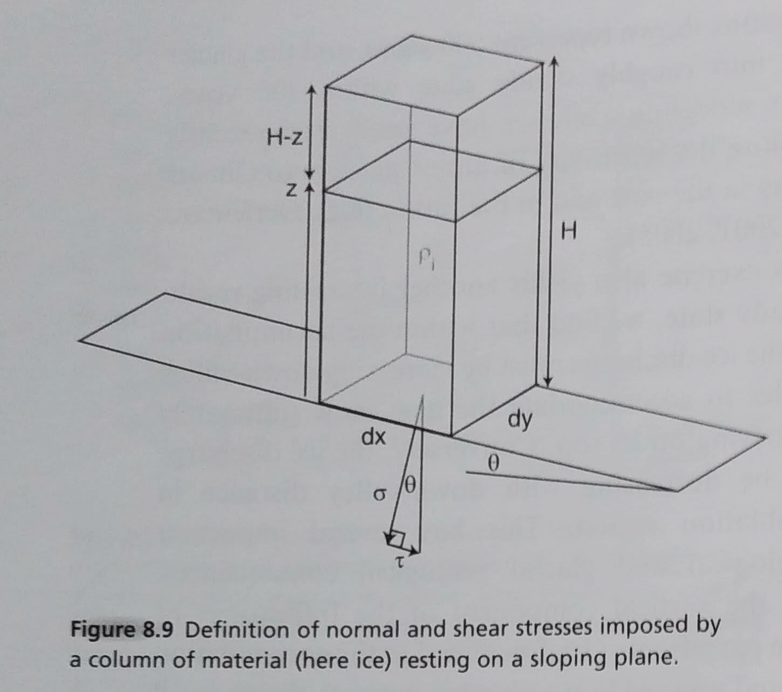

Slide 10
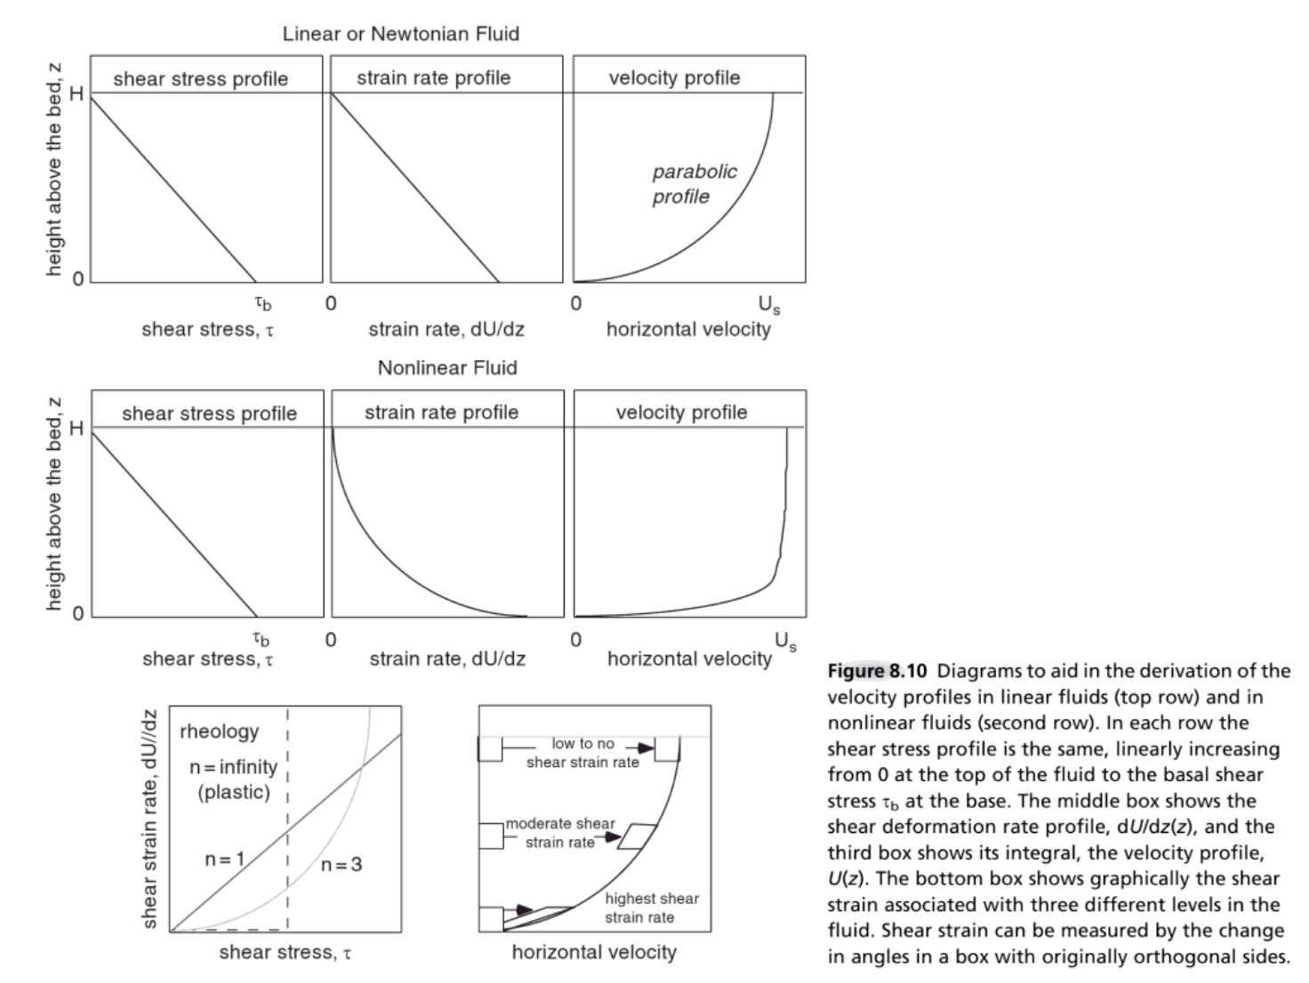
Anderson & Anderson 2010

Slide 11
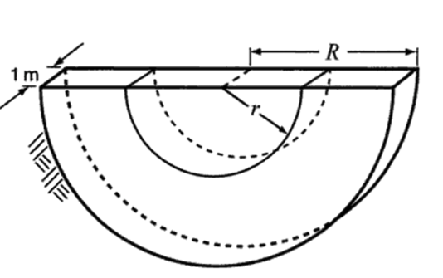
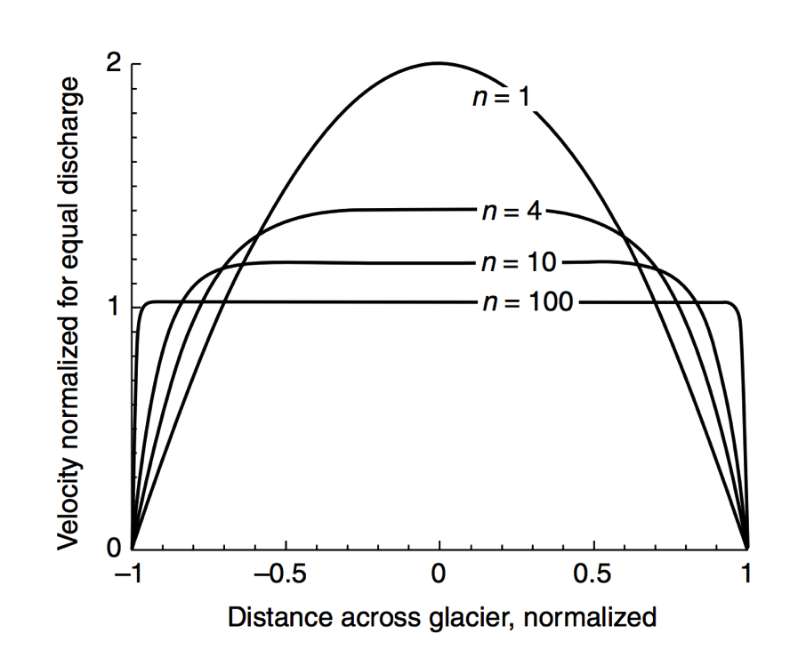
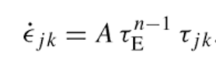
Stress → strain: rheology of water ice near 273K
Dislocation creep:
“toothpaste tube” limit
in practice “regularized”
Glen’s Flow Law
n = approximately 3
Q ~ 60 kJ/mol
Nye-Glen law for incompressible, isotropic ice
Semicircular channel, radius R
Effects of grain orientation and grain size can be important (but less so than the
stress and temperature effects)

Slide 12
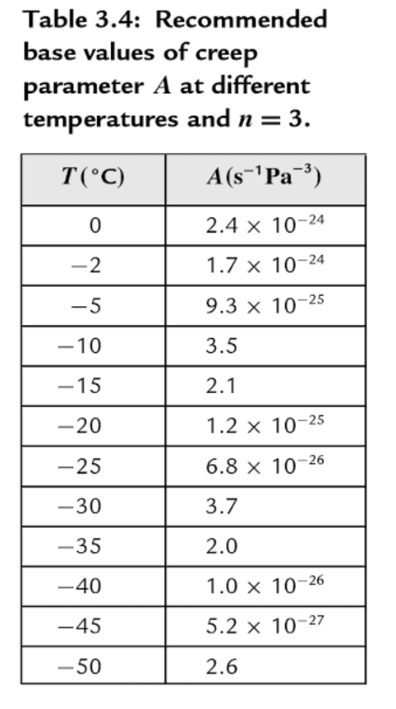
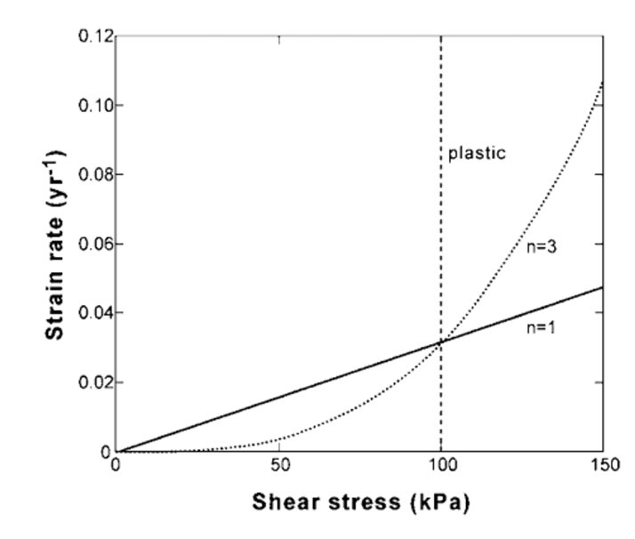
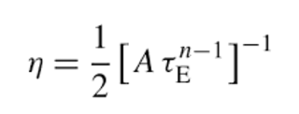
Strong temperature dependence and strong shear-stress dependence
Error relative to ice-sheet data: factor of 3
10¹⁴ Pa s
Cuffey & Patterson 2010
Effective viscosity decreases as shear stress increases

Slide 13
Pure shear vs. simple shear

Slide 14
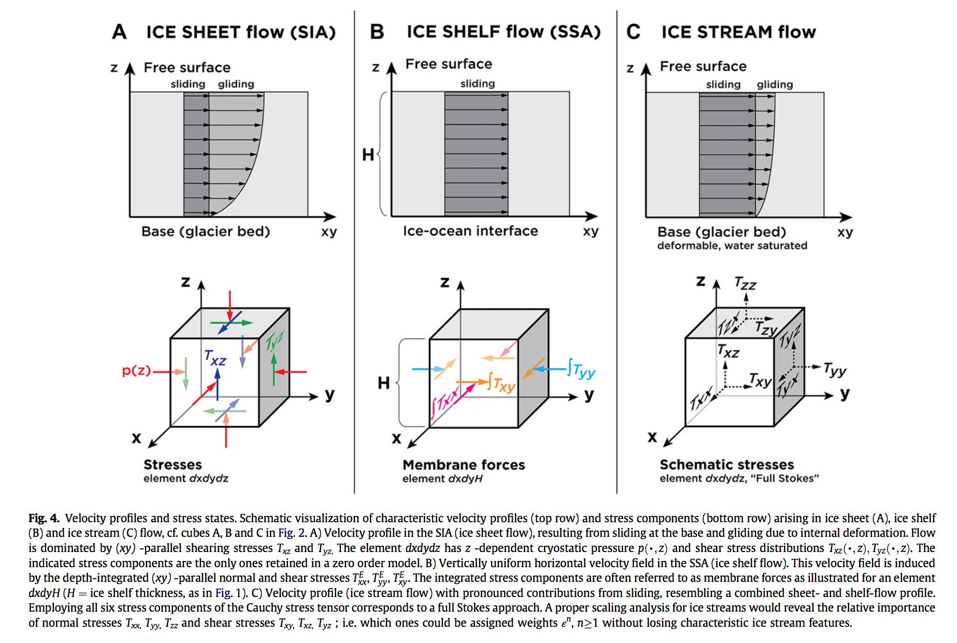
Stress: which components of stress to consider?
neglects
longitudinal
and transverse
stresses
SIA: Shallow Ice Approximation
SSA: Shallow Shelf Approximation
Kirchner et al.,
Quaternary Science Reviews 2011

Slide 15
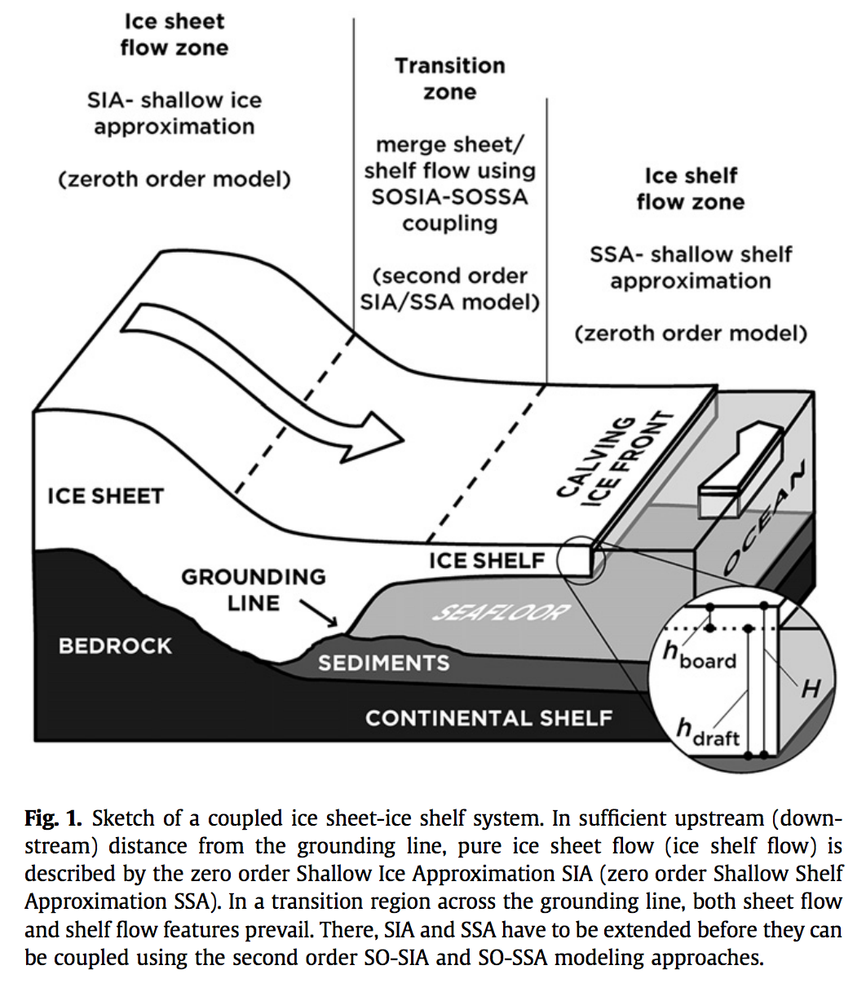
Stress: which components of stress to consider?
Kirchner et al. 2011
Quaternary Science
Reviews

Slide 16
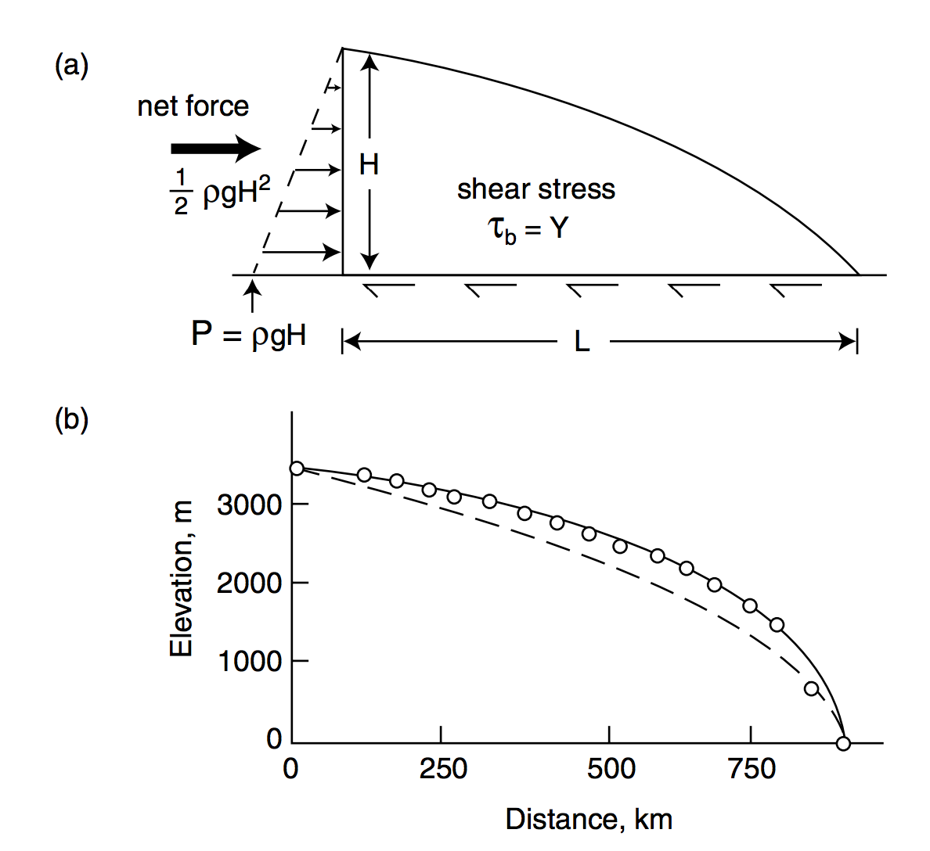
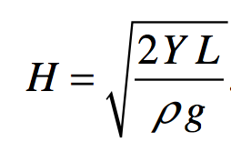
Plastic-flow approximation to ice sheet profiles (steady state)
Assume Y = 10⁵ Pa (larger for cold ice)
circles: East Antarctic
ice sheet between Vostok
and Mirny stations
parabolic
Melosh 2011, ch. 11

Slide 17
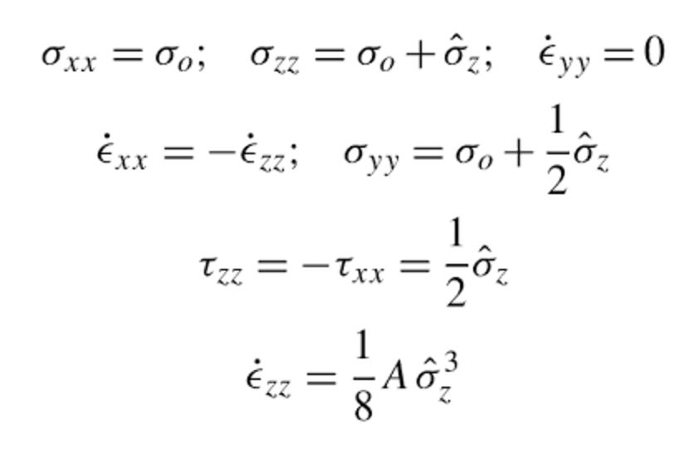
Example: how long to seal a system of crevasses?
Assume Glen’s law

Slide 18
The flow of ice
ICE MOVEMENT – GLEN’S LAW
TEMPERATURE STRUCTURE WITHIN ICE SHEETS
EFFECT OF GLACIAL EROSION ON TOPOGRAPHY
(Earth examples)

Slide 19
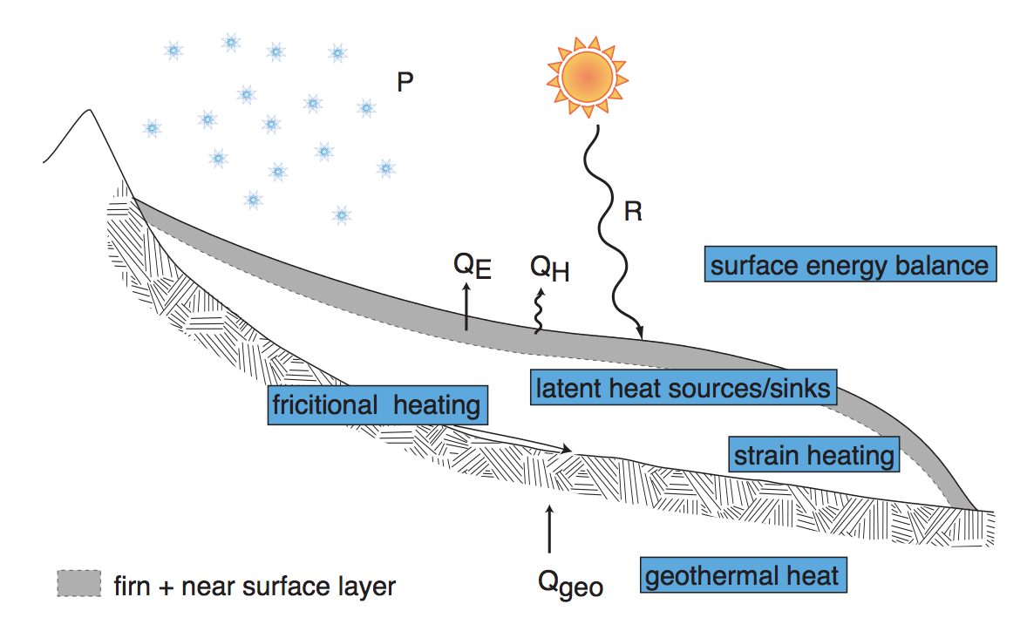
Andy Anschwanden, Glaciology Summer School

Slide 20
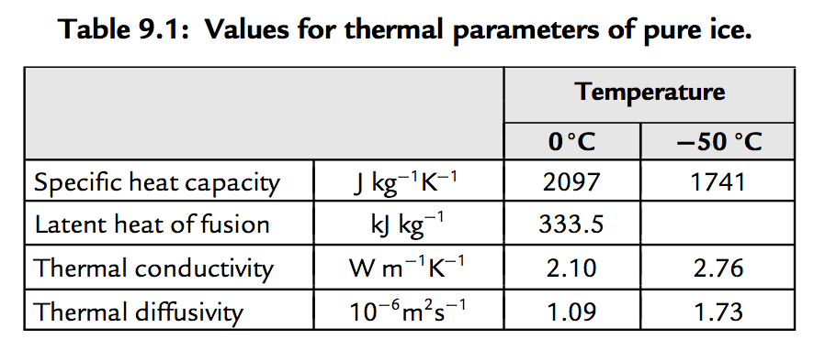
Decay of T signal of climate forcing with depth
a way to quantify
exceptional late-20th
warmth relative to
earlier centuries
Cuffey & Patterson, ch. 9 (supplementary reading)

Slide 21
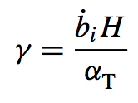
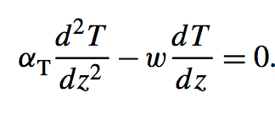
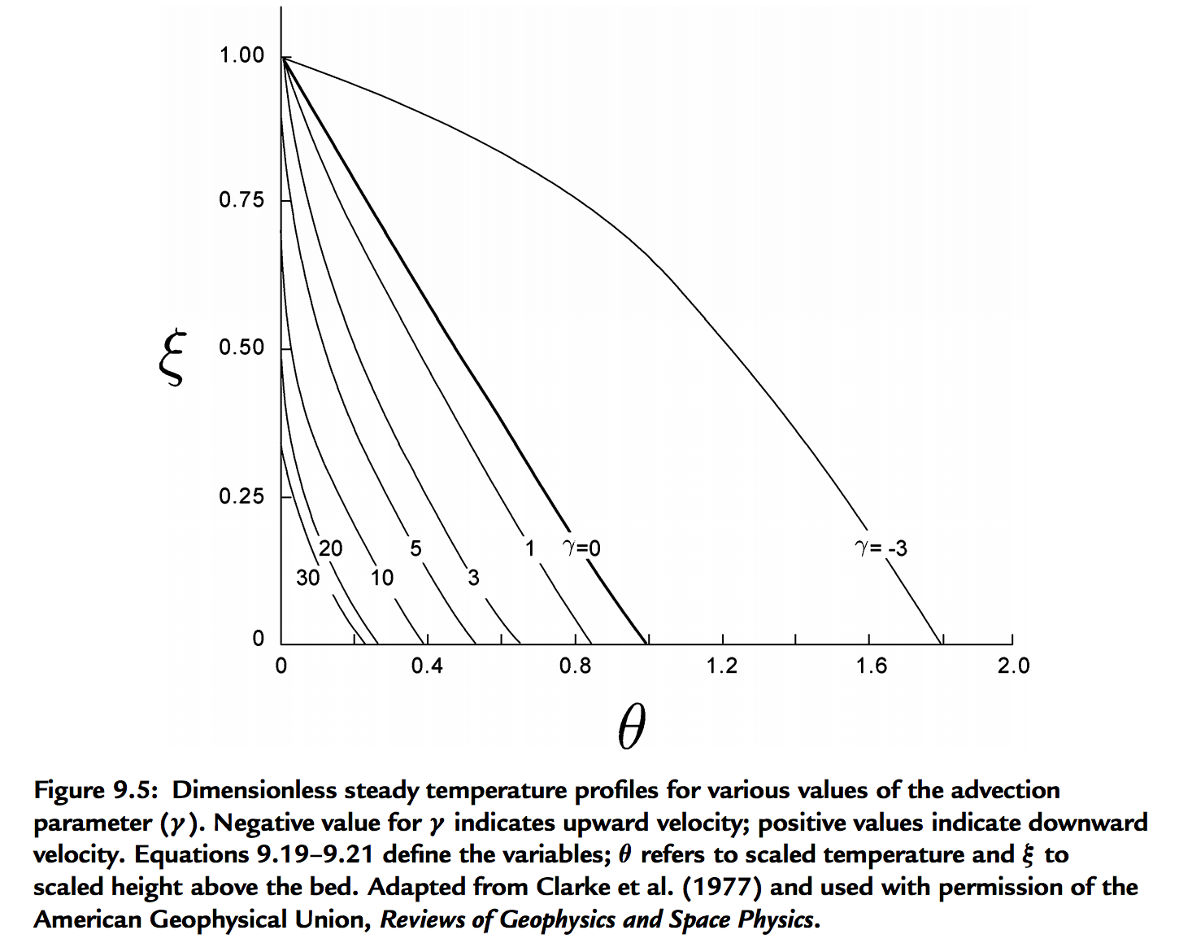
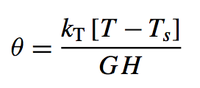
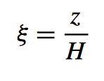
For slow-flowing ice sheets (e.g., Mars) → shear heating unimportant, temperature set by geothermal heat flow modified by advection of cold ice from above
Thermal structure of an ice sheet: neglecting horizontal advection
surface mass
balance:
thickness/time
signed
Peclet
number
Constant heat flow at z = 0
(Geothermal + shear heating)
Mass removed at bed
(e.g., rapid lateral flow)
(Ice divide)
Cuffey & Patterson, ch. 9 (supplementary reading)

Slide 22
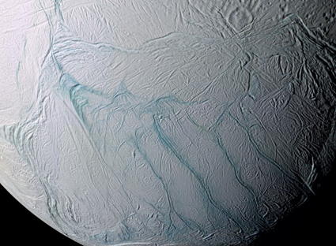
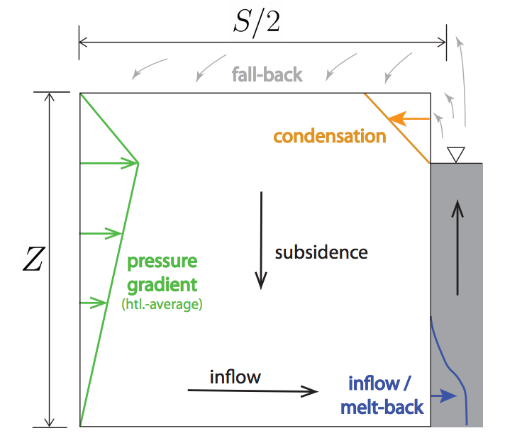
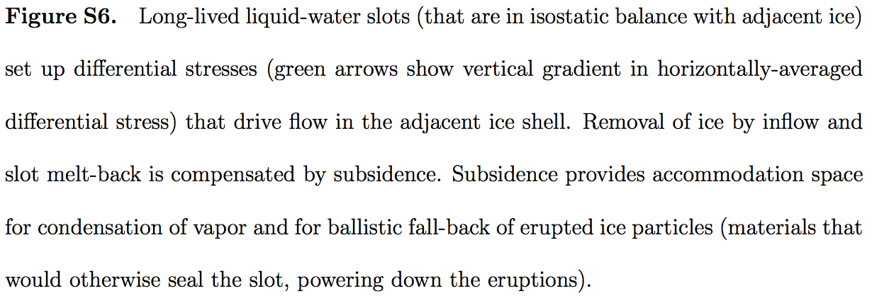
Linking thermal structure and ice flow: crevasse-closure regulation of the rate of volcanism on Enceladus?
Kite & Rubin 2016

Slide 23
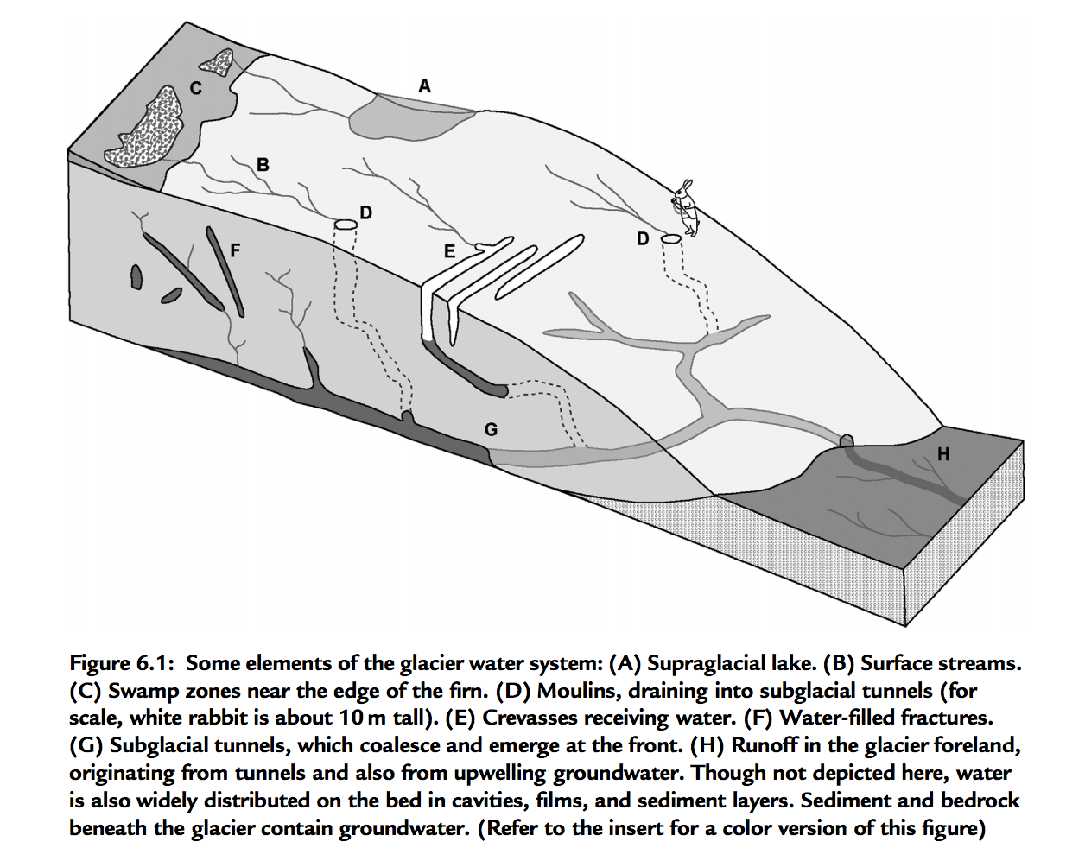
Wet-based ice sheets
Basal melt
Applications: ice streams
will Greenland + Antarctic ice shelf collapse take a few millenia or a few centuries?

Slide 24
The flow of ice
ICE MOVEMENT – GLEN’S LAW
TEMPERATURE STRUCTURE WITHIN ICE SHEETS – ESKERS (Mars examples)
EFFECT OF GLACIAL EROSION ON TOPOGRAPHY
(Earth examples)

Slide 25
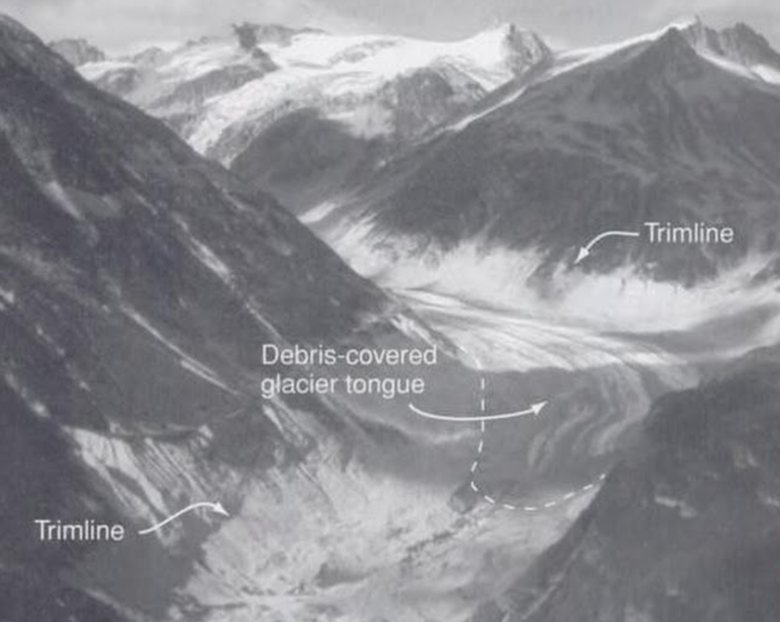
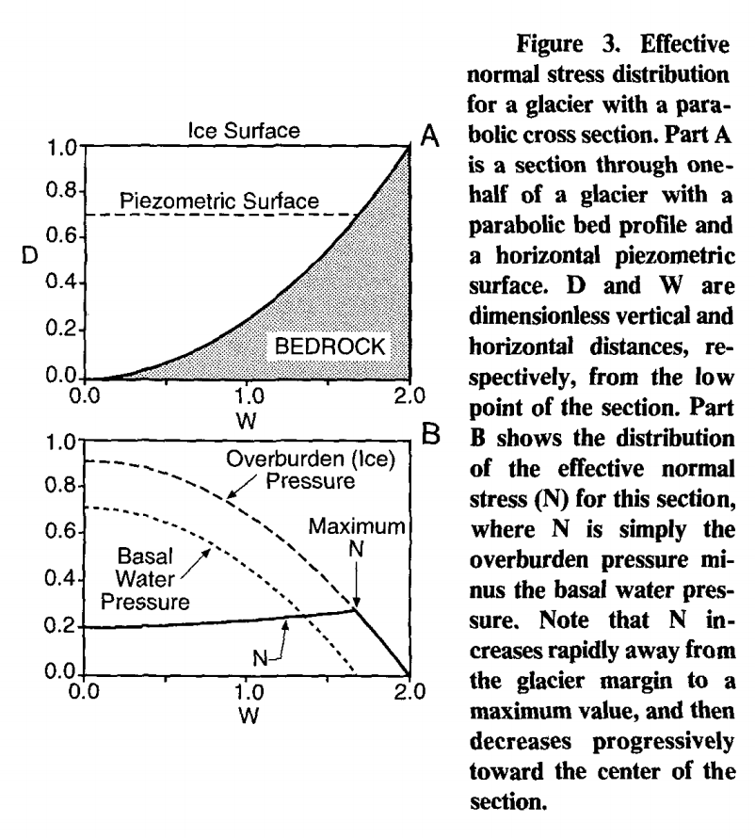
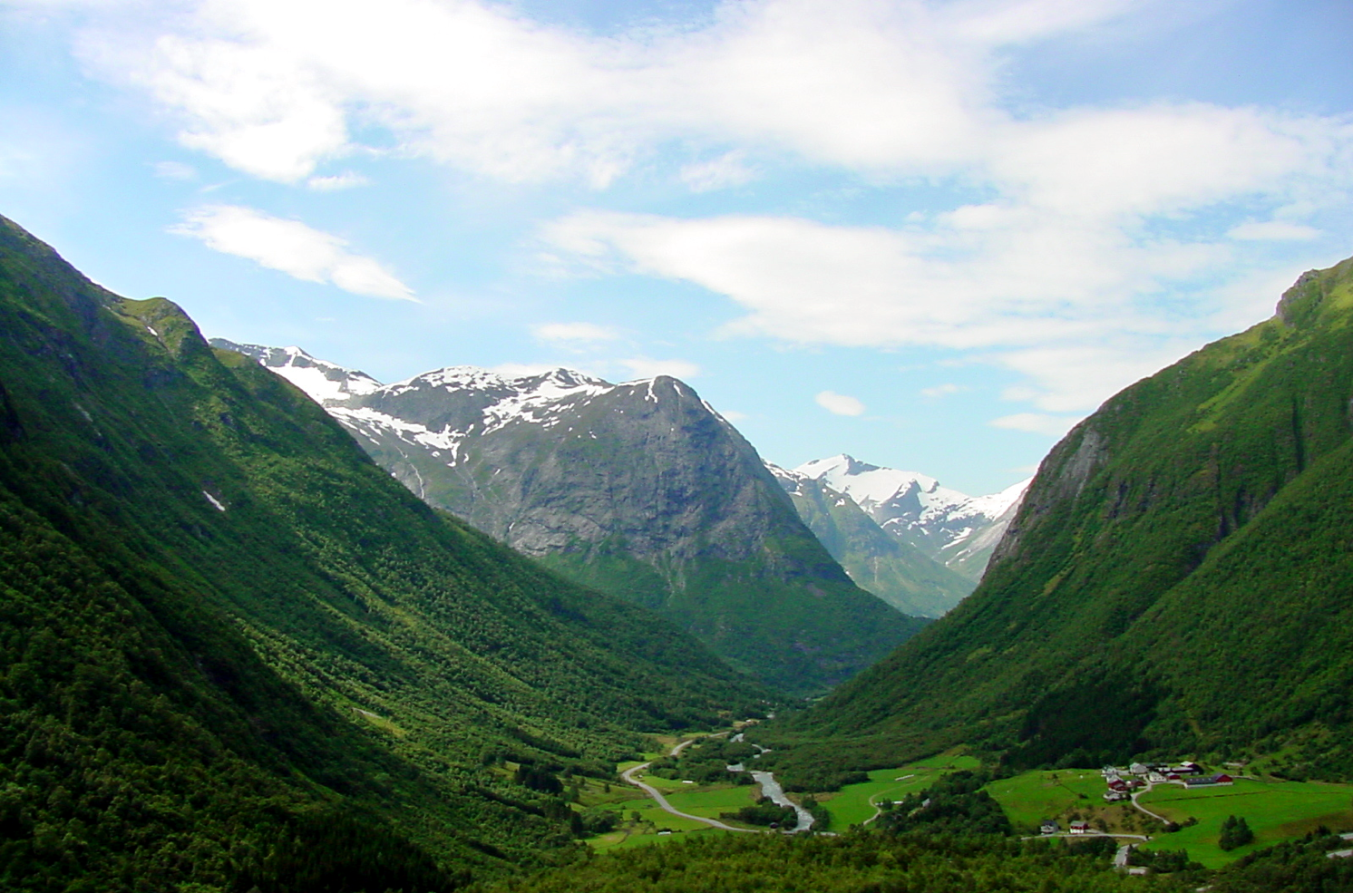
Origin of U-shaped glacial valleys: role of water table
Harbor, 1992, GSA Bulletin

Slide 26
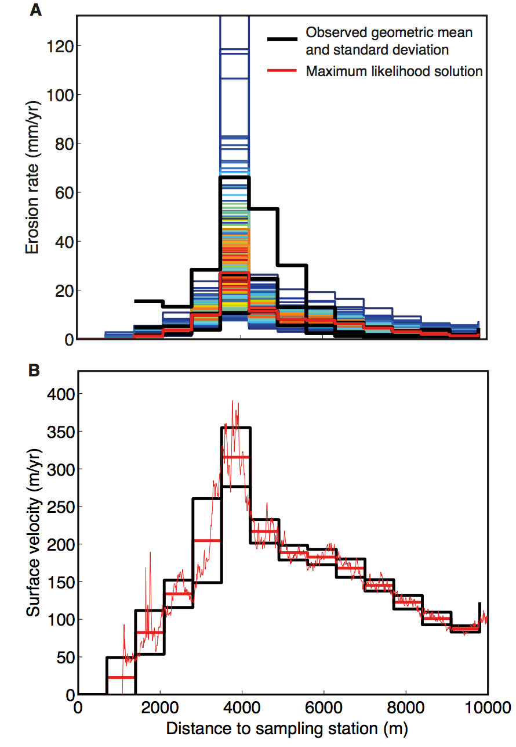
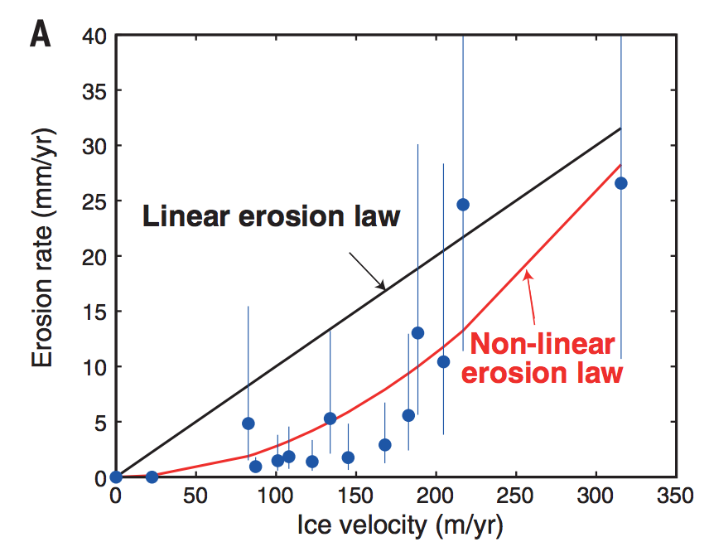
Glacial abrasion and plucking scales as (sliding velocity)²
using metamorphic grade
of eroded rocks as a proxy
for distance upstream
Herman et al. Science 2015
Abrasion, quarrying

Slide 27
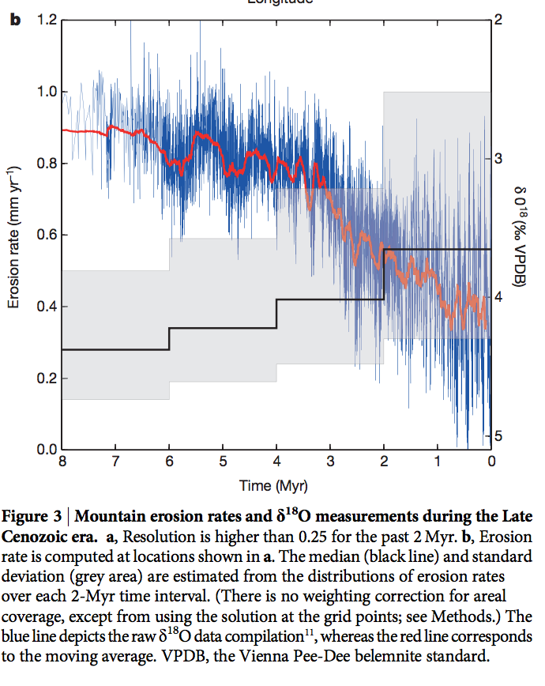
Global increase in erosion rate in the last 2 Myr – possibly due to increase in glaciation
Herman et al. Science 2013
(thermochronology compilation)

Slide 28
Key points from today’s lecture
Mass balance of a glacier or ice sheet
Glen’s Law
Nondimensional T-vs-depth as a function of accumulation rate for fixed basal heat flow
Other points:
Approximations to the full Stokes equation: locations where they are and are not acceptable
Glacial erosion parameterization

Slide 29
Bonus slides

Slide 30
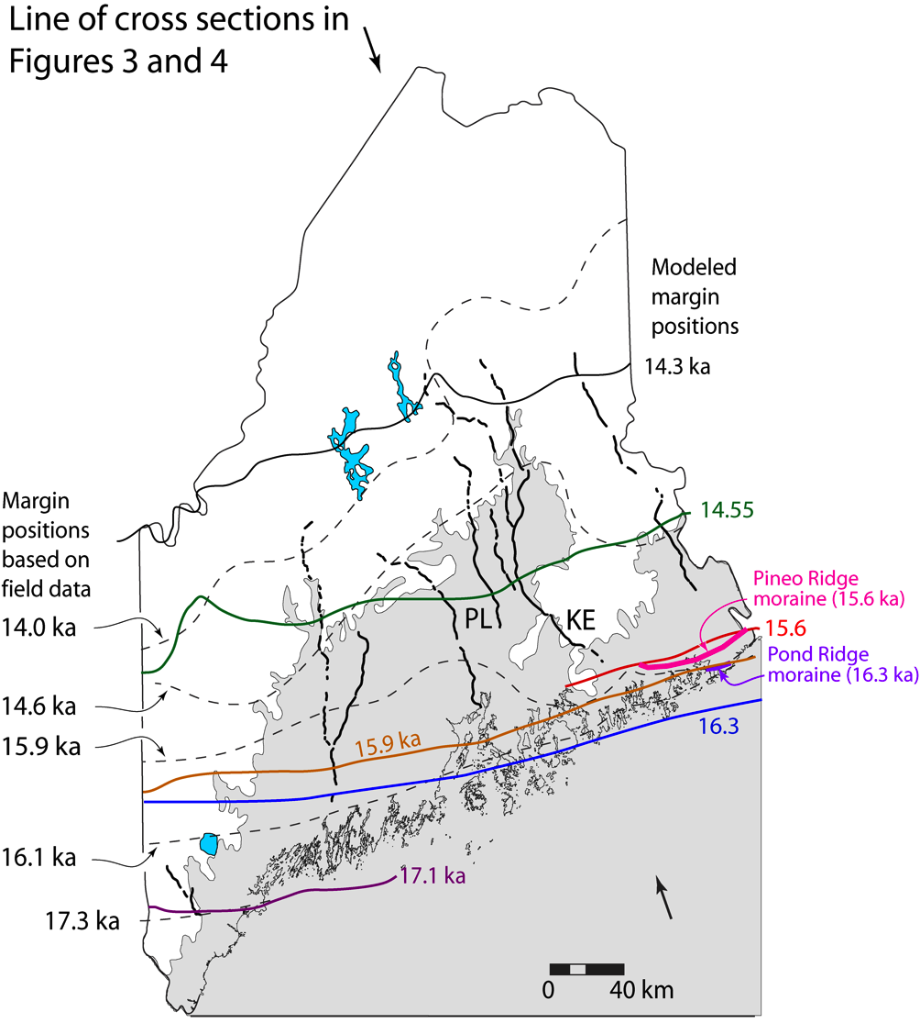
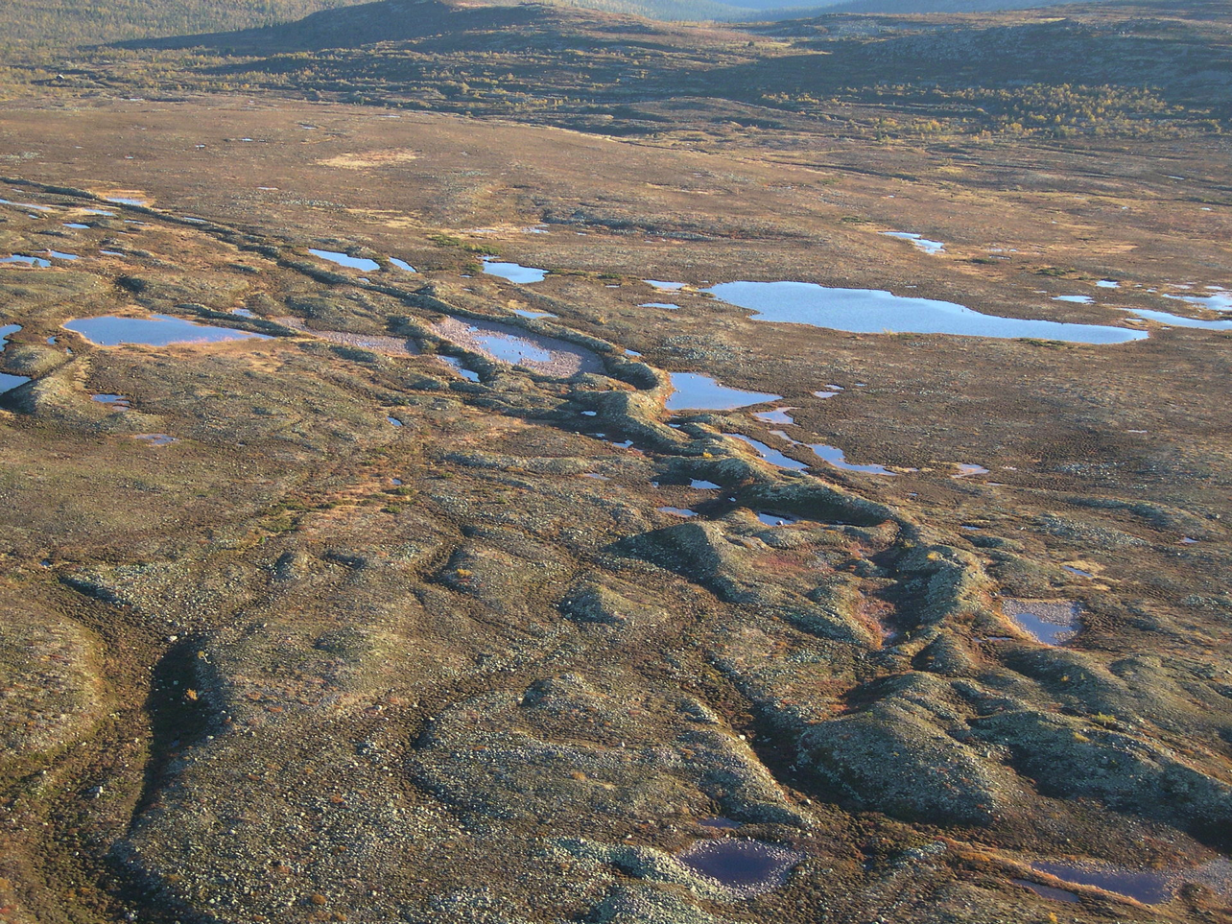
Eskers:
sand+gravel ridges deposited from
subglacial water channels
Katahdin esker system,
Maine
Eskers can flow uphill: why?

Slide 31
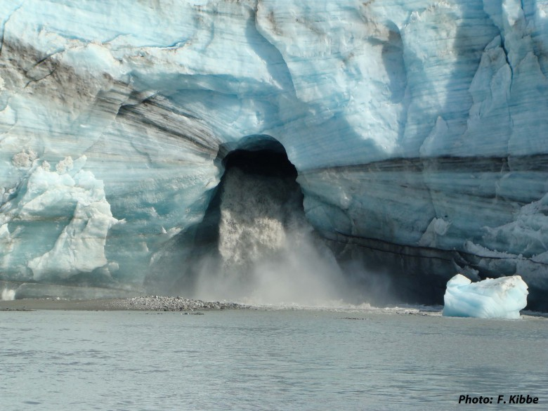
How are subglacial conduits kept open?
Viscous inflow of warm ice will seal conduits near the ocean interface
in decades, unless opposed e.g. Rothlisberger 1972

Slide 32
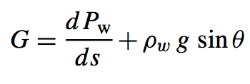
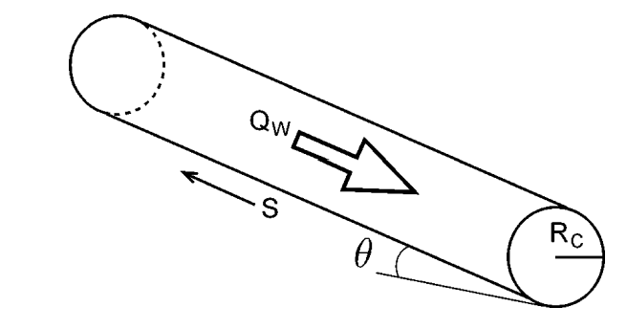
Nye (1953) / Rothlisberger (1972) theory for subglacial conduits
applications: plumbing system of cryovolcanoes on Enceladus and Ceres
Assume: water temperature = ice temperature
work done per unit volume of
water per unit distance along
flow
pressure driving closure
A,n: creep parameters for ice
Energy required to raise water temperature
(pressure dependence of the melting point
of ice):
melt-back rate
warming of
water
heat generated
by flow of water
Following Cuffey, ch. 6., p.198-199
(suggested reading)

Slide 33
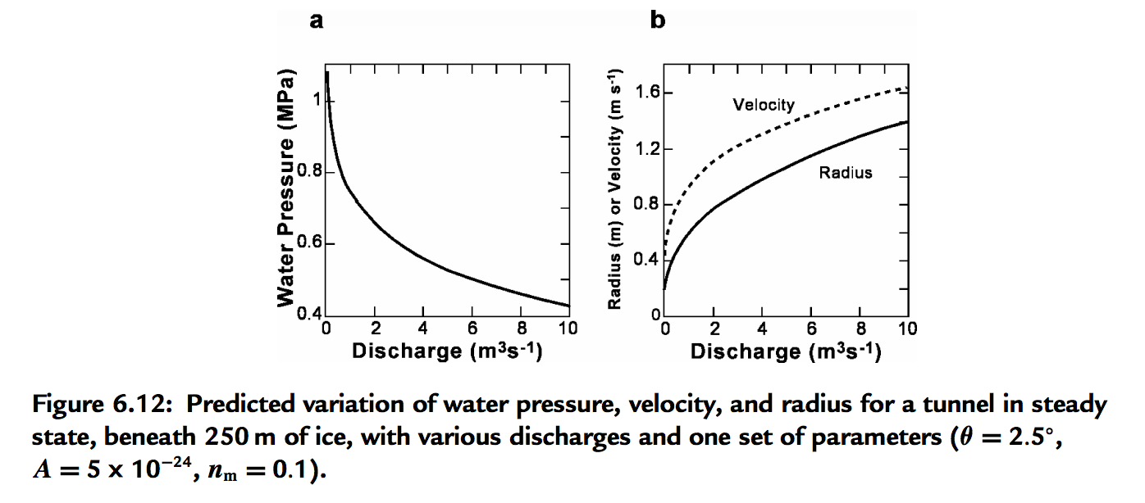
Pressure reduction in big Rothlisberger channels causes them to parasitize flow from smaller channels

Slide 34
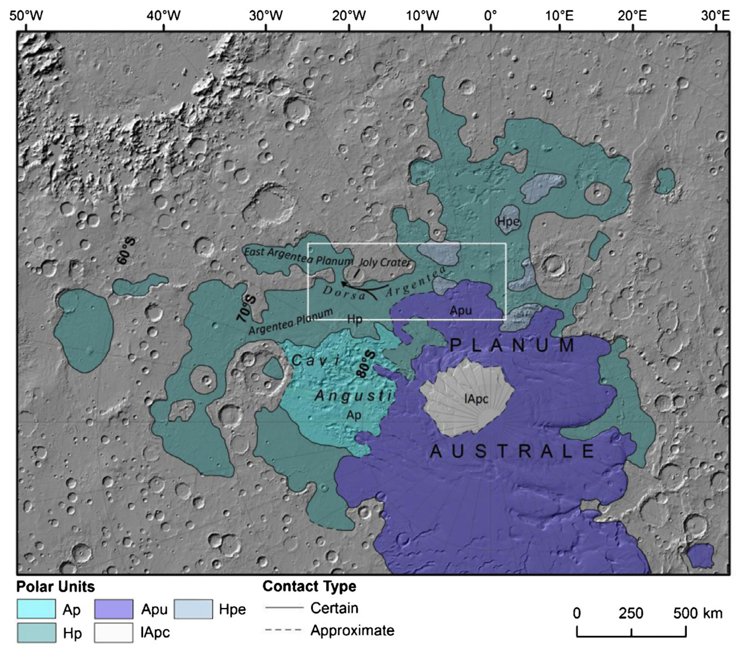
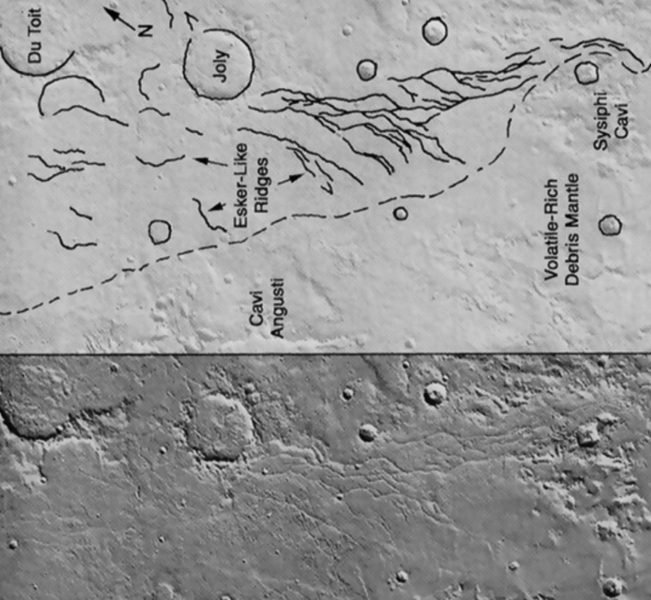
Example: Mars, Dorsa Argentea Formation eskers (~3.5 Ga)
Fastook et al. Icarus 2012
Butcher et al. Icarus 2016 – South Pole of Mars

Slide 35
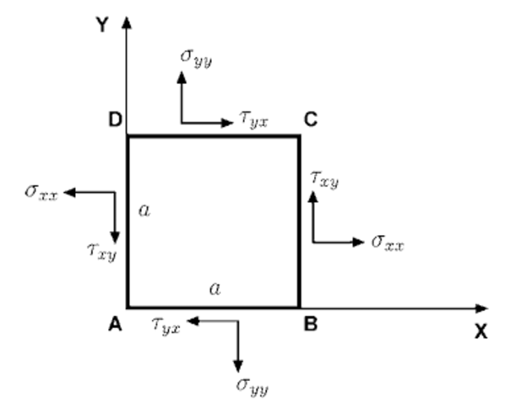
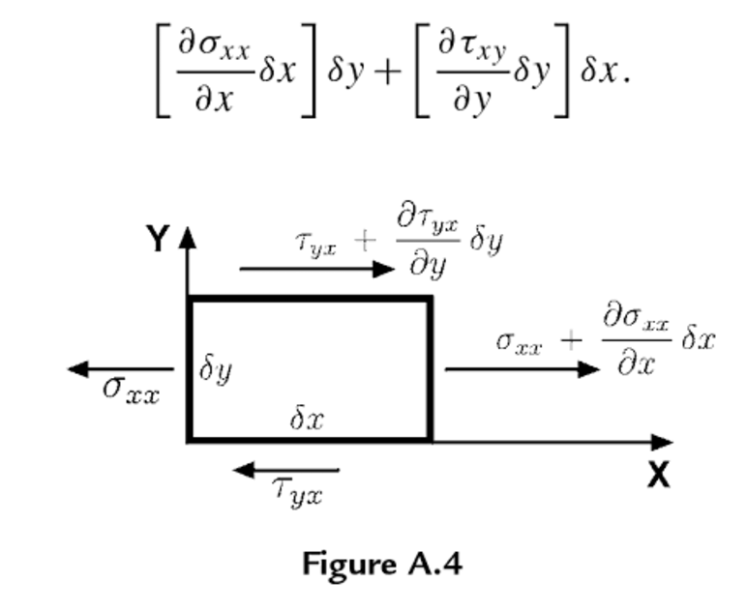
Review of stress and strain
Definitions (2D – real case is 3D):
Assumption: Forces are balanced
(no rotational acceleration nor lateral acceleration)
Infinitesimal strain (invalid for complexly folded ice)
Convention: Extensional stresses defined as +ve
(note: in some engineering contexts, compression is +ve)
Rotate coordinate system to maximize normal
stresses (these are then called the principal stresses)
Subtract off pressure:

Slide 36
Ice is incompressible, so only deviatoric stresses matter for flow
0 - Pressure:
Ice flow is pressure-independent
for pressure within glaciers
Effective stress:

Slide 37
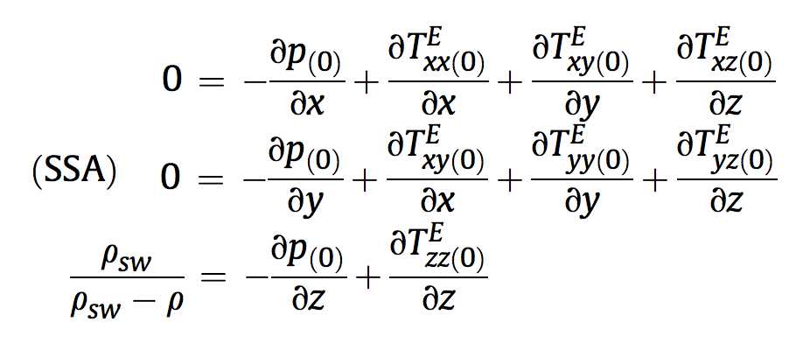
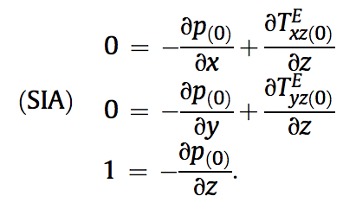
Stress: which components of stress to consider?
non-dimensionalized
SHALLOW SHELF APPROXIMATION
SHALLOW ICE APPROXIMATION
floating

Slide 38
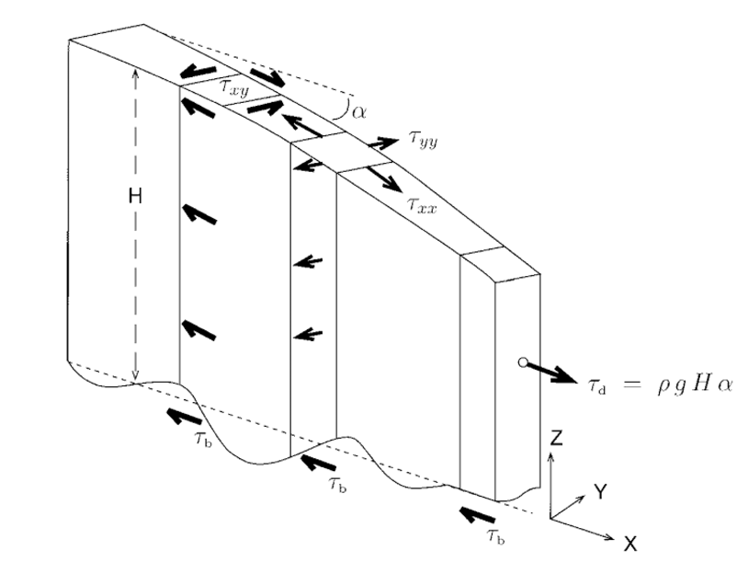
Vertically integrated force balance (map-plane models)
Cuffey & Patterson 2010
e.g. Fastook & Chapman, J. Glaciol., 1989

