Slide 1
GEOS 28600
The science of landscapes:
Earth & Planetary Surface Processes
Lecture 6
Monday 27 January 2020

Slide 2
Magma and lava
MAKING MAGMA: ADIABATIC DECOMPRESSION MELTING
EXPLOSIVE ERUPTIONS: SPEED LIMIT
LAVA FLOW RULES

Slide 3
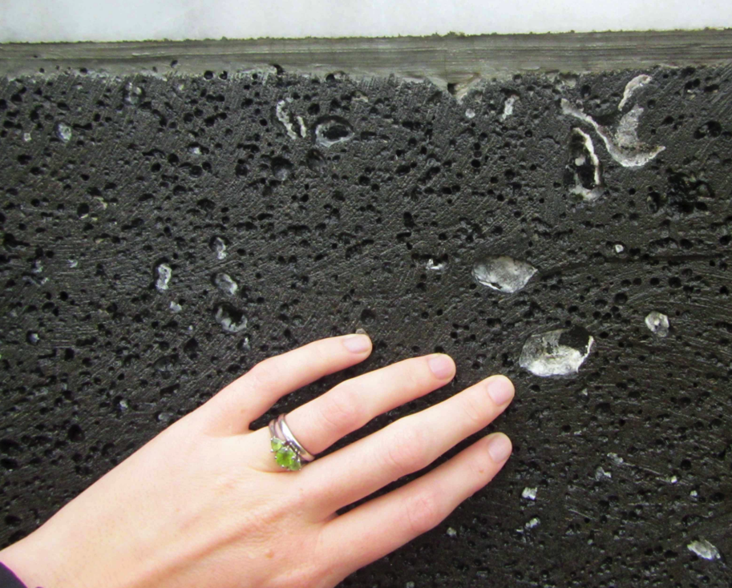
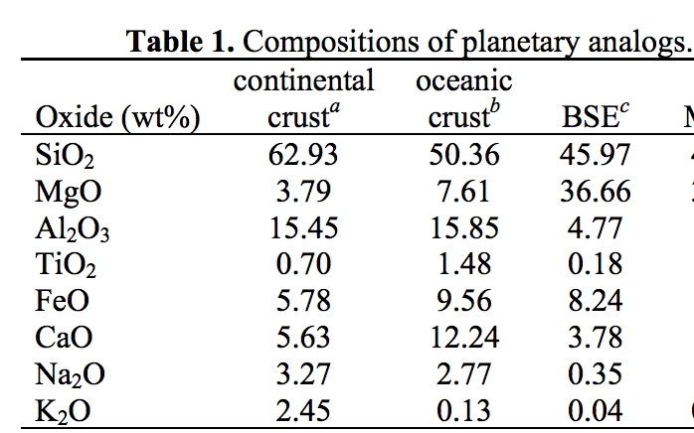
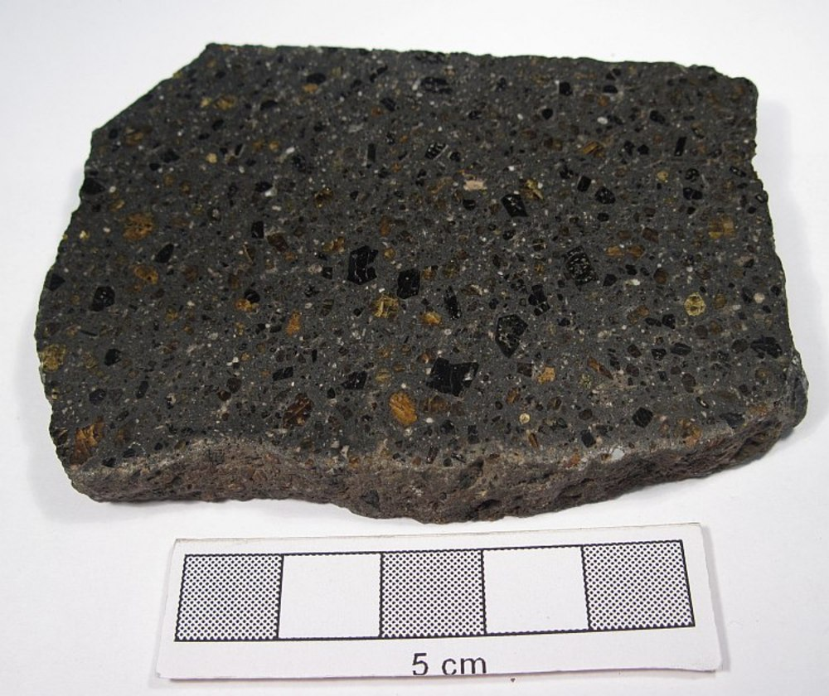
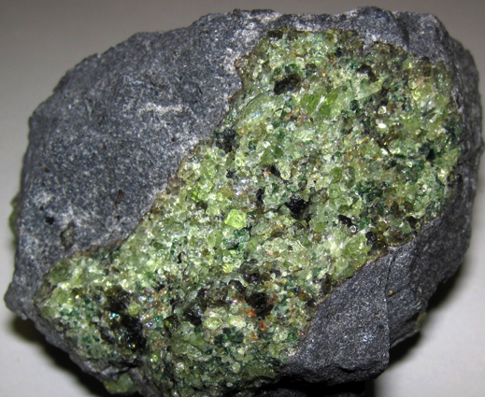
Magmas are produced by partial melting
Basalt is a dark, igneous rock characterized by small
grain sizes (less than about 1 mm) and containing
roughly equal proportions of plagioclase feldspar
and calcium-rich pyroxene, with less than 20% of other
minerals (e.g. olivine, Fe-Ti oxides).
- Basaltic Volcanism on the Terrestrial Planets, 1981
volatiles prefer the melt phase
(H2O, CO2 …) leading to bubbles
basalt: 45-55 wt% SiO2
Bulk Silicate Earth (BSE)
(<45 wt% SiO2)
olivine-dominated rock
yields a melt that
upon crystallisation gives
olivine-poor rock

Slide 4
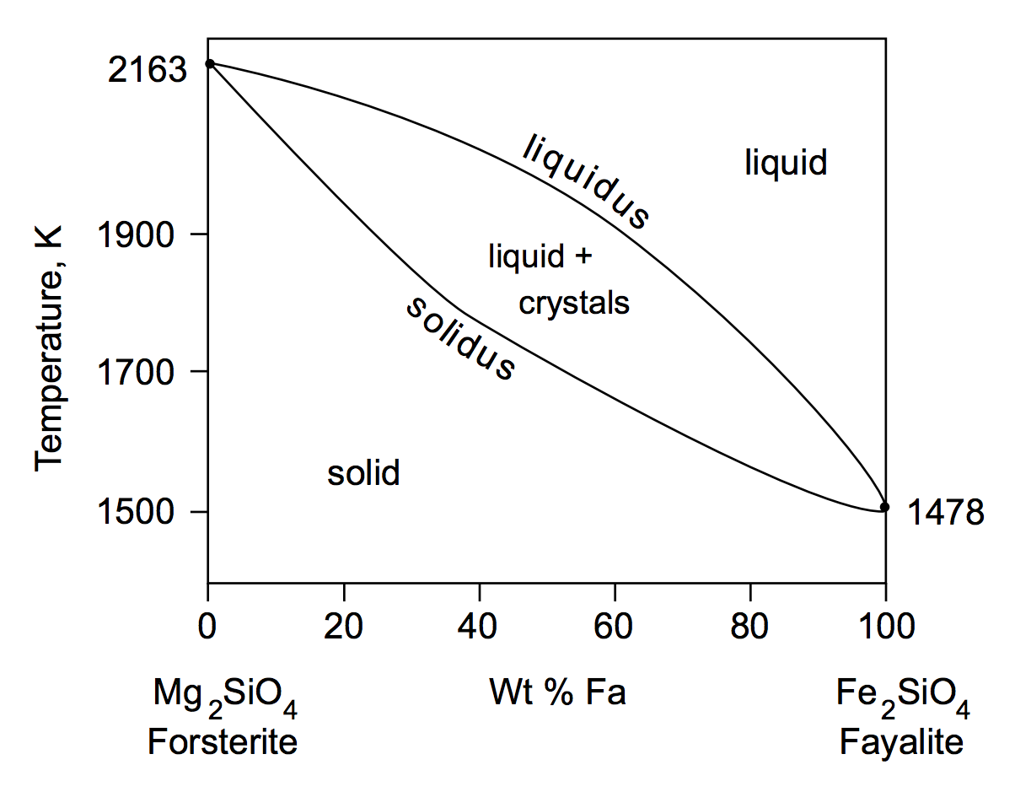
Melting mixtures: example

Slide 5
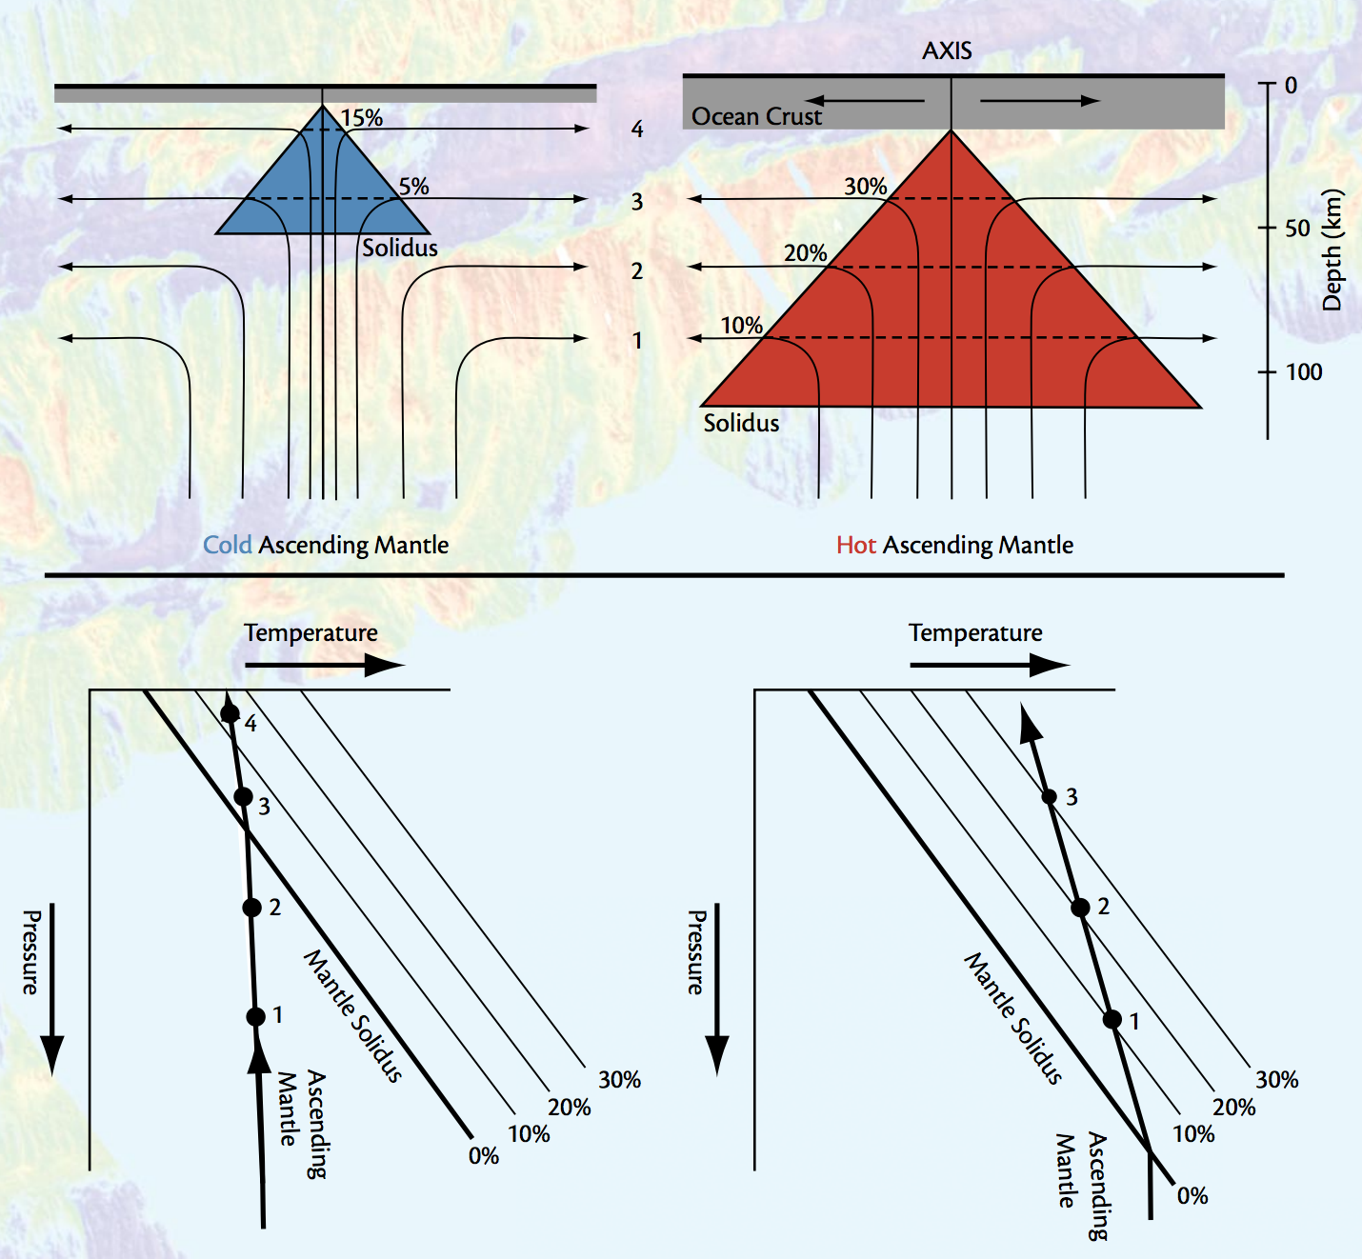
Magma production rate increases with upwelling velocity, partial melt fraction, and the width of the melt zone
http://www.people.fas.harvard.edu/~langmuir/Papers/Oceanography_langmuir_forsyth.pdf

Slide 6
Magma and lava
WRAP-UP: RIDGE PUSH
MAKING MAGMA: ADIABATIC DECOMPRESSION MELTING
EXPLOSIVE ERUPTIONS: SPEED LIMIT
LAVA FLOW RULES

Slide 7
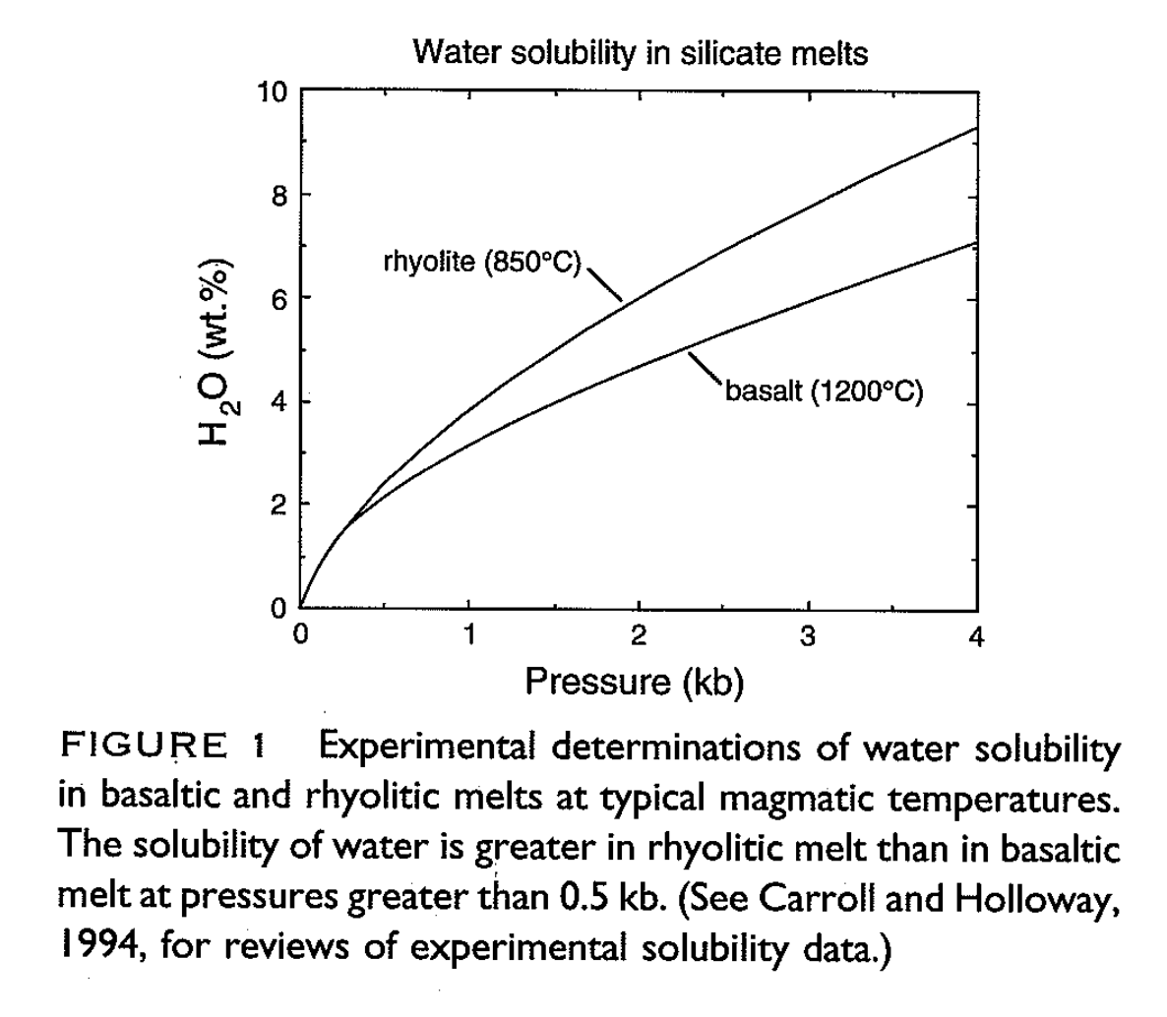
Explosive eruptions are driven by the exsolution of dissolved volatiles
Mantle water content
today is estimated at
~100 ppmw.
What would be the
percentage of
water in Earth’s mantle
if the Earth’s ocean
were dissolved in
mantle melt?
Earth’s
seafloor
Wallace & Anderson
1999

Slide 8
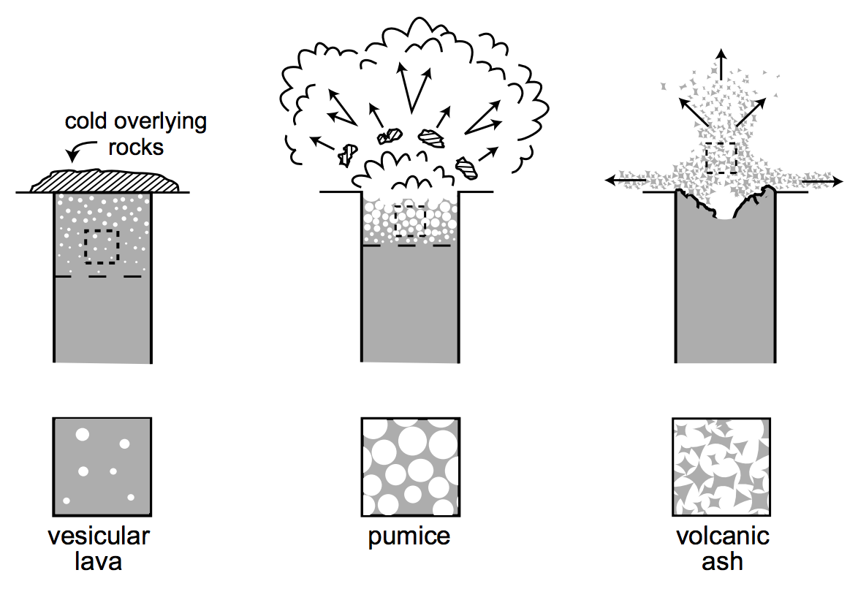
Explosive eruptions are driven by the exsolution of dissolved volatiles

Slide 9
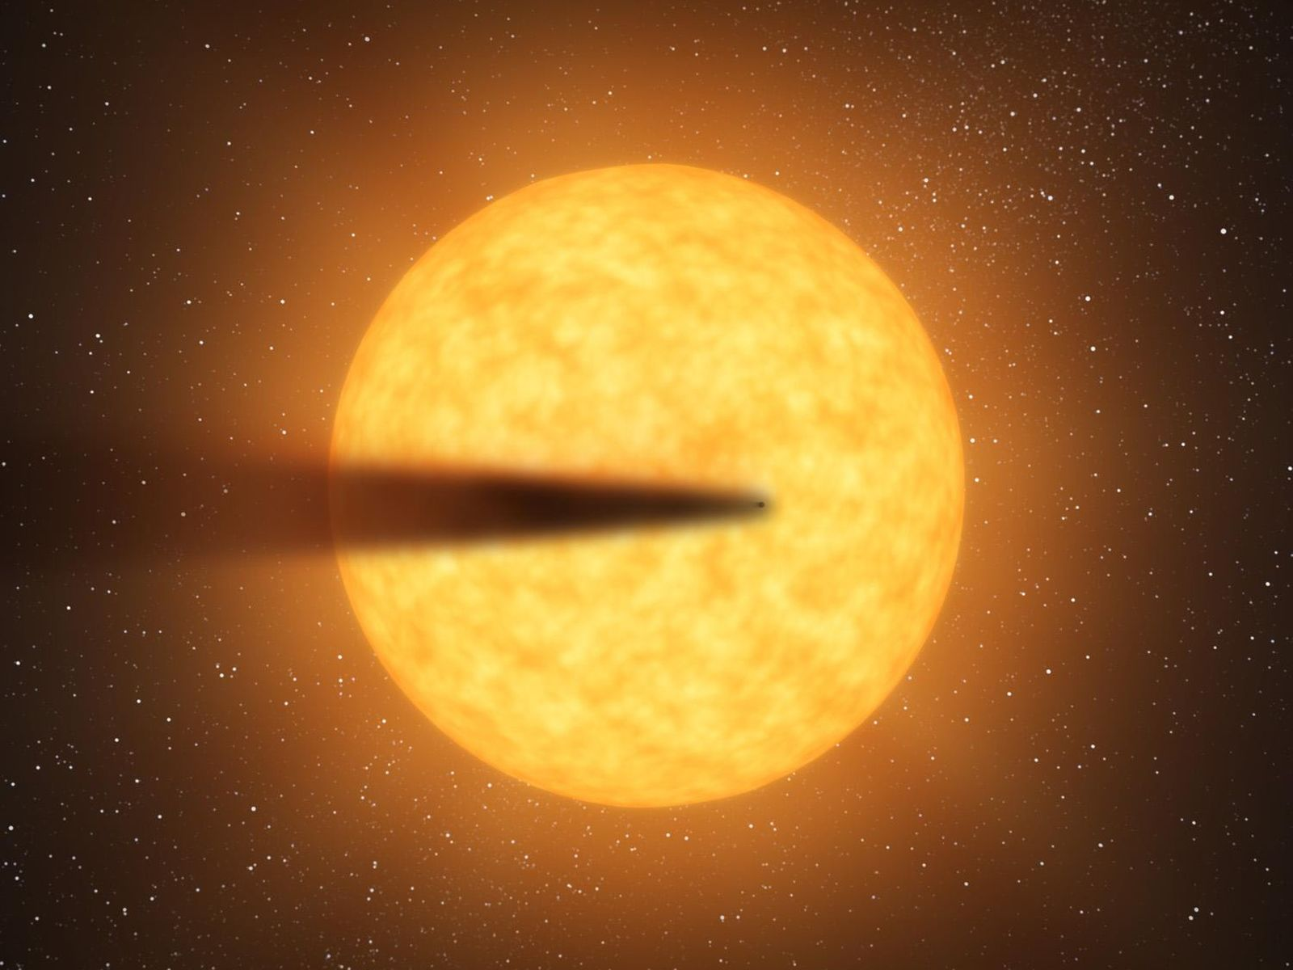
Disintegrating magma planet KIC 12557548b
Loss rate: 0.4 (Earth masses)/Gyr in dust
(100,000 tons/s) = 2500x Earth
size of planet
unknown;
only dust tail
is observed
NASA

Slide 10
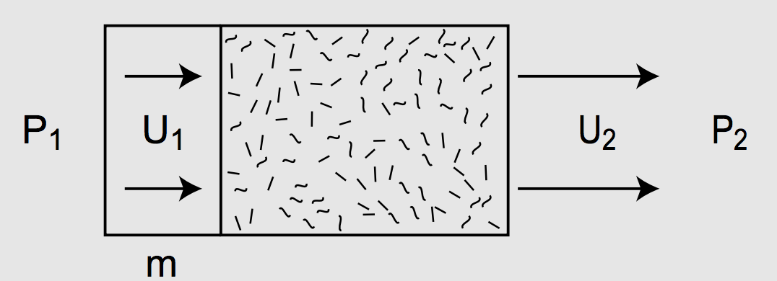
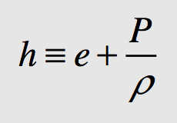
Can volcanic eruptions launch ash to escape velocity on KIC 1255758b?
specific enthalpy

Slide 11
Magma and lava
WRAP-UP: RIDGE PUSH
MAKING MAGMA: ADIABATIC DECOMPRESSION MELTING
EXPLOSIVE ERUPTIONS: SPEED LIMIT
LAVA FLOW RULES

Slide 12
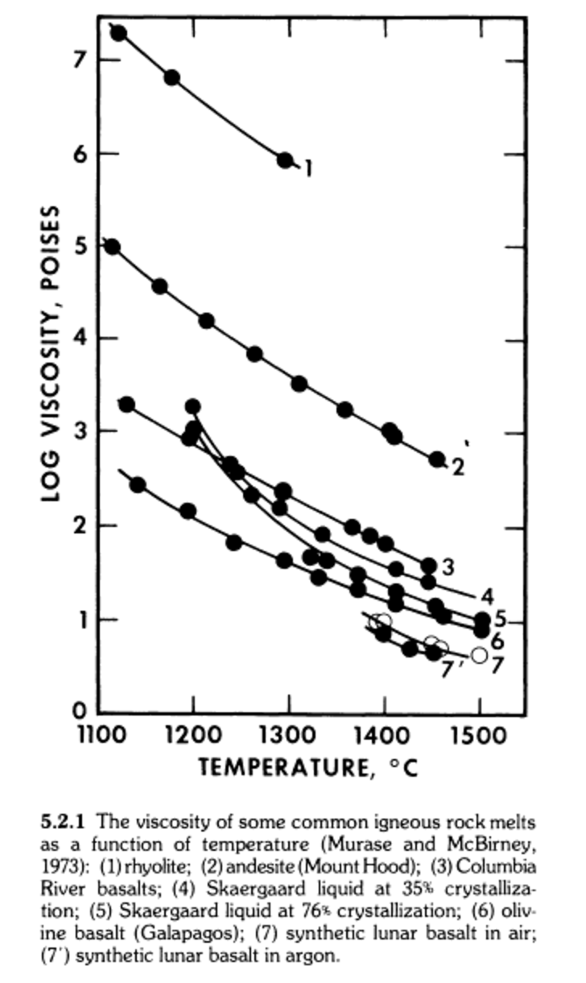
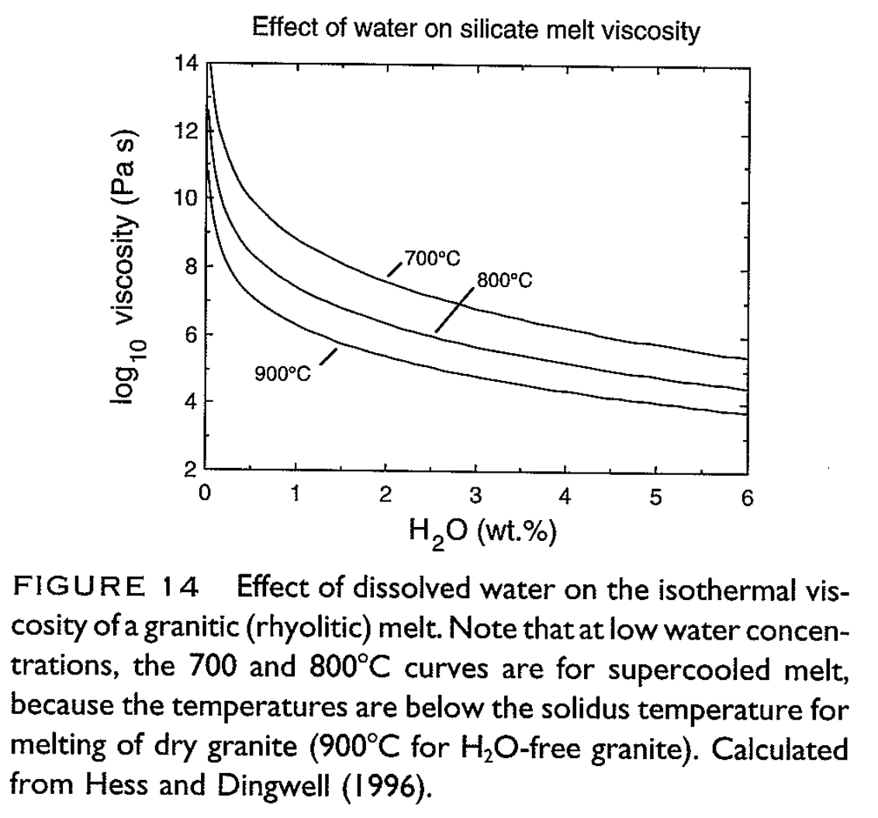
Data: Viscosity of magma decreases with increasing T, decreasing SiO₂, and increasing H₂O
Wallace & Anderson, in
Encyclopedia of Volcanoes, 1999
“Basaltic Volcanism on the Terrestrial Planets,” p.703

Slide 13
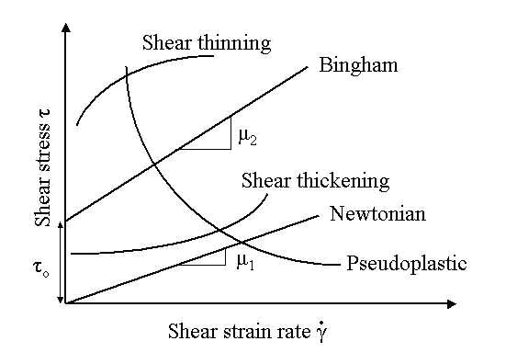
Bingham rheology is a very simple and widely used description of lava flow rheology

Slide 14
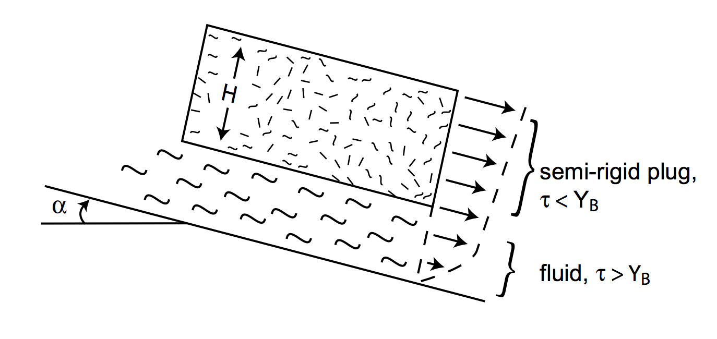
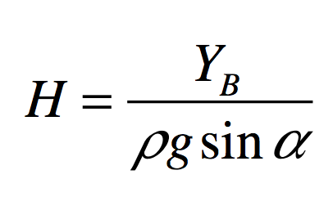
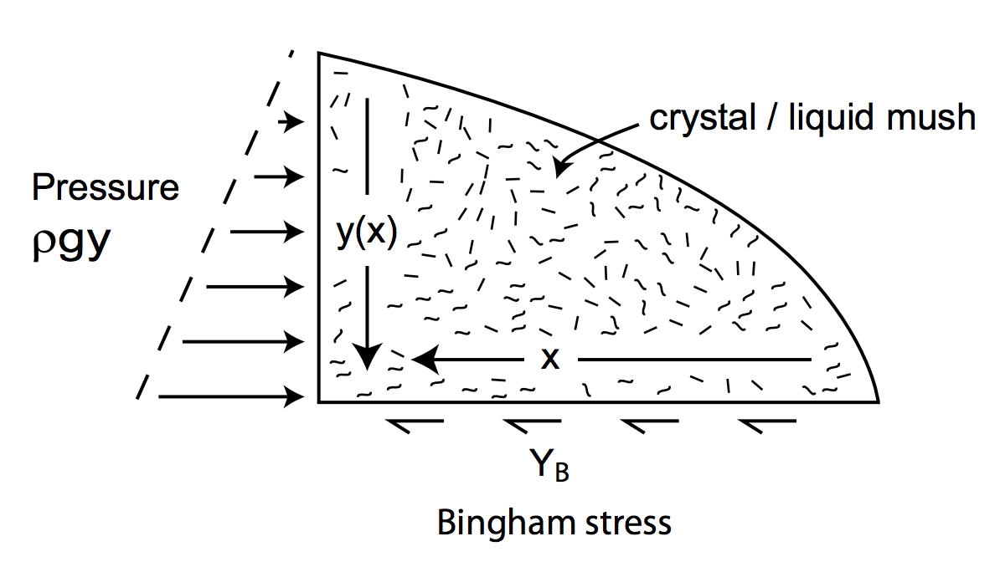
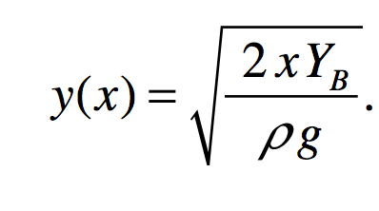
Bingham rheology can be applied to steady state flow geometry
angle of shield volcano?

Slide 15
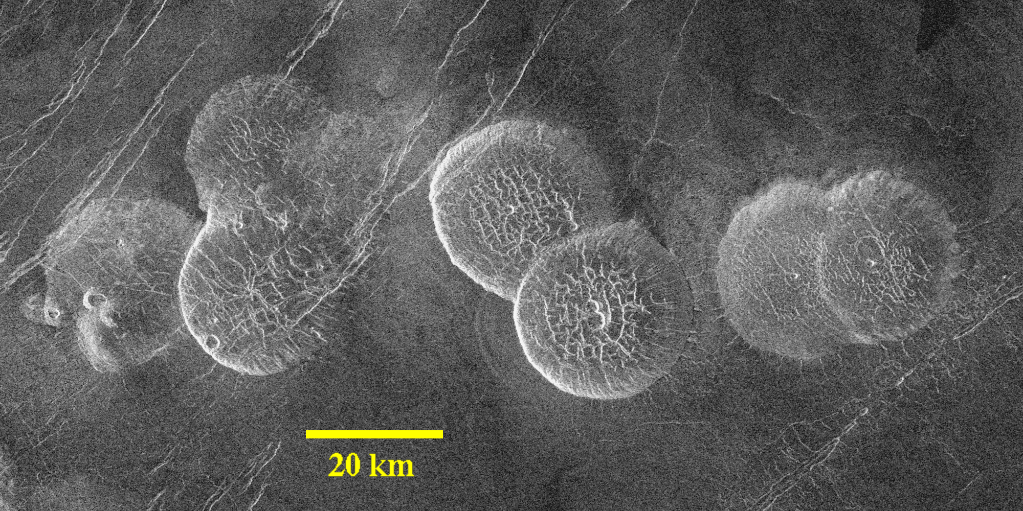
Example: pancake domes on Venus
Height “less than 1 km”
Bingham model is
approximate and
does not include
effect of strength on
cooling
Pancake domes on Venus

Slide 16
Key points: magma and lava
Diagram and explain the process of magma production by partial melting
Understand the energetic limits on explosive volcanic eruptions
Controls on lava flow rheology and how to infer rheology from flow measurements

Slide 17
Volcanism, part 2
DIAGNOSING VOLCANISM
PYROCLASTIC FLOWS
VOLCANIC HOT SPRING DEPOSITS

Slide 18
Key points: volcanism, part 2
Know three ways of distinguishing cooled lava flows from frozen water deposits from orbit.
Explain long pyroclastic flow runout distances.
Explain volcanic hot spring terraces.

Slide 19
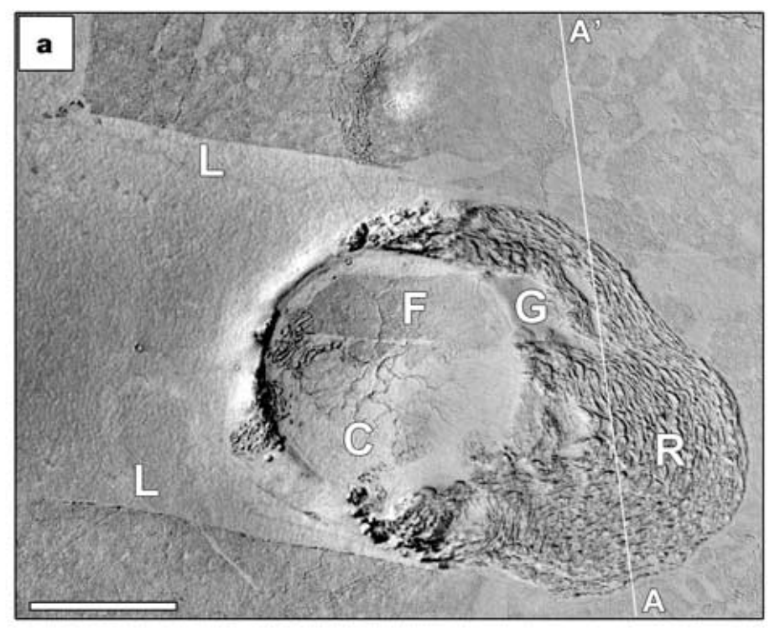
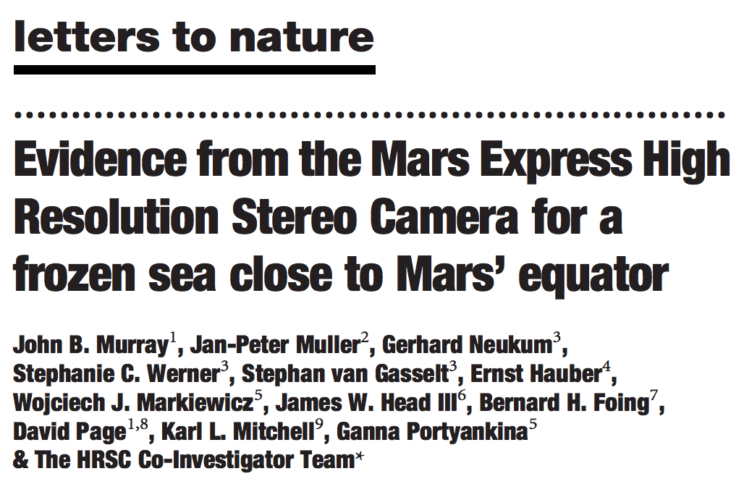
S. Elysium, Mars: lava lake or frozen water ocean?
Significance:
Youngest plains on Mars (and among the smoothest)
Why not use spectroscopy to get composition?
S. Elysium is covered by a thin layer of dust
Murray et al. Nature 2005
Note: the lava origin of S. Elysium was never seriously in doubt. Nevertheless, the long-running controversy that resulted usefully highlights some pitfalls to be avoided in geomorphology work.

Slide 20
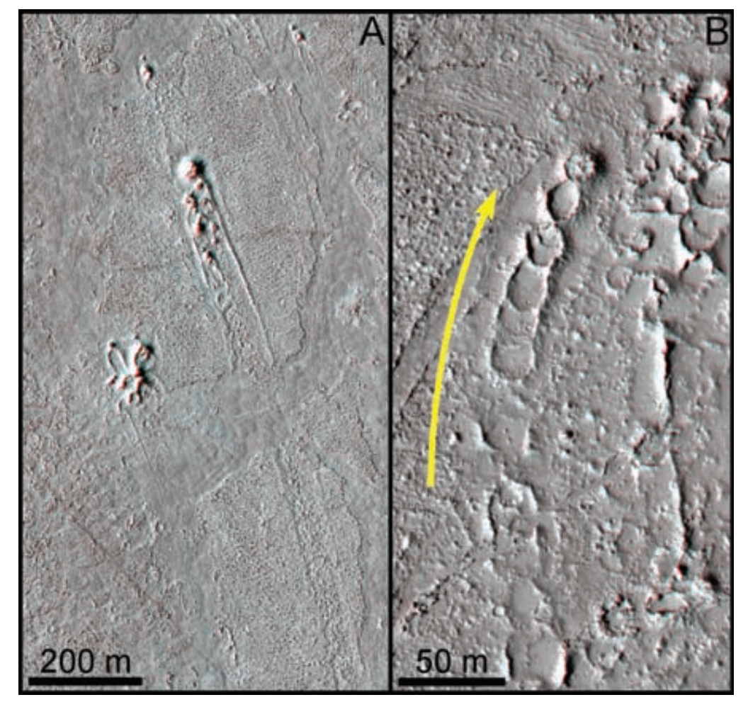
Hydrovolcanic cones are diagnostic for lava-water (or lava-ice) interaction
Jaeger et al. Science 2007
Lava velocity for Newtonian
rheology – (i) square channel,
(ii) very wide channel

Slide 21
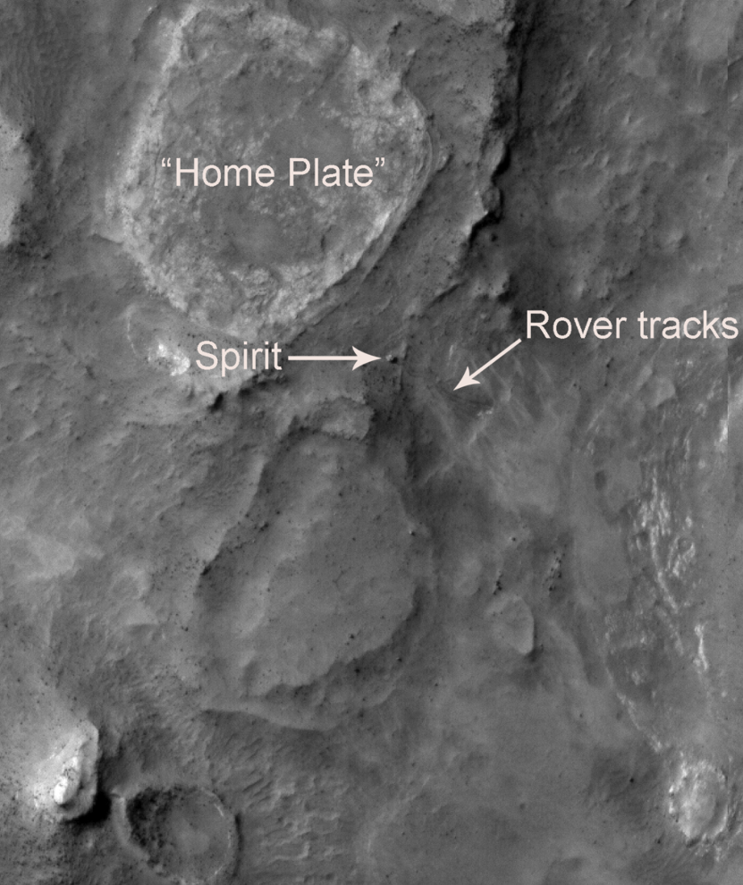
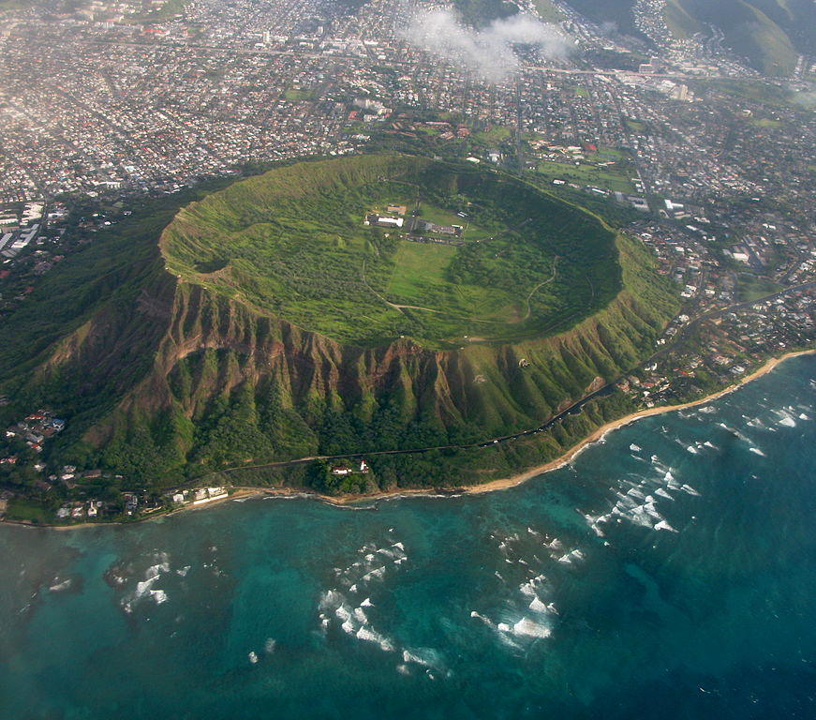
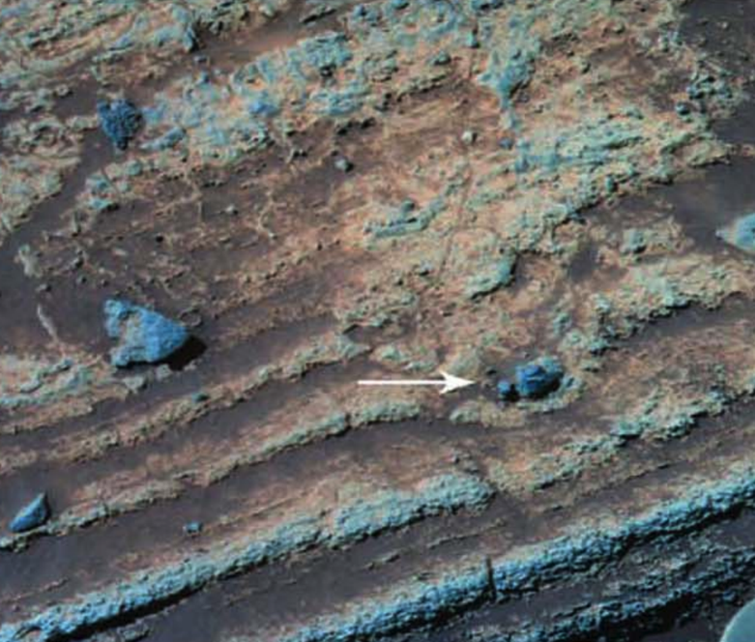
Phreatomagmatic eruptions occur when ascending
batches of magma rapidly vaporise shallow-subsurface
groundwater or ice.
Diamond Head, Oahu:
80 m
Home Plate, Mars
4 cm

Slide 22
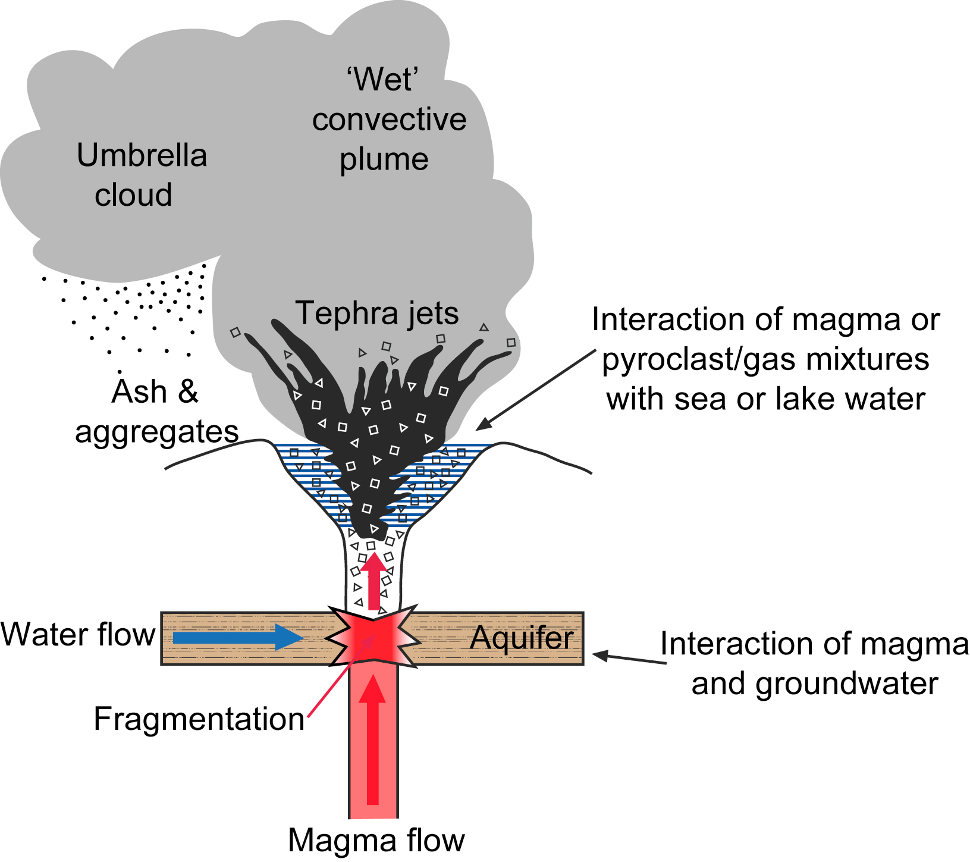

Slide 23
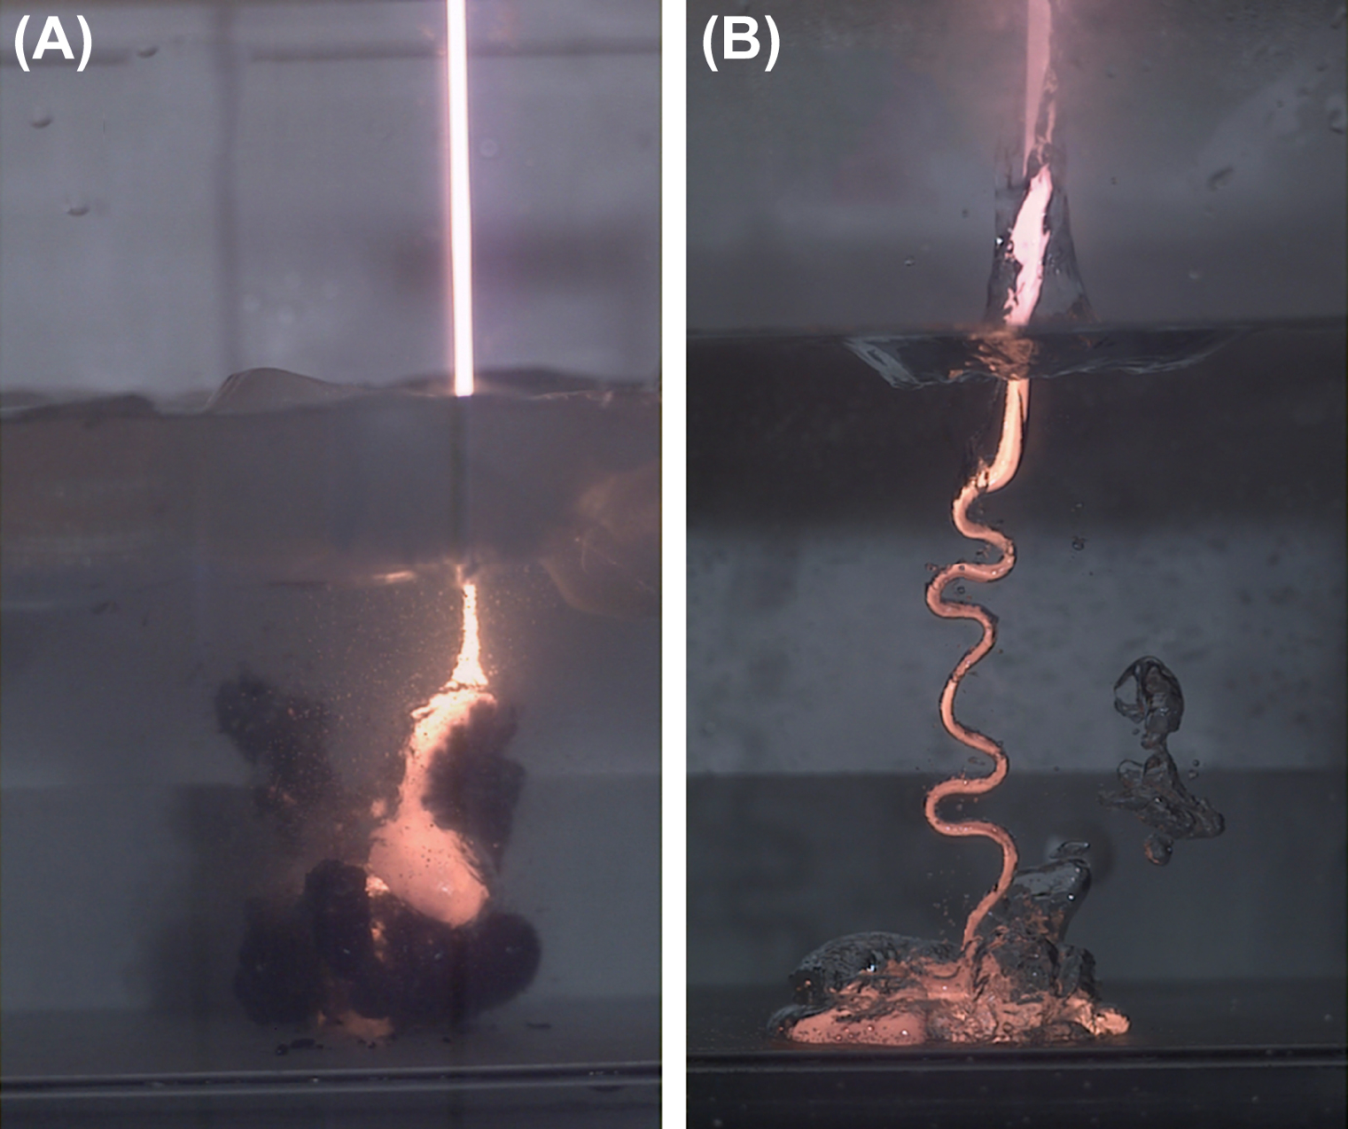
Thermohydraulic explosions are triggered when insulating vapor films separating magma and water break down.
cm-wide
magma jet
Optimum (most explosive)
magma-water mingling
scale is (0.01 – 0.1) m
(Zimanowski et al.,
in Encylopedia of Volcanoes
2nd edition, 2015)
efficient
cooling due
to thin vapor films
magma jet entering 275K water
magma jet entering 370K water

Slide 24
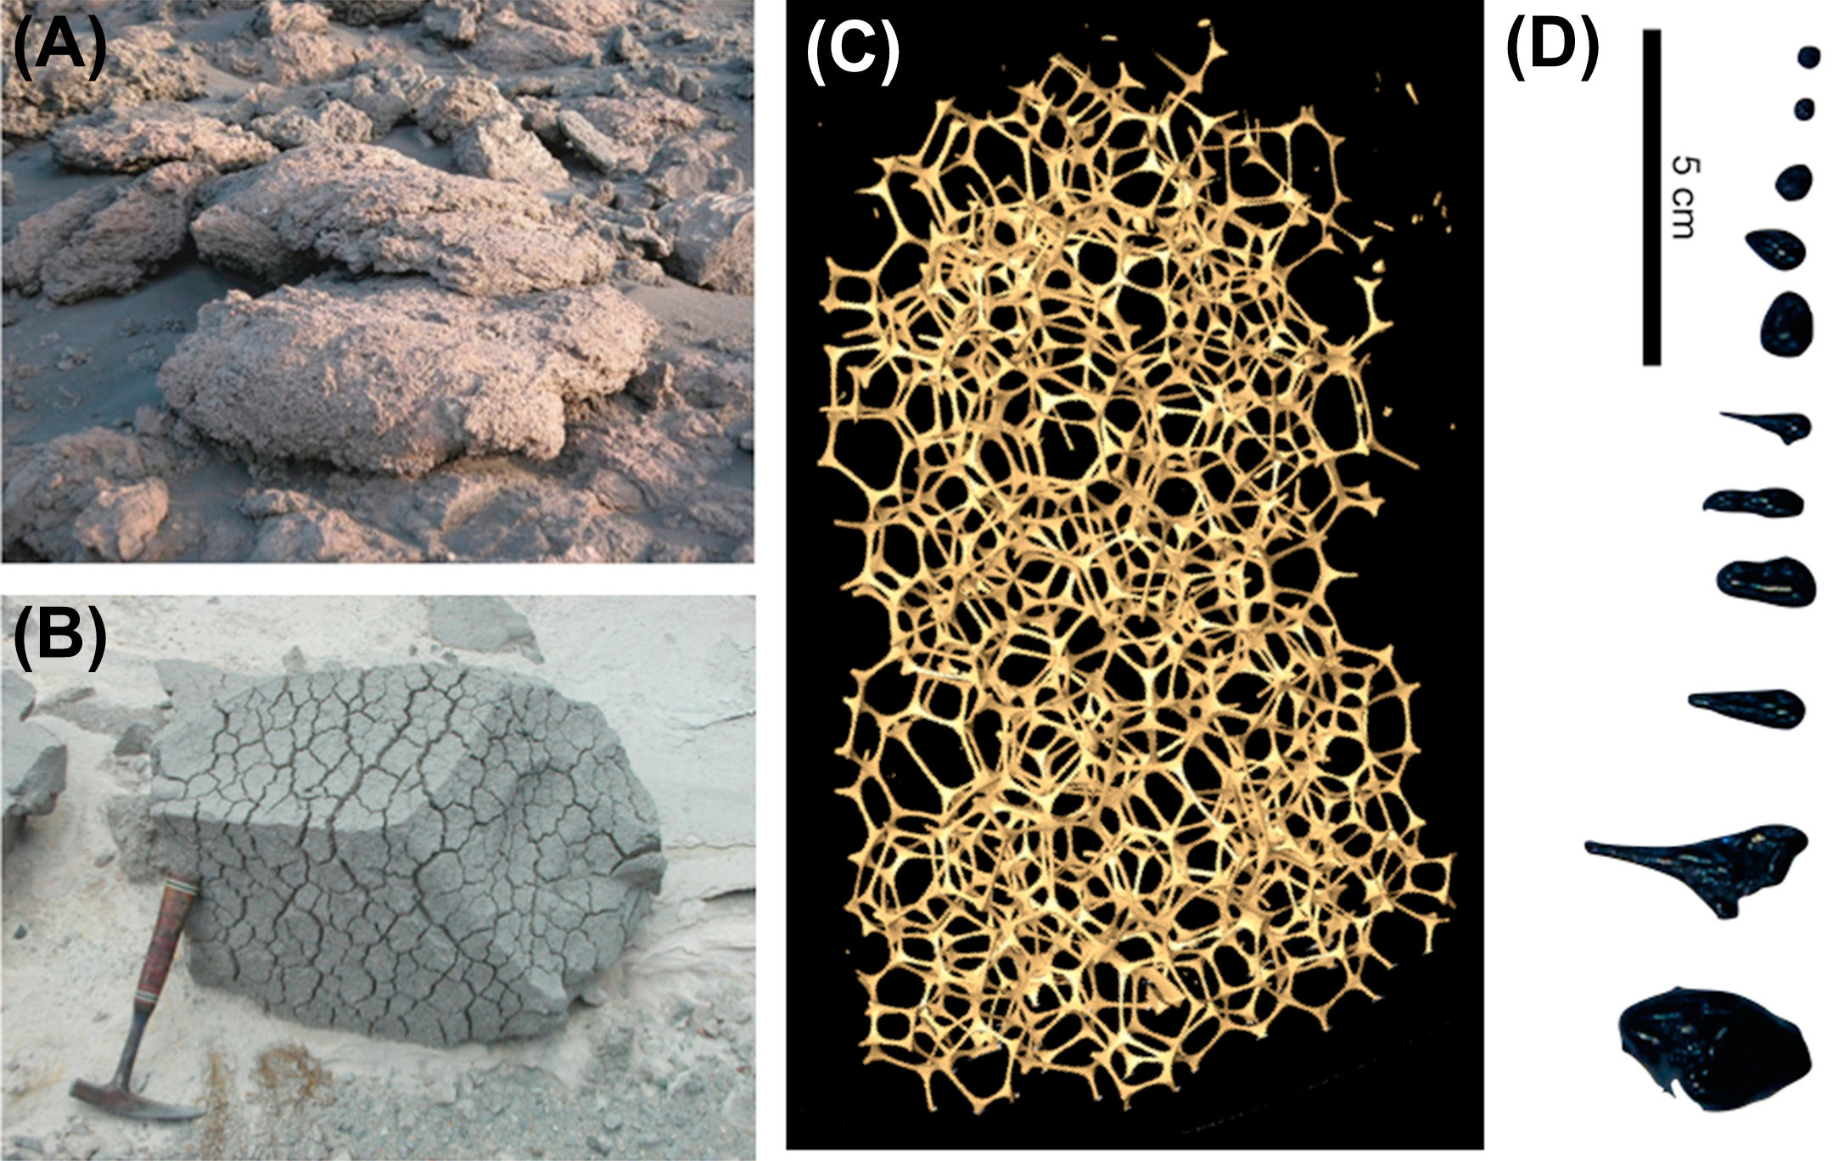
Bubble expansion can produce highly veiscular textures

Slide 25
Rheology indicator: lava coils
Approximately 50 m across
Ryan & Christensen, Science, 2012

Slide 26
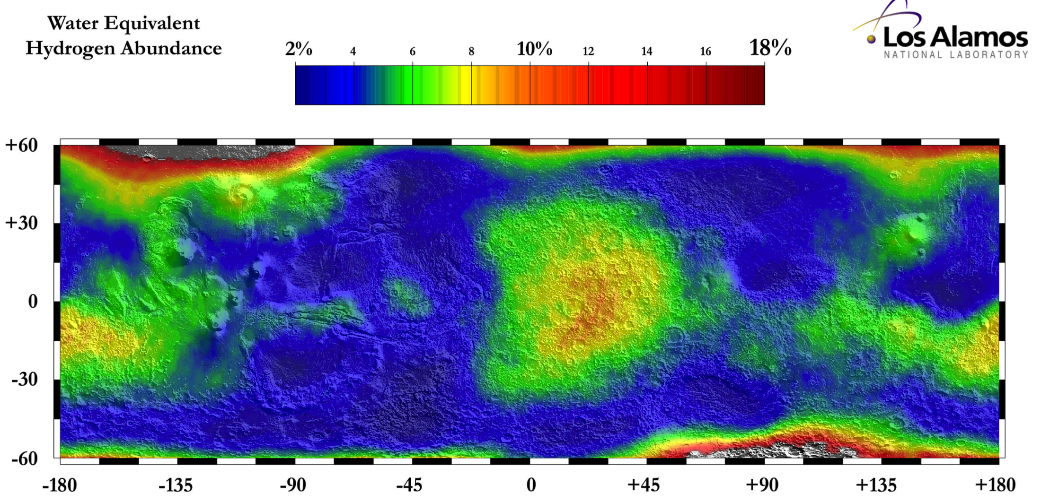
Neutron spectroscopy shows minimal hydrogen in topmost meter of S. Elysium
S. Elysium
Hydrogen can be in the form of water, or hydrated minerals

Slide 27
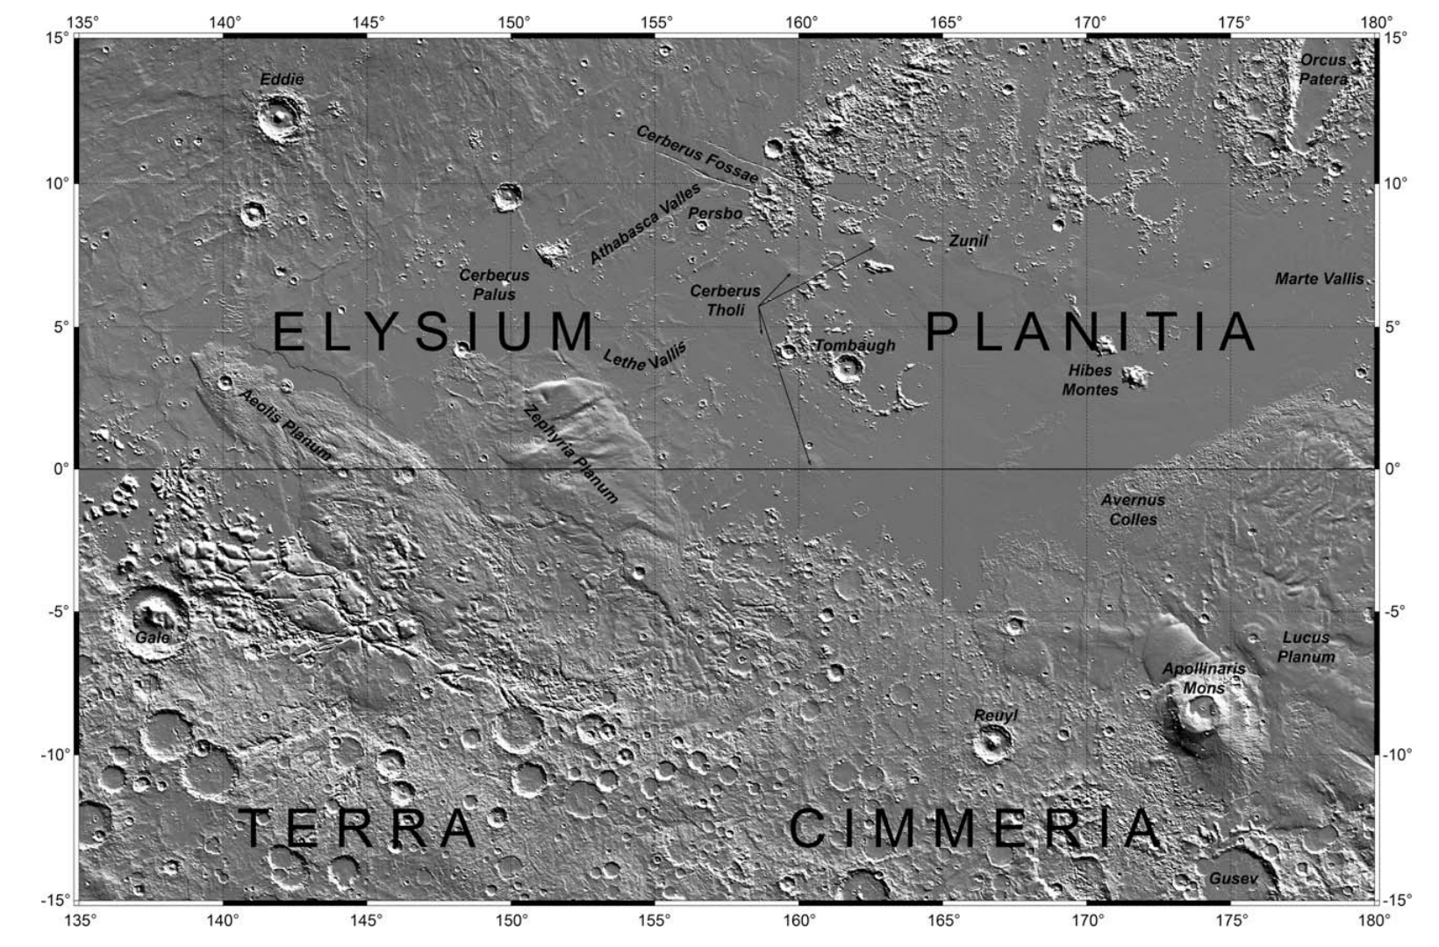
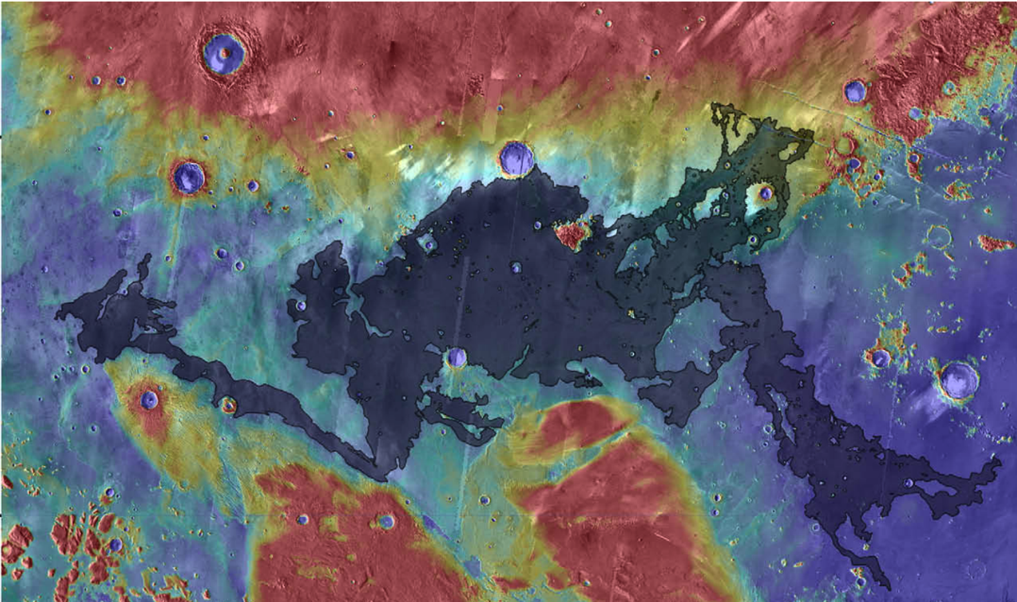
Turbulent lava flow (Jaeger et al. Icarus 2010) permits thermal and mechanical erosion

Slide 28
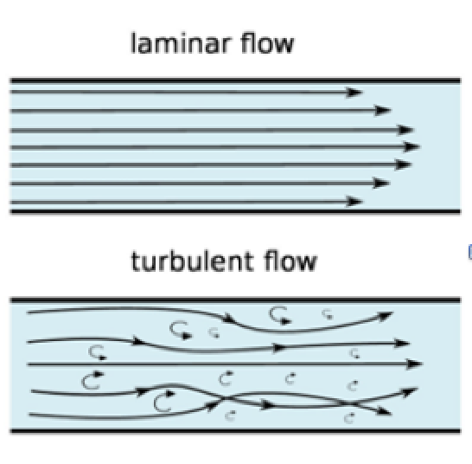
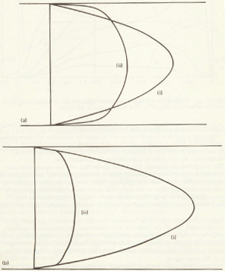
For laminar lava flows (all flows witnessed by humans), a stable chilled boundary layer armors the substrate from thermal and mechanical erosion. For turbulent lava flows (Early Earth, Io, Mars, ?Moon), mixing prevents the armoring stable boundary layer from developing.
Reynolds number =
(>2000 for turbulent flow)
laminar
x
v
turbulent
laminar
turbulent
x
y
Tritton 1988

Slide 29
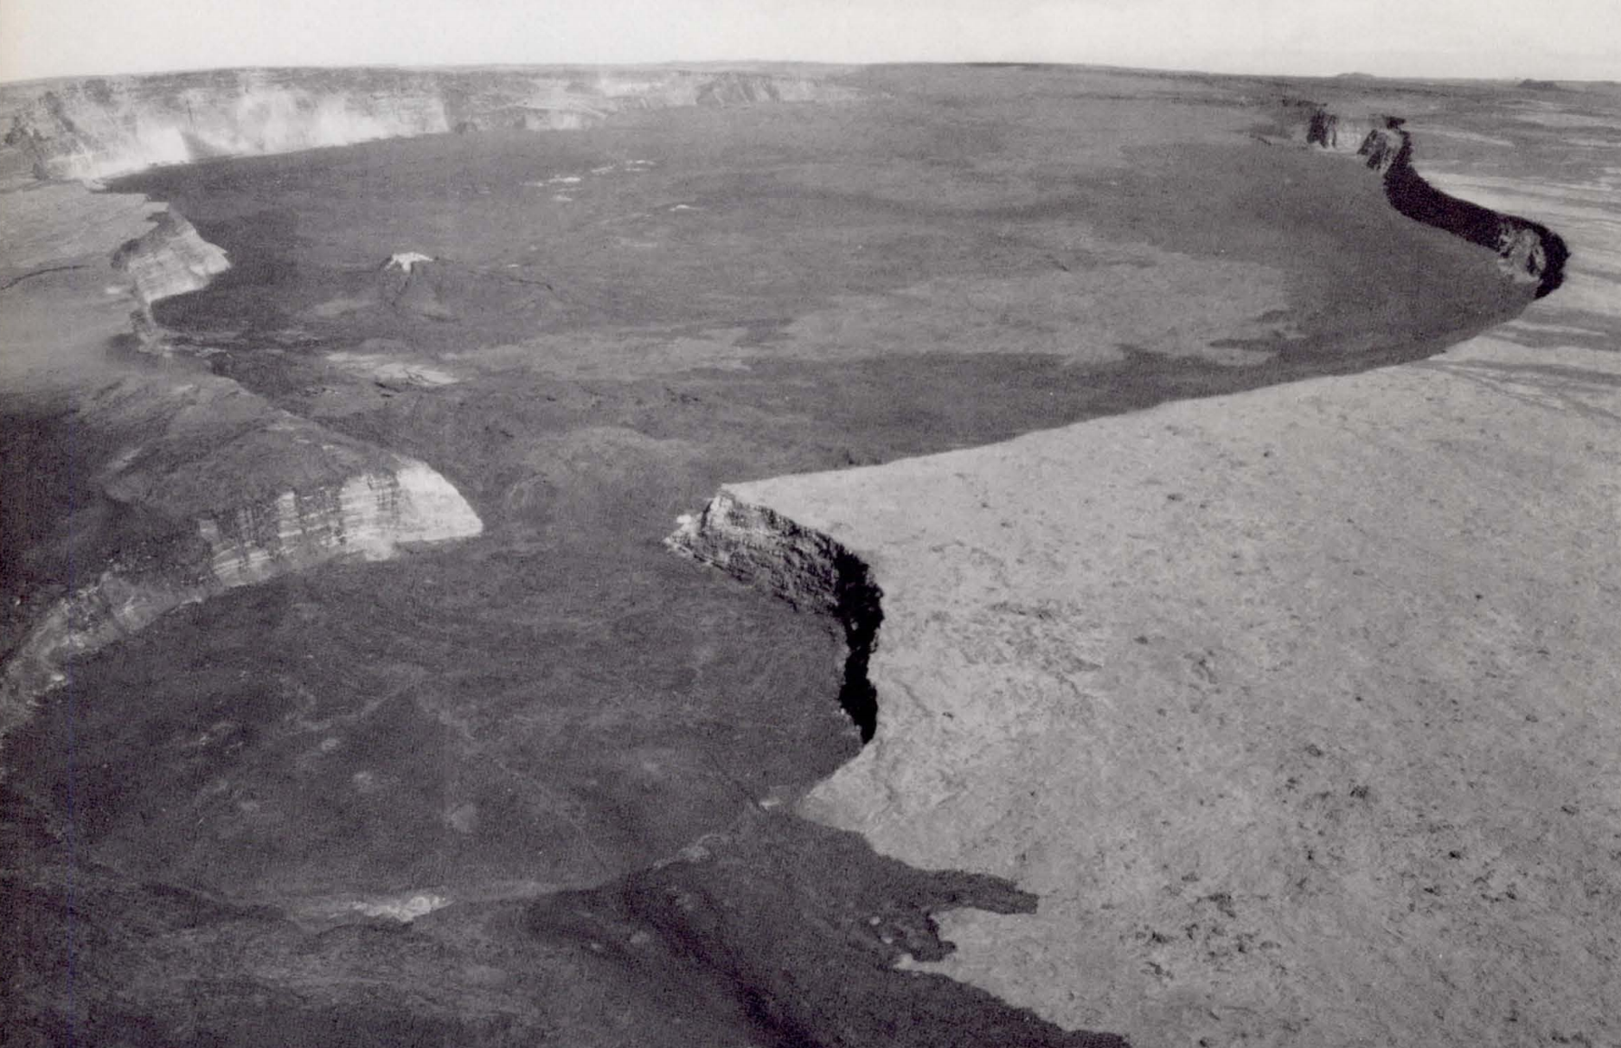
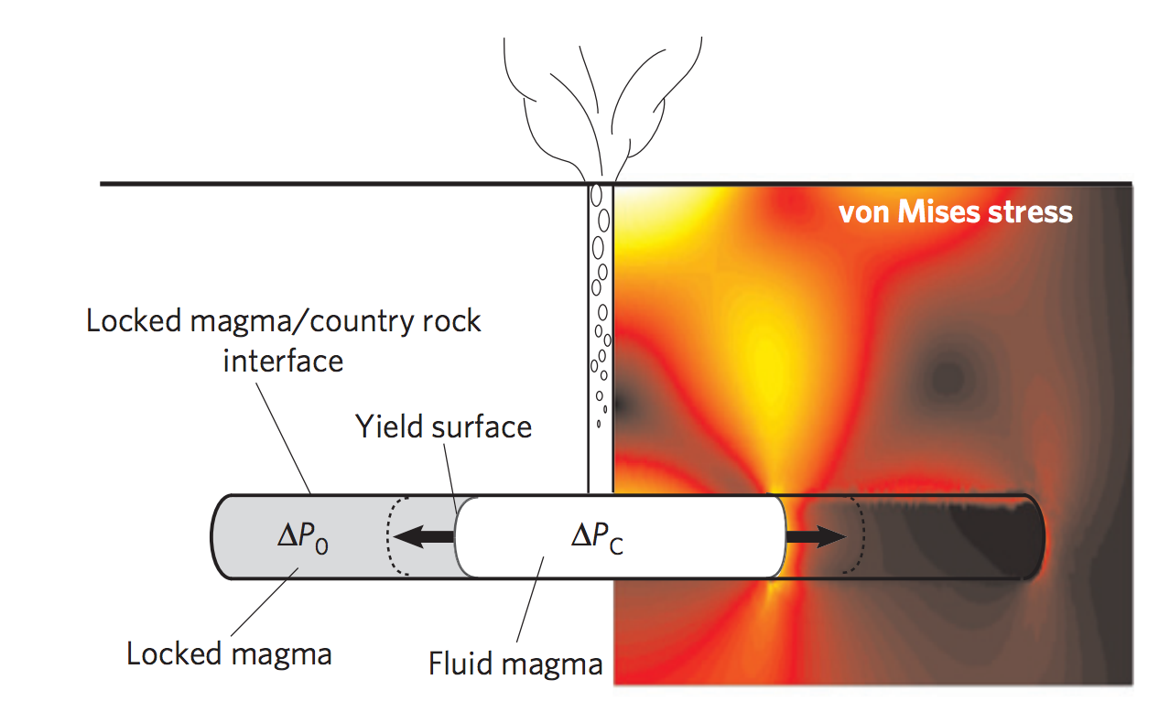
Calderas: diagnostic for volcanism
Carr 1980
Karlstrom et al. Nature Geosci. 2012
(von Mises stress ~ elastic energy
of distortion)

Slide 30
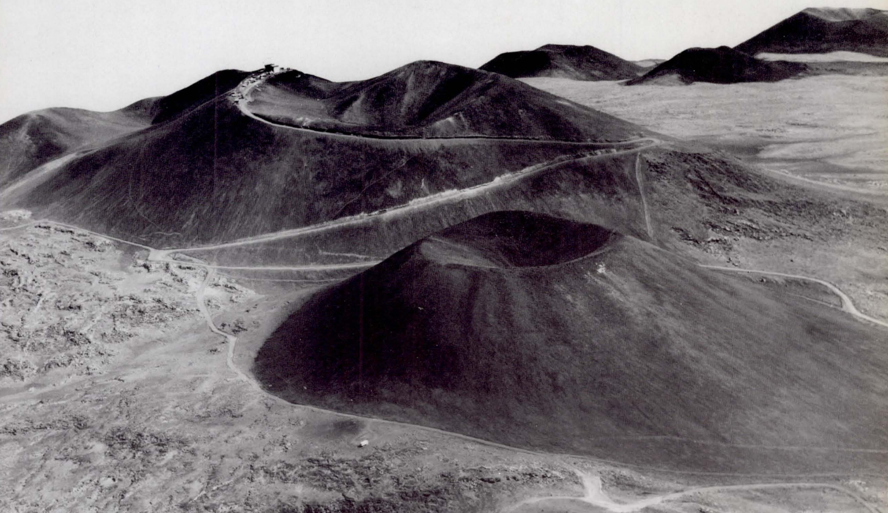
Cinder cones: diagnostic for volcanism
Carr 1980

Slide 31
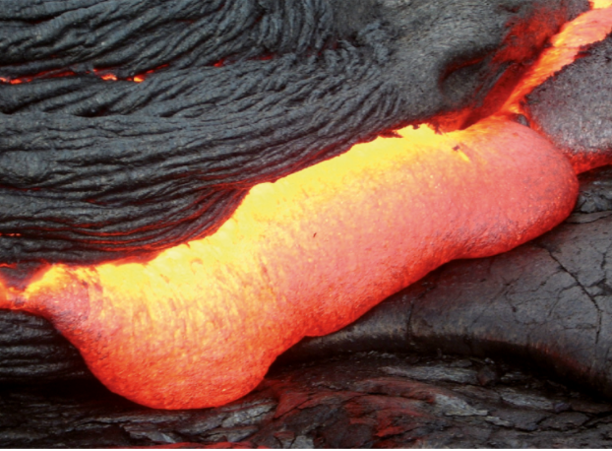
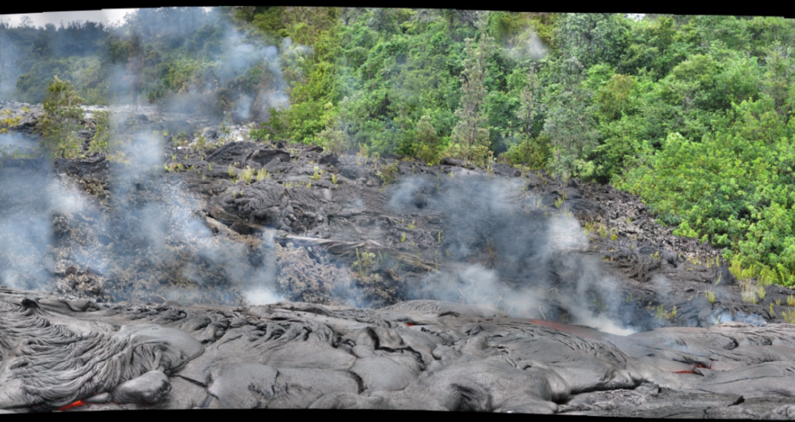
Smooth-topped pahoehoe flows extend rapidly by lobe breakout
glassy, ropy texture
The lava flow in the foreground of this picture is moving from L to R. Rate-of-advance was ~20 m in 1 hour's observation. Jun 2009
E. Kite

Slide 32
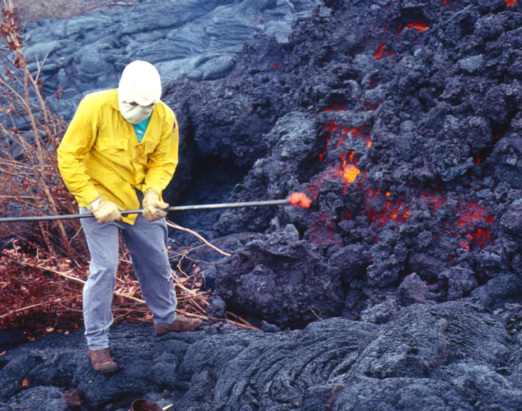
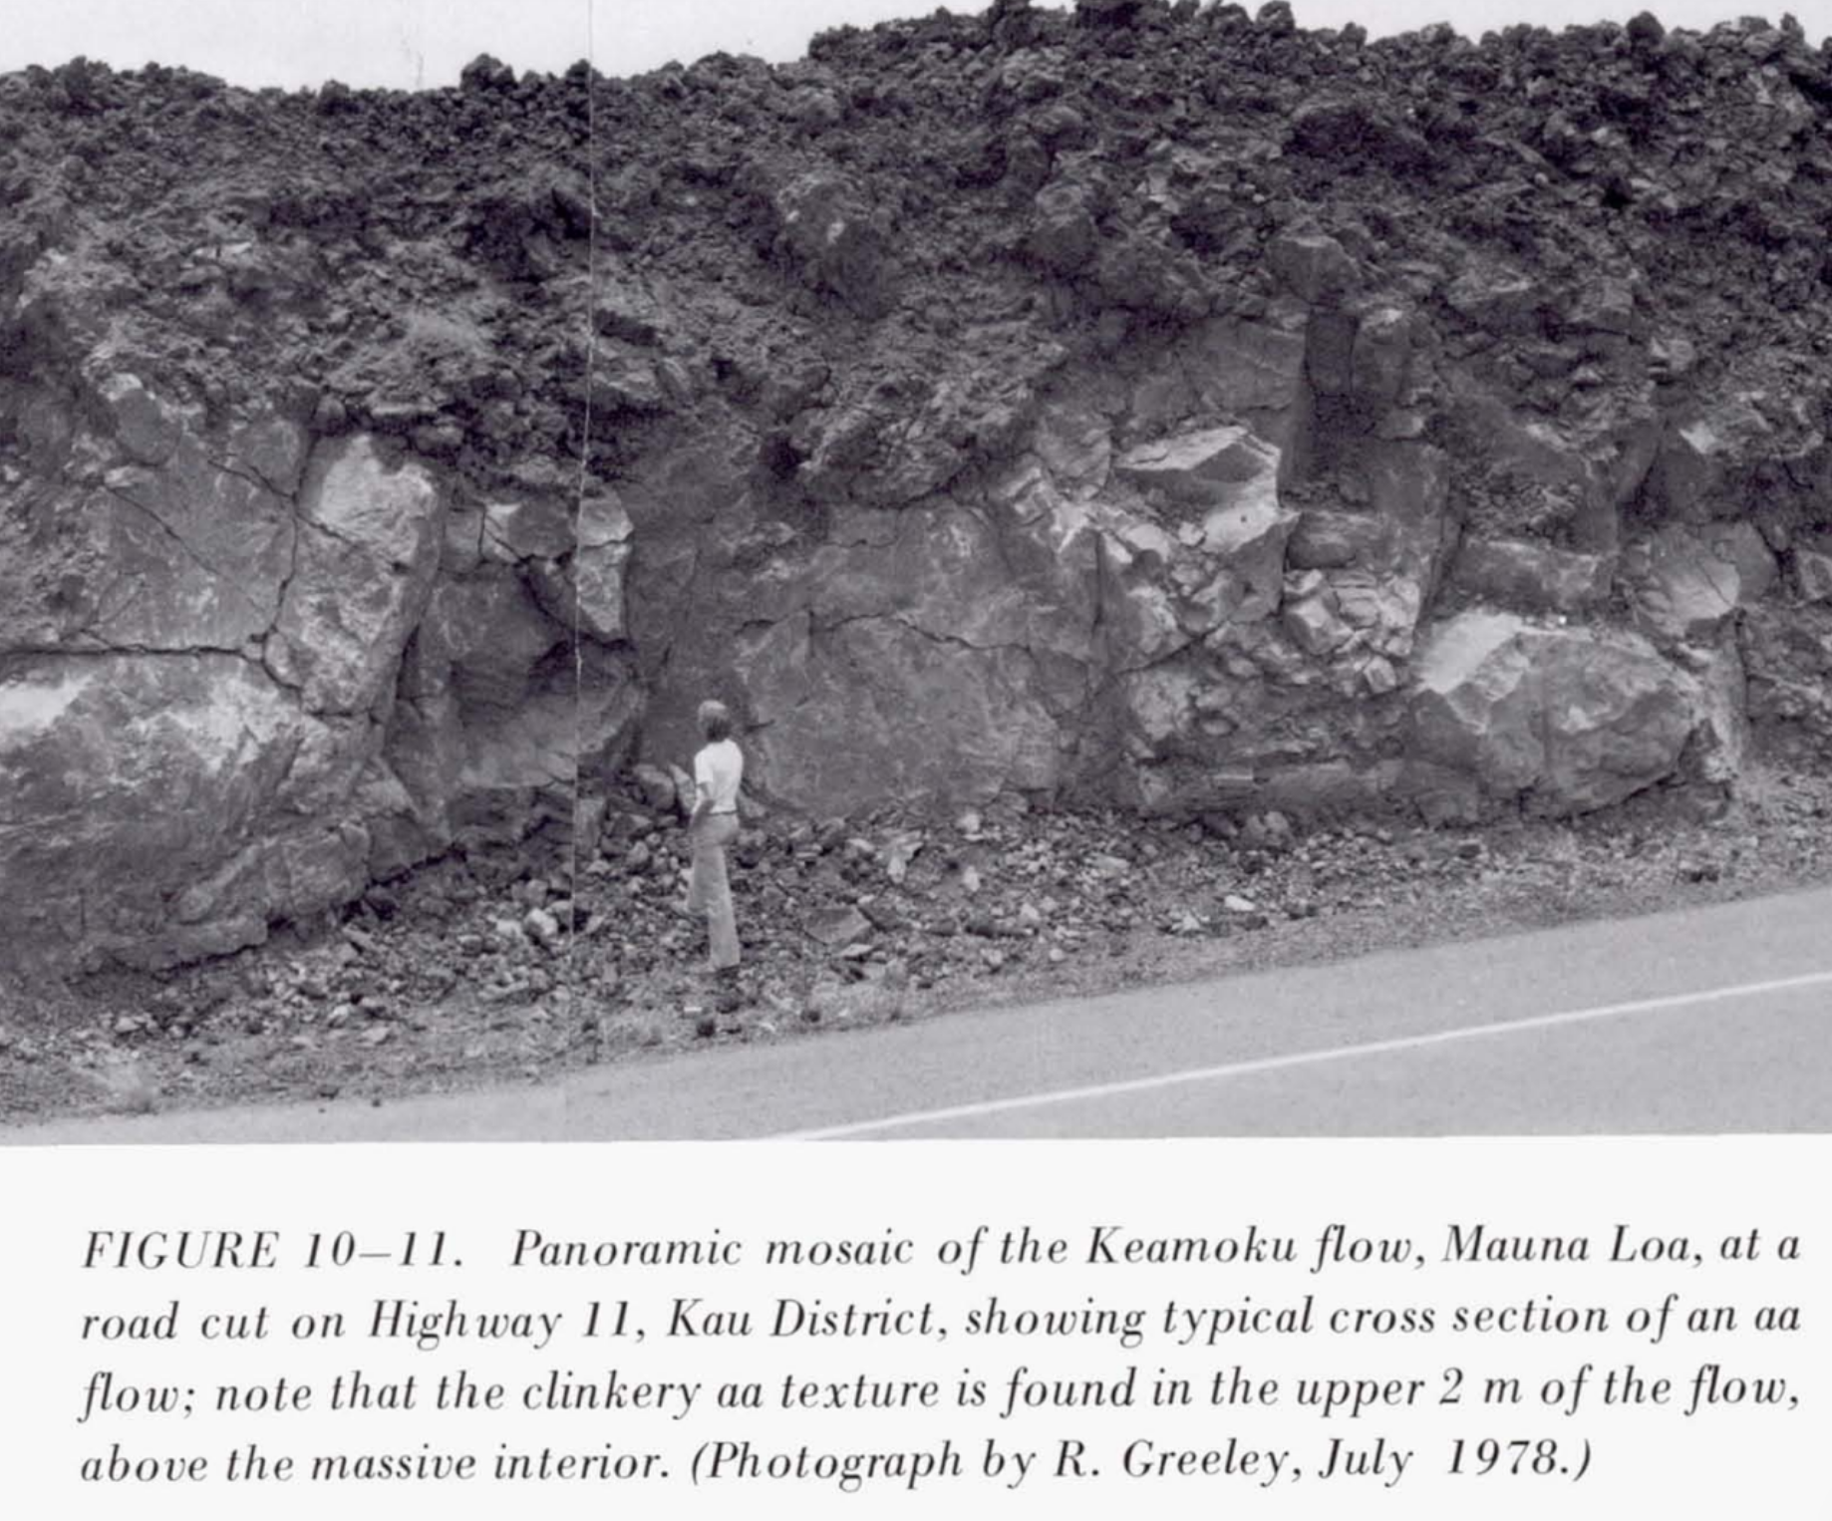
Rough topped A’a flows extend steadily and (usually) slowly

Slide 33
Volcanism, part 2
WRAP-UP: LAB 1
DIAGNOSING VOLCANISM
PYROCLASTIC FLOWS
VOLCANIC HOT SPRING DEPOSITS

Slide 34
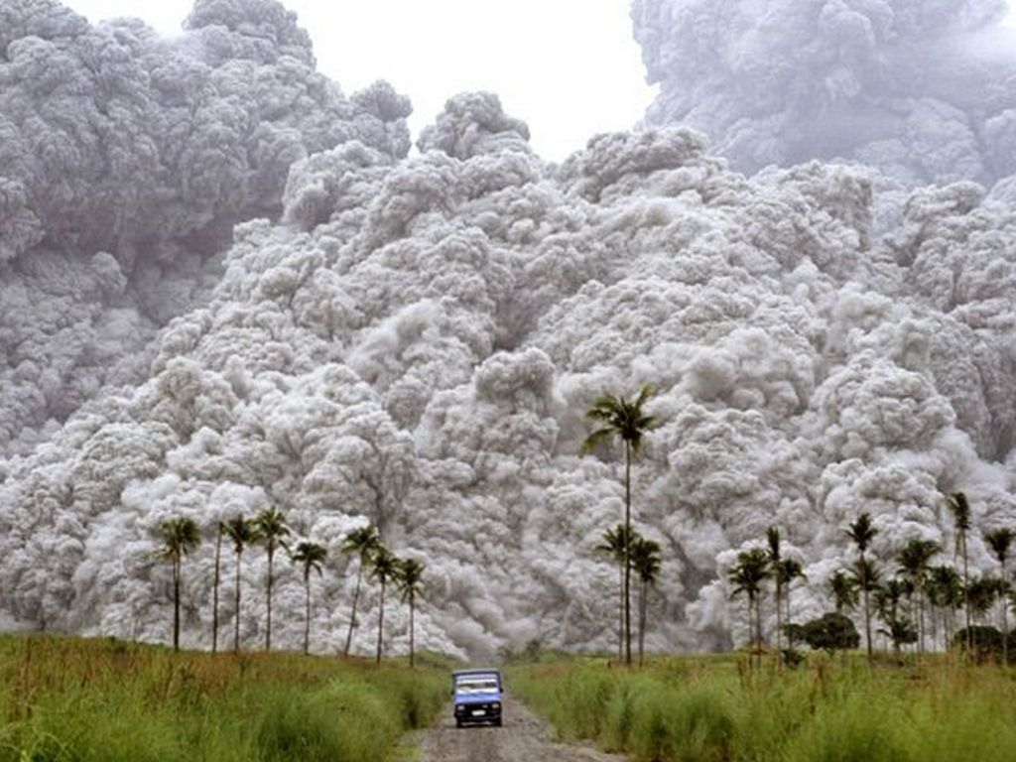

Slide 35
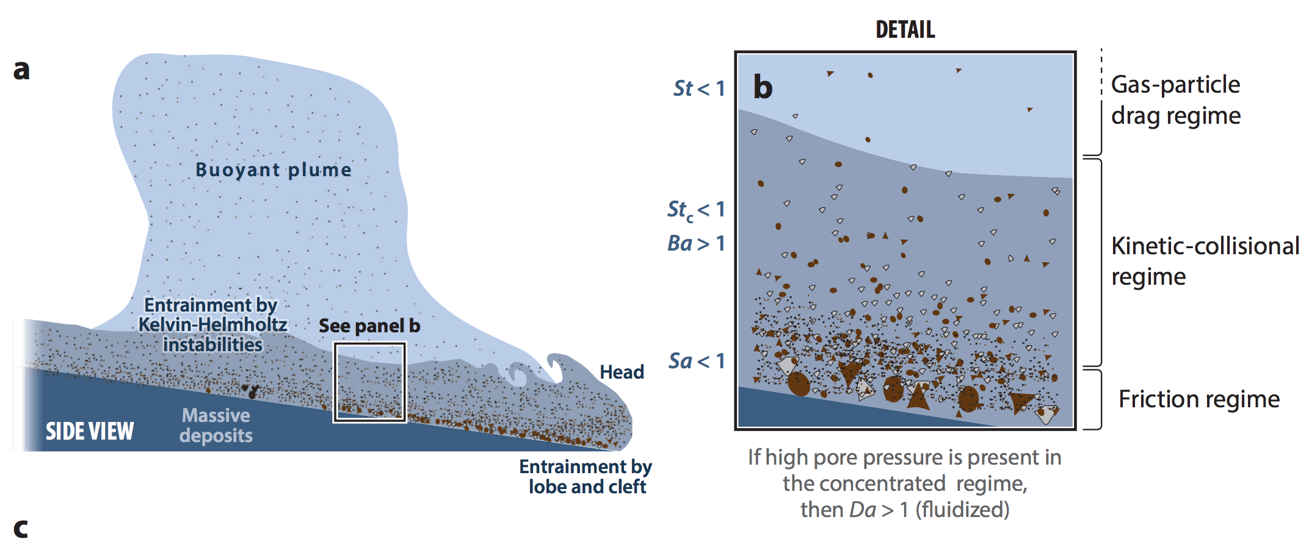
Long runout distances of pyroclastic flows are permitted by gas entrainment
Dufek, Annual Reviews, 2016

Slide 36
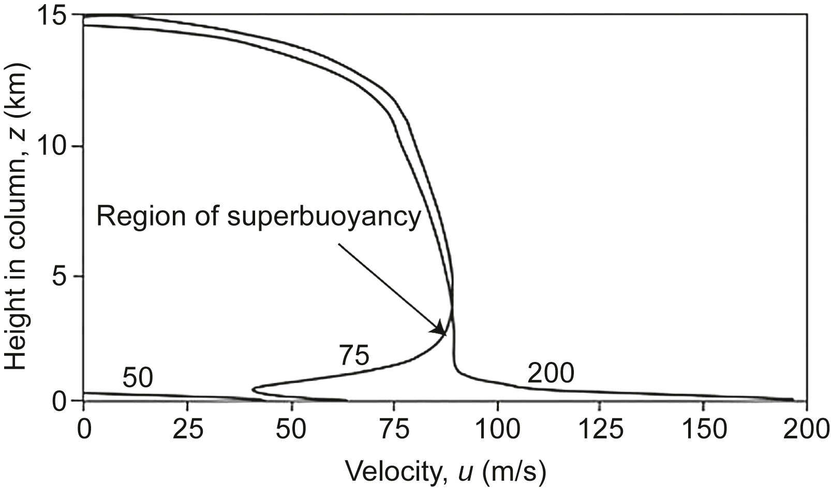
Vent exit velocity controls pyroclastic flows versus regional ash dispersal.
How will changing atmospheric pressure (e.g., Mars) affect ash dispersal?
levelling-off corresponds to “umberella phase”
of eruption → stratospheric dispersal of ash
entrainment and heating of cold air
leads to bouyant plume
this will become a pyroclastic
flow
Vertical
Woods (2013)

Slide 37
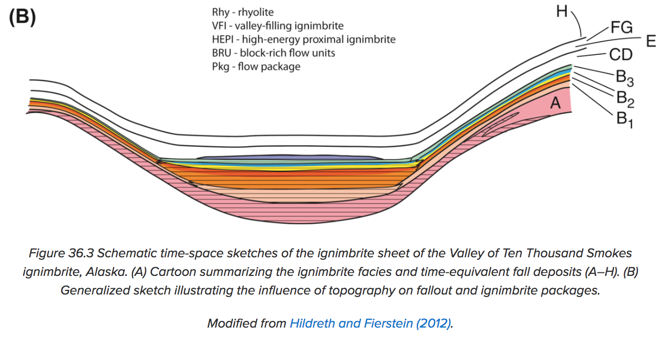
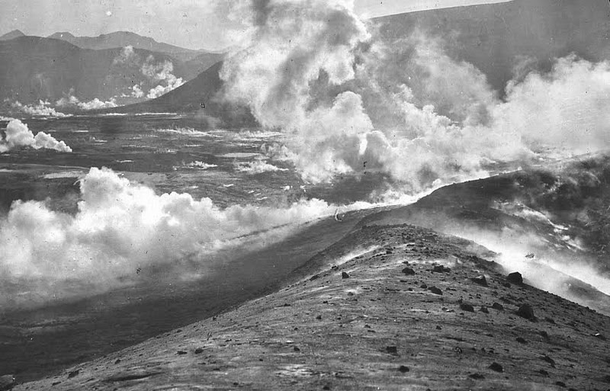
Pyroclastic flows can be distinguished from ash falls by how they modify the landscape.
z
x
Pyroclastic flows can overtop obstacles
but generally head downslope.
Ash falls blanket the landscape.
Degassing of pyroclastic materials
after flow stop can leave diagnostic
“pitted terrain.”
Degassing of Katmai 1912 pyroclastic flow
(Valley of Ten Thousand Smokes)

Slide 38
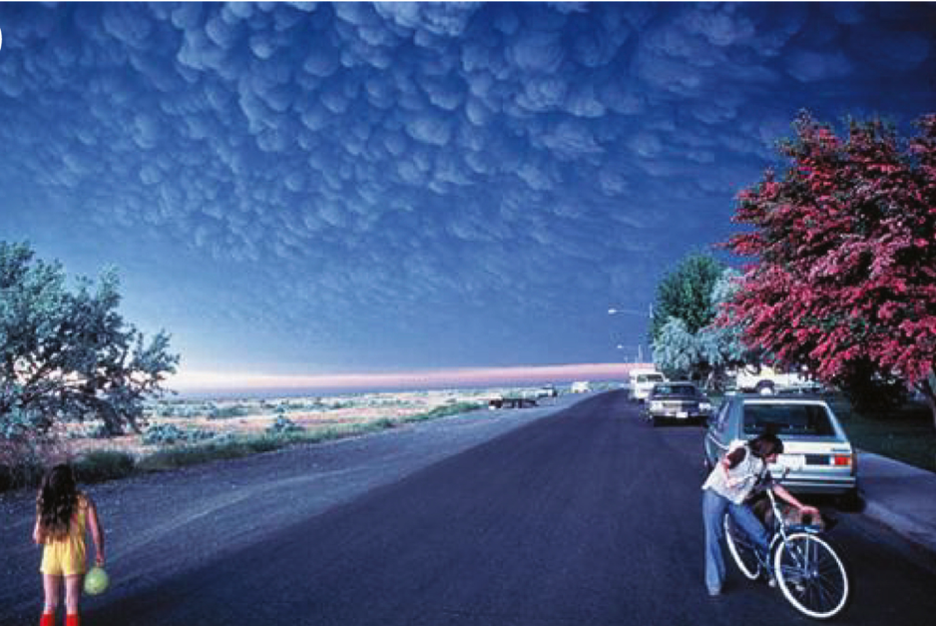
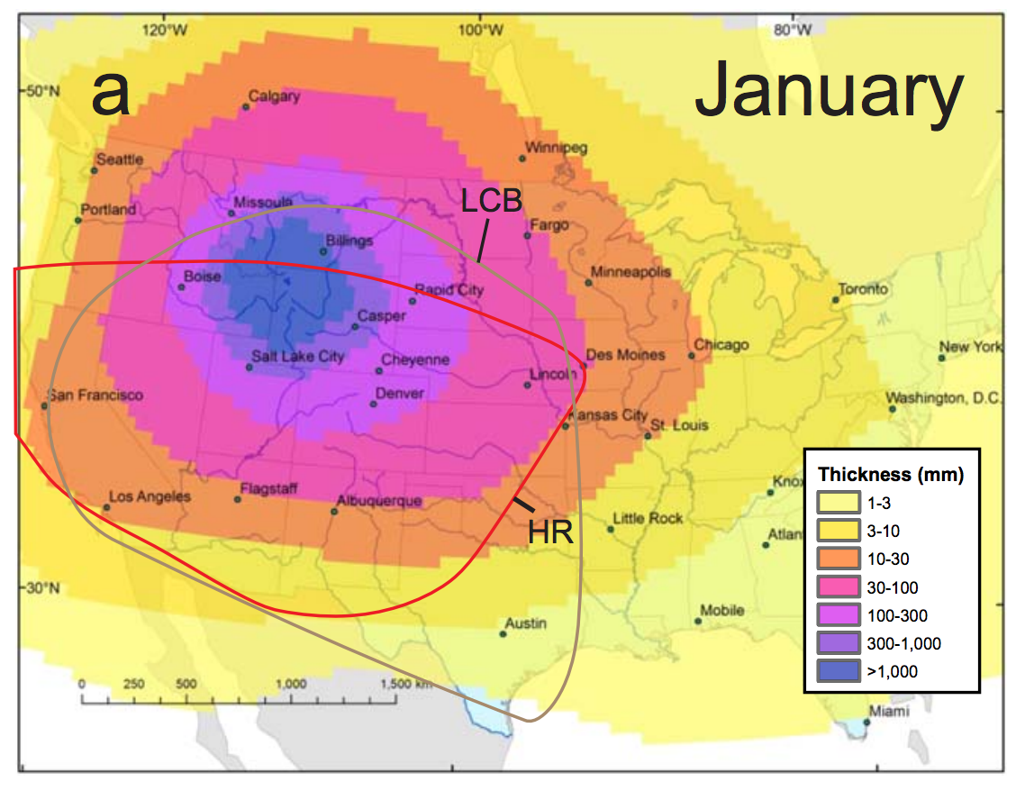
Ash dispersal
Mastin et al. G^3 2014
Colors: predictions;
solid lines: past ash falls
North-Central Texas
3m of ash
from LCB
eruption 640 Kya

Slide 39
Ash may be an important part of Mars’ sedimentary record. Ash dispersal calculations for Mars:
e.g. Crumpler et al. JGR 2011;
Bandfield et al. JGR 2013.
Model output – assumes large total erupted volume – Kerber et al. 2013

Slide 40
Volcanism, part 2
WRAP-UP: LAB 1
DIAGNOSING VOLCANISM
PYROCLASTIC FLOWS
VOLCANIC HOT SPRING DEPOSITS

Slide 41
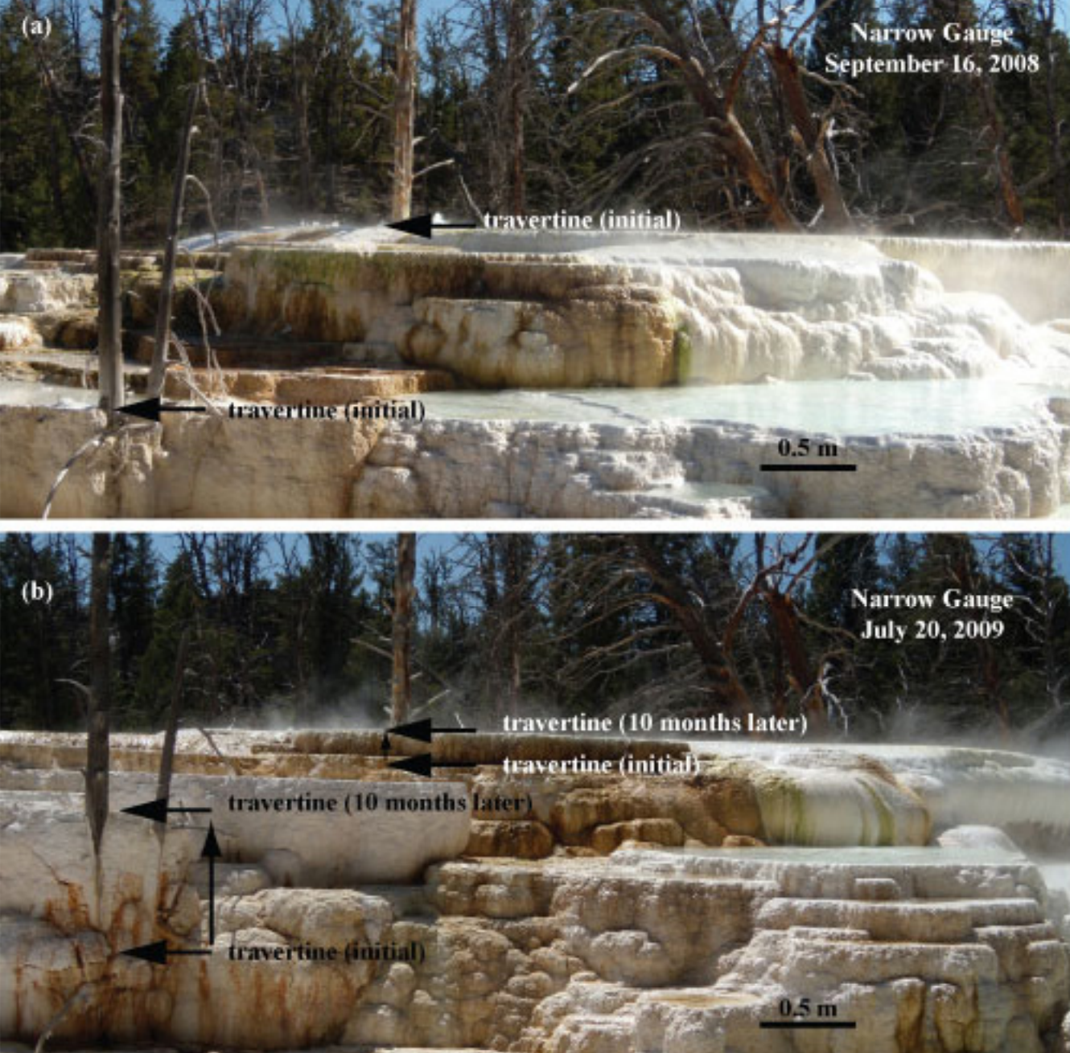
University
of Wyoming
Can also
form in silica

Slide 42
https://www.youtube.com/watch?v=3cys_mQ5sro

Slide 43
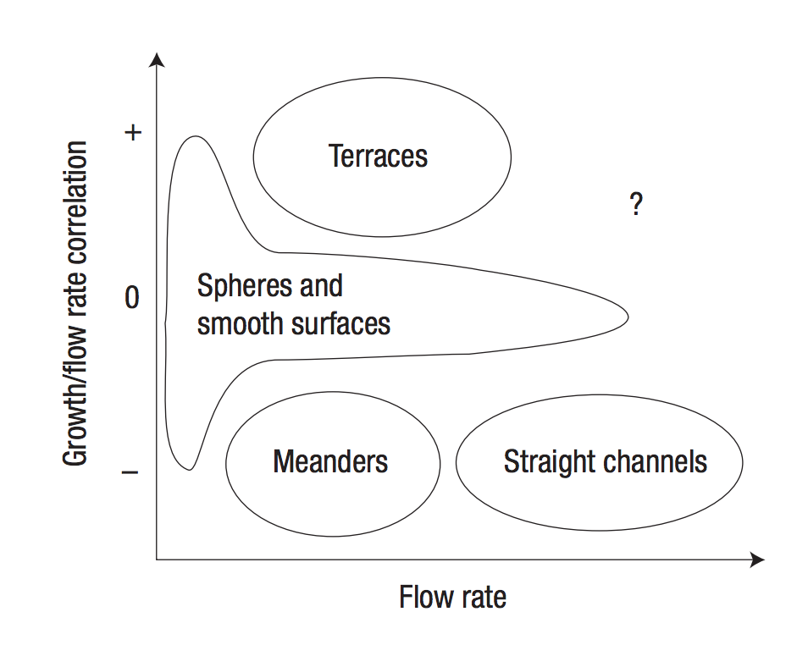
covered in
subsequent
weeks

Slide 44
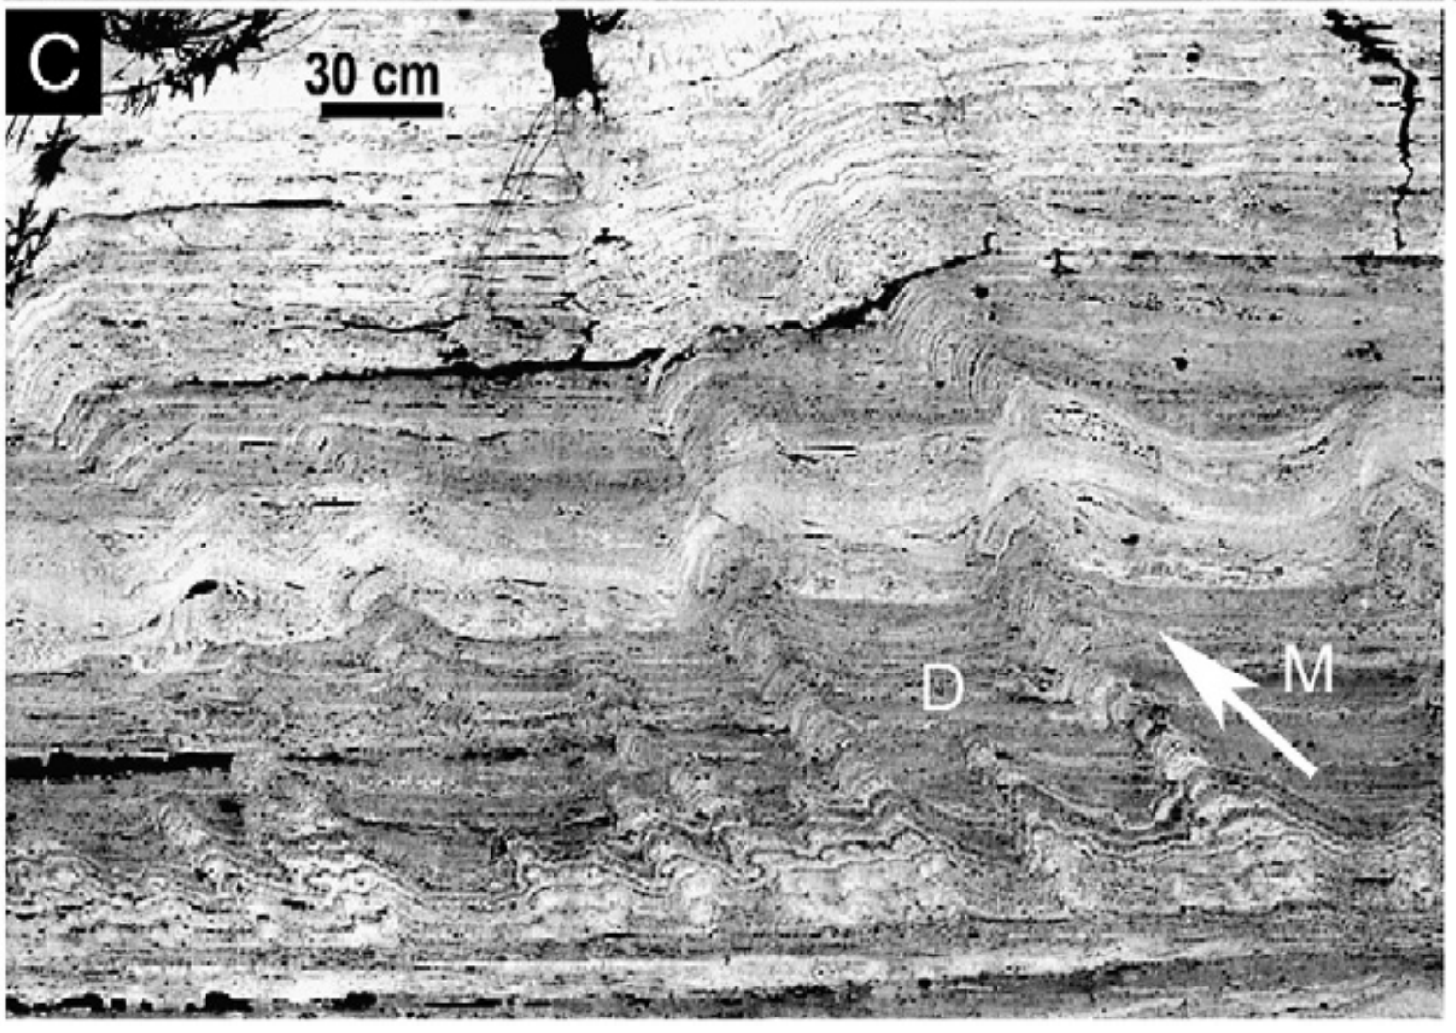
Hammer et al., EPSL 2007

Slide 45
Hot spring deposits on Mars
1cm scale bars
Ruff & Farmer, Nature Communications 2016

Slide 46
Key points: volcanism, part 2
Know three ways of distinguishing cooled lava flows from frozen water deposits from orbit.
Explain long pyroclastic flow runout distances.
Explain volcanic hot spring terraces.

Slide 47
The flow of ice: why, how,
and what are the effects?
ICE MOVEMENT – GLEN’S LAW
TEMPERATURE STRUCTURE WITHIN ICE SHEETS – ESKERS
EFFECT OF GLACIAL EROSION ON TOPOGRAPHY

Slide 48
A dome of cryo-lava on dwarf planet Ceres
NASA/JPL
Ruesch et al. Science 2016

Slide 49
Glaciers on Mars: debris covers
protect 10⁸-10⁹ yr old ice
deflation:
loss of most
ice through
debris cover
thickness of debris
cover <10 m

Slide 50
Nitrogen glaciers of Sputnik Planum (Pluto)
40 km
100km
Water-ice mountains are 3 km high
Pluto surface temperature ~40 K
e.g. see Umurhan et al. Icarus 2017 (suggested reading)

Slide 51
The topographic signature of glacial erosion of rock on Earth: “glacial buzzsaw”
Hypsometric maxima for 60km x 60km areas
Egholm et al. Nature 2009
Gamburtsev mountains: today 3 km under Antarctic ice (nucleus for the Antarctic ice sheet, buried 33.7 Ma )
Positive feedbacks on ice
sheet growth: albedo,
elevation → adiabatic
lapse rate
Radar mapping of buried
paleo-topography
Rose et al. EPSL 2013
Ancient cirques preserved by cold-based ice

Slide 52
Ice flow physics will determine how fast Antarctica melts
Lifetime of anthropogenic CO2 in atmosphere: 10s of Kyr
Worst case for Antarctic melting (no geoengineering): centuries
Reasonable central guess: a few thousand years.
See Schoof & Hewitt 2013 (required reading)
Archer & Kite, “The ultimate social cost of carbon”, in prep.

Slide 53
Key points from today’s lecture
Glen’s Law
Approximations to the full Stokes equation: locations where they are and are not acceptable
Nondimensional T-vs-depth as a function of accumulation rate for fixed basal heat flow
Glacial erosion parameterization

Slide 54
The flow of ice
ICE MOVEMENT – GLEN’S LAW
TEMPERATURE STRUCTURE WITHIN ICE SHEETS – ESKERS (Mars examples)
EFFECT OF GLACIAL EROSION ON TOPOGRAPHY
(Earth examples)

Slide 55
Climate drives accumulation+ablation patterns, which drive glacial flow
Therefore, changes in glacier length (recorded by e.g. moraines, historical photographs)
can be a proxy for changes in climate.

Slide 56
Mass balance on Earth favors ice accumulation at high elevations. Mass balance on Mars may favor ice accumulation at low elevations.
Orographic precipitation; low temperatures disfavor melting + sublimation
Sublimation rate increases as pressure decreases
Fastook et al., Icarus 2008

Slide 57
Review of stress and strain
Definitions (2D – real case is 3D):
Assumption: Forces are balanced
(no rotational acceleration nor lateral acceleration)
Infinitesimal strain (invalid for complexly folded ice)
Convention: Extensional stresses defined as +ve
(note: in some engineering contexts, compression is +ve)
Rotate coordinate system to maximize normal
stresses (these are then called the principal stresses)
Subtract off pressure:

Slide 58
Ice is incompressible, so only deviatoric stresses matter for flow
0 - Pressure:
Ice flow is pressure-independent
for pressure within glaciers
Effective stress:

Slide 59
Pure shear vs. simple shear

Slide 60
Stress → strain: rheology of water ice near 273K
Dislocation creep:
“toothpaste tube” limit
in practice “regularized”
Glen’s Flow Law
n = approximately 3
Q ~ 60 kJ/mol
Nye-Glen law for incompressible, isotropic ice
Semicircular channel, radius R
Effects of grain orientation and grain size can be important (but less so than the
stress and temperature effects)

Slide 61
Strong temperature dependence and strong shear-stress dependence
10¹⁴ Pa s
Effective viscosity decreases as shear stress increases

Slide 62
Stress: which components of stress to consider?
neglects
longitudinal
and transverse
stresses
SIA: Shallow Ice Approximation
SSA: Shallow Shelf Approximation
Kirchner et al.,
Quaternary Science Reviews 2011

Slide 63
Stress: which components of stress to consider?
Kirchner et al. 2011
Quaternary Science
Reviews

Slide 64
Stress: which components of stress to consider?
non-dimensionalized
SHALLOW ICE APPROXIMATION
SHALLOW ICE APPROXIMATION
floating

Slide 65
Vertically integrated force balance (map-plane models)
Cuffey & Patterson 2010
e.g. Fastook & Chapman, J. Glaciol., 1989

Slide 66
Plastic-flow approximation to ice sheet profiles (steady state)
Assume Y = 10⁵ Pa (larger for cold ice)
circles: East Antarctic
ice sheet between Vostok
and Mirny stations
parabolic
Melosh 2011, ch. 11

Slide 67
Example: how long to seal a system of crevasses?
Assume Glen’s law
Error relative to ice-sheet data: factor of 3
Cuffey & Patterson 2010

Slide 68
The flow of ice
ICE MOVEMENT – GLEN’S LAW
TEMPERATURE STRUCTURE WITHIN ICE SHEETS + ESKERS (Mars examples)
EFFECT OF GLACIAL EROSION ON TOPOGRAPHY
(Earth examples)

Slide 69
Andy Anschwanden, Glaciology Summer School

Slide 70
Decay of T signal of climate forcing with depth
a way to quantify
exceptional late-20th
warmth relative to
earlier centuries
Cuffey & Patterson, ch. 9 (supplementary reading)

Slide 71
For slow-flowing ice sheets (e.g., Mars) → shear heating unimportant, temperature set by geothermal heat flow modified by advection of cold ice from above
Thermal structure of an ice sheet: neglecting horizontal advection
surface mass
balance:
thickness/time
signed
Peclet
number
Constant heat flow at z = 0
(Geothermal + shear heating)
Mass removed at bed
(e.g., rapid lateral flow)
(Ice divide)
Cuffey & Patterson, ch. 9 (supplementary reading)

Slide 72
Linking thermal structure and ice flow: crevasse-closure regulation of the rate of volcanism on Enceladus?
Kite & Rubin, Proc. Nat’l. Acad. Sci., 2016

Slide 73
Wet-based ice sheets
Basal melt
Applications: ice streams
will Greenland + Antarctic ice shelf collapse take a few millenia or a few centuries?

Slide 74
Eskers:
sand+gravel ridges deposited from
subglacial water channels
Katahdin esker system,
Maine
Eskers can flow uphill: why?

Slide 75
How are subglacial conduits kept open?
Viscous inflow of warm ice will seal conduits near the ocean interface
in decades, unless opposed e.g. Rothlisberger 1972

Slide 76
Nye (1953) / Rothlisberger (1972) theory for subglacial conduits
applications: plumbing system of cryovolcanoes on Enceladus and Ceres
Assume: water temperature = ice temperature
work done per unit volume of
water per unit distance along
flow
pressure driving closure
A,n: creep parameters for ice
Energy required to raise water temperature
(pressure dependence of the melting point
of ice):
melt-back rate
warming of
water
heat generated
by flow of water
Following Cuffey, ch. 6., p.198-199
(suggested reading)

Slide 77
Pressure reduction in big Rothlisberger channels causes them to parasitize flow from smaller channels

Slide 78
Example: Mars, Dorsa Argentea Formation eskers (~3.5 Ga)
Fastook et al. Icarus 2012
Butcher et al. Icarus 2016 – South Pole of Mars

Slide 79
The flow of ice
ICE MOVEMENT – GLEN’S LAW
TEMPERATURE STRUCTURE WITHIN ICE SHEETS – ESKERS (Mars examples)
EFFECT OF GLACIAL EROSION ON TOPOGRAPHY
(Earth examples)

Slide 81
Origin of U-shaped glacial valleys: role of water table
Harbor, 1992, GSA Bulletin

Slide 82
Glacial abrasion and plucking scales as (sliding velocity)²
using metamorphic grade
of eroded rocks as a proxy
for distance upstream
Herman et al. Science 2015
Abrasion, quarrying

Slide 83
Global increase in erosion rate in the last 2 Myr – possibly due to increase in glaciation
Herman et al. Science 2013
(thermochronology compilation)

Slide 84
Key points from today’s lecture
Glen’s Law
Approximations to the full Stokes equation: locations where they are and are not acceptable
Nondimensional T-vs-depth as a function of accumulation rate for fixed basal heat flow
Glacial erosion parameterization

