Slide 1
GEOS 28600
The science of landscapes:
Earth & Planetary Surface Processes
Lecture 4
Wednesday 15 January 2020

Slide 2
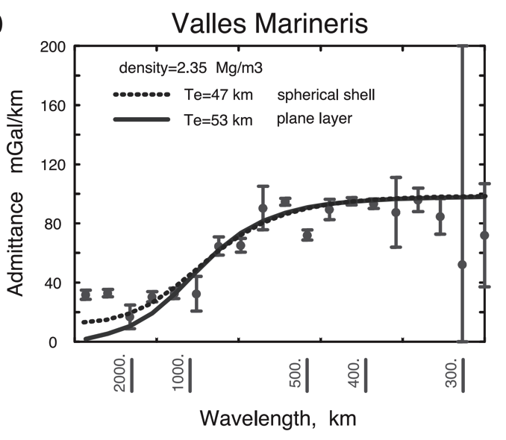
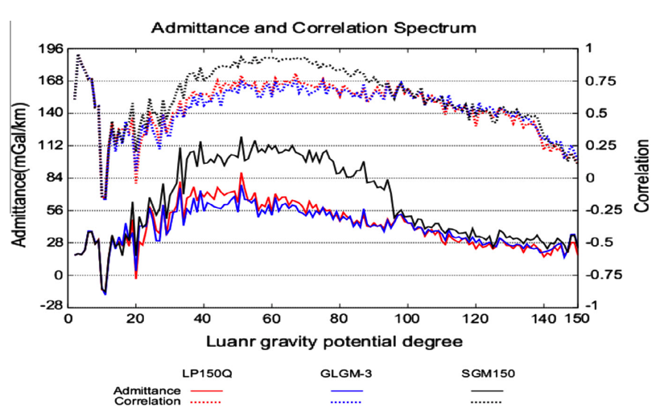
Different worlds show similar behavior in gravity-topography ratio (“admittance”) as a function of wavelength
2πGρΔz
Moon
Mars
Admittance is sometimes calculated using “Bouguer gravity”, gravity that
has been corrected for mass of topography
In this course we only use “free-air gravity” (uncorrected for topography).

Slide 3
How is topography supported?
WRAP-UP TRUE POLAR WANDER FROM LECTURE 1
REVIEW REQUIRED READING (CHAPTER 2 IN MELOSH)
_____________________________________________________________
EXPECTATIONS AND OBSERVATIONS: BOUGUER GRAVITY EQUATION, GRAVITY-TOPOGRAPHY CORRELATION, ADMITTANCE
MECHANISMS: AIRY ISOSTASY, FLEXURE
(MEMBRANE STRESSES)
APPLICATIONS: DENSITY/POROSITY; INFERENCE OF BURIED OCEANS; STRENGTH → HEAT FLOW → THERMAL HISTORY

Slide 4
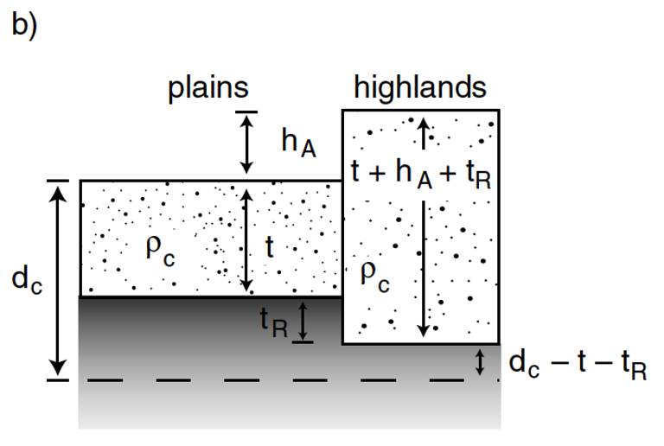
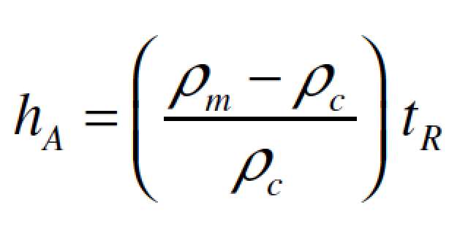
Airy isostasy (floating)
Free-air gravity anomaly is negligibly small for loads small compared to planet radius

Slide 5
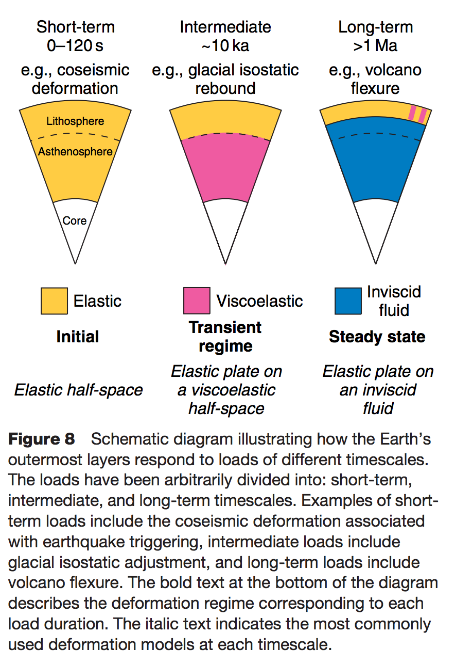
Definition of the lithosphere
elastic lithosphere
– supports loads over geologic time
separate from:
seismic lithosphere – permits earthquakes
thermal boundary layer
layer that is conductively affected
by the cold boundary condition of
the planet’s surface
Watts, in Treatise on Geophysics
(1st edn.), 2007

Slide 6
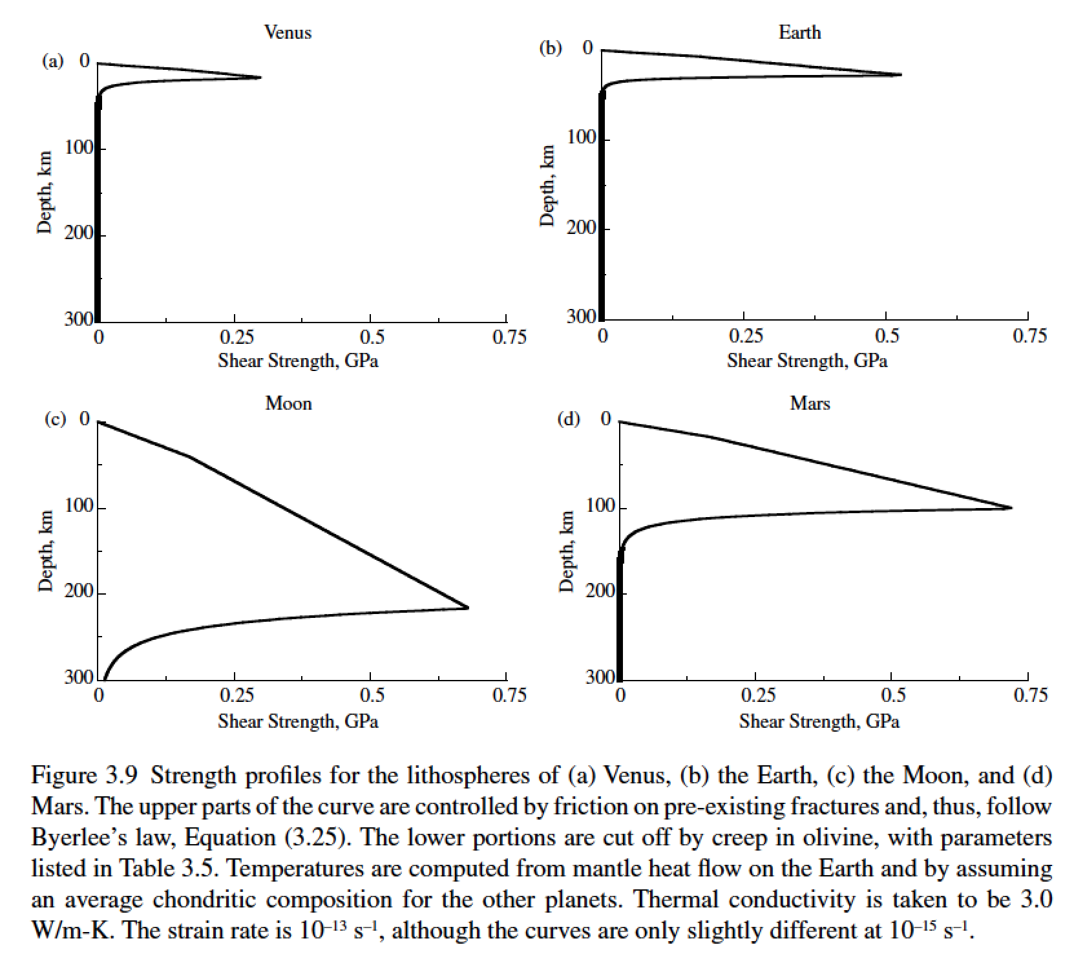
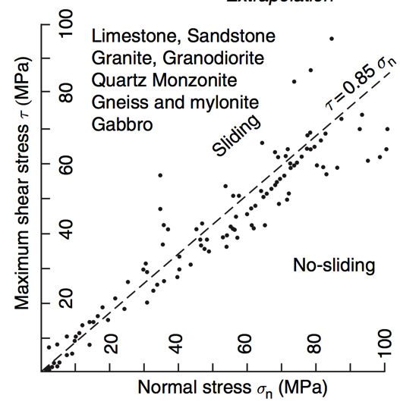
Lithosphere: strength versus depth
g=8.9 m s⁻²
g=9.8 m s⁻²
g=1.6 m s⁻²
g=3.7 m s⁻²
Byerlee’s law

Slide 7
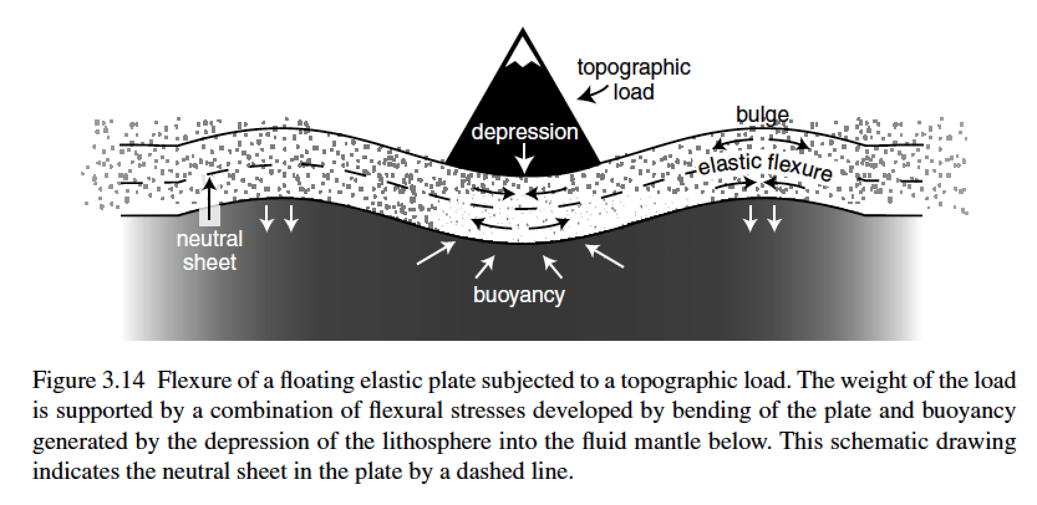
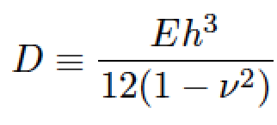
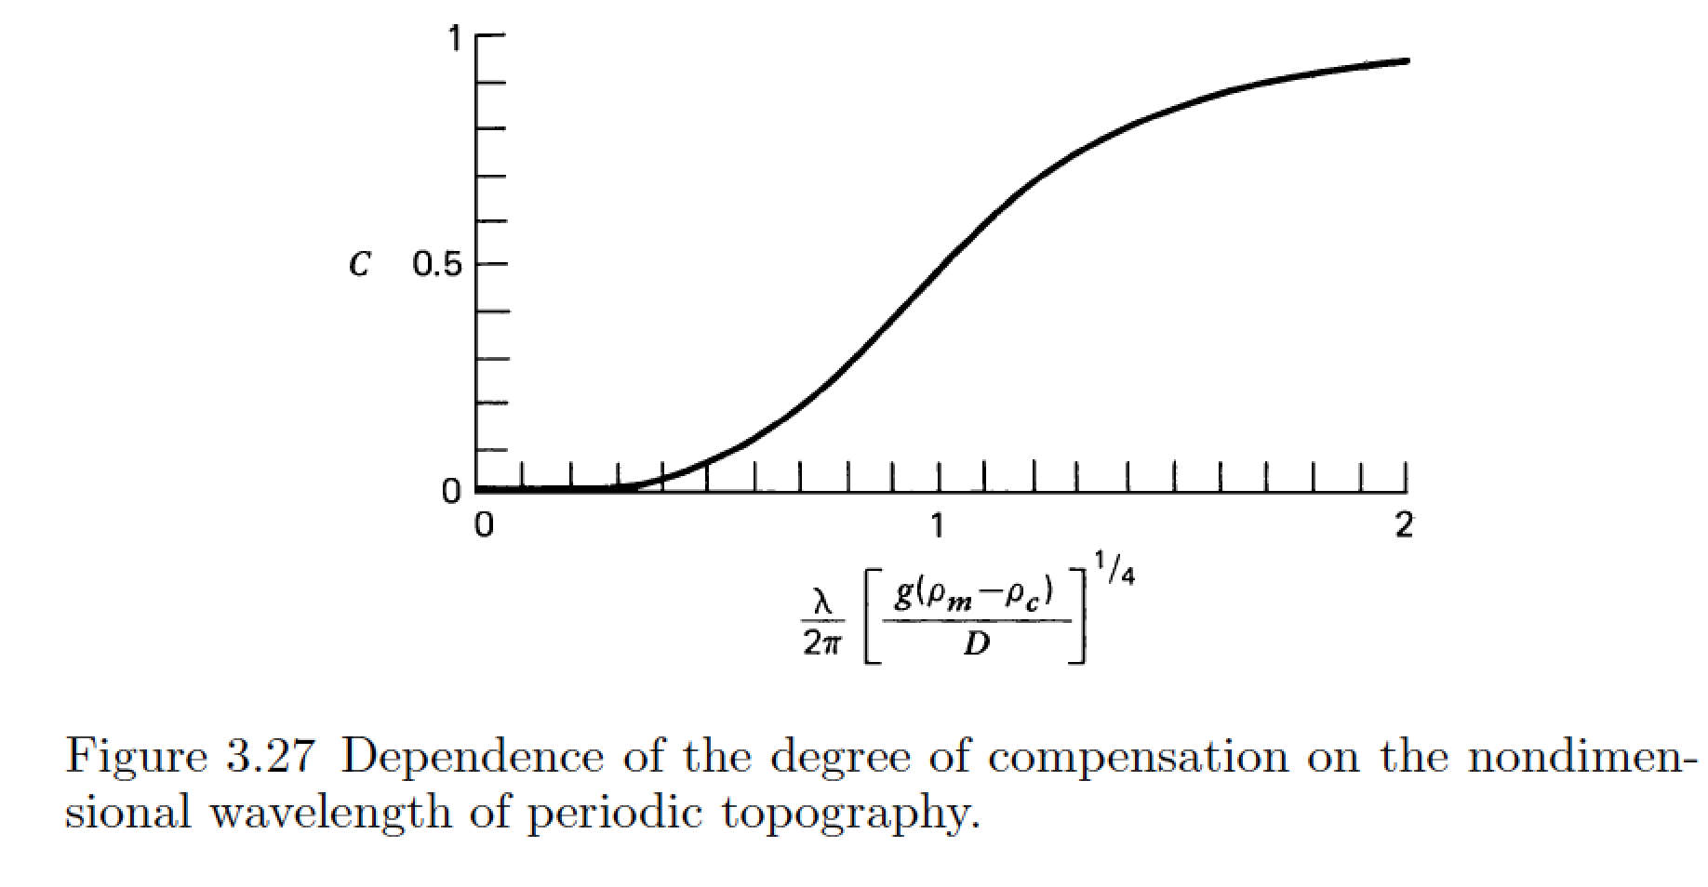
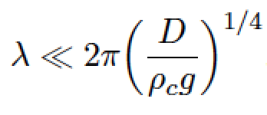
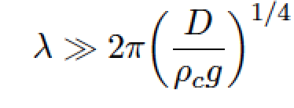
stiffness (Pa, N m⁻²)
Young’s modulus
elastic thickness (m)
Poisson’s ratio (0.25 – 0.33, dimensionless)
flexural rigidity (N m)
compensation, c
Compensation curves
can be used to constrain
D
wavelength (m)
m = [ (kg m s⁻²)/(kg m⁻³ × m s⁻²) ]^{1/4}

Slide 8
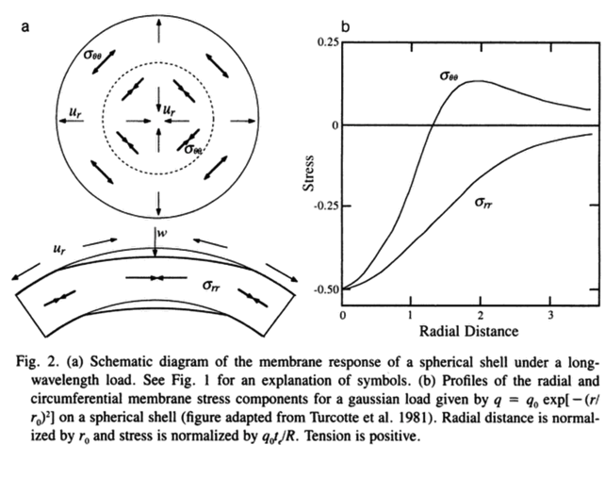
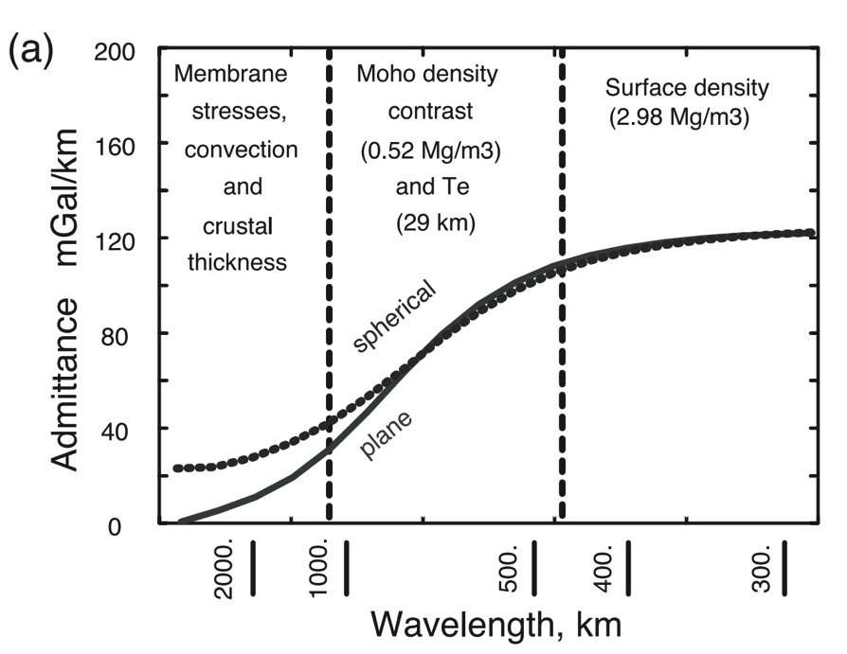
A different technique is needed for loads with wavelength comparable to the radius of the planet (consider membrane stresses)
Banerdt et al., ch. in
Kieffer et al. (eds). “Mars”, 1992
McKenzie et al. EPSL 2002

Slide 9
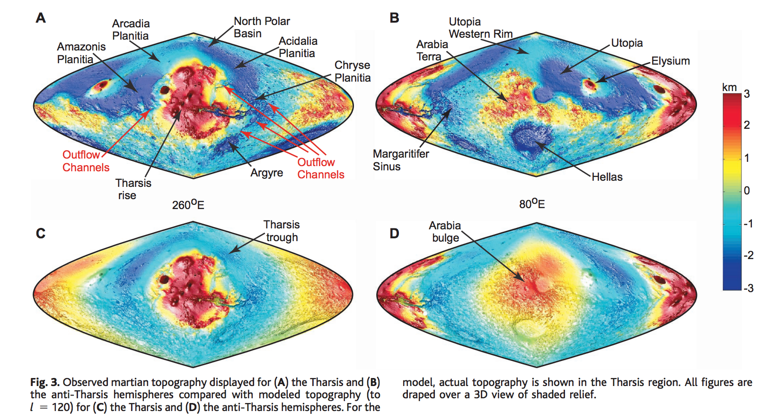
Membrane support example: Tharsis (volcanic province) load on Mars
Phillips et al. Science 2001

Slide 10
How is topography supported?
WRAP-UP TRUE POLAR WANDER FROM LECTURE 1
REVIEW REQUIRED READING (CHAPTER 2 IN MELOSH)
_____________________________________________________________
EXPECTATIONS AND OBSERVATIONS: BOUGUER GRAVITY EQUATION, GRAVITY-TOPOGRAPHY CORRELATION, ADMITTANCE
MECHANISMS: AIRY ISOSTASY, FLEXURE
(MEMBRANE STRESSES)
APPLICATIONS: DENSITY/POROSITY; INFERENCE OF BURIED OCEANS; STRENGTH → HEAT FLOW → THERMAL HISTORY

Slide 11
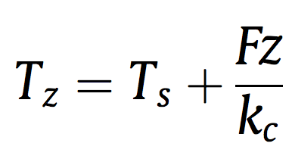
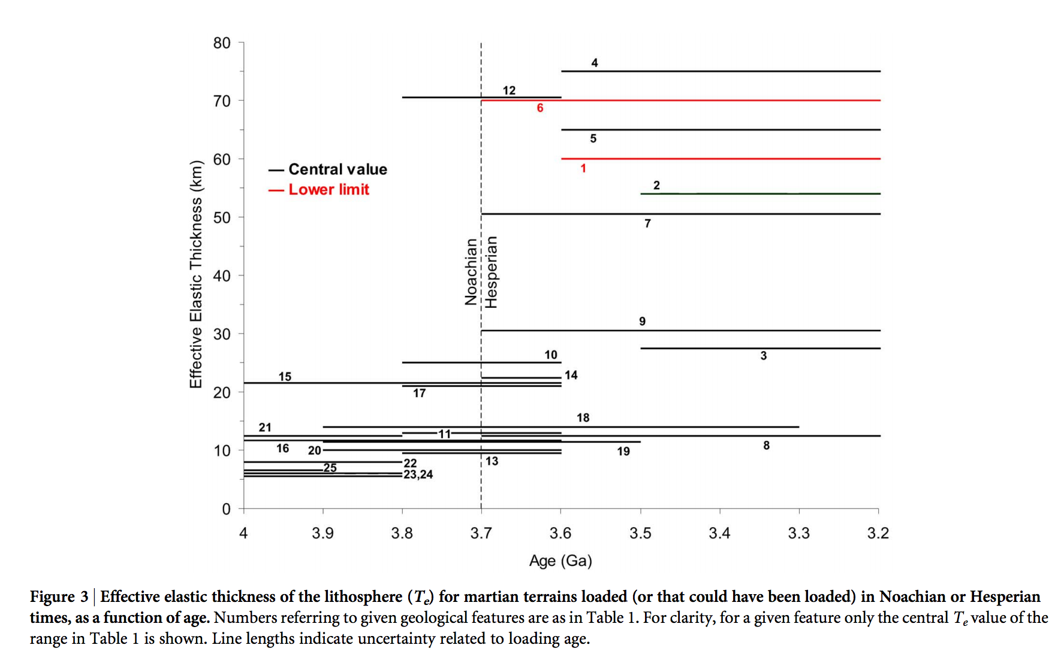
Thermal history of Mars
heat flow (W m⁻²)
depth(m)
Base of elastic lithosphere corresponds to T ~ 550-600 C
(McNutt, JGR, 1984)
thermal
conductivity
(W m⁻¹ K⁻¹)
surface T(K)
Major reduction
in Mars’ geothermal
heat flow at around
the time that the
surface was drying out.
Ruiz et al., Nature Scientific Reports, 2014

Slide 12
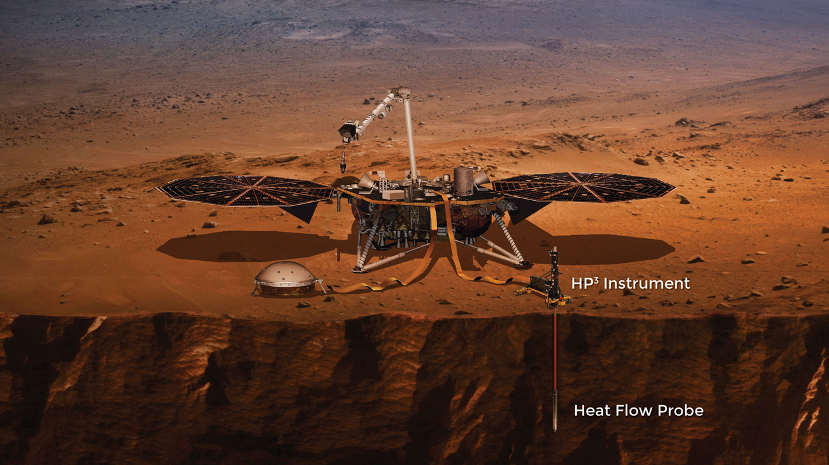

Slide 13
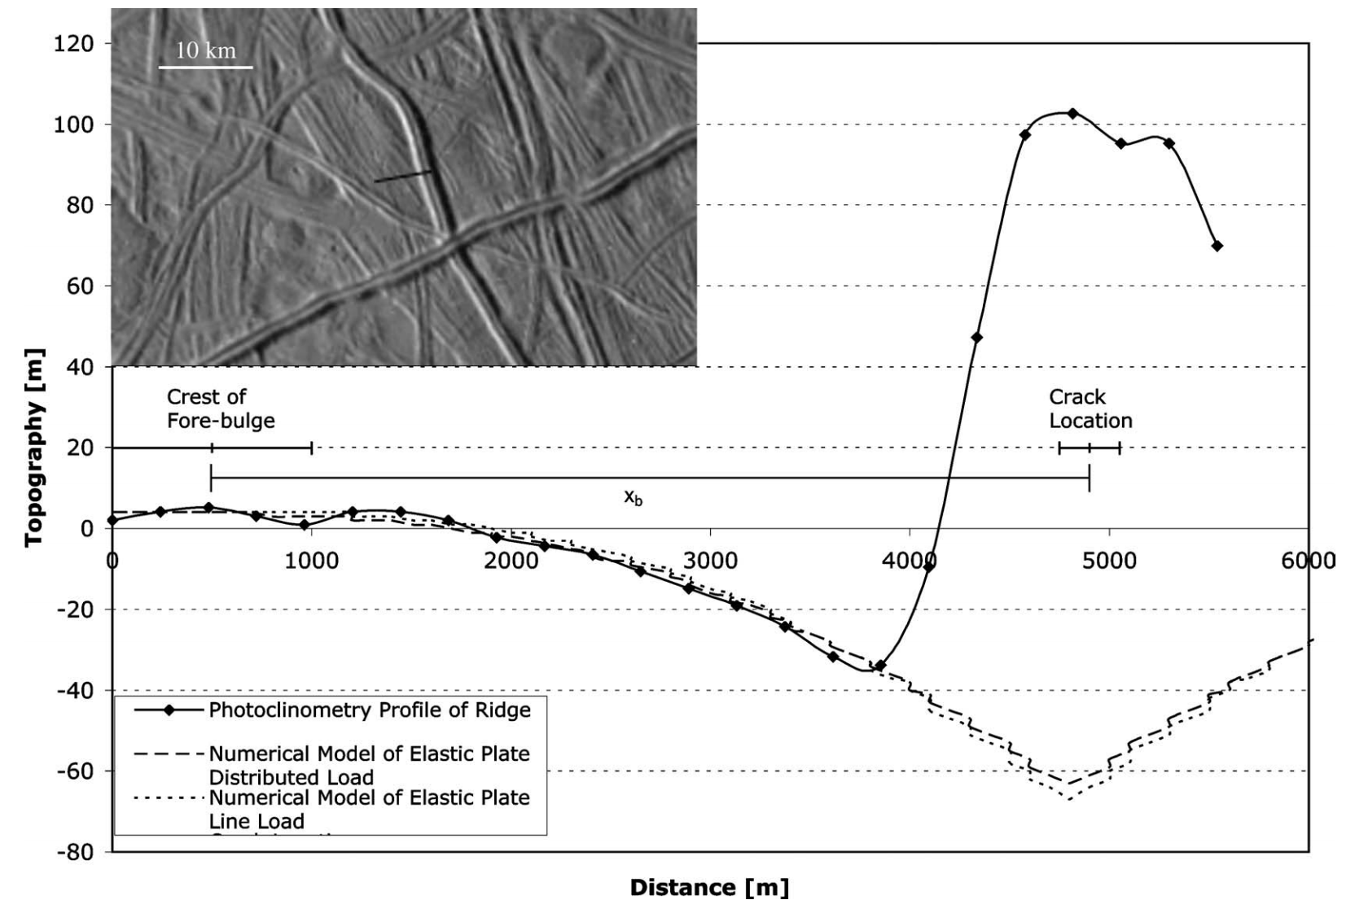
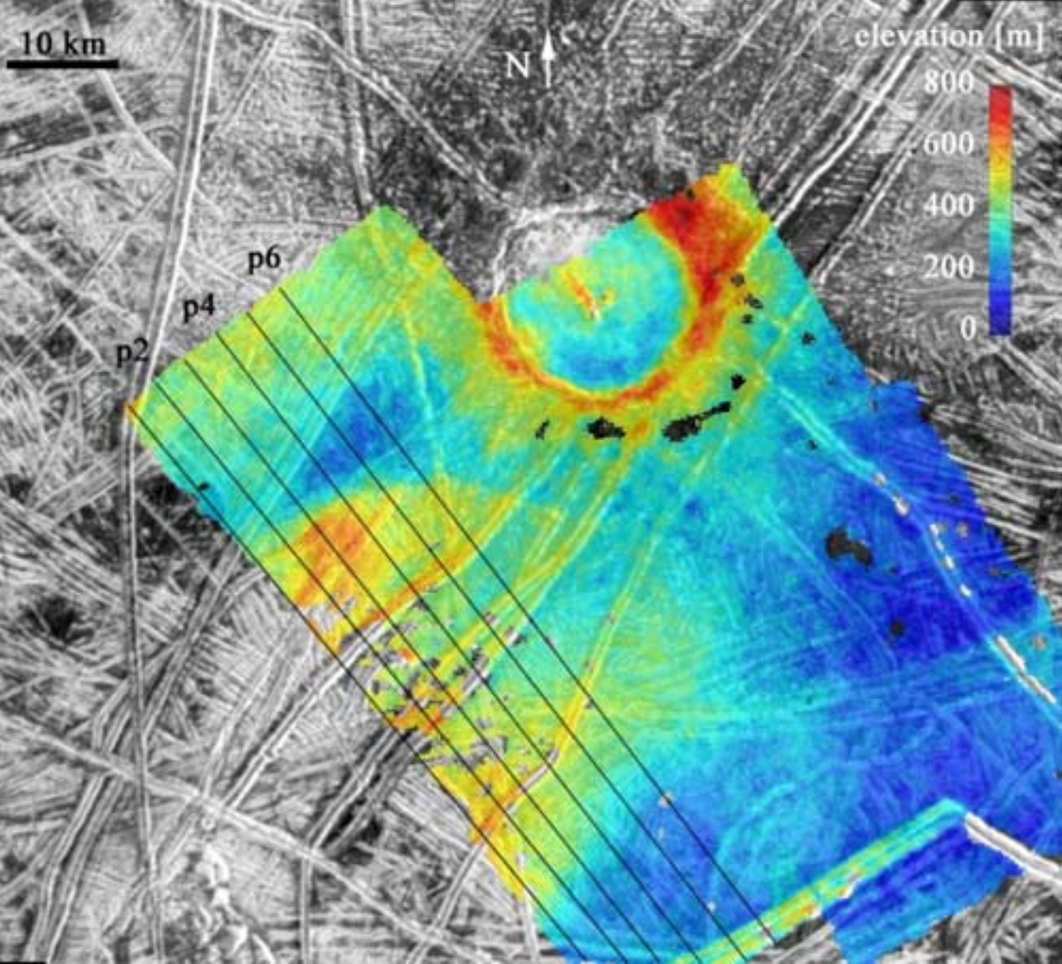
Inferring oceans on Europa
Hurford et al. Icarus 2005
Billings & Kattenhorn Icarus 2005
Elastic thickness is
small
Ice is soft and warm at
shallow depths
(From Europa’s overall
density) water substance
persists to great depth
Most of the water is
very warm and likely
liquid

Slide 14
Key points: topography versus gravity
Relationship between topography & gravity at length scales much larger than, comparable to, and much smaller than, the lithospheric thickness.
Explanation of Airy isostasy
Quantities inferred from topography←→gravity comparison.
Next lecture: what limits the height of mountains?

Slide 15
What limits the height of mountains?
CRUSTAL FLOW: THE MECHANISM THAT LIMITS THE HEIGHT OF TIBET AND THE ALTIPLANO
HOW EROSION CAN LIFT MOUNTAINS: THE PROCESS RELATIONSHIP BETWEEN THE HEIGHT OF TIBET AND THE HEIGHT OF MT. EVEREST

Slide 16
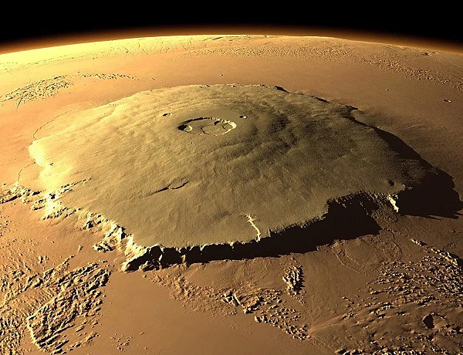
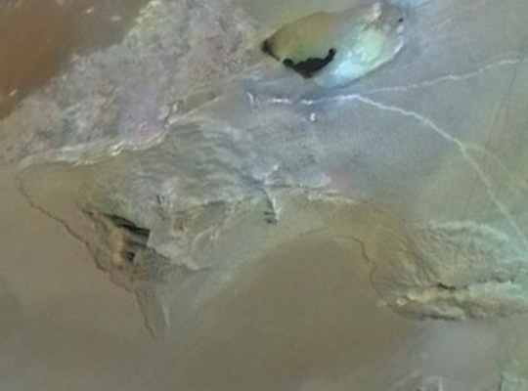
Maximum mountain height in solar system context
Volcanic extrusion: Mars
Whole-lithosphere breaking? Io, Boosaule Mons

Slide 17
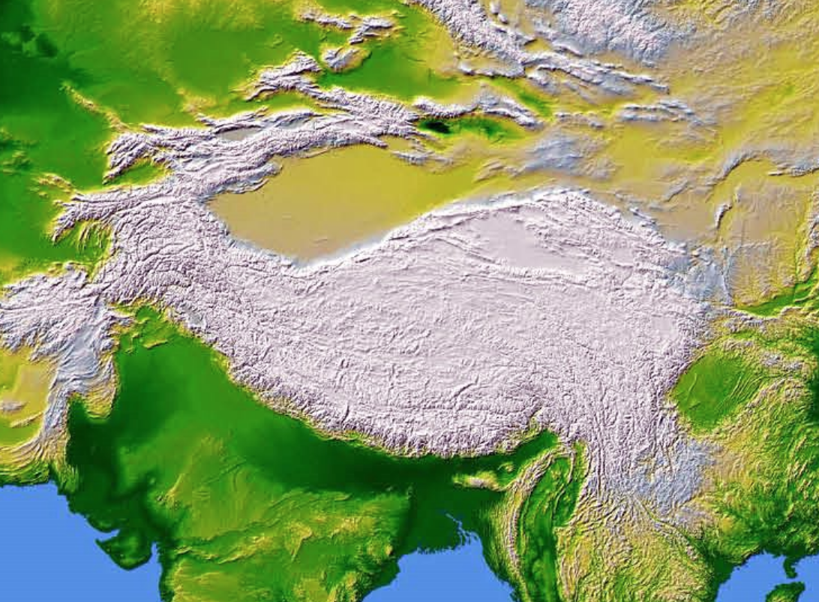
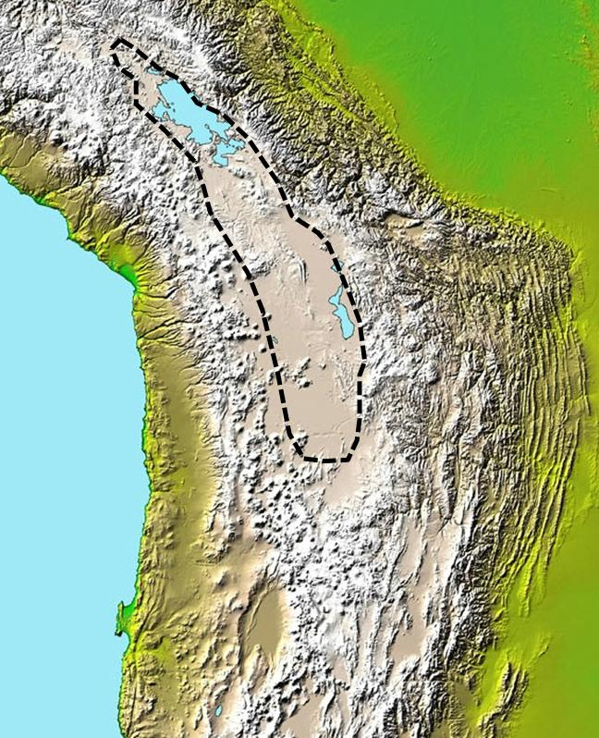
What limits the height of mountain belts on Earth?
Tibet
Altiplano

Slide 18
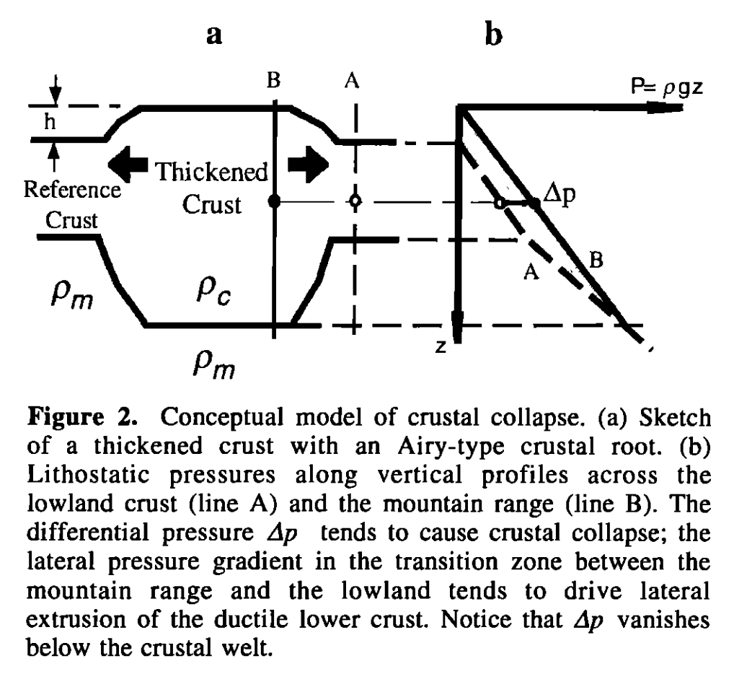
Isostasy is not an equilibrium state
Liu & Shen, Tectonics, 1998

Slide 19
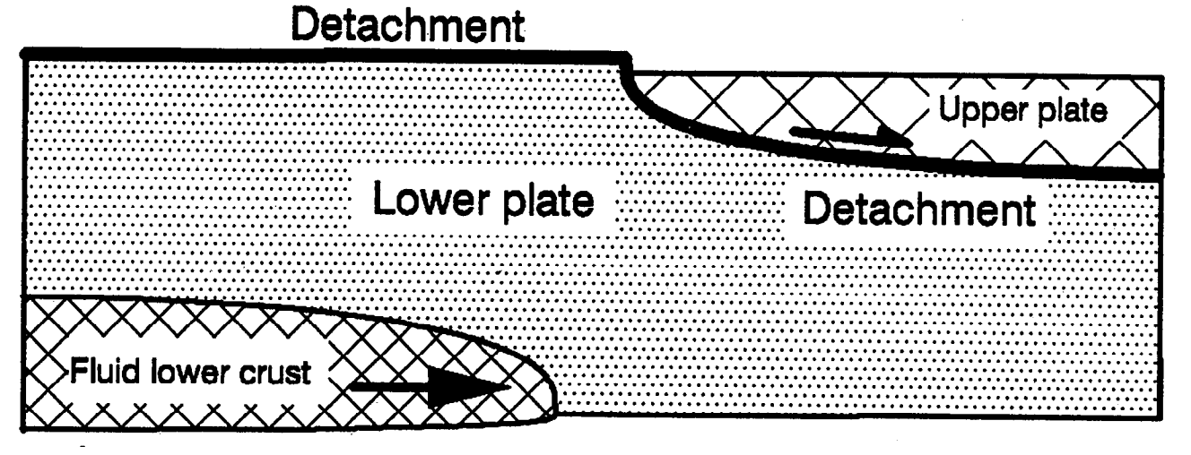
Crustal flow
McKenzie et al. JGR 2000

Slide 20
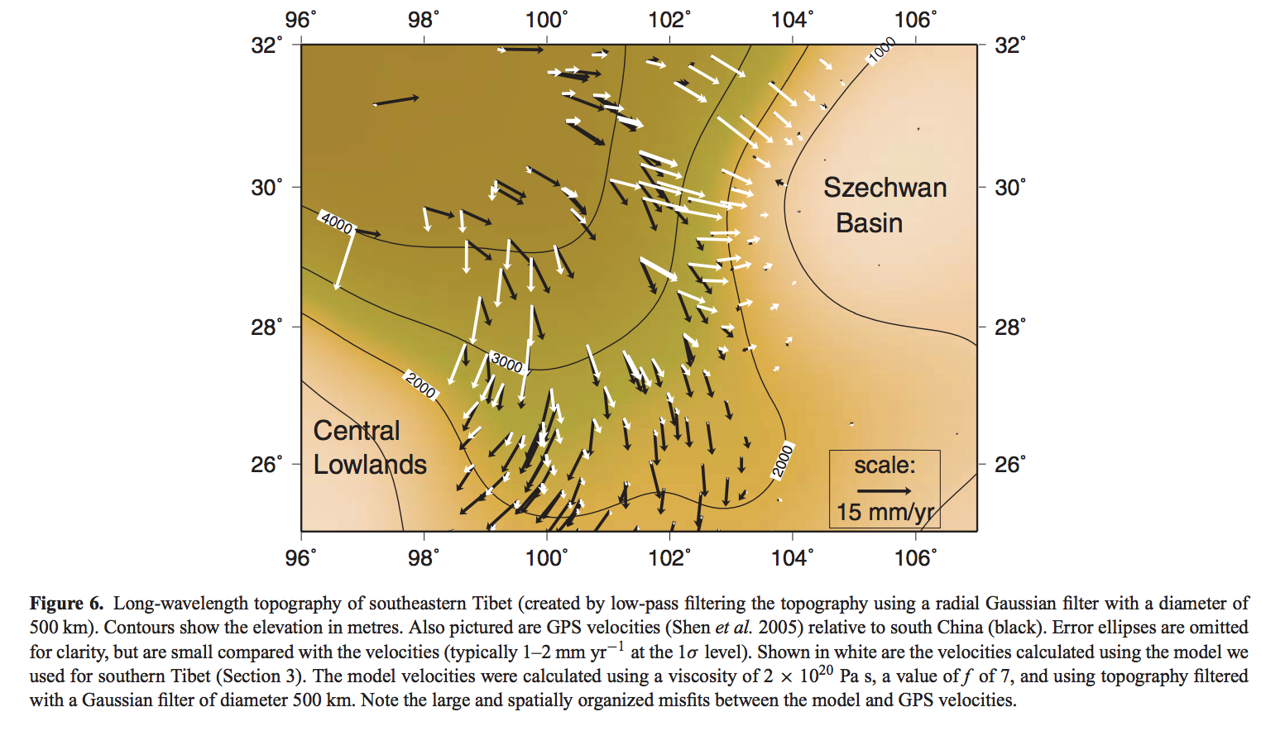
Gravitational collapse of mountain belts
Copley & McKenzie, Geophys. J. Int. 2007

Slide 21
What limits the height of mountains?
CRUSTAL FLOW: THE MECHANISM THAT LIMITS THE HEIGHT OF TIBET AND THE ALTIPLANO
HOW EROSION CAN LIFT MOUNTAINS: THE PROCESS RELATIONSHIP BETWEEN THE HEIGHT OF TIBET AND THE HEIGHT OF MT. EVEREST

Slide 22
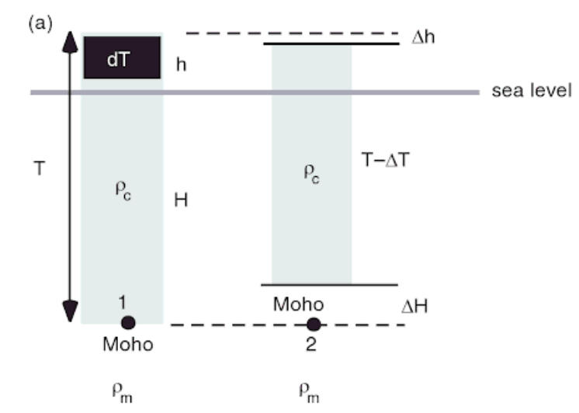
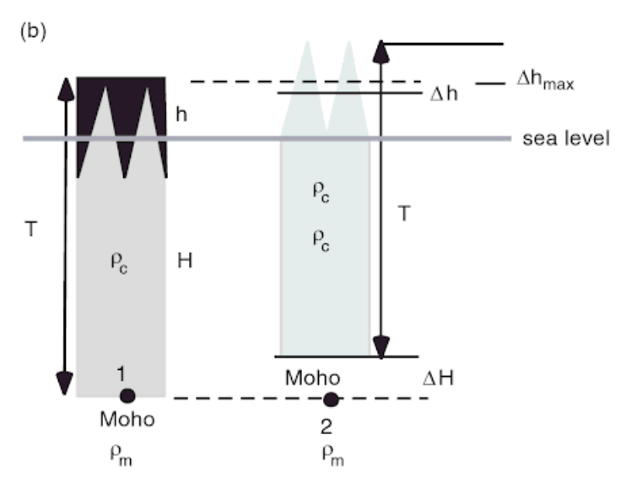
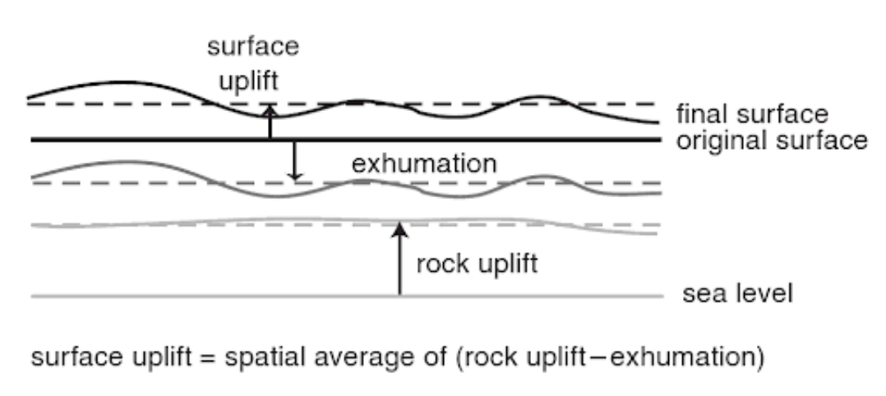
adapted from Molnar & England 1990 Nature

Slide 23
Additional slides

