Slide 1
GEOS 28600
The science of landscapes:
Earth & Planetary Surface Processes
Lecture 3
Monday 13 January 2020
true polar wander.

Slide 2
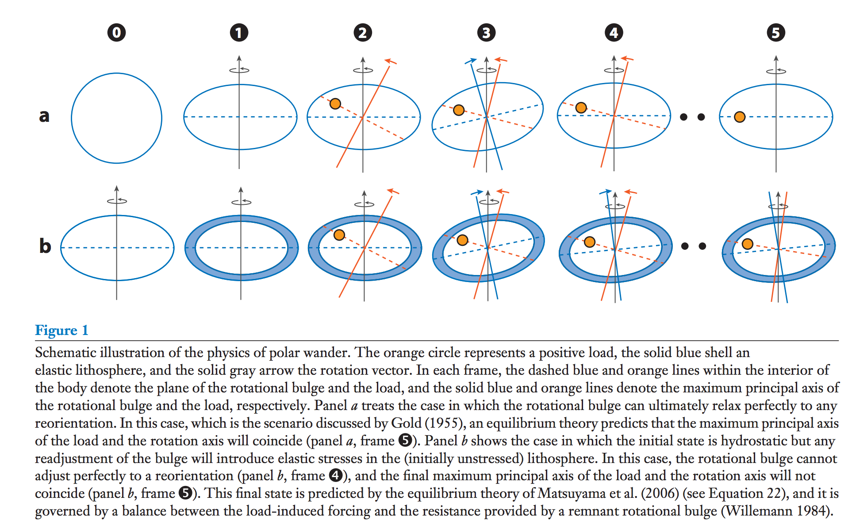
True polar wander – migration of +ve (-ve) nonhydrostatic mass anomalies to equator (poles)
Over geologic time, energy dissipation within viscous interior will align the spin axis
with the maximum moment of inertia.
Matsuyama et al., Annual Reviews of Earth & Planetary Science, 2014

Slide 3
Significance of true polar wander
(Potentially rapid) shifts of (paleo)latitude
Complicate reconstruction of past climate

Slide 4
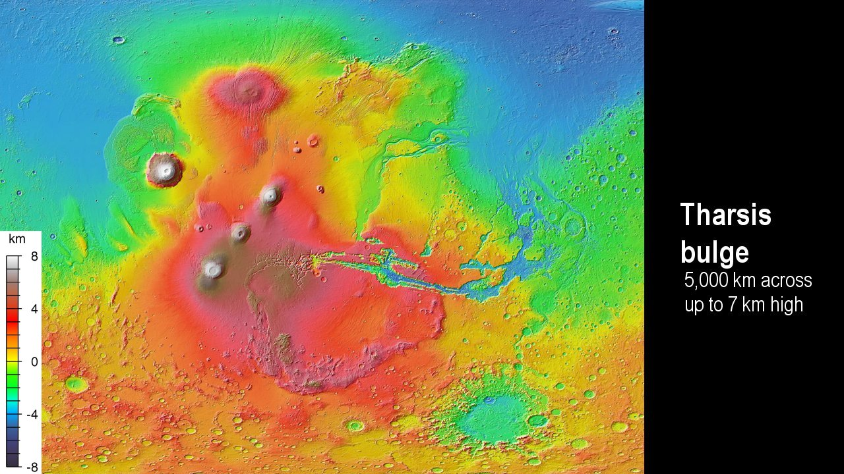
Matsuyama & Manga, JGR, 2010

Slide 5
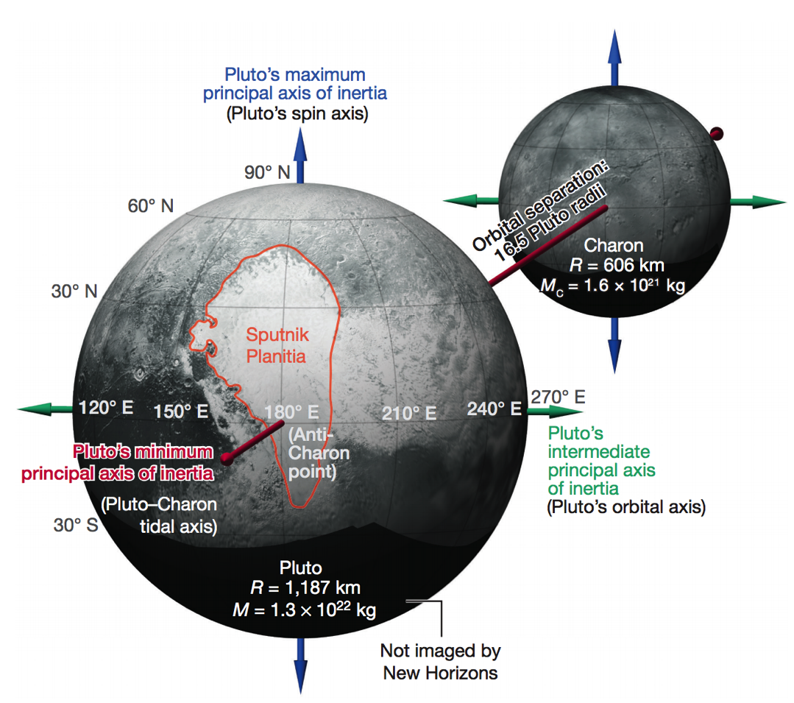
TPW on Pluto
Keane et al. Nature 2016

Slide 6
Key points from today’s lecture
Relationship between topography & gravity at length scales much larger than, comparable to, and much smaller than, the lithospheric thickness.
Explanation of Airy isostasy
Quantities inferred from topography←→gravity comparison.

Slide 7
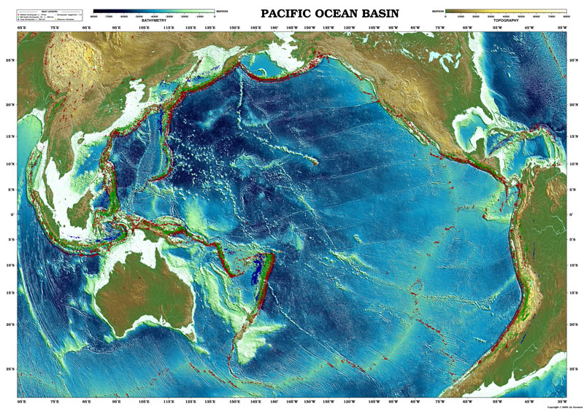
Topography of the oceans: How is topography supported?

Slide 8
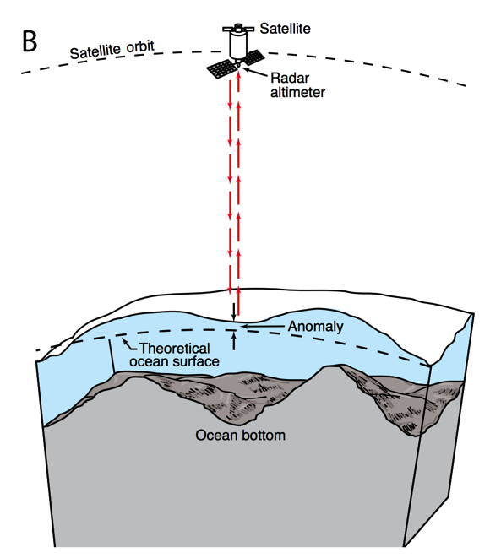
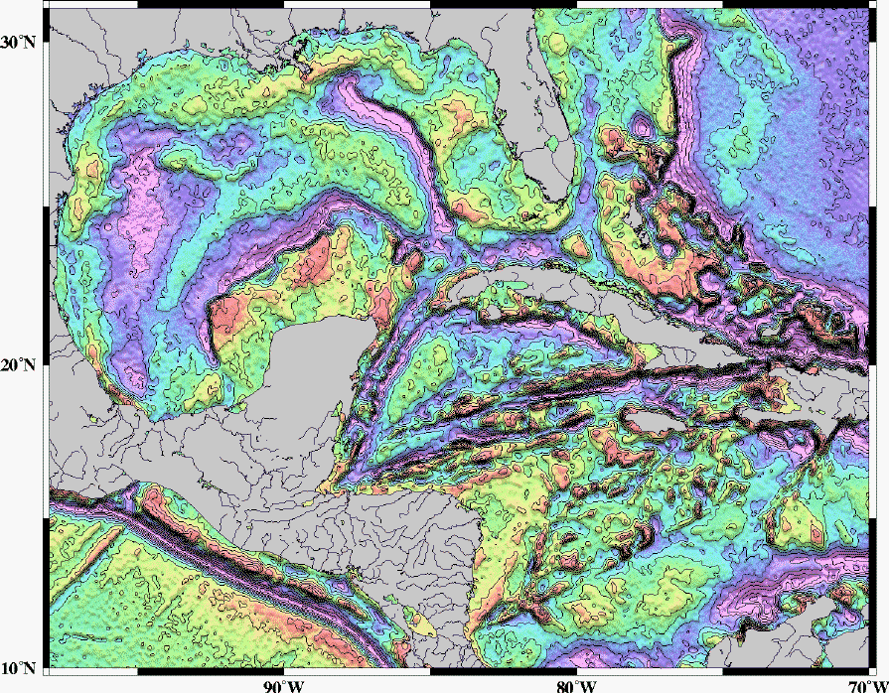
Mapping underwater volcanoes from space
Wessel et al. Oceanography 2010
Smith & Sandwell 1997

Slide 9
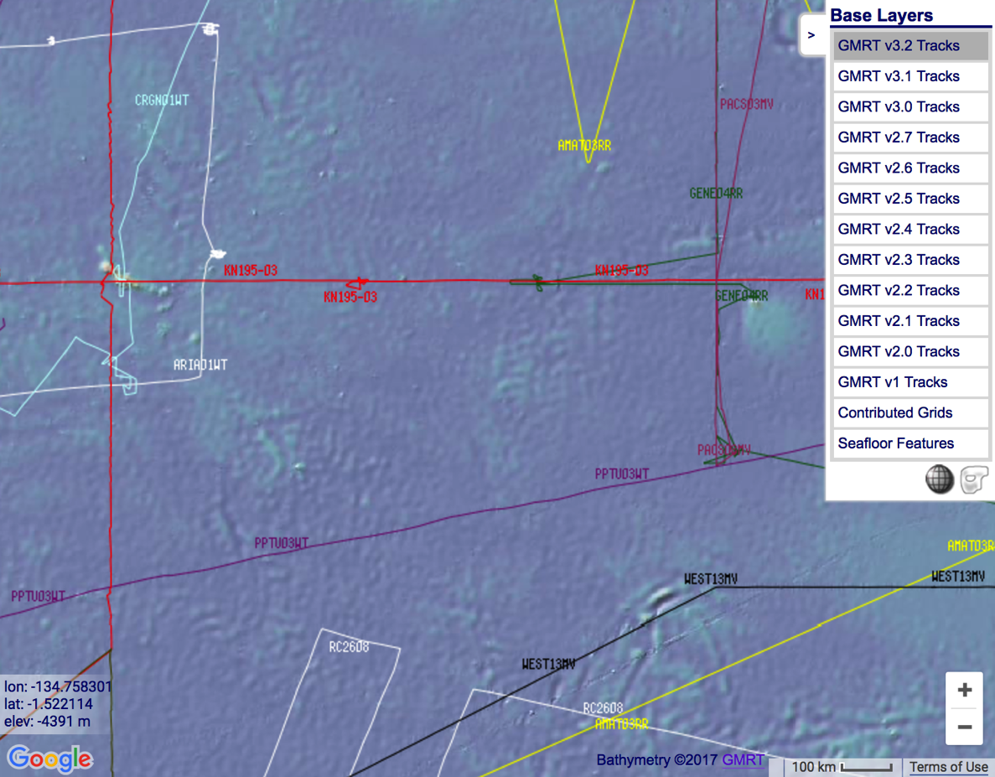
http://www.marine-geo.org/portals/gmrt/
Most Earth seafloor “bathymetry” is actually inferred from constraints on gravity!
gaps between tracks: bathymetry
inferred from altimetry→ gravity
gaps
are
large!
sonar bathymetry

Slide 10
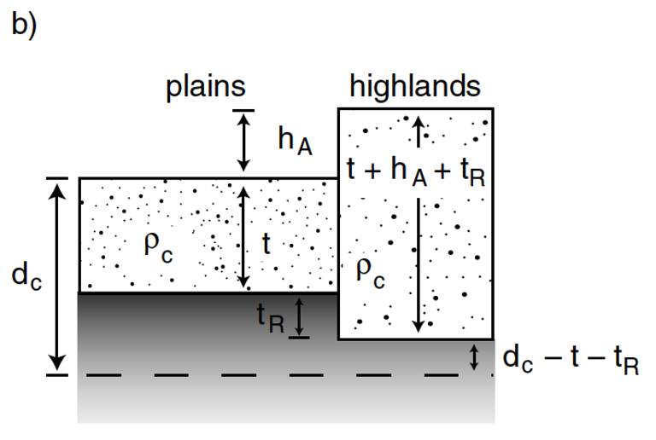
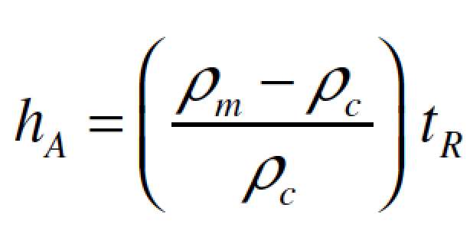
Airy isostasy (floating)
Free-air gravity anomaly is negligibly small for loads small compared to planet radius

Slide 11
Switch to chalkboard

Slide 12
How is topography supported?
EXPECTATIONS AND OBSERVATIONS: BOUGUER GRAVITY EQUATION, GRAVITY-TOPOGRAPHY CORRELATION, ADMITTANCE
MECHANISMS: AIRY ISOSTASY, FLEXURE
(MEMBRANE STRESSES)
APPLICATIONS: DENSITY/POROSITY; INFERENCE OF BURIED OCEANS; STRENGTH
→ HEAT FLOW → THERMAL HISTORY

Slide 13
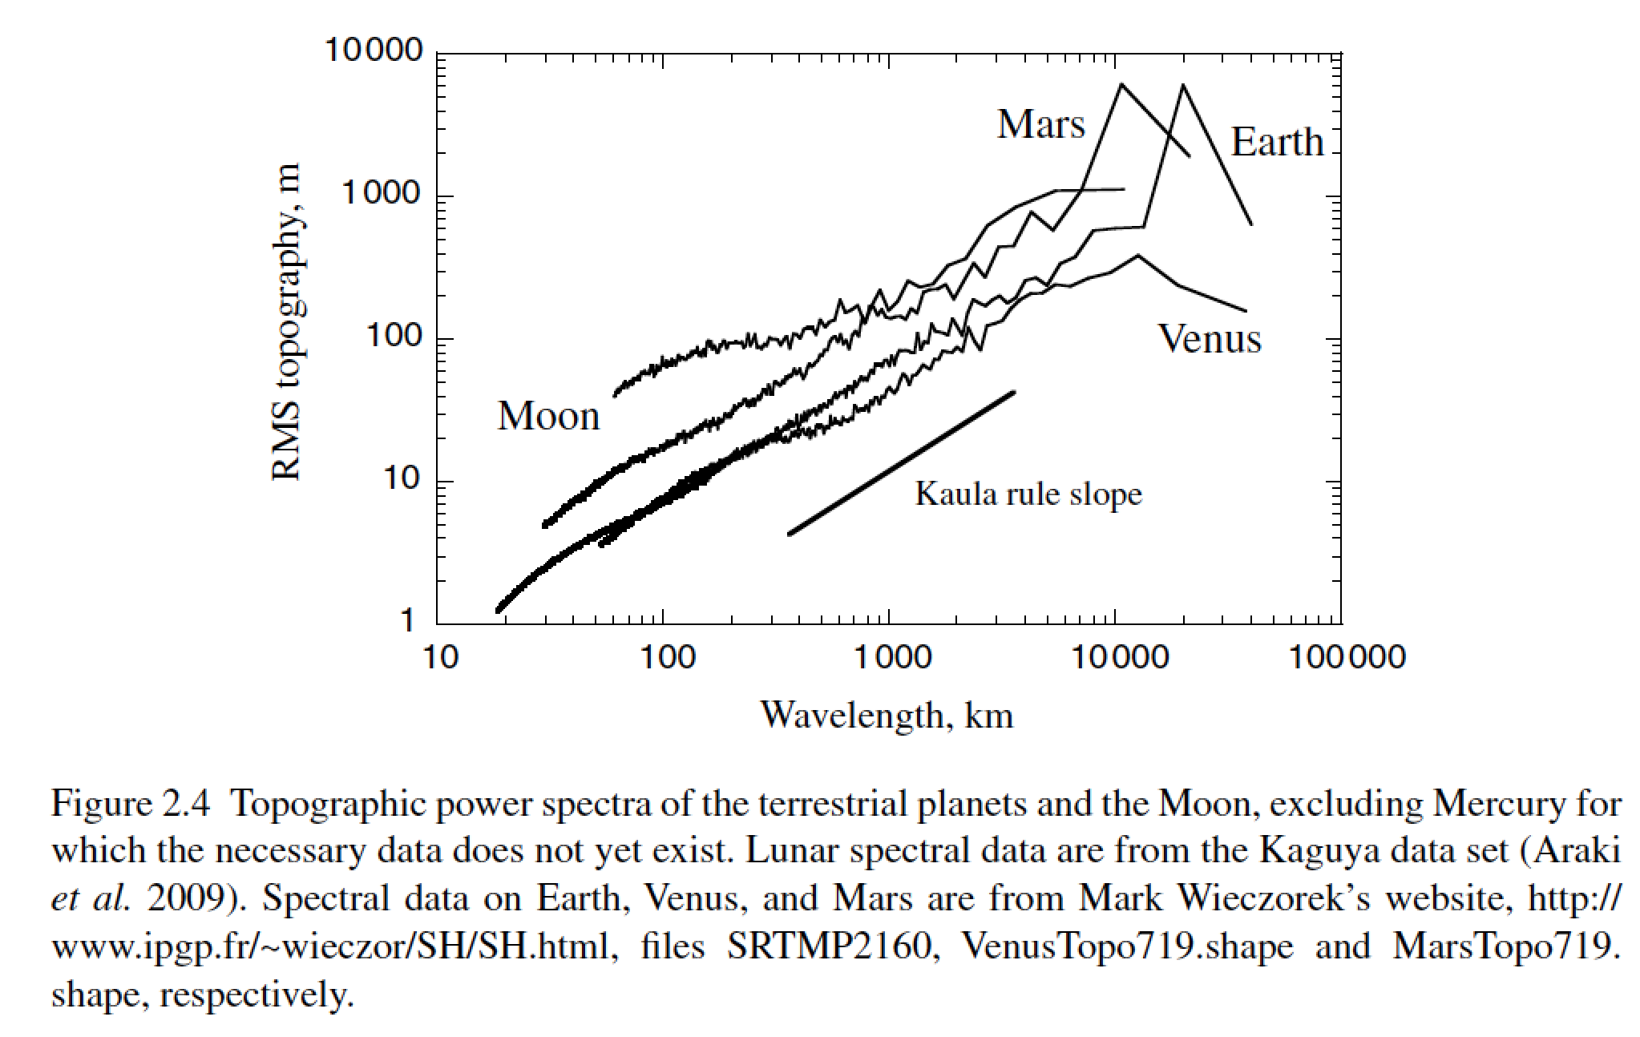
Unsolved theory problem (Rosenberg, Aharonson & Sari, JGR 2015)
Matern functions? (Simons et al. AGU 2015)

Slide 14
How is topography supported?
WRAP-UP TRUE POLAR WANDER FROM LECTURE 2
REVIEW REQUIRED READING (CHAPTER 2 IN MELOSH)
_____________________________________________________________
EXPECTATIONS AND OBSERVATIONS: BOUGUER GRAVITY EQUATION, GRAVITY-TOPOGRAPHY CORRELATION, ADMITTANCE
MECHANISMS: AIRY ISOSTASY, FLEXURE
(MEMBRANE STRESSES)
APPLICATIONS: DENSITY/POROSITY; INFERENCE OF BURIED OCEANS; STRENGTH → HEAT FLOW → THERMAL HISTORY

Slide 15
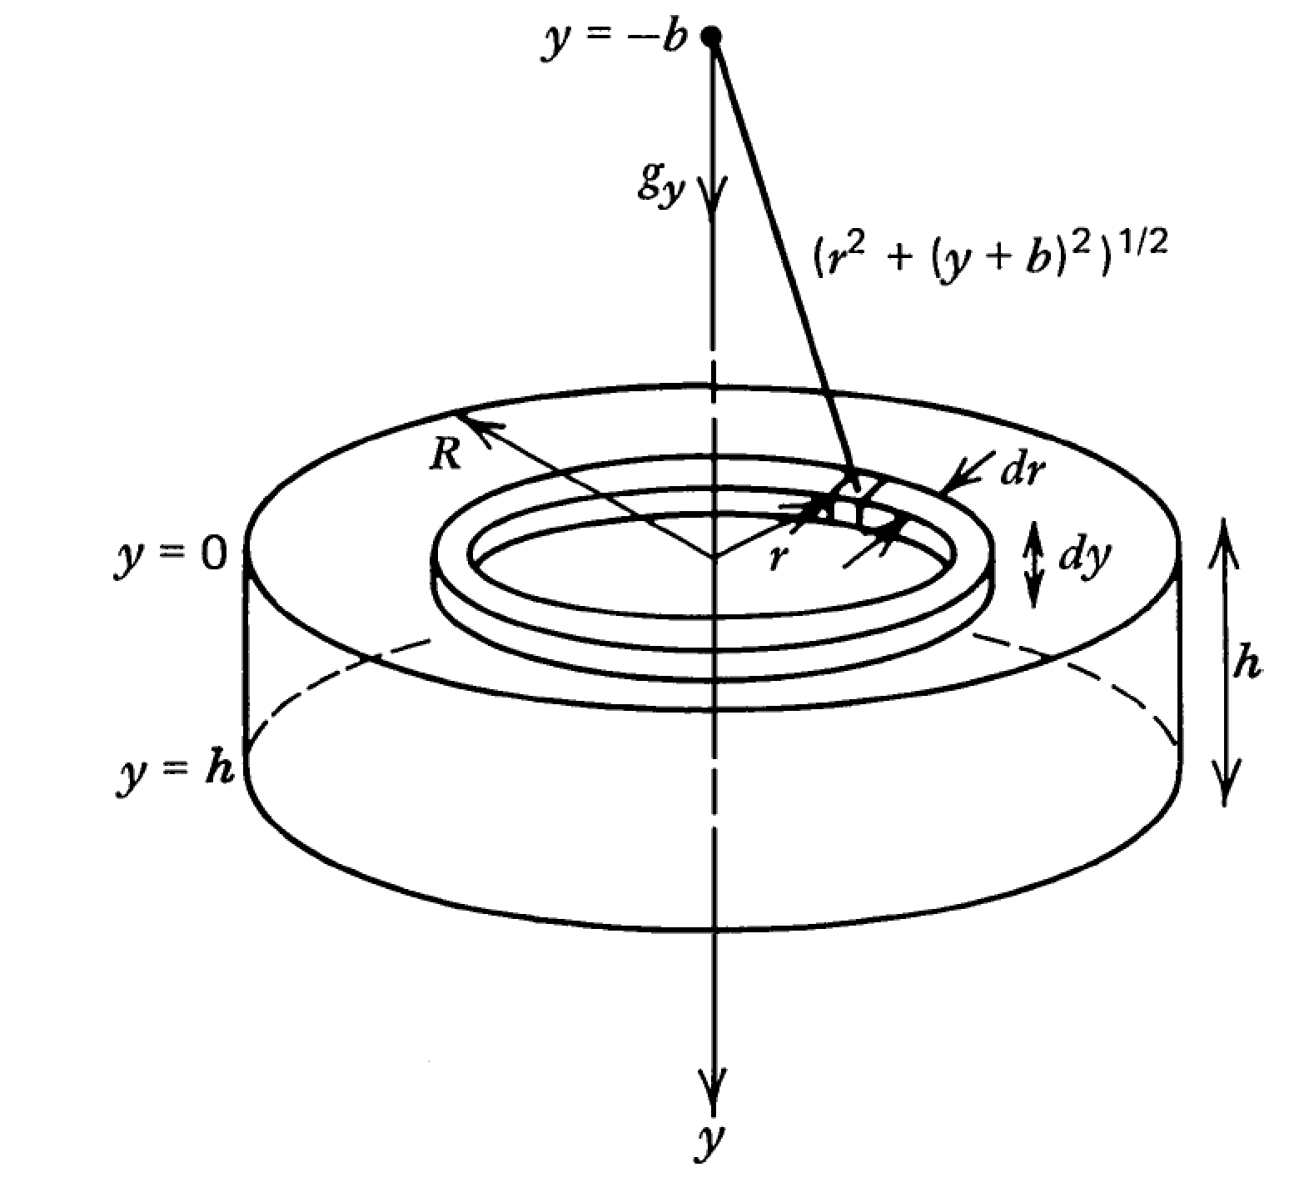

Slide 16
Following Turcotte & Schubert (2nd edn):

Slide 17
Example: map underwater volcanoes from space
Wessel et al. Oceanography 2010
Smith & Sandwell 1997

Slide 18
http://www.marine-geo.org/portals/gmrt/
Most Earth seafloor “bathymetry” is actually inferred from constraints on gravity!
gaps between tracks: bathymetry
inferred from altimetry→ gravity
gaps
are
large!
sonar bathymetry

Slide 19
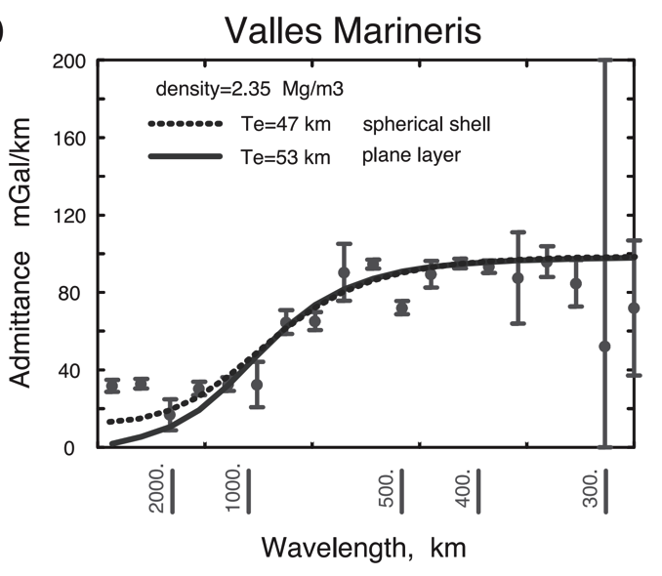
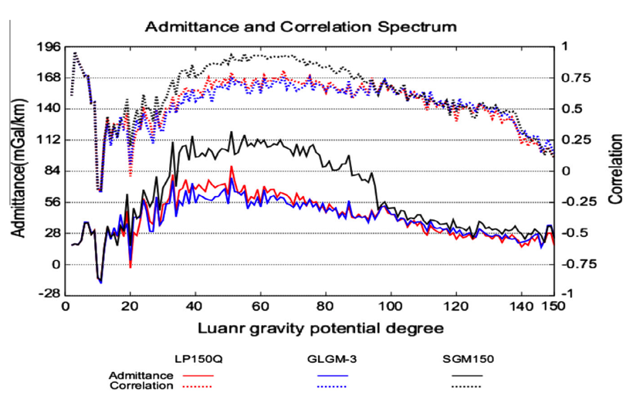
Different worlds show similar behavior in gravity-topography ratio (“admittance”) as a function of wavelength
2πGρΔz
Moon
Mars
Admittance is sometimes calculated using “Bouguer gravity”, gravity that
has been corrected for mass of topography
In this course we only use “free-air gravity” (uncorrected for topography).

Slide 20
How is topography supported?
WRAP-UP TRUE POLAR WANDER FROM LECTURE 1
REVIEW REQUIRED READING (CHAPTER 2 IN MELOSH)
_____________________________________________________________
EXPECTATIONS AND OBSERVATIONS: BOUGUER GRAVITY EQUATION, GRAVITY-TOPOGRAPHY CORRELATION, ADMITTANCE
MECHANISMS: AIRY ISOSTASY, FLEXURE
(MEMBRANE STRESSES)
APPLICATIONS: DENSITY/POROSITY; INFERENCE OF BURIED OCEANS; STRENGTH → HEAT FLOW → THERMAL HISTORY

Slide 21
Airy isostasy (floating)
Free-air gravity anomaly is negligibly small for loads small compared to planet radius

Slide 22
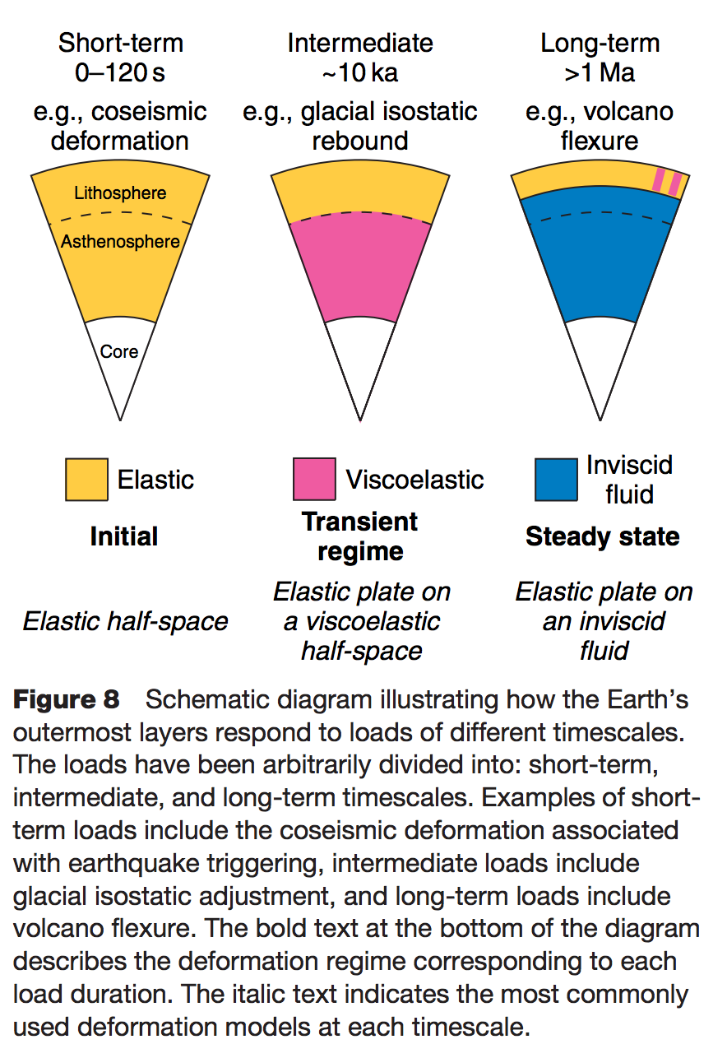
Definition of the lithosphere
elastic lithosphere
– supports loads over geologic time
separate from:
seismic lithosphere – permits earthquakes
thermal boundary layer
layer that is conductively affected
by the cold boundary condition of
the planet’s surface
Watts, in Treatise on Geophysics
(1st edn.), 2007

Slide 23
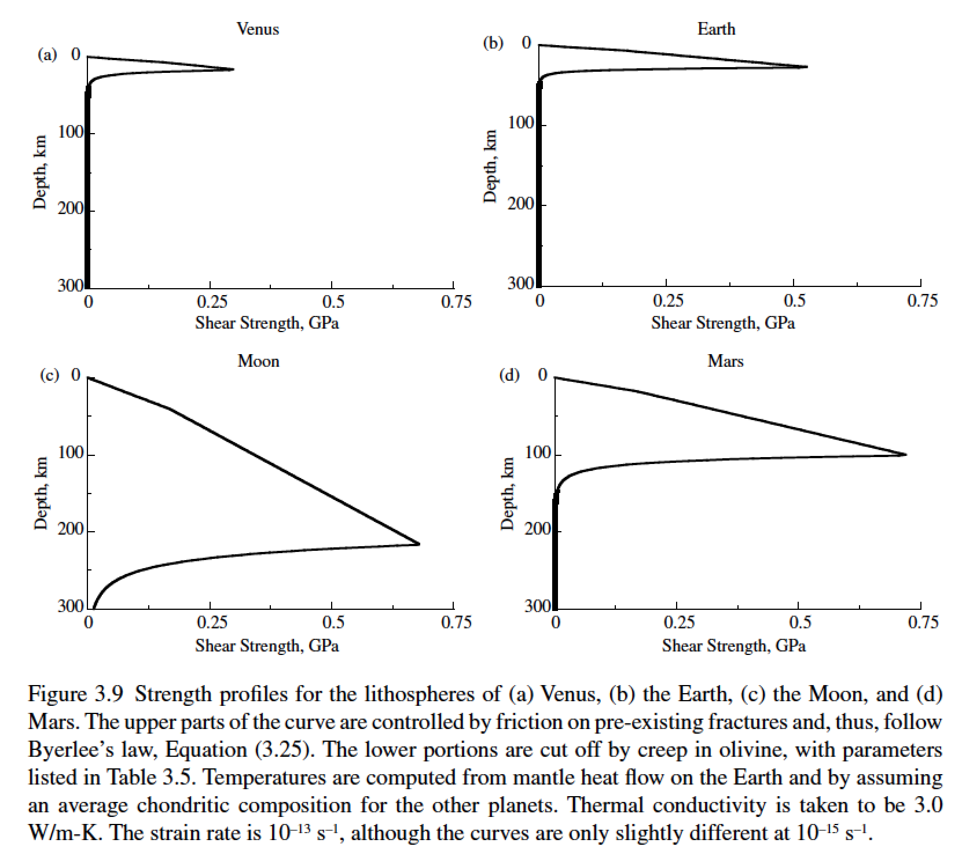
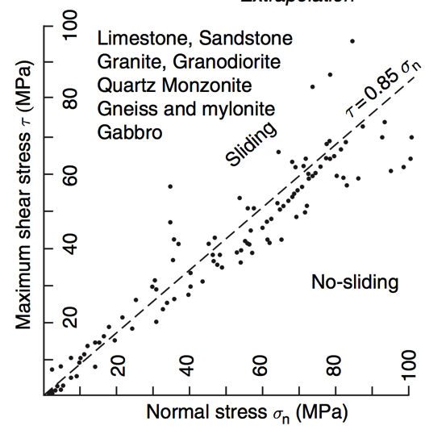
Lithosphere: strength versus depth
g=8.9 m s⁻²
g=9.8 m s⁻²
g=1.6 m s⁻²
g=3.7 m s⁻²
Byerlee’s law

Slide 24
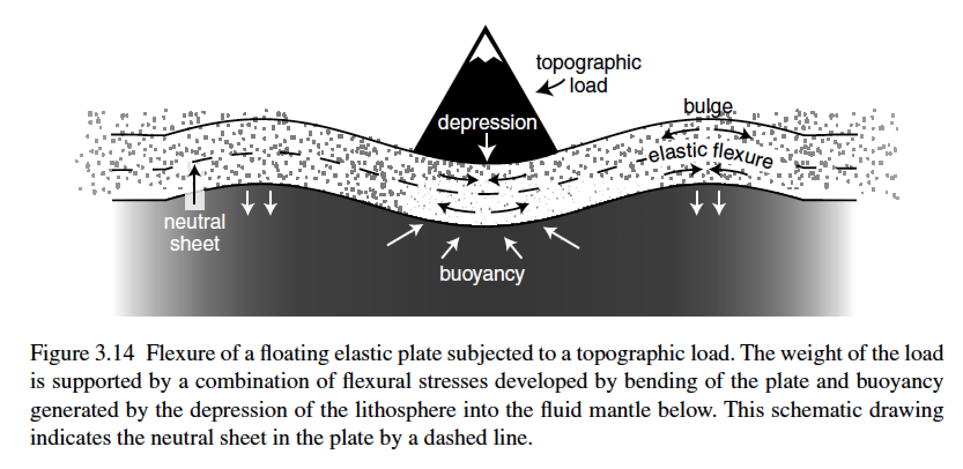
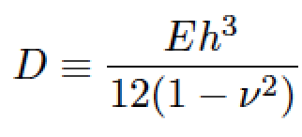
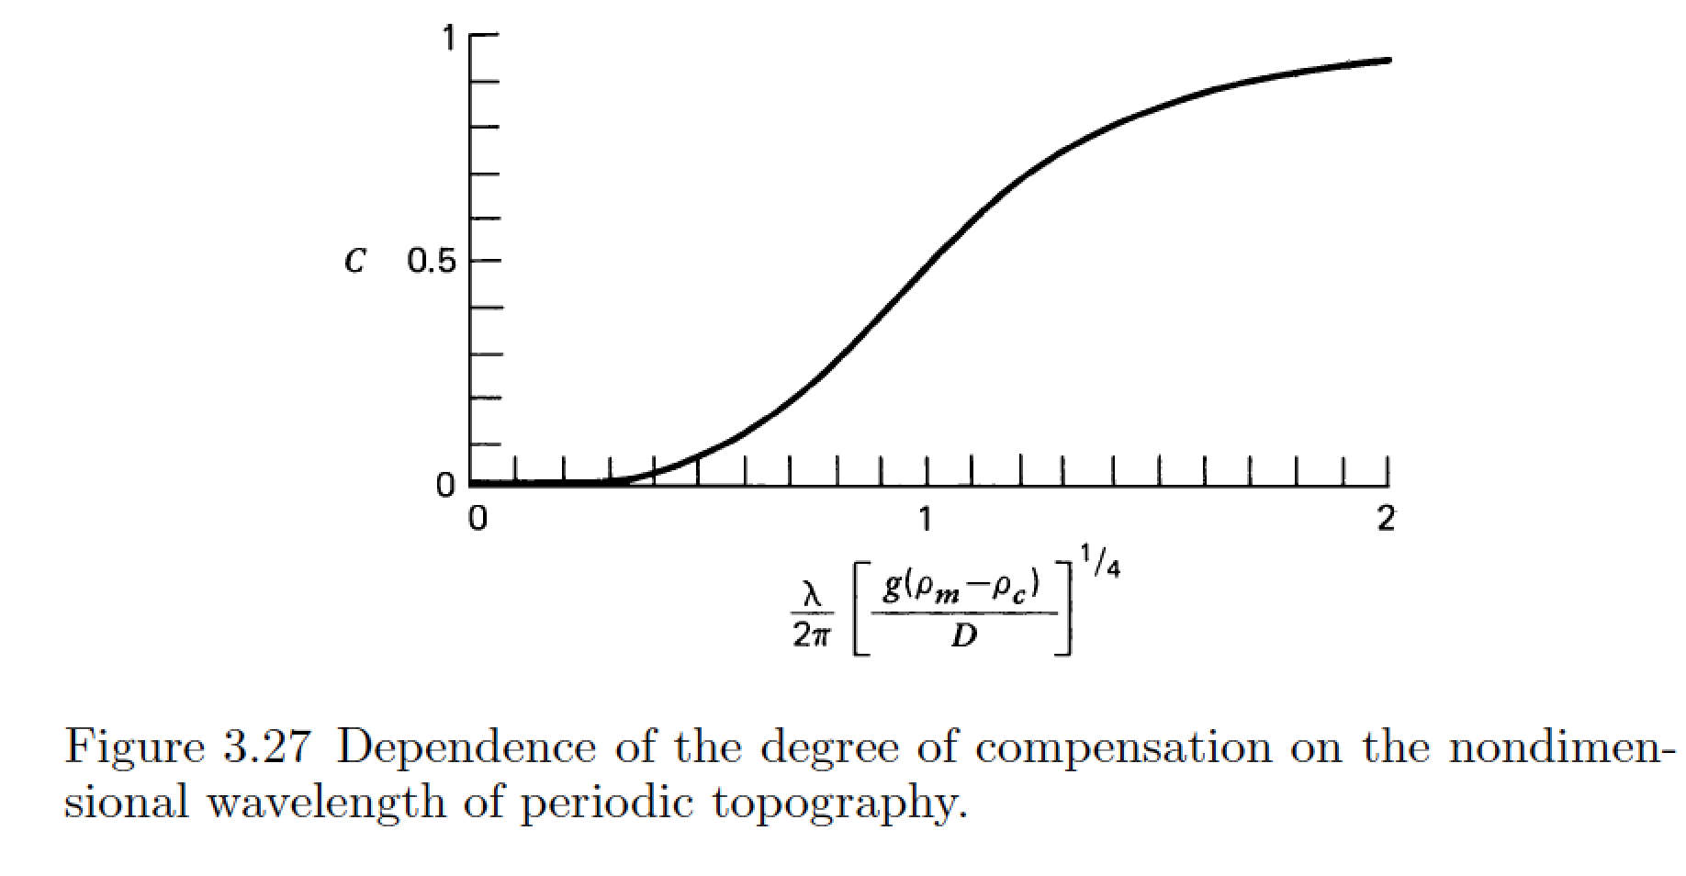
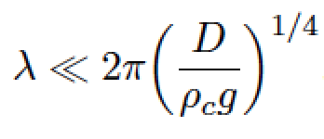
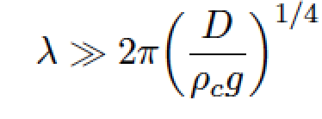
stiffness (Pa, N m⁻²)
Young’s modulus
elastic thickness (m)
Poisson’s ratio (0.25 – 0.33, dimensionless)
flexural rigidity (N m)
compensation, c
Compensation curves
can be used to constrain
D
wavelength (m)
m = [ (kg m s⁻²)/(kg m⁻³ × m s⁻²) ]^{1/4}

Slide 25
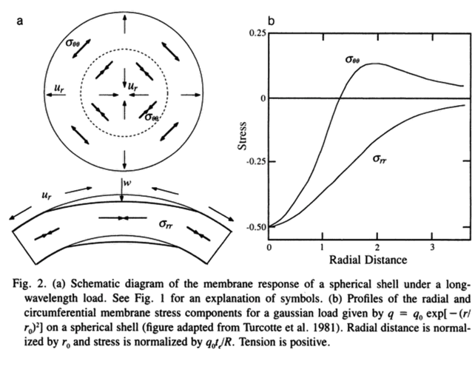
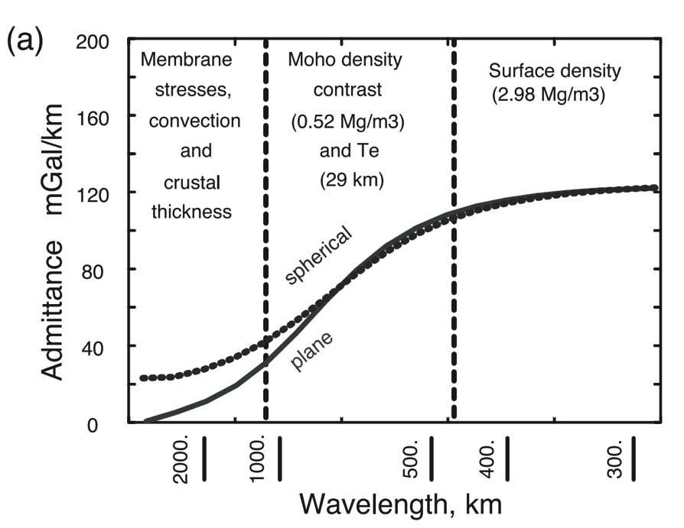
A different technique is needed for loads with wavelength comparable to the radius of the planet (consider membrane stresses)
Banerdt et al., ch. in
Kieffer et al. (eds). “Mars”, 1992
McKenzie et al. EPSL 2002

Slide 26
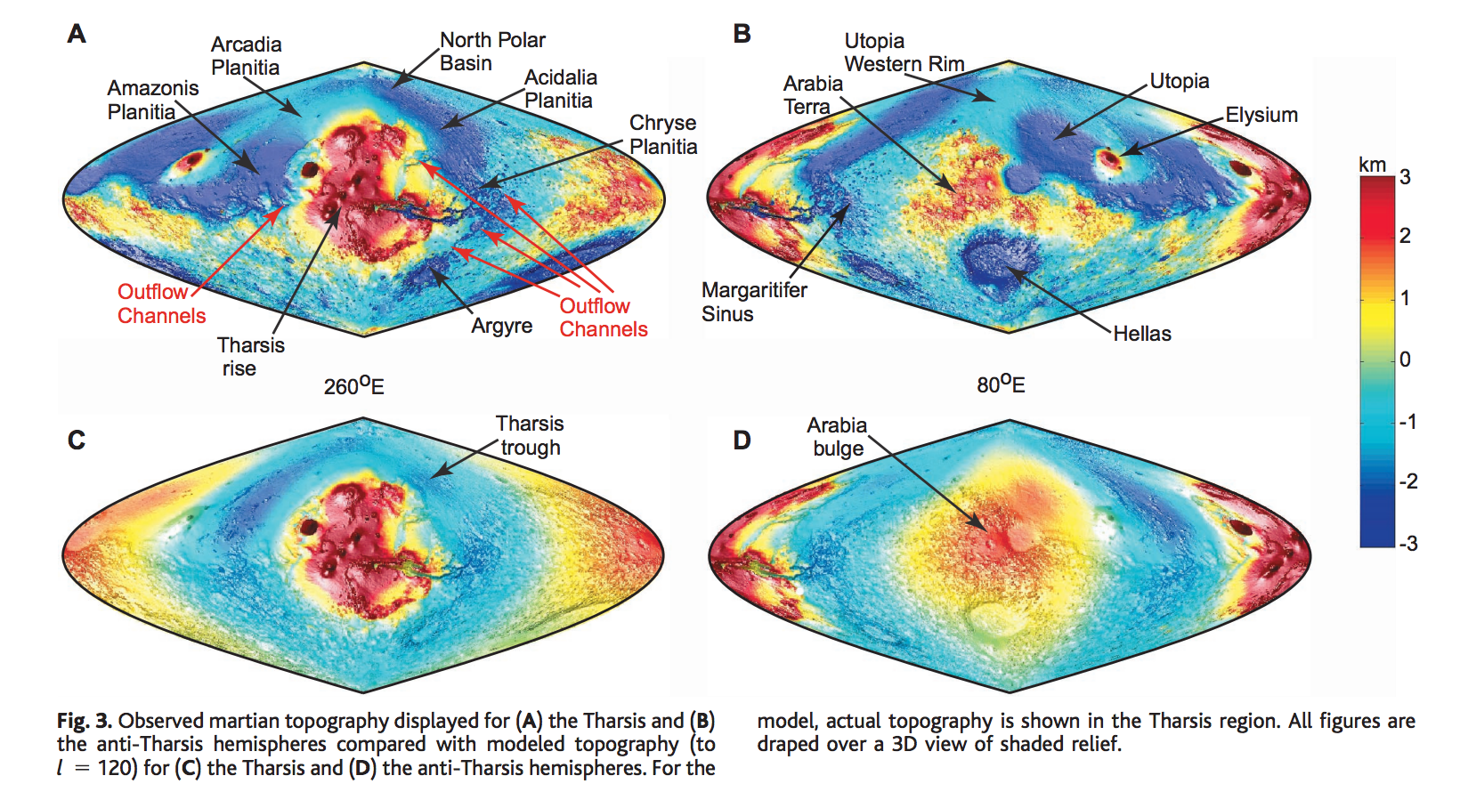
Membrane support example: Tharsis (volcanic province) load on Mars
Phillips et al. Science 2001

Slide 27
How is topography supported?
WRAP-UP TRUE POLAR WANDER FROM LECTURE 1
REVIEW REQUIRED READING (CHAPTER 2 IN MELOSH)
_____________________________________________________________
EXPECTATIONS AND OBSERVATIONS: BOUGUER GRAVITY EQUATION, GRAVITY-TOPOGRAPHY CORRELATION, ADMITTANCE
MECHANISMS: AIRY ISOSTASY, FLEXURE
(MEMBRANE STRESSES)
APPLICATIONS: DENSITY/POROSITY; INFERENCE OF BURIED OCEANS; STRENGTH → HEAT FLOW → THERMAL HISTORY

Slide 28
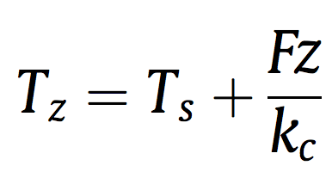
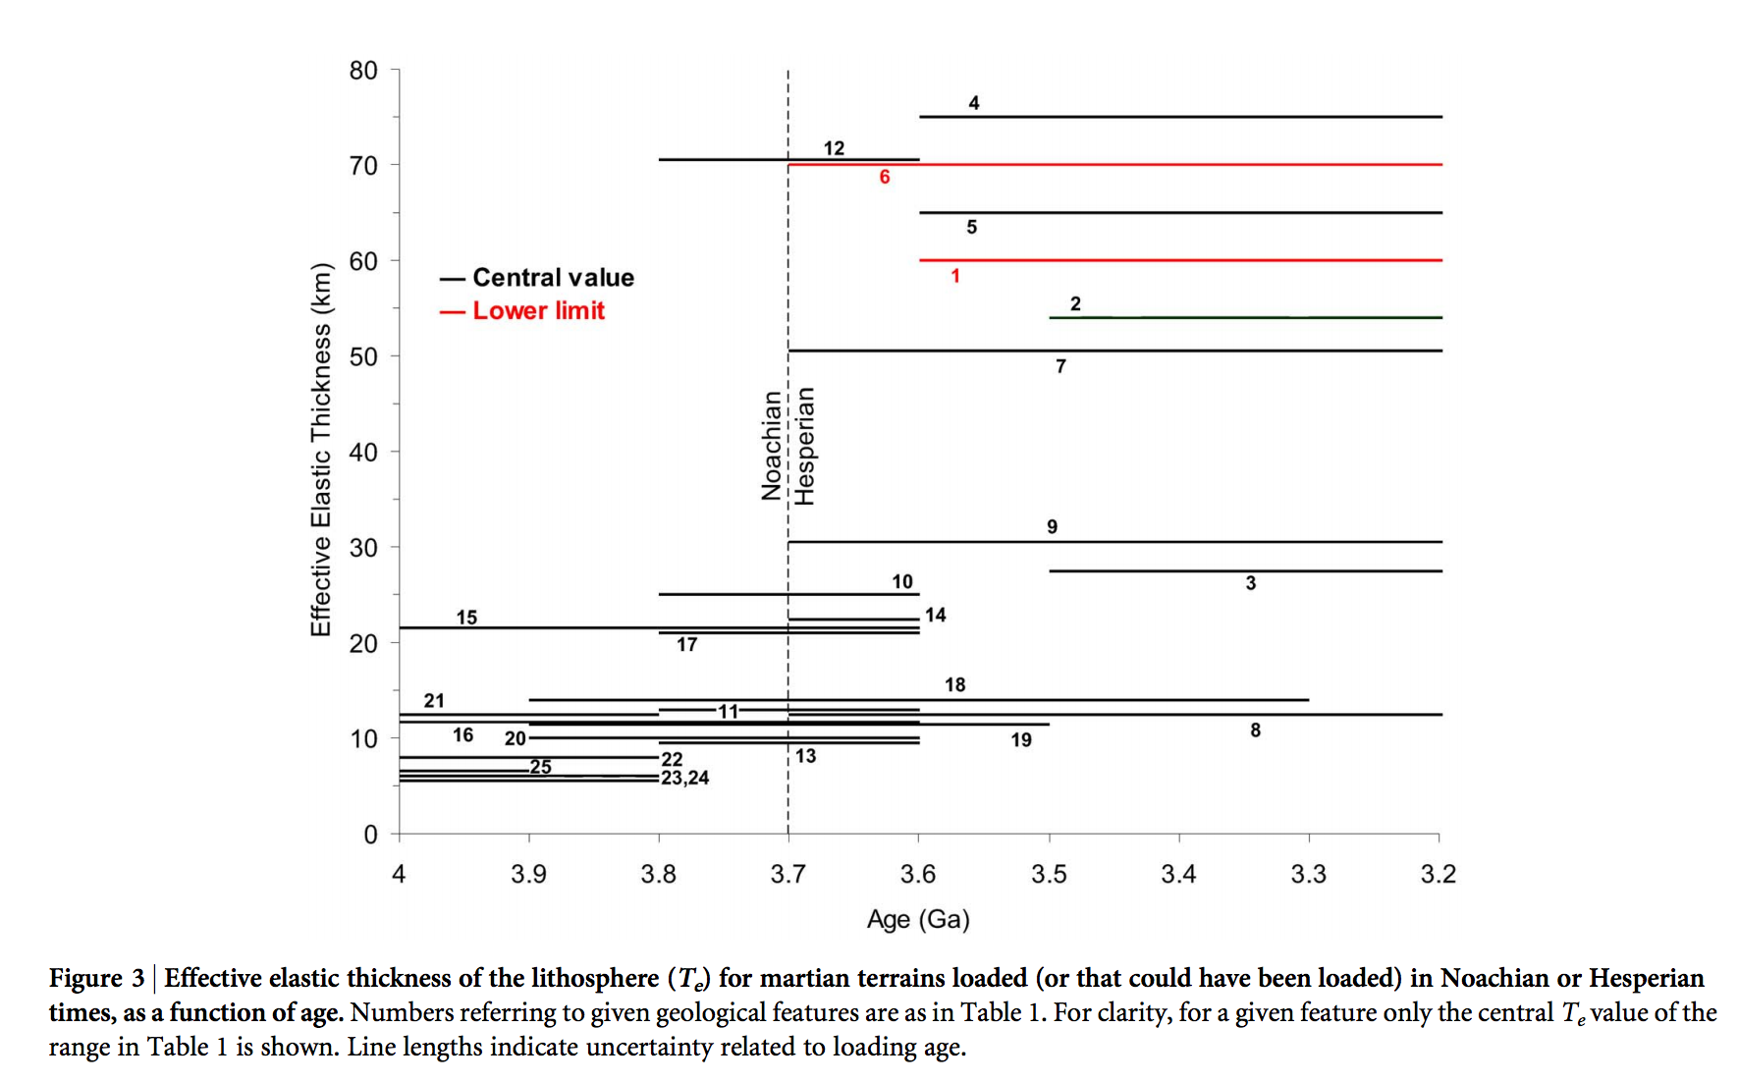
Thermal history of Mars
heat flow (W m⁻²)
depth(m)
Base of elastic lithosphere corresponds to T ~ 550-600 C
(McNutt, JGR, 1984)
thermal
conductivity
(W m⁻¹ K⁻¹)
surface T(K)
Major reduction
in Mars’ geothermal
heat flow at around
the time that the
surface was drying out.
Ruiz et al., Nature Scientific Reports, 2014

Slide 29
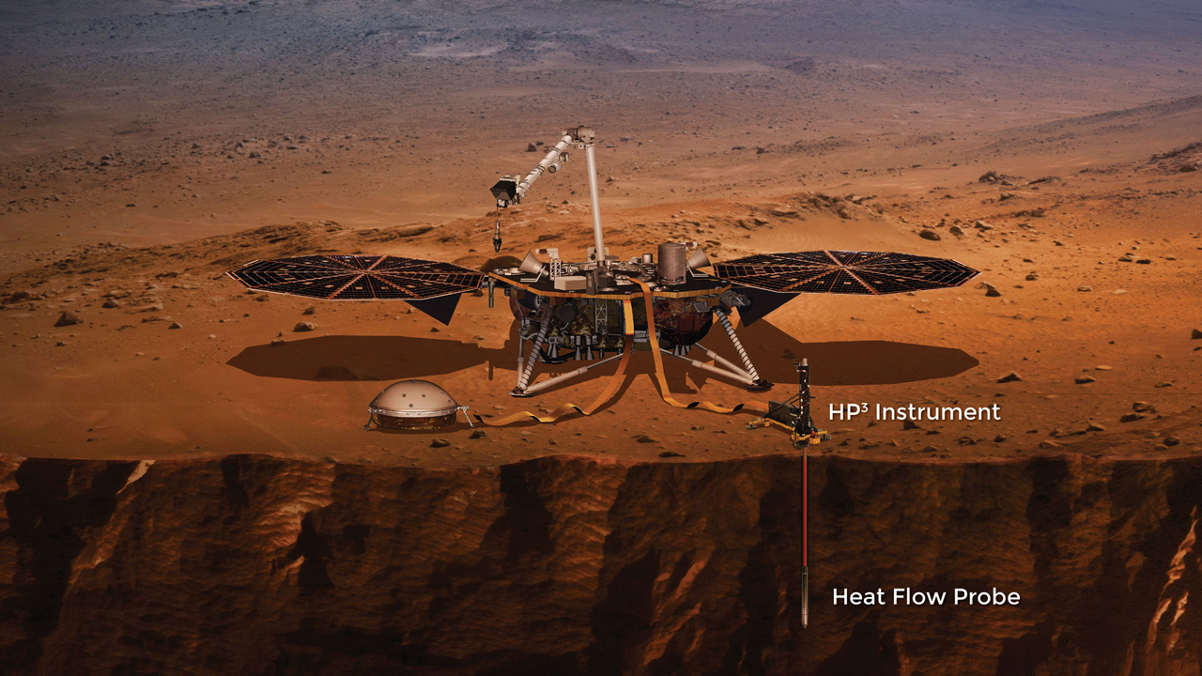

Slide 30
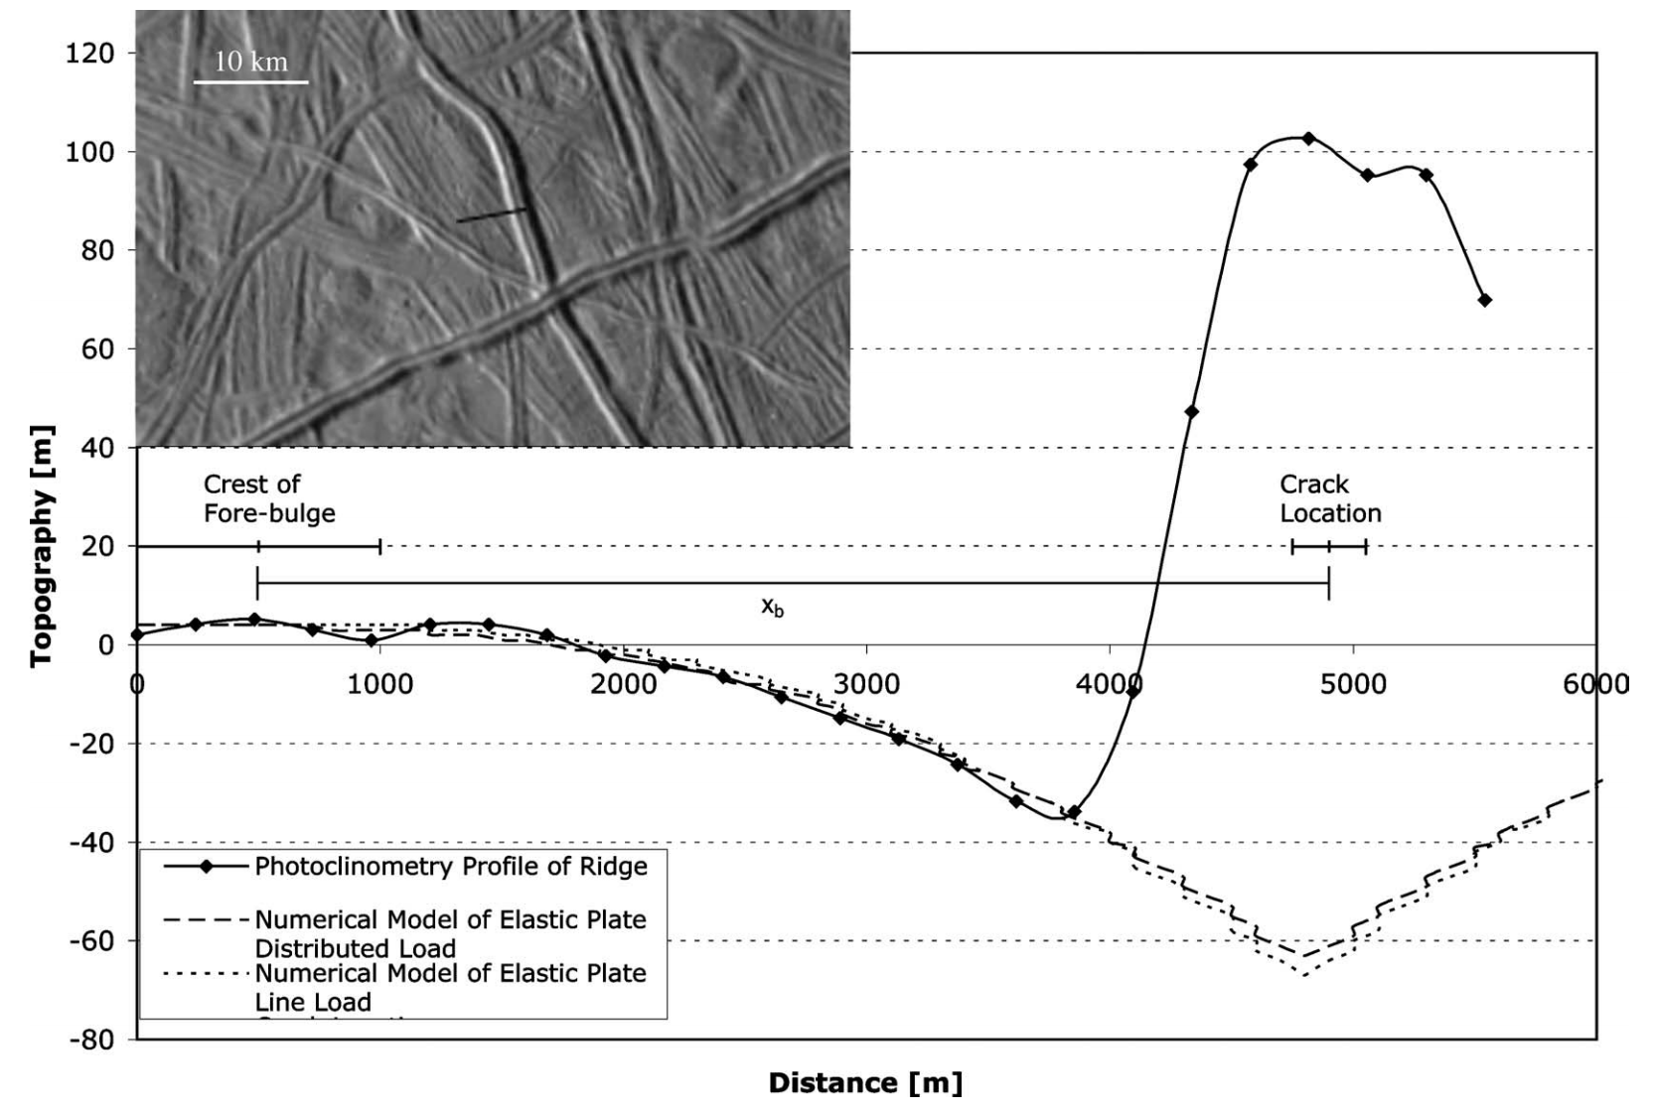
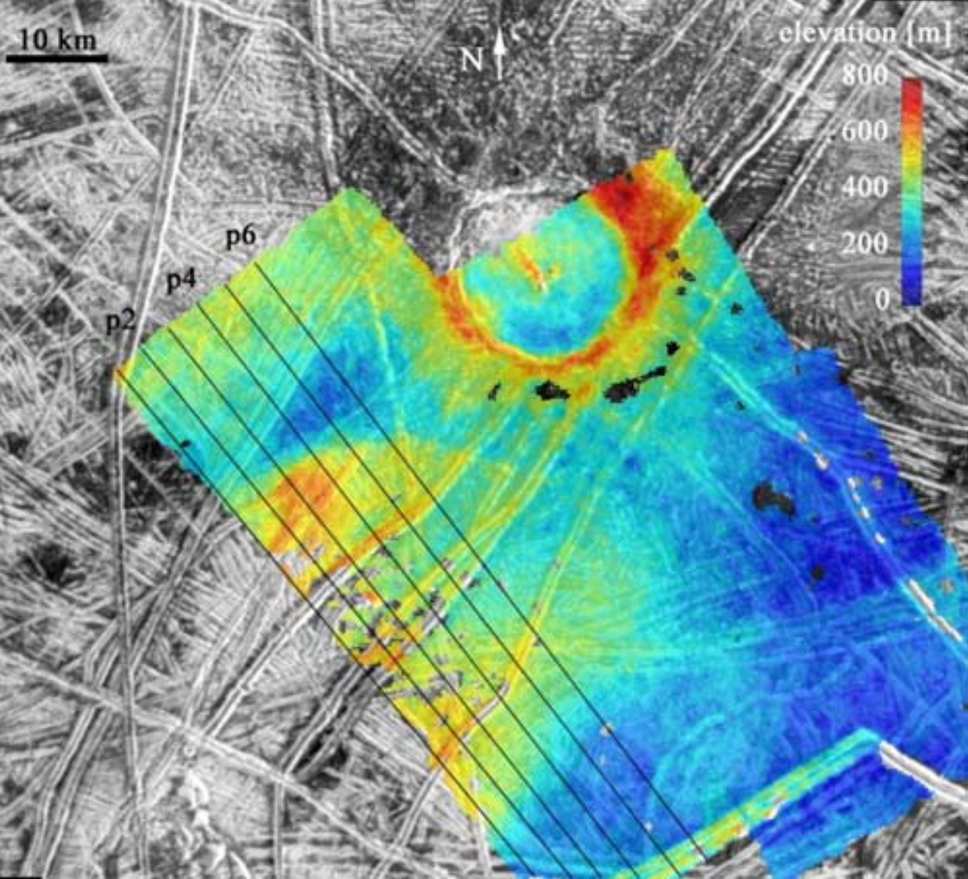
Inferring oceans on Europa
Hurford et al. Icarus 2005
Billings & Kattenhorn Icarus 2005
Elastic thickness is
small
Ice is soft and warm at
shallow depths
(From Europa’s overall
density) water substance
persists to great depth
Most of the water is
very warm and likely
liquid

Slide 31
Key points: topography versus gravity
Relationship between topography & gravity at length scales much larger than, comparable to, and much smaller than, the lithospheric thickness.
Explanation of Airy isostasy
Quantities inferred from topography←→gravity comparison.
Next lecture: topography and tectonics.

