Slide 1
GEOS 28600
The science of landscapes:
Earth & Planetary Surface Processes
Lecture 18
Monday 9 March 2020
Methods in geomorphology → Titan

Slide 2
Count layers (tree rings, varves).
Optically stimulated luminescence.
Radiocarbon - ¹⁴C.
Spike of radioactive elements (e.g. tritium) associated with atmospheric nuclear testing.
Cosmogenic dating.
Fission track.
(U-Th)/He & other exhumation methods.
Shared event of known age.
The sedimentary record.

Slide 3
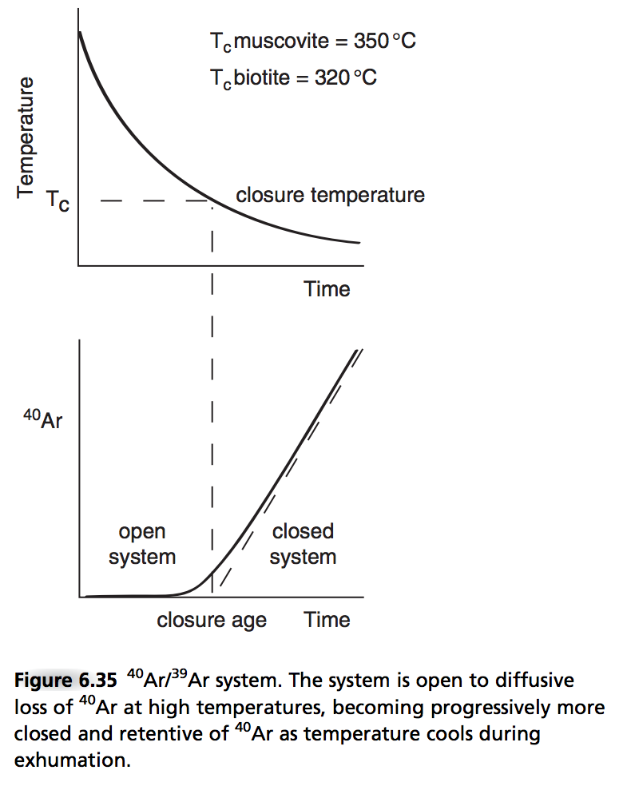
The meaning of “closure temperature”
Closure temperature varies
depending on what’s escaping,
and on what mineral it’s escaping
from.

Slide 4
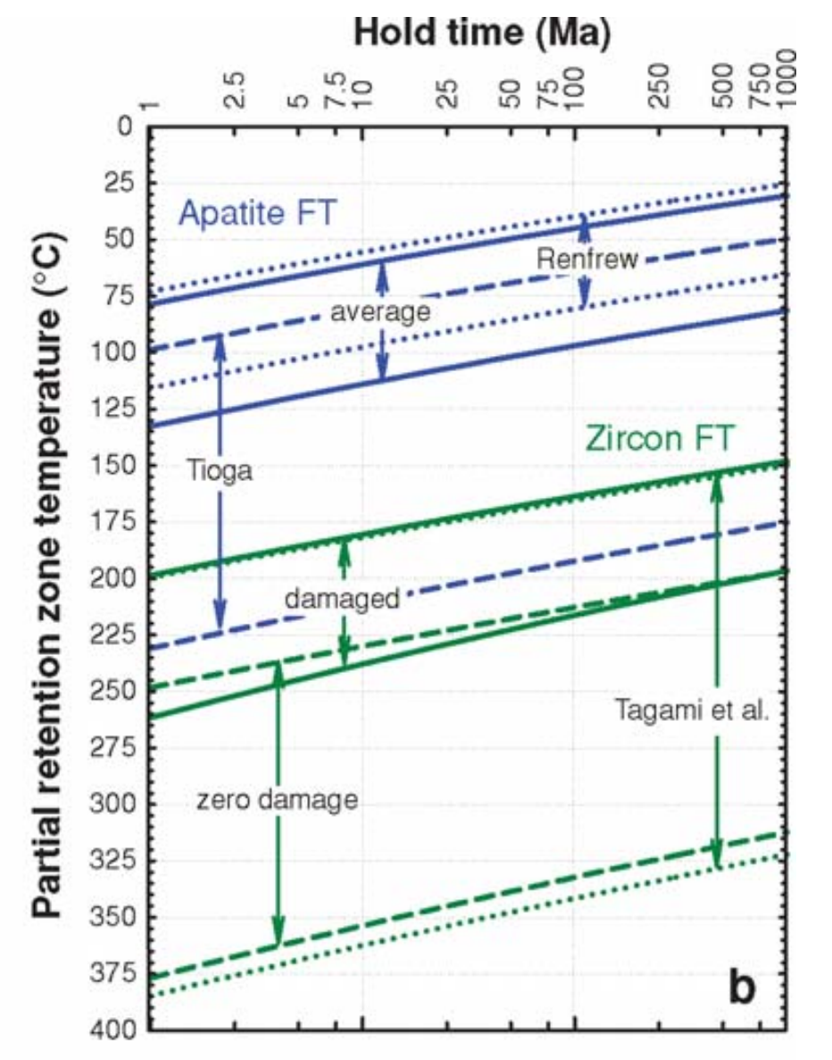
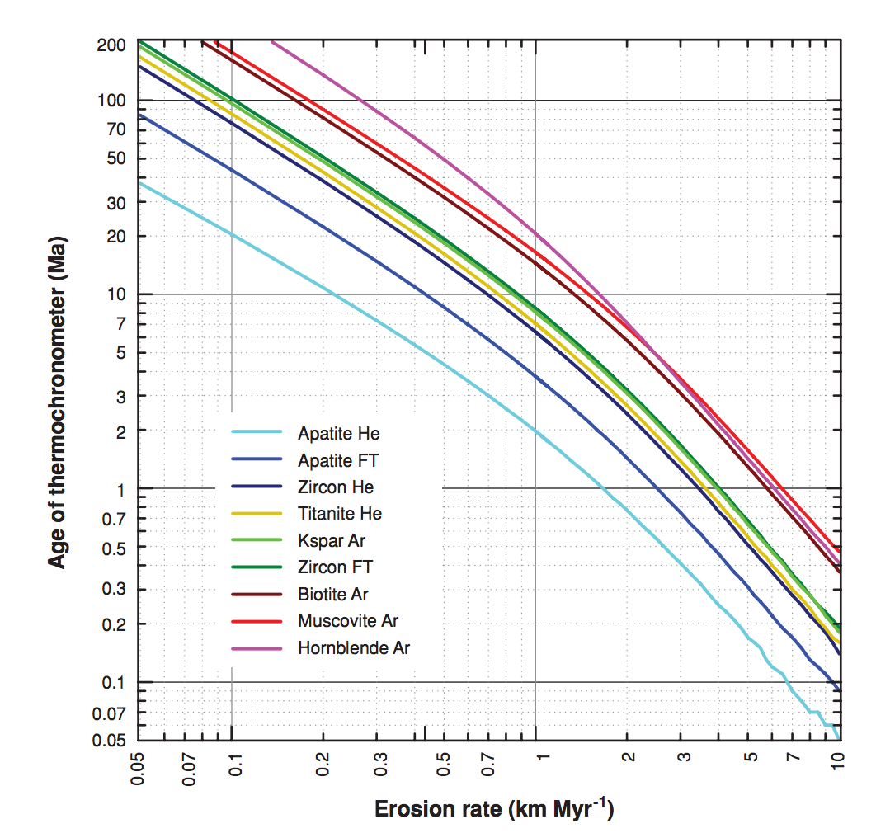
(6) Fission track.
why are these
not straight lines?
Mountain belt uplift:
Pe = L*u/kappa ~ 30 km*(1 mm/yr)/10⁻⁶ m²s⁻¹ ~ 1
Reiners & Brandon,
Annual Reviews 2006

Slide 5
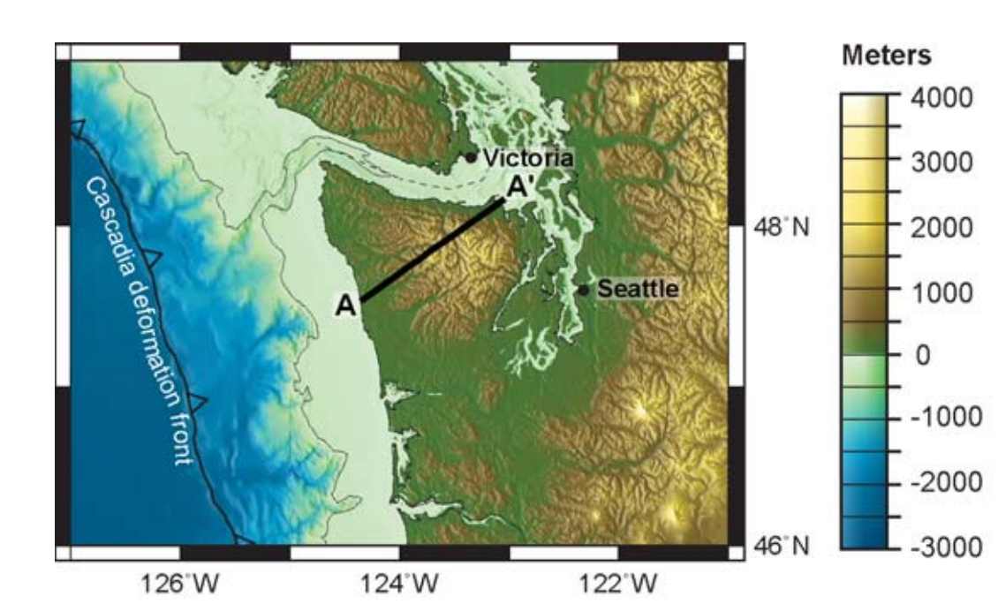
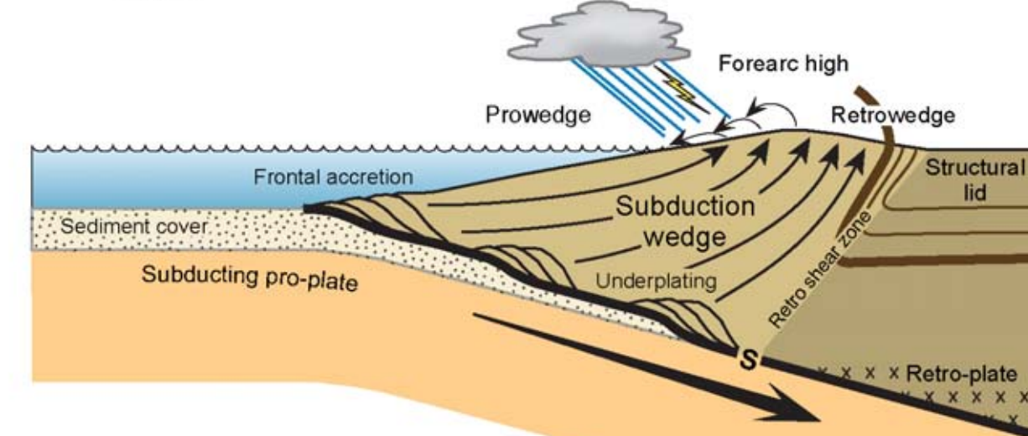
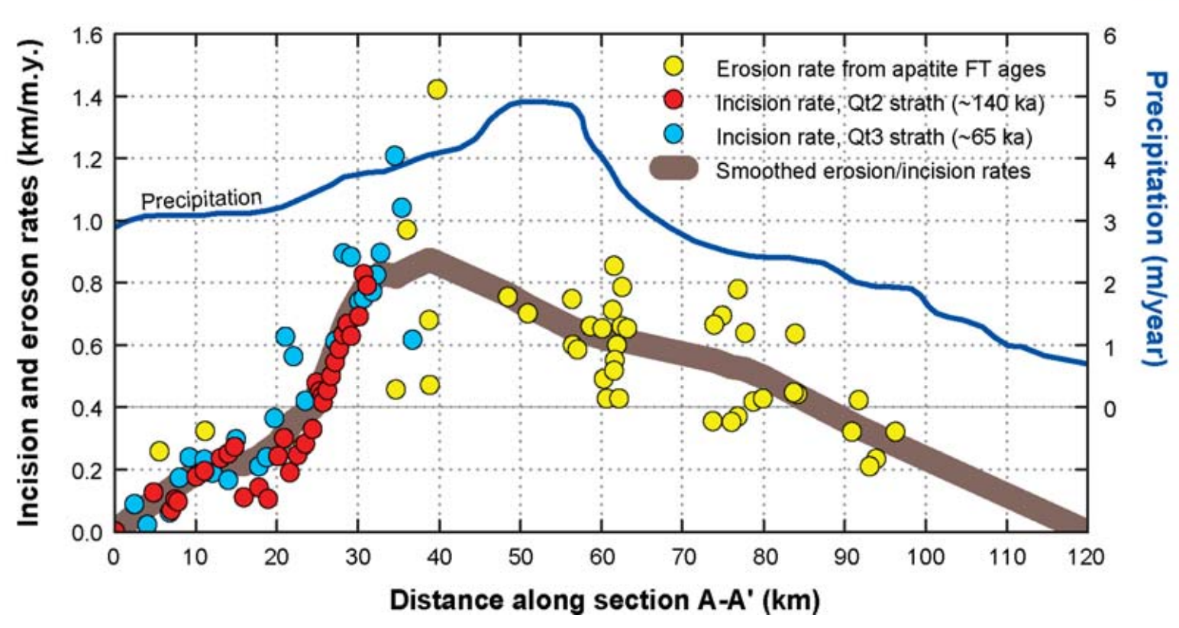
Example application: Olympic Peninsula
“strath” rates: uplift
of dated marine terraces

Slide 6
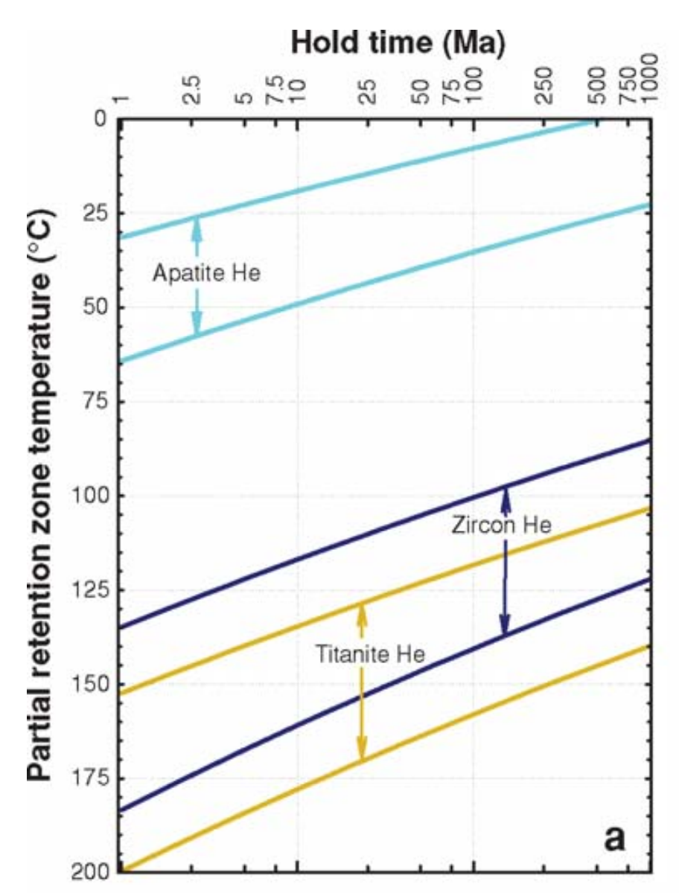
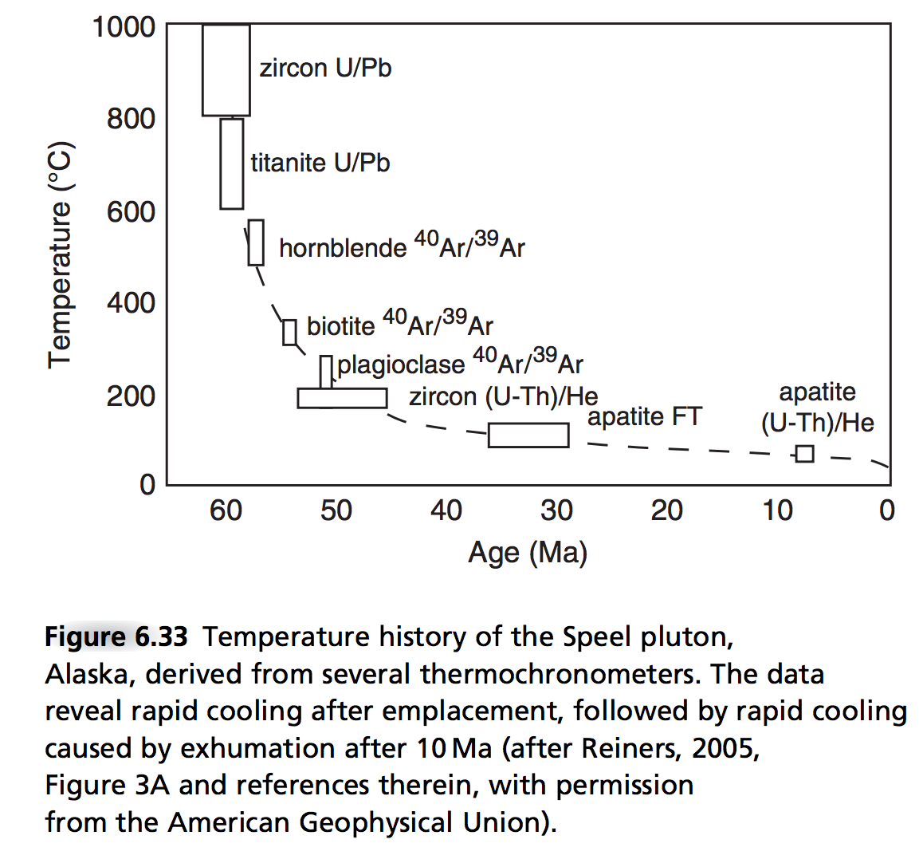
(7) (U-Th)/He & other exhumation methods.
Thermally activated
diffusive loss of
radiogenic ⁴He

Slide 7
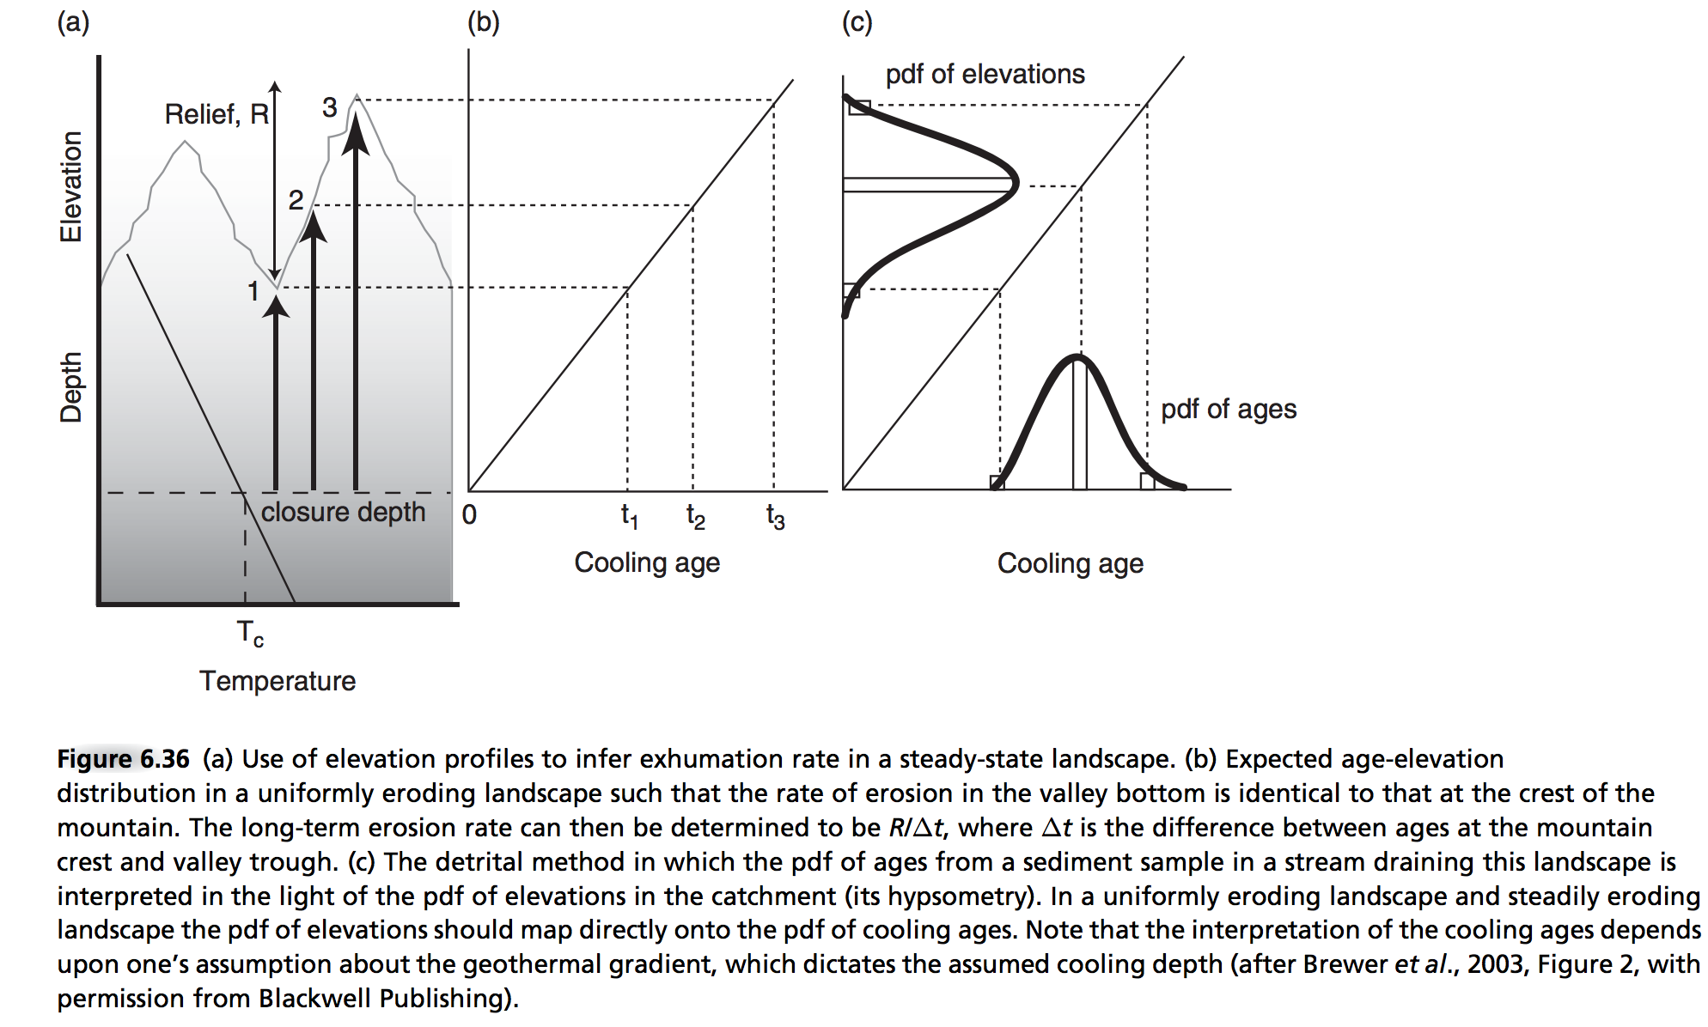
(7) - Detrital thermochronology
Enabling technology: ⁴⁰Ar/³⁹Ar ages of individual grains

Slide 8
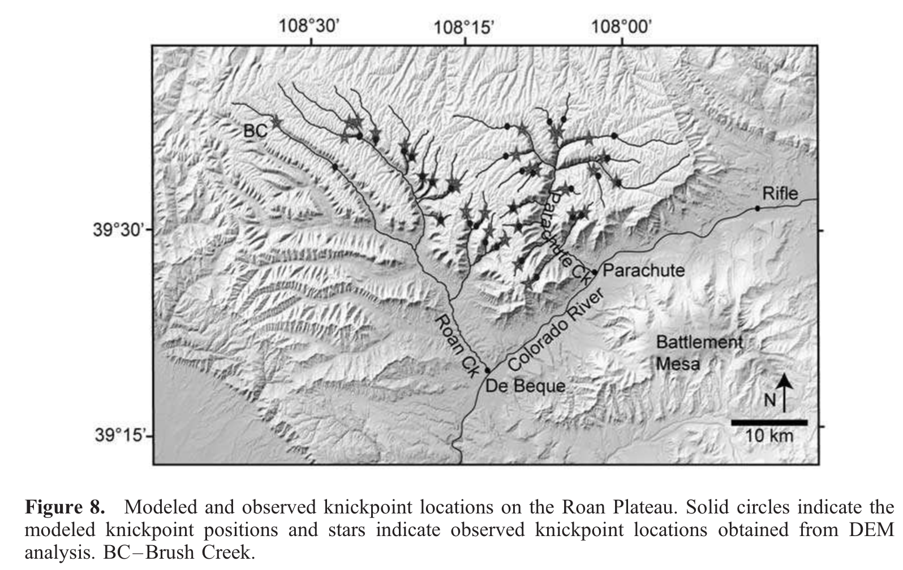
(8) Shared event of known age.
Berlin et al. JGR-Earth Surface, 2007
Example: Roan Plateau, NW Colorado:
8 Ma incision
by Colorado River
Test of streampower incision
model
See also Crosby & Whipple
JGR 2006.
Strengths: Natural experiment.
Weaknesses: Relative, not absolute method (though can be calibrated by other methods)
Age range of applicability: Unrestricted in principle; in practice, post-180 Ma
(for which ~complete plate reconstructions are available).

Slide 9
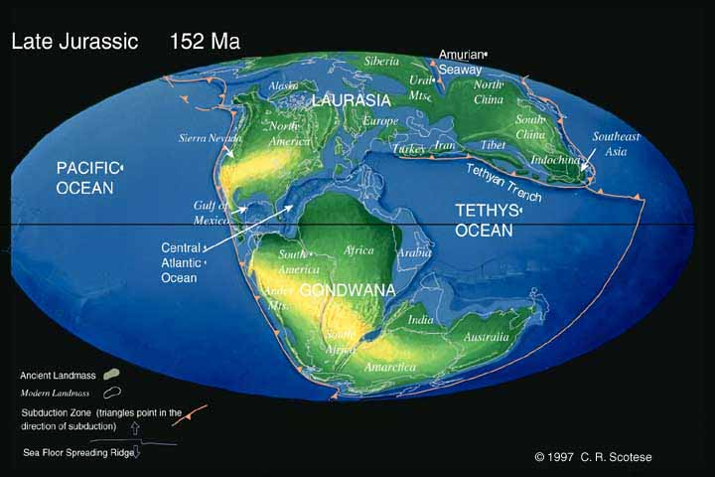
Gondwana rifting

Slide 10
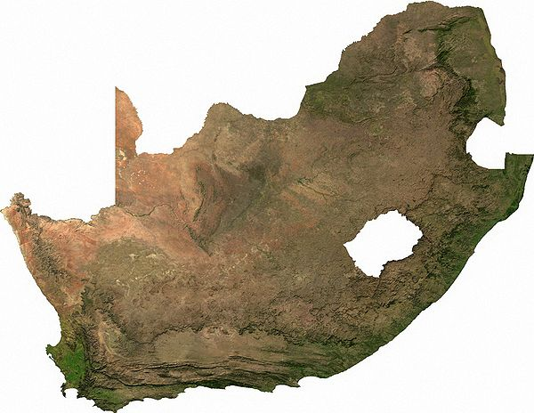
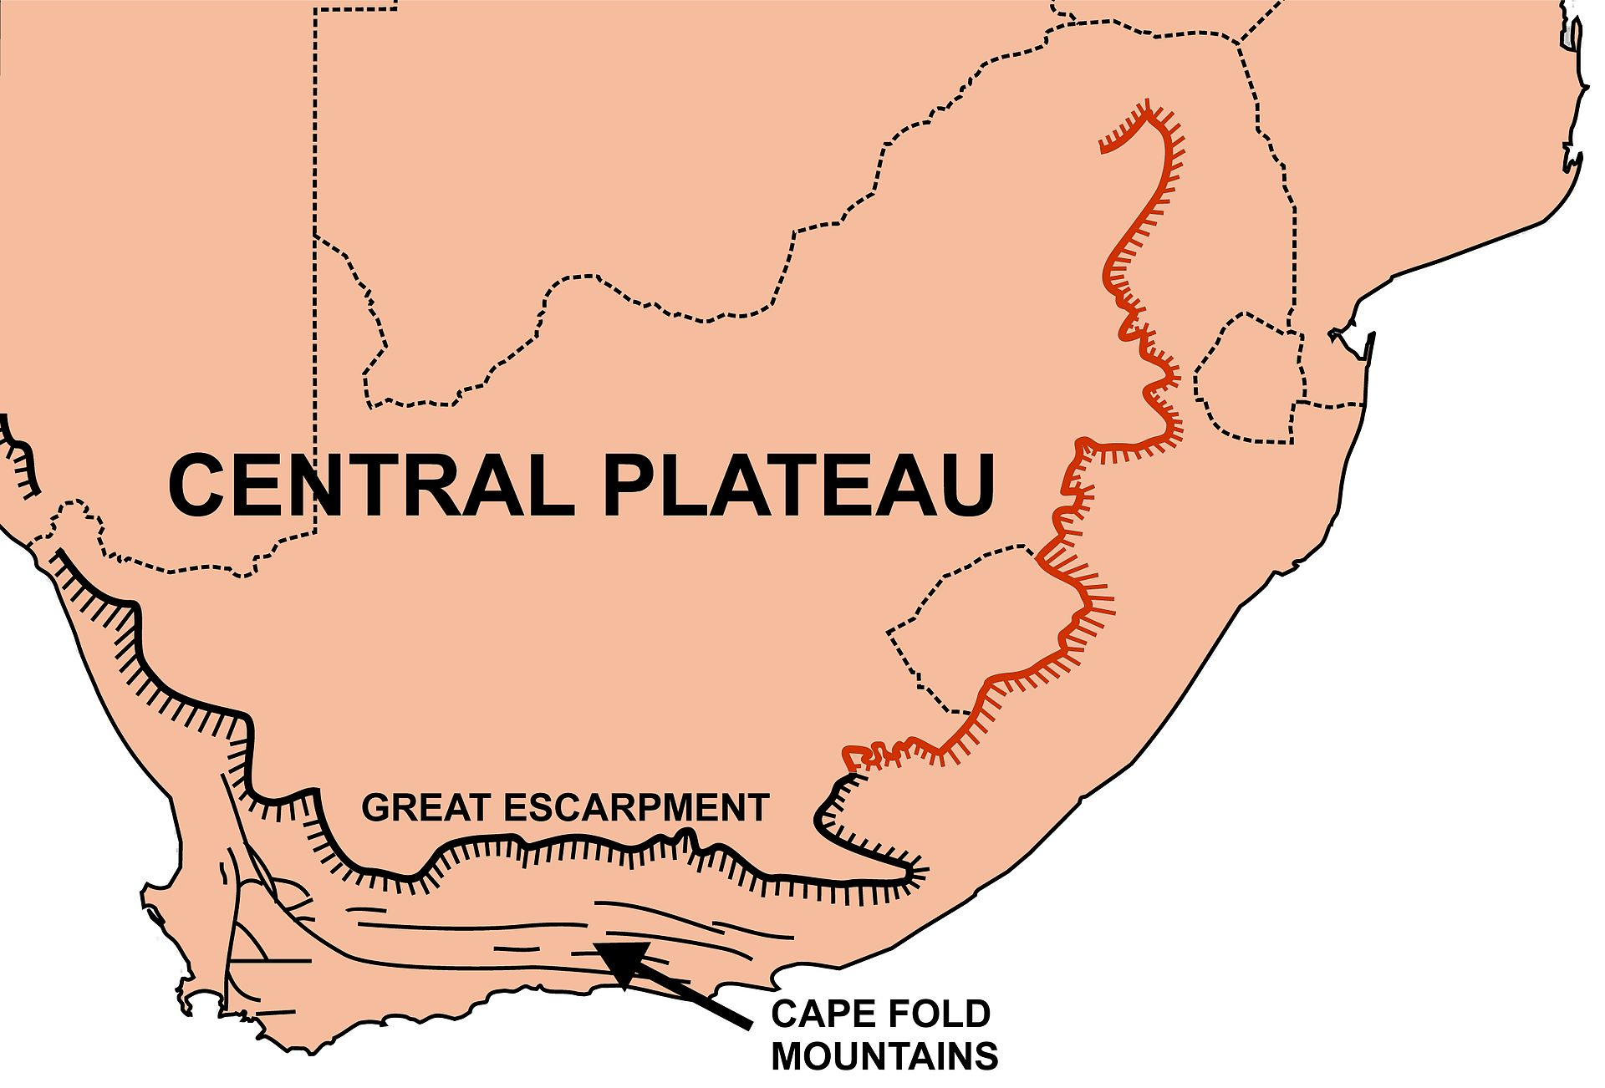
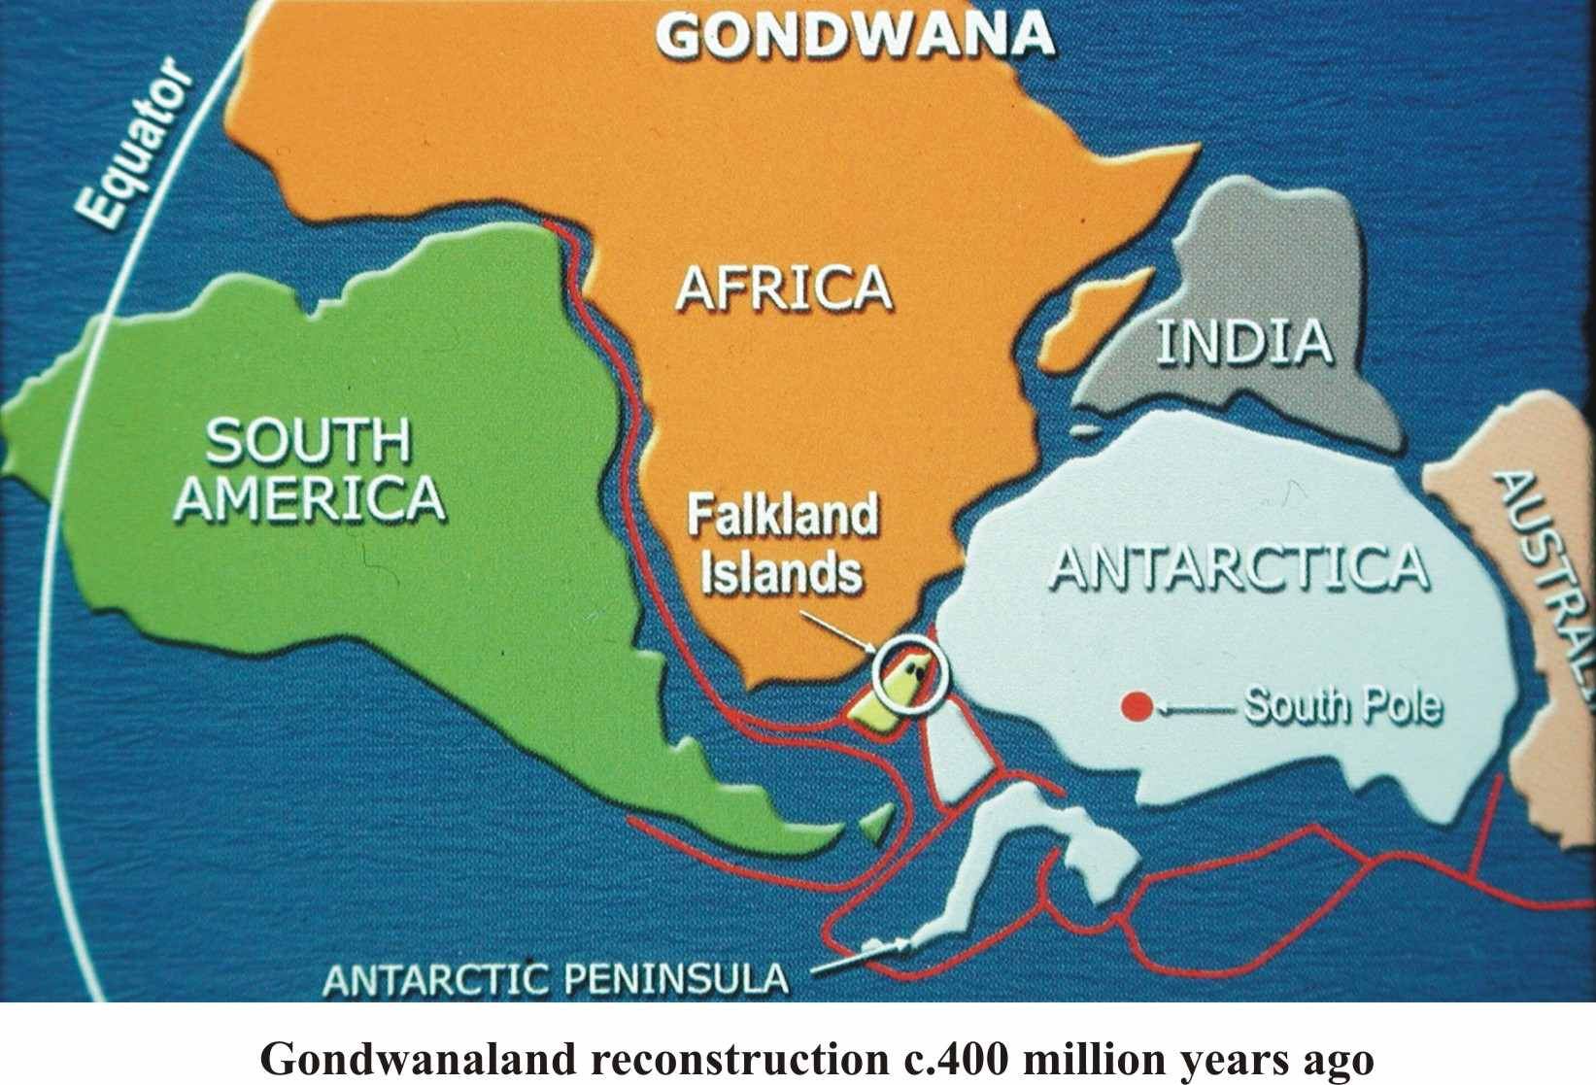
(8) Shared event of known age
Other example: Gondwana Scarp,
known as “Great Escarpment” in S. Africa
South Africa: rifting ~160 Ma
(plate tectonic reconstruction)
Scarp retreat rate: ~1 km/Myr

Slide 11
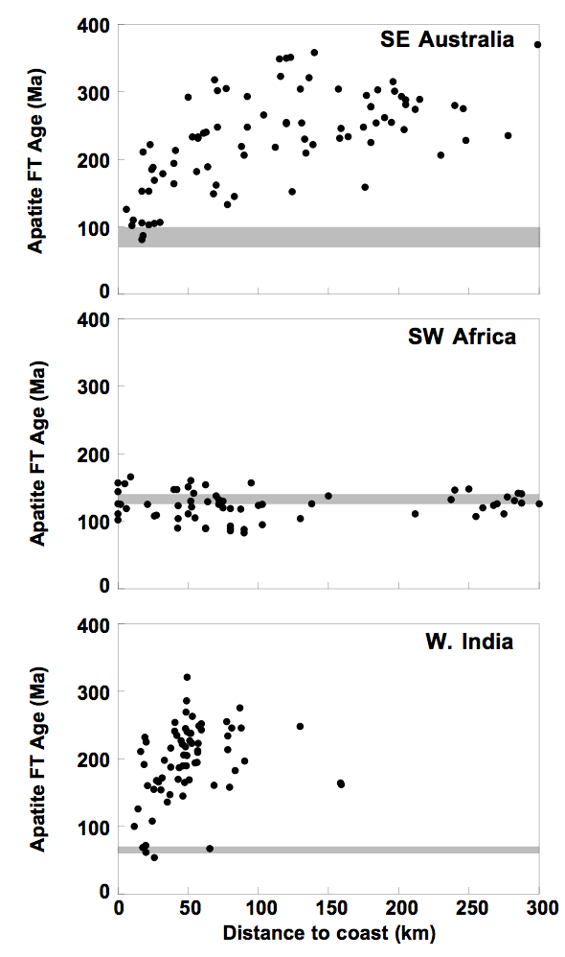
Scarp retreat following continental break-up is constrained by apatite fission-track data

Slide 12
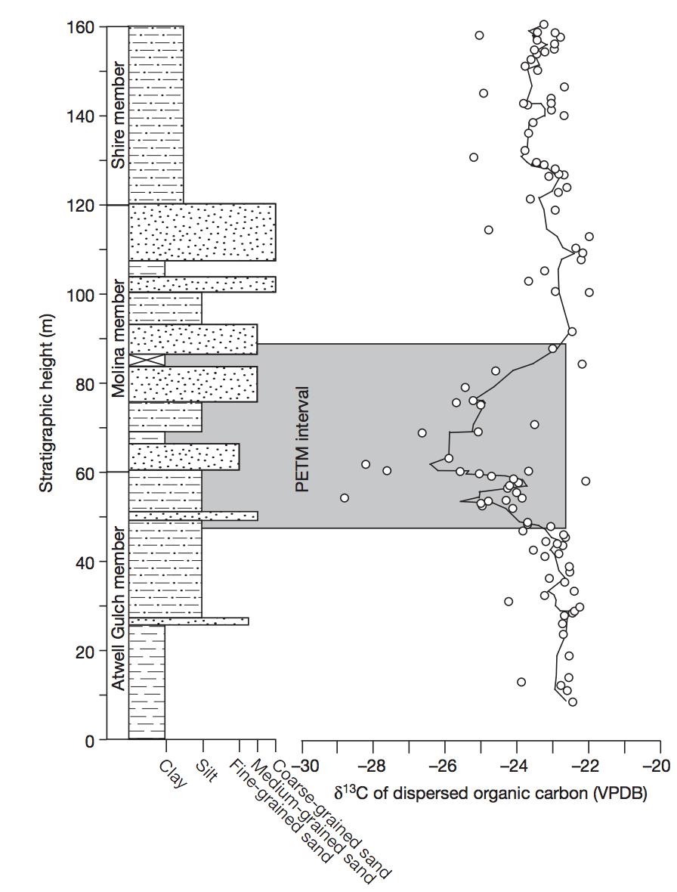
(9) The sedimentary record.
Foreman et al. Nature 2012
method with great
promise for the future;
see required reading
Allen 2008
4-6 deg C increase in
global T accompanied
by 2x-4x increase in
pCO₂
Strengths: Records information about fully-vanished landscapes.
Weaknesses: Changes in grain size + channel dimensions have multiple possible explanations.
Age range of application: < 3.5 Ga on Earth; <4.1 Ga on Mars (for orbiter methods)

Slide 13
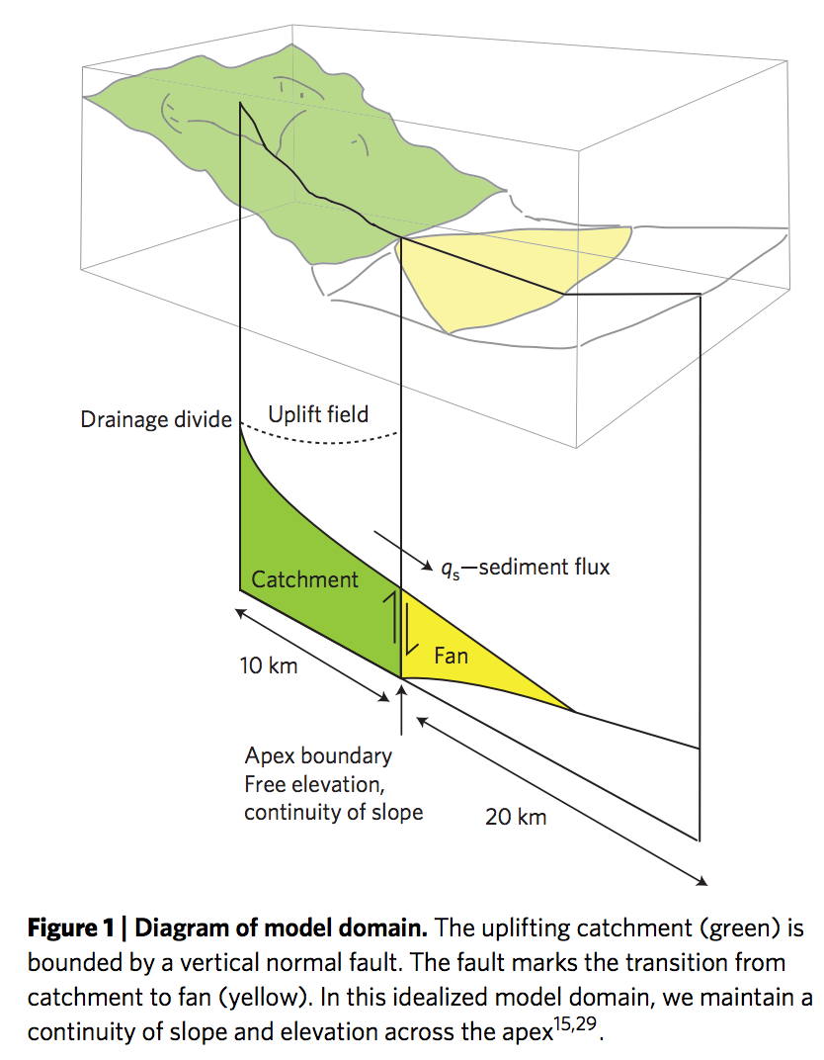
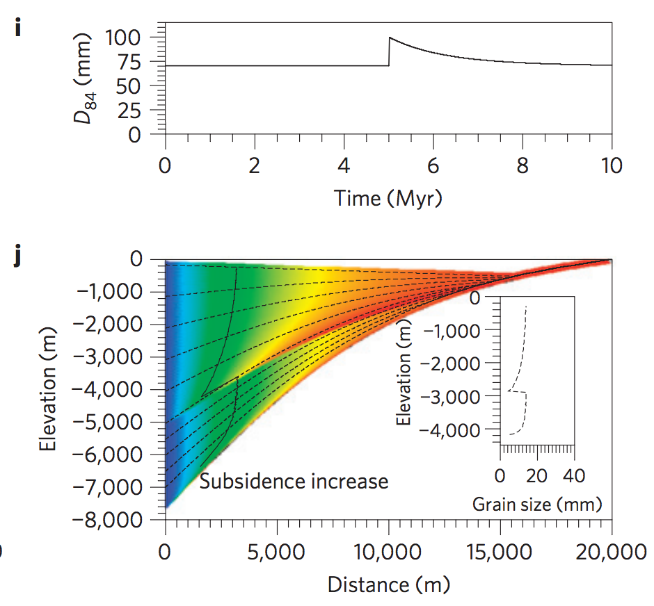
Example (idealized model):
Armitage et al. Nature Geoscience 2011

Slide 14
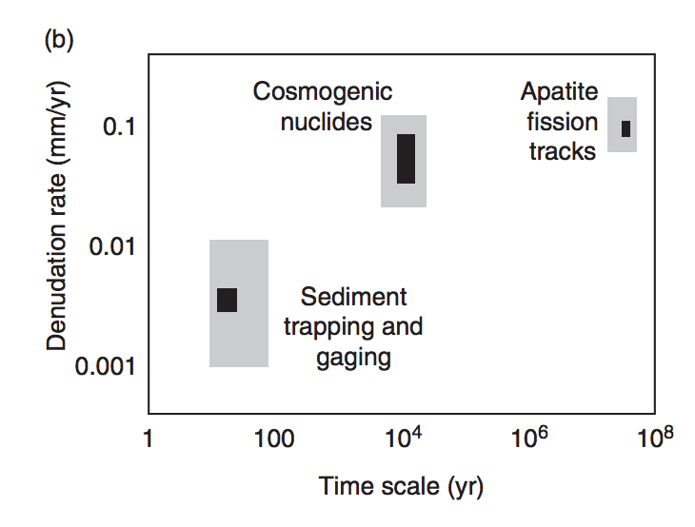
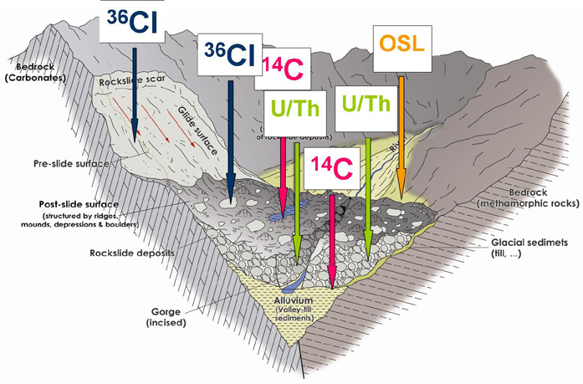
Integration and cross-checking of methods.
Anderson &
Anderson, ch. 6
University of Innsbruck

Slide 15
Landscape evolution: sources of data
SOME MAJOR LANDSCAPE EVOLUTION PROBLEMS
DATE/RATE DATA ON EARTH
DATE/RATE DATA ON OTHER PLANETS

Slide 16
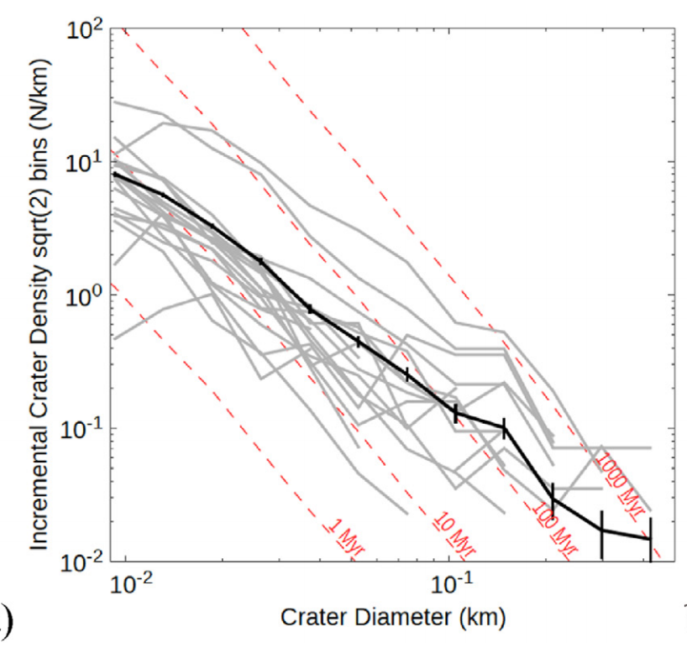
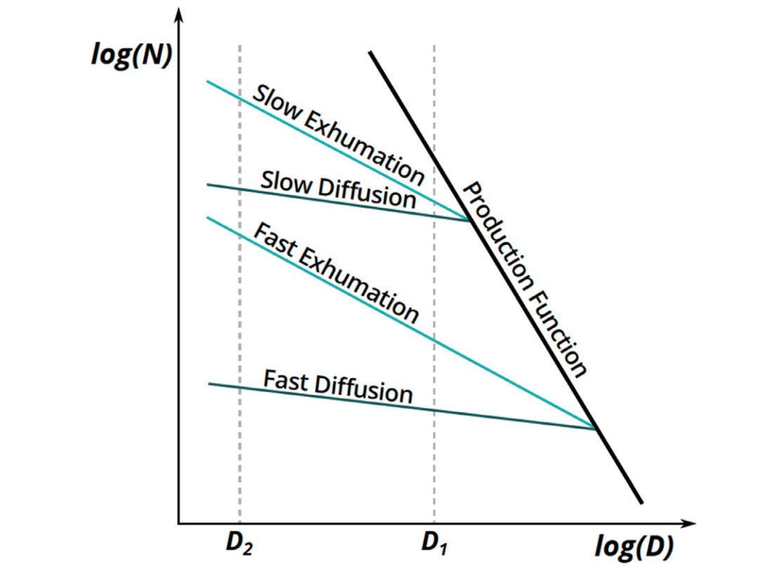
(P1) Crater-density constraints on burial and exhumation.
CONCEPT:
DATA:
Kite & Mayer 2017
Strengths: Can be applied anywhere on Mars;
Can give past sedimentation rates.
Weaknesses: Difficult to date steep slopes (small area, distorted craters)
Age range of validity: In principle, applies to all timescales.
In practice, restricted to 1-100 Myr for erosion rates

Slide 17
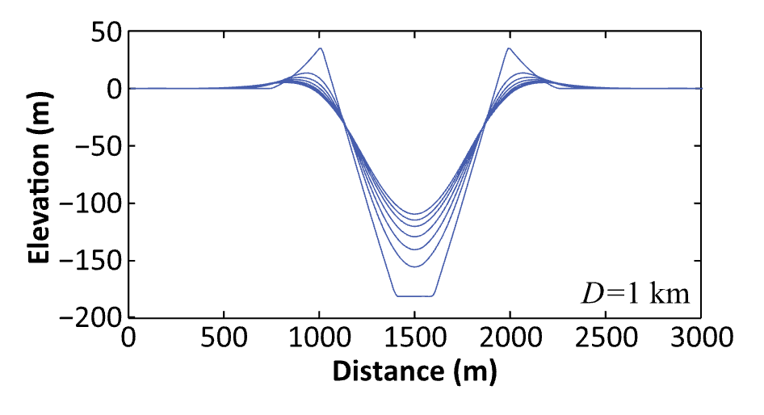
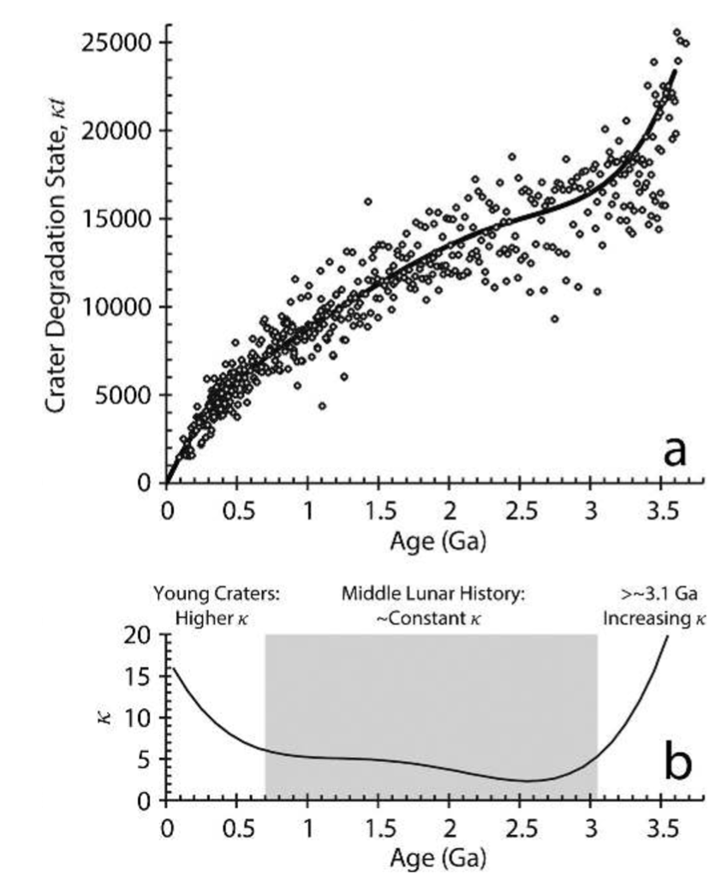
(P2) Statistical approaches (e.g. crater modification)
Fassett & Thomson, JGR-Planets, 2014 – Goal:measure crater degradation on the moon vs. time.
Plot the diffusional degradation of individual craters as a function of the crater density of the
terrains that host them. Map the crater density to absolute age using Apollo radiometric dates.

Slide 18
Key points
For each Earth-based dating method, know the principle, advantages, disadvantages, example application, age range of application, for each technique.
Explain the evidence for and against a Pleistocene uptick in global erosion on Earth (two arguments for and two arguments against, plus geographic context)

Slide 20
Surface processes as a record of climate: Titan
EXPLORATION OF TITAN
CLIMATE DRIVERS
SURFACE PROCESS RESPONSE

Slide 21
Surface processes as a record of climate: Titan
EXPLORATION OF TITAN
CLIMATE DRIVERS
SURFACE PROCESS RESPONSE

Slide 22
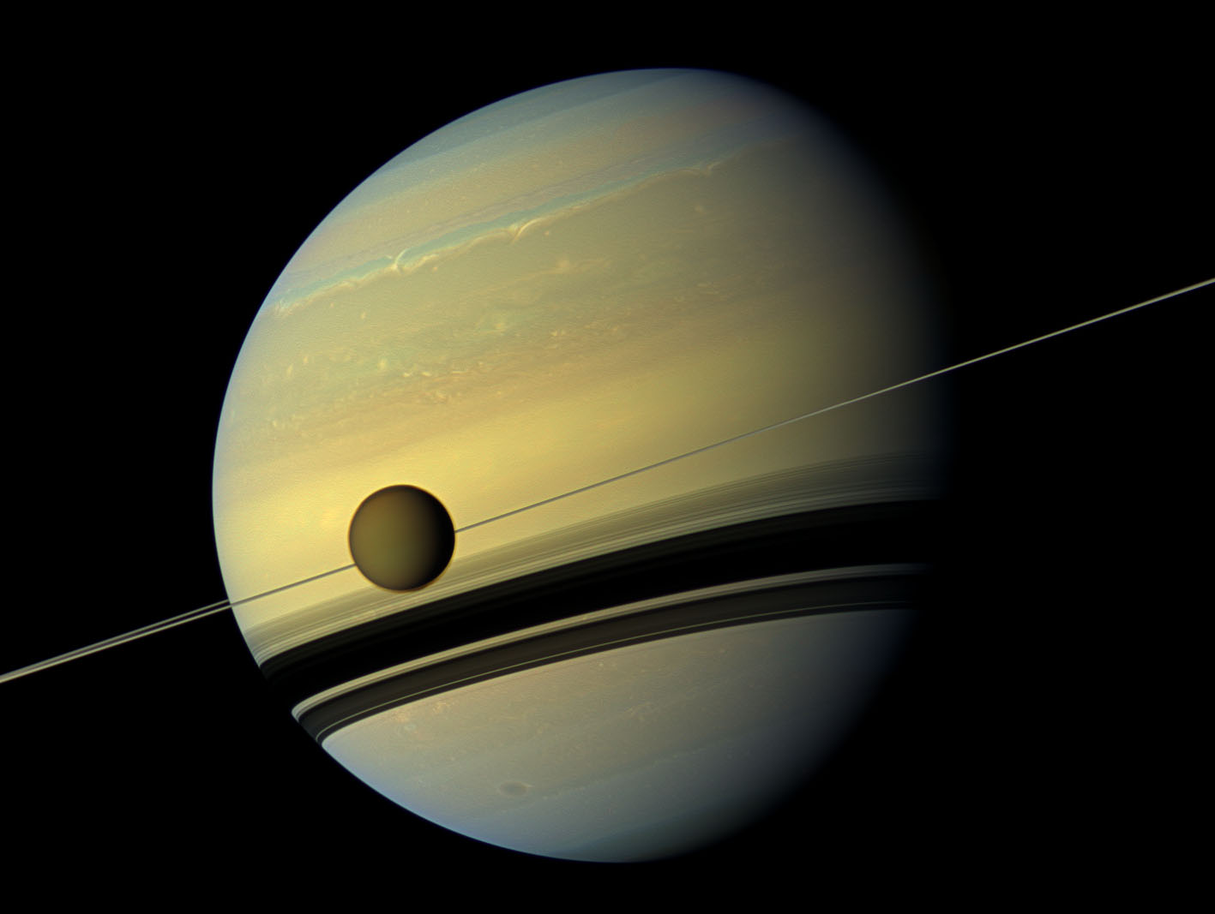
Titan is a moon of Saturn (10x Earth’s separation from the Sun, 29 years orbital period)
5th-largest solid-surface object in the Solar System (bigger than Mercury, smaller than Mars)
Titan is in a 16-day orbit
around Saturn (e = 0.03) & always
keeps the same face
pointed to Saturn.
Low density → ½ H₂O,
½ rock
10² less sunlight
→ (10²)^{1/4} = 3x
less temperature
from L(1-α) = εσT4
T_{surf} ~ 100K
H₂O will behave
as rock; CH₄ close
to its triple point
Titan’s spin axis is co-aligned
with Saturn’s spin axis
Saturn’s obliquity is 27°
→ strong seasonal cycle every 29 years

Slide 23
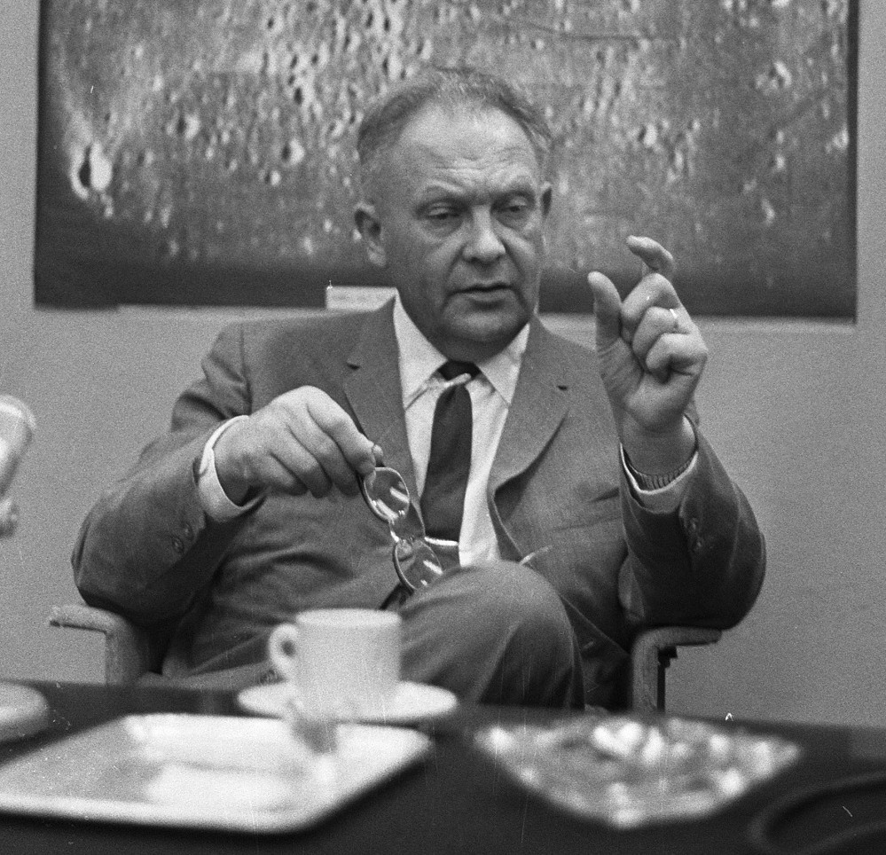
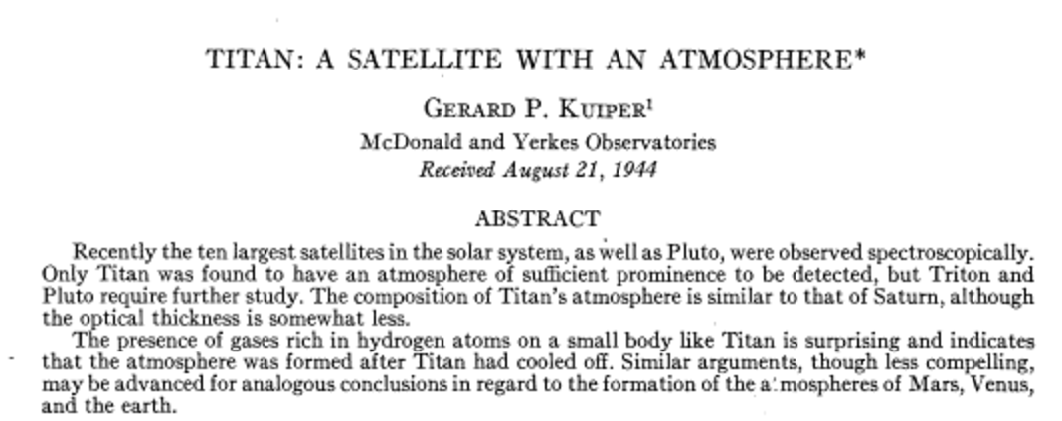
Titan’s hazy atmosphere was discovered by G. Kuiper (University of Chicago)
1.5 bars surface pressure
(kg/m² equivalent to 11 bars on Earth)
98.4% N₂ (always a gas on modern Titan)
1.4% CH₄ (liquid and gas on modern Titan)
UV light from the Sun fragments CH₄
near the top of the atmosphere. The fragments
recombine and further react to form C₂H₆, C₃H₈,
HCN, eventually forming solid soot particles that sink.
… H escapes to space.
Astrophysical Journal, 1944

Slide 24
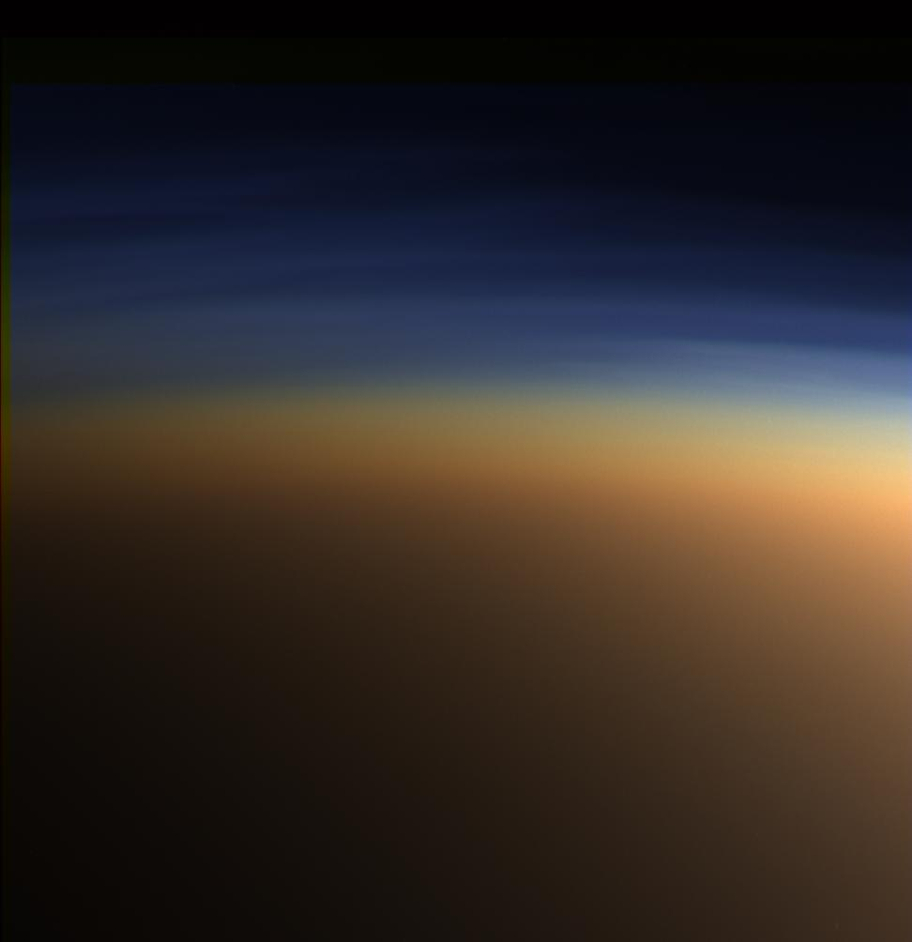
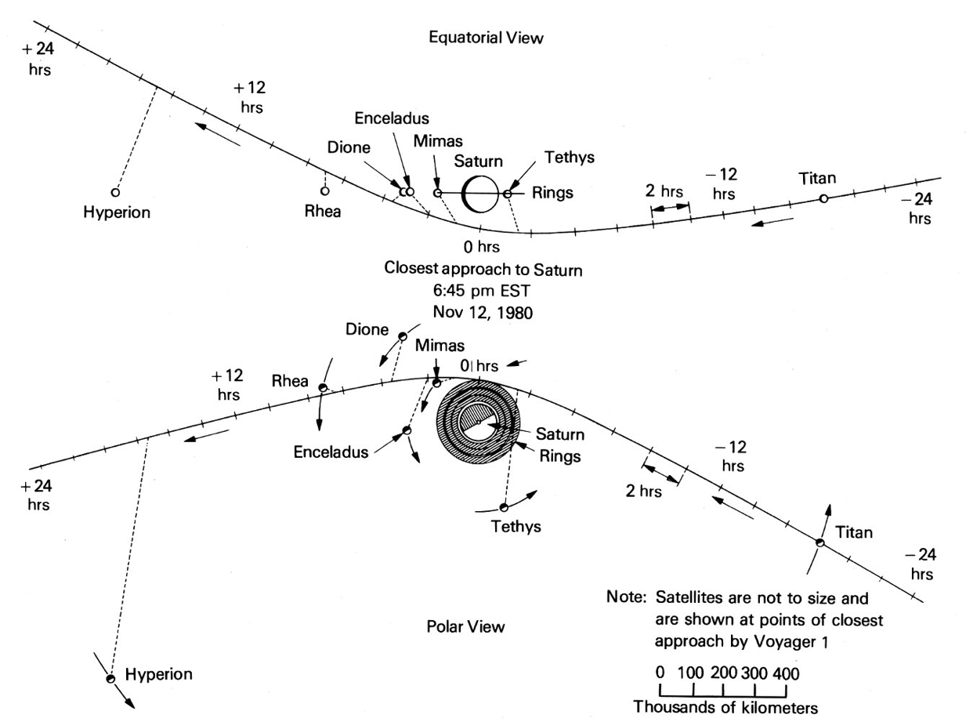
In 1980, Voyager 1’s trajectory permitted a close encounter with Titan (at the expense of a flyby of Pluto), but Voyager was unable to see through the haze

Slide 25
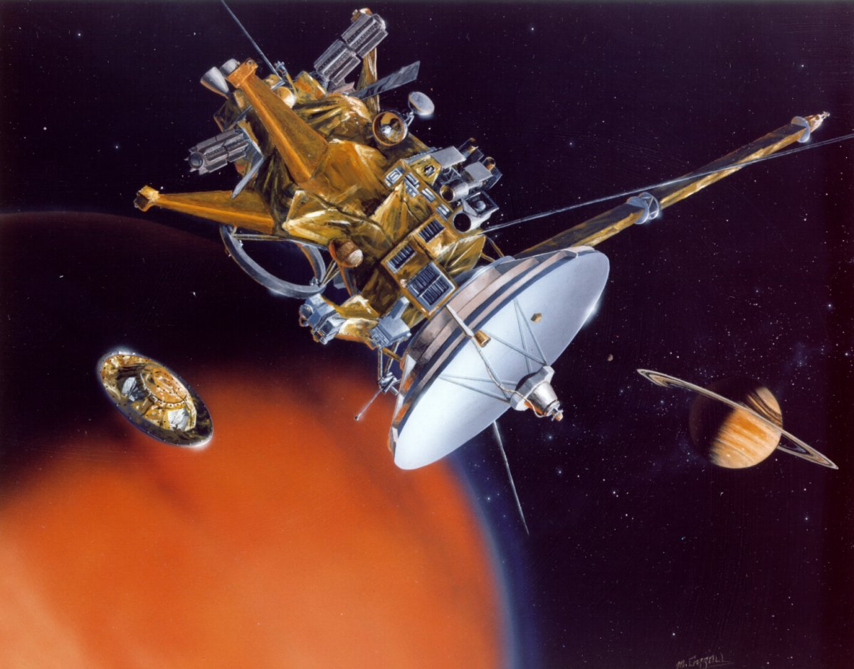
The Cassini-Huygens mission (launch 1997, Saturn orbit 2004-2017) was designed to see beneath Titan’s haze
camera/spectrometer
filters set for wavelengths
in which CH₄ absorbs little
“Cassini” parent
spacecraft
(orbits Saturn,
multiple close
Saturn flybys)
one dish serves
synthetic aperture
radar, altimeter, and
communications linkhuy
“Huygens”
Titan lander
Descent Imager +
Surface Science Package
landed at 10 S 192 W

Slide 26
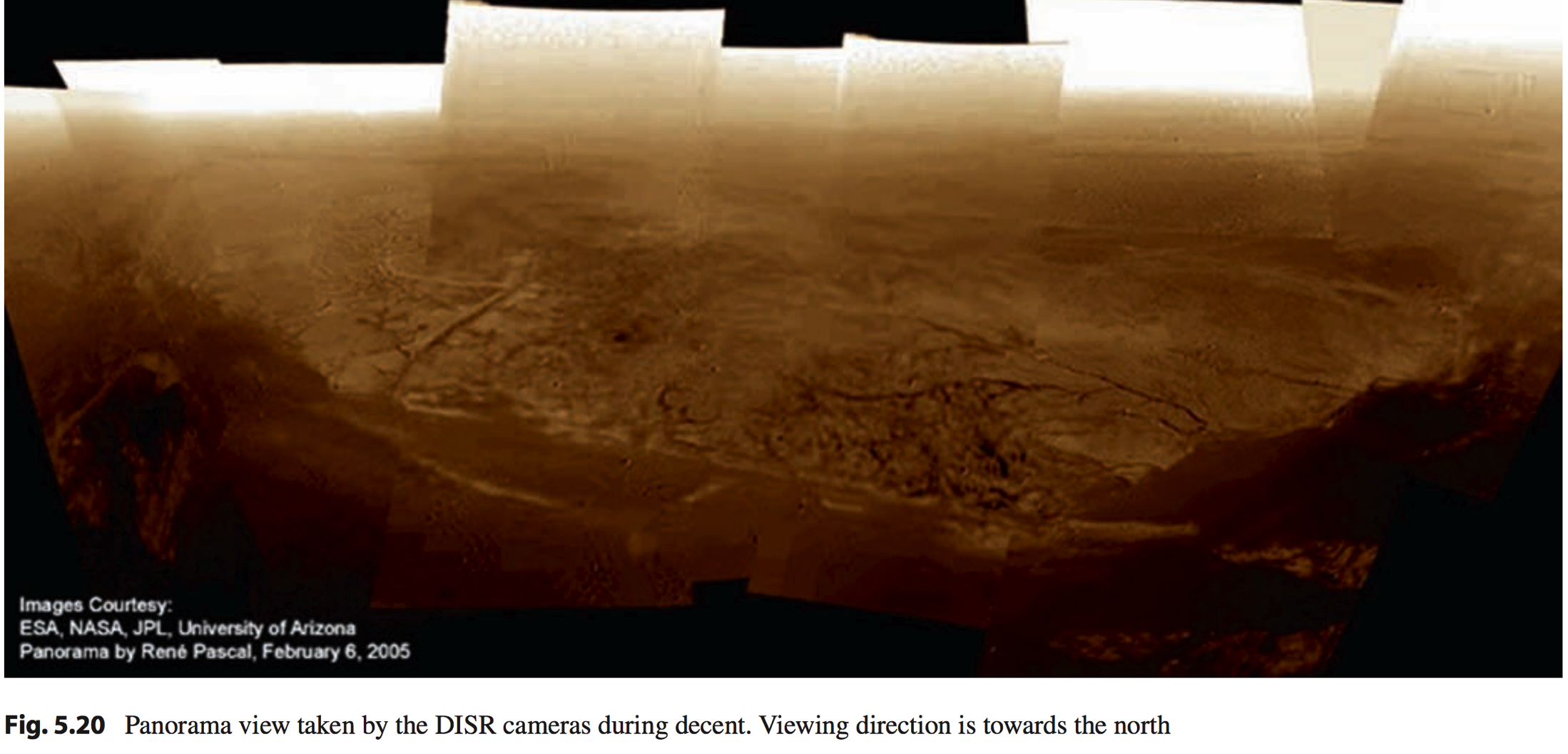
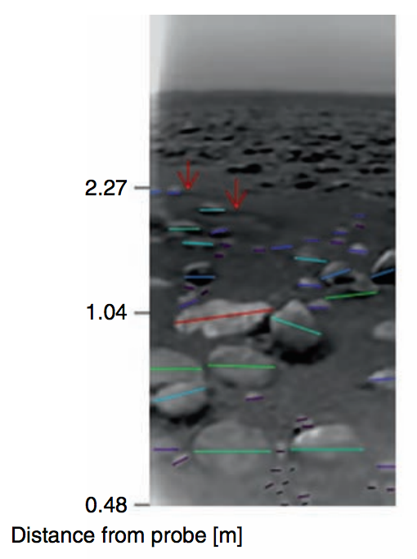
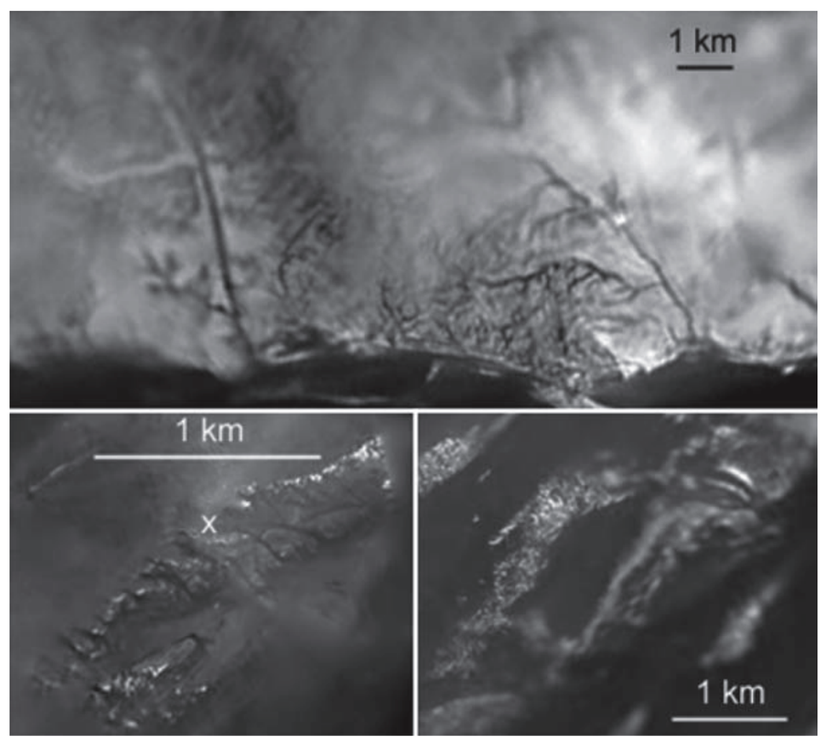
Huygens landed on Titan in Jan 2005
Jaumann et al. 2009

Slide 27
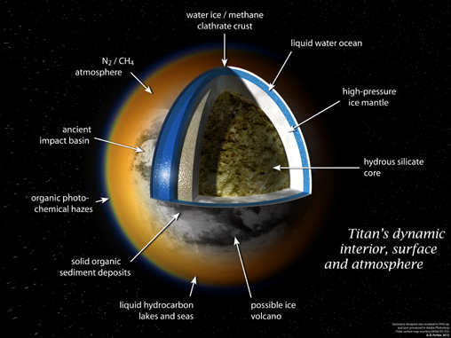
Titan has a buried global ocean, almost certainly liquid water The surface is mostly solid hydrocarbons
Diurnal tide measured in
the degree-2 gravity of Titan
Amplitude of gravity tide
corresponds to a diurnal surface
shape bulge of ~10 m amplitude
A solid moon would show a bulge
of ~1 m amplitude → Titan’s
outer water ice shell is mechanically
fully decoupled from the interior on
16-day timescales
Speculative models of atmosphere-
interior coupling: CH4 released
to atmosphere from cryovolcanoes

Slide 28
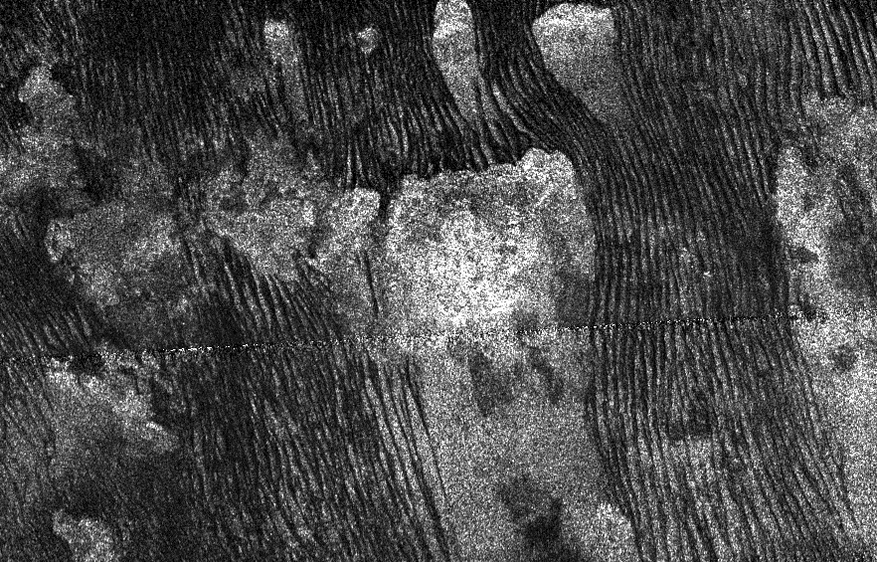
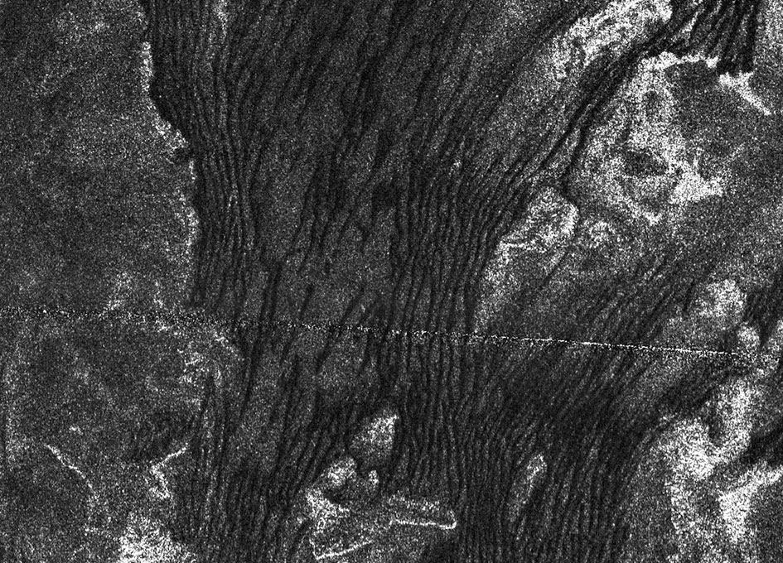
Low latitudes: sand dunes
Height 200m, spacing ~2 km
Dunes parallel to net wind

Slide 29
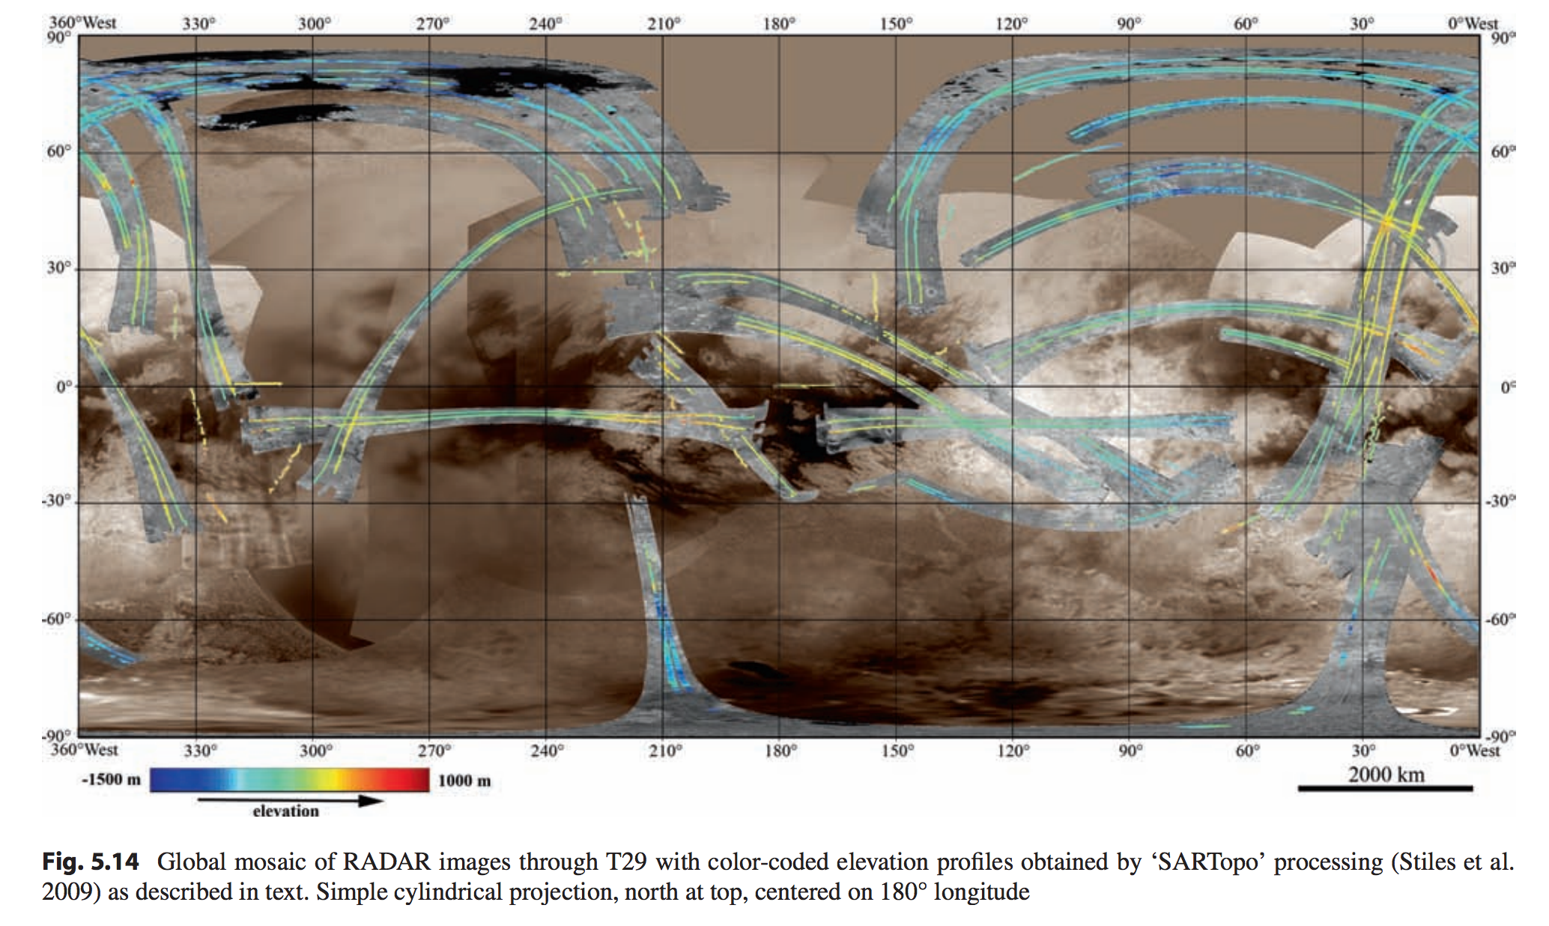
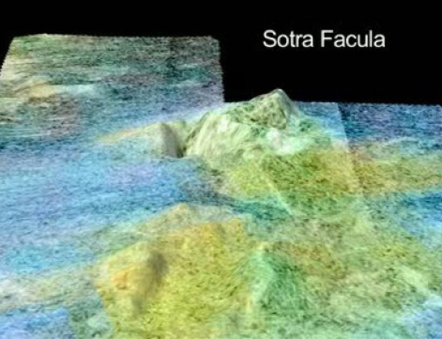
Sources of elevation data for Titan: radar altimetry, radar stereogrammetry, and “SARTopo”
Sub-Saturn point
Anti-Saturn point
Sub-Saturn point

Slide 30
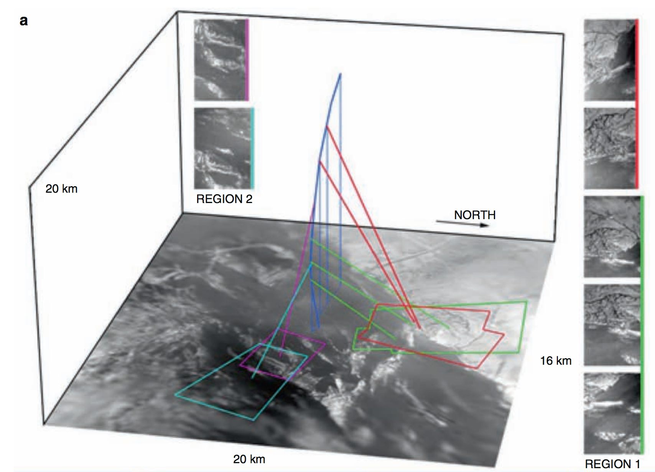
Serendipitous stereo photogrammetry from Huygens as it spun under parachute (1/2)
Jaumann et al. 2009

Slide 31
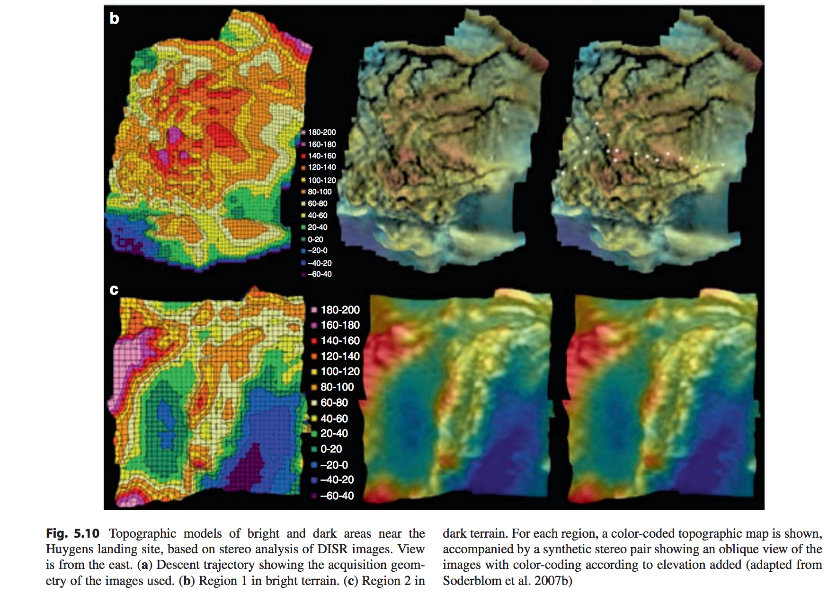
Serendipitous stereo photogrammetry from Huygens as it spun under parachute (2/2)
Jaumann et al. 2009

Slide 32
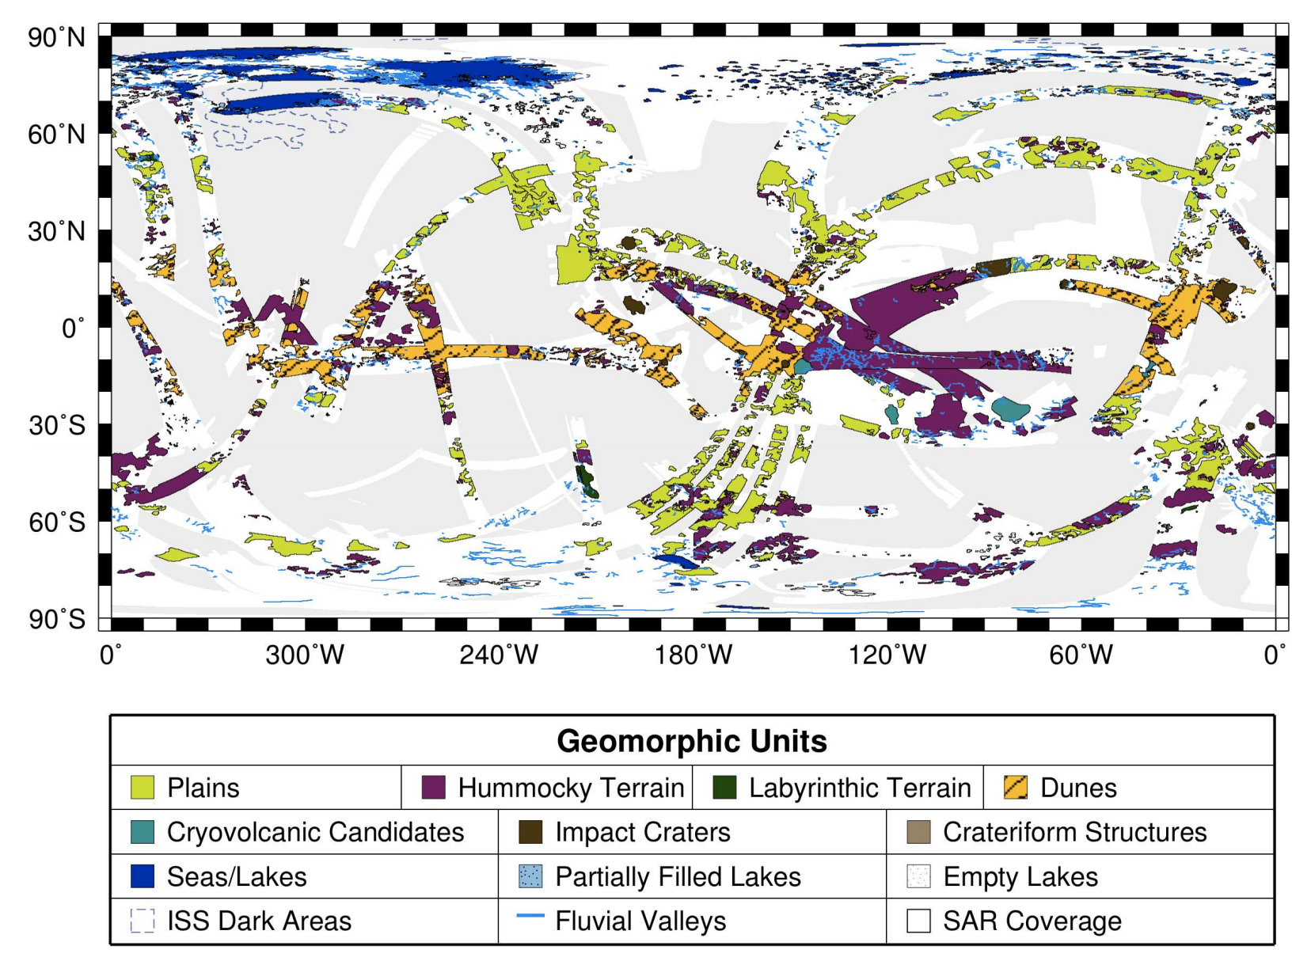
Titan geography: Low latitude soot dunes, polar methane lakes and seas. Few impact craters → 0.1-1 Gyr surface age (similar to Earth)
Aharonson et al. 2013

Slide 33
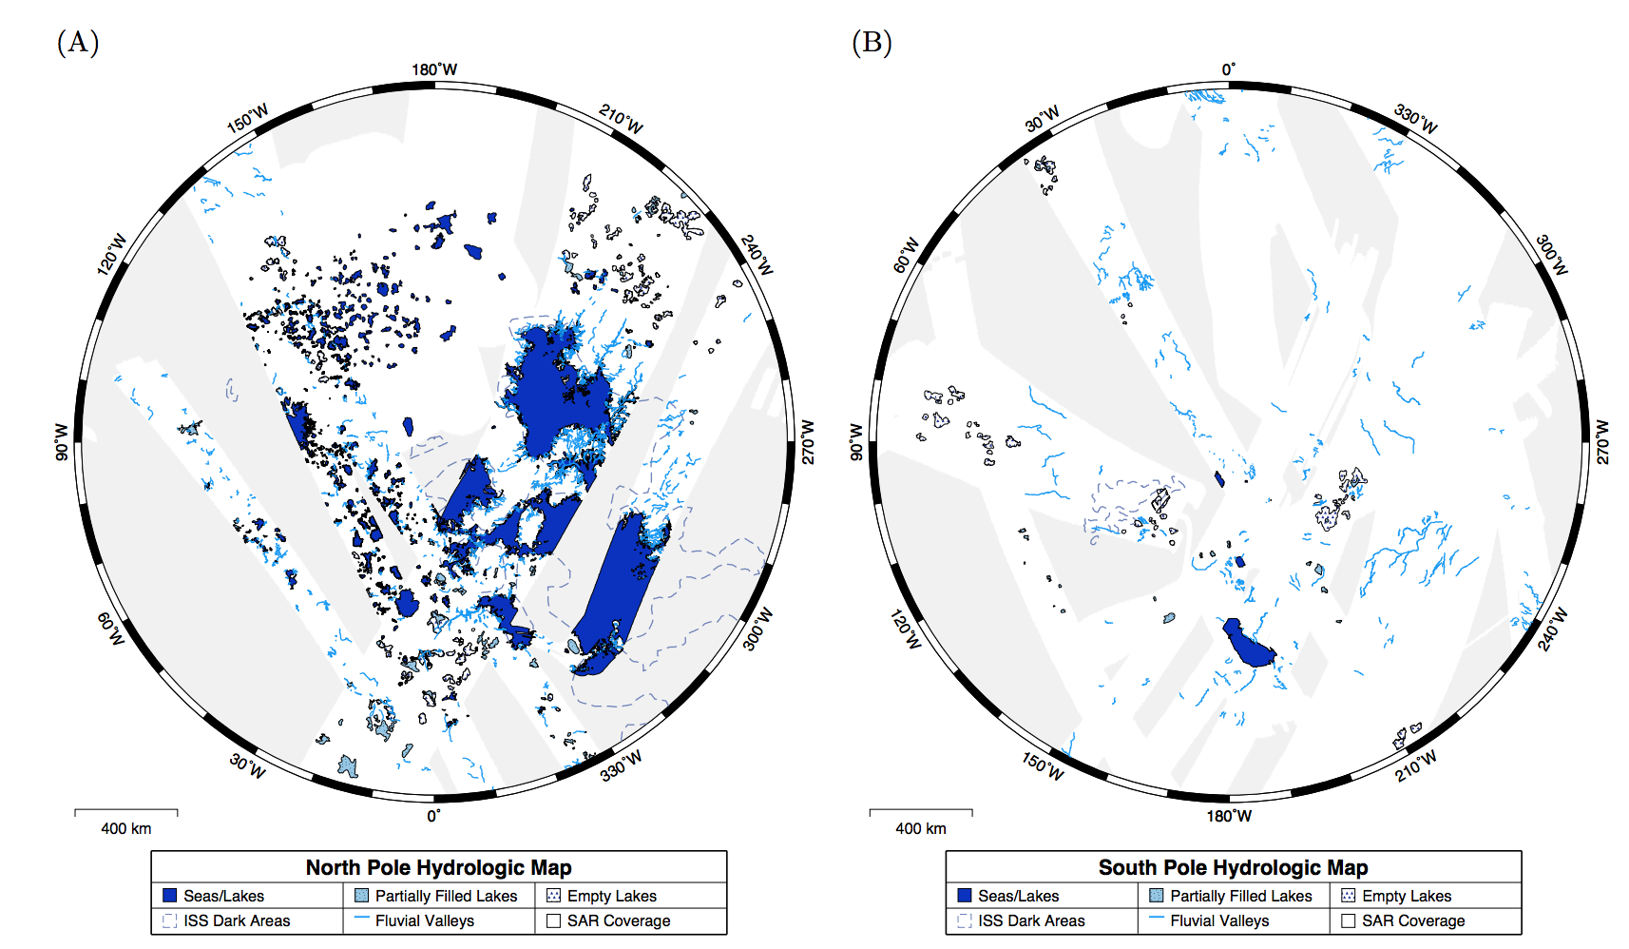
High latitudes: lakes and seas
Liquid coverage is ~1% of planet surface area (not including ephemeral lakes); >10% in North Polar region.
Lakes are mostly in the N hemisphere

Slide 34
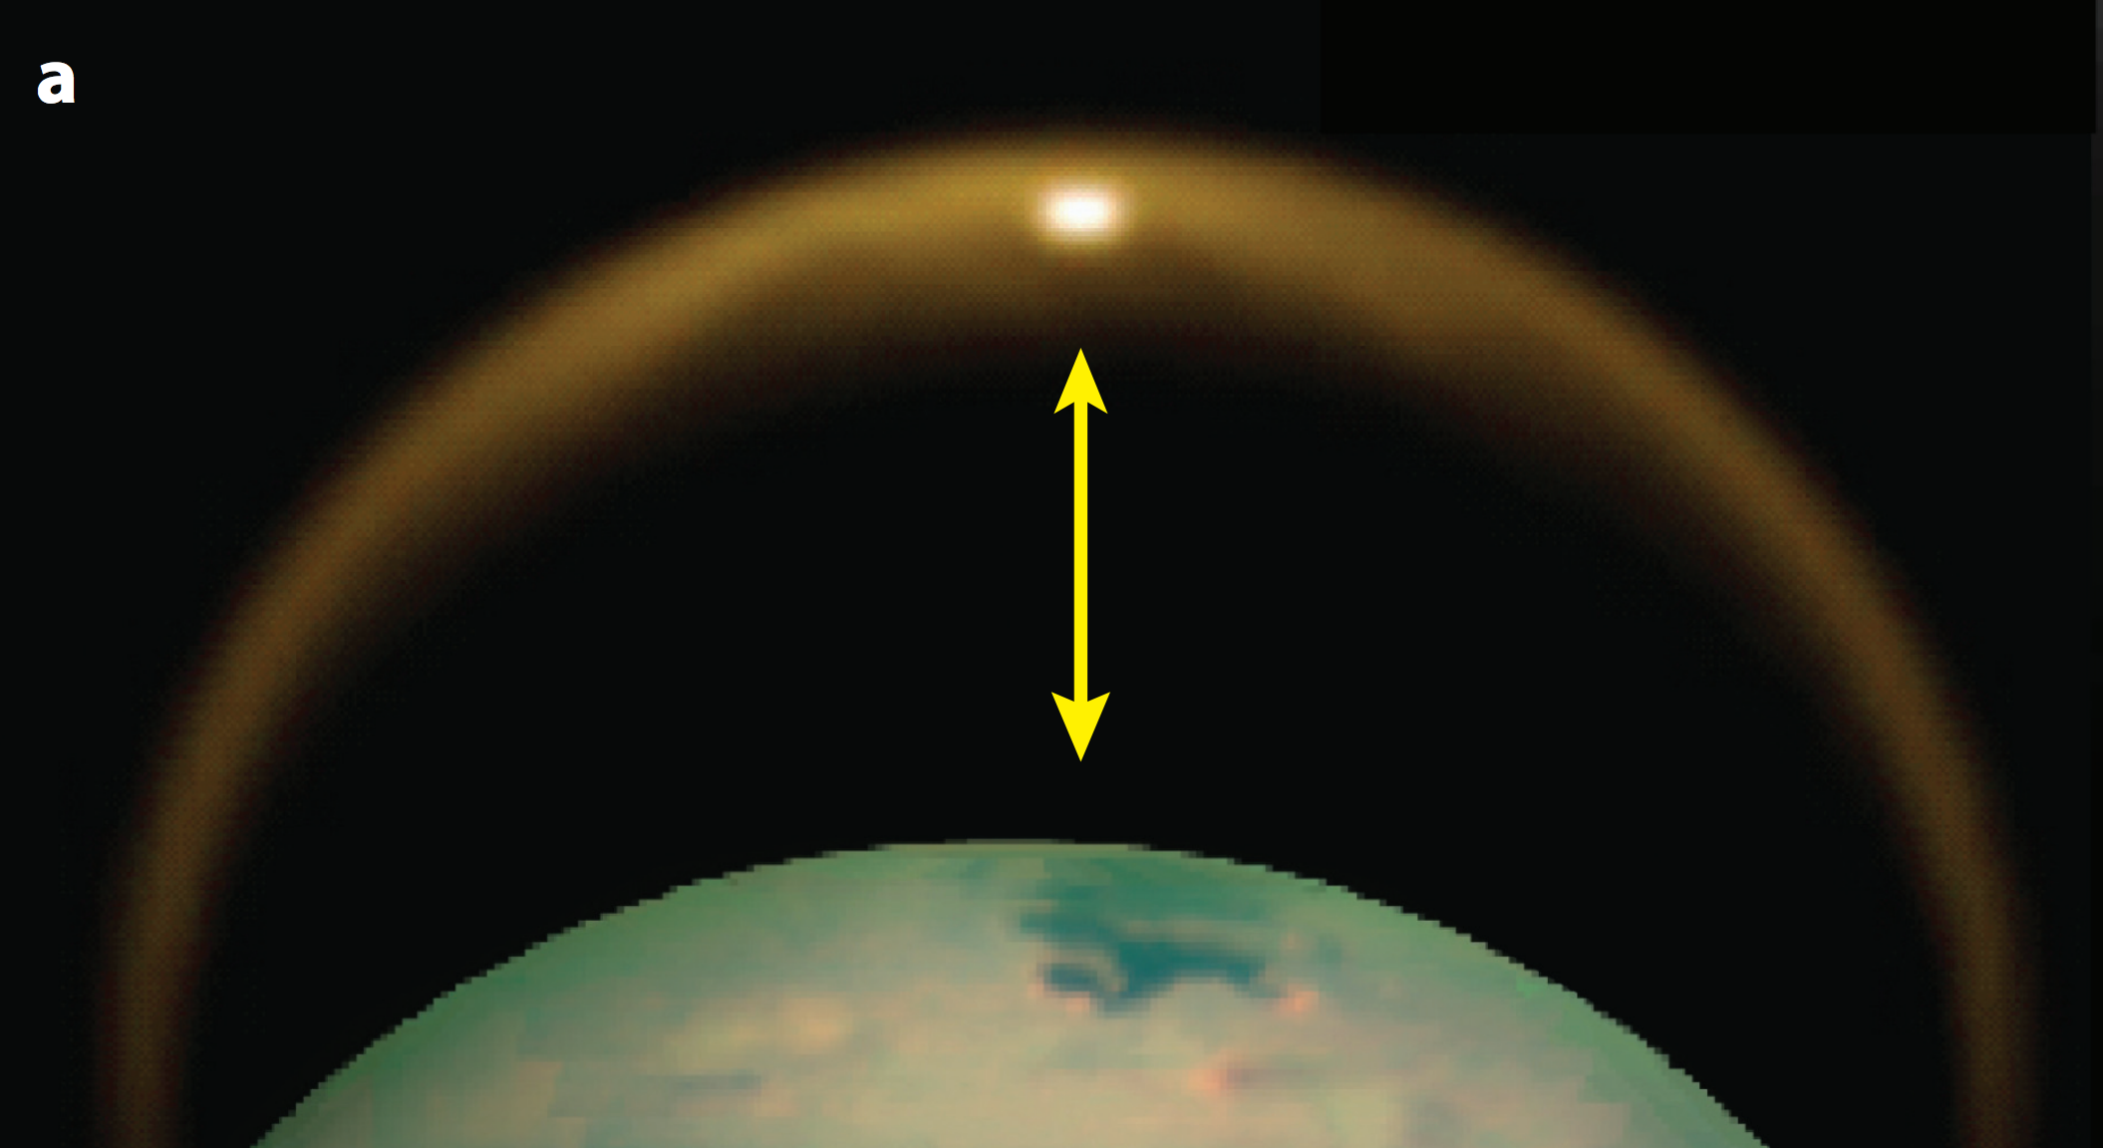
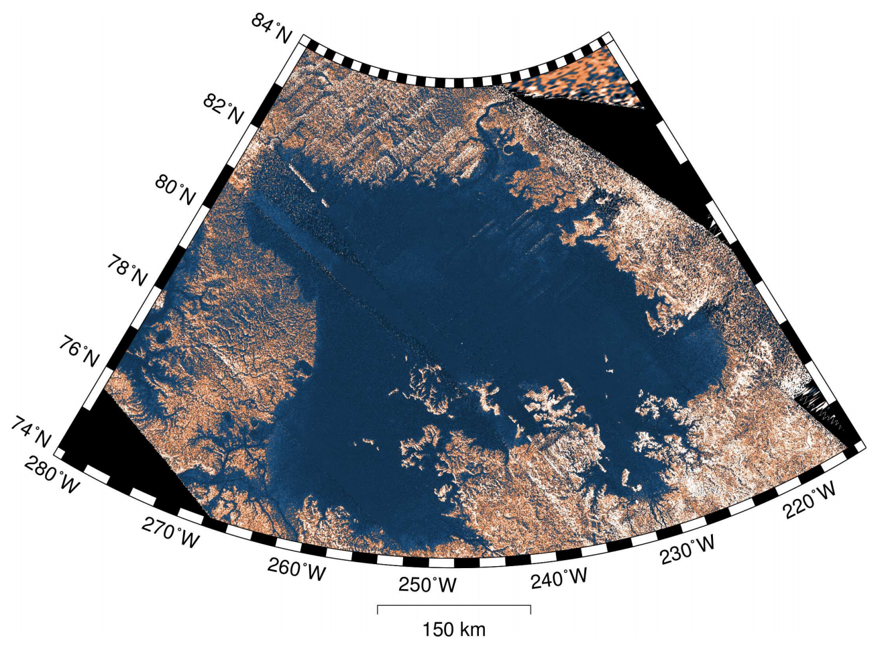
Evidence for lakes and seas includes spectrum consistent with liquid methane, extreme smoothness (minimal radar return, specular reflection), radar reflections from both seabed+(sea surface), translucency in visible light, shoreline morphology, uniform topographic elevation, & location in topographic lows.
Specular reflection

Slide 35
Surface processes as a record of climate: Titan
EXPLORATION OF TITAN
CLIMATE DRIVERS
SURFACE PROCESS RESPONSE

Slide 36
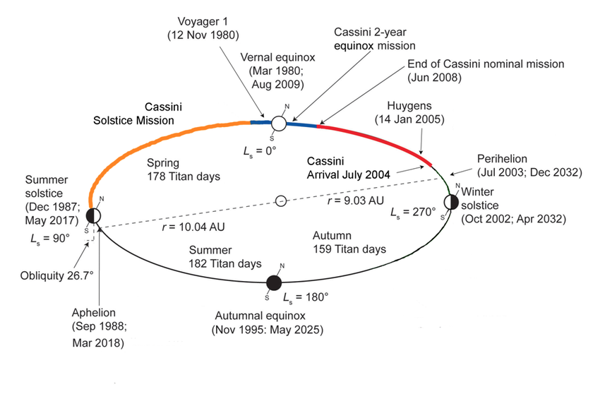
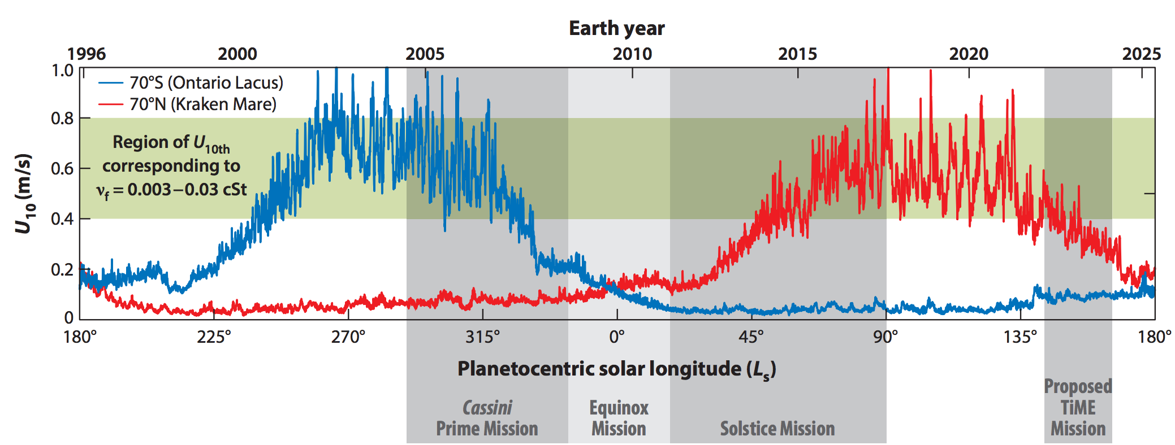
Seasons on Titan (= Seasons on Saturn)
eccentric orbit
of Saturn
MODEL:
consistent
with very limited data
(presence/absence of waves)

Slide 37
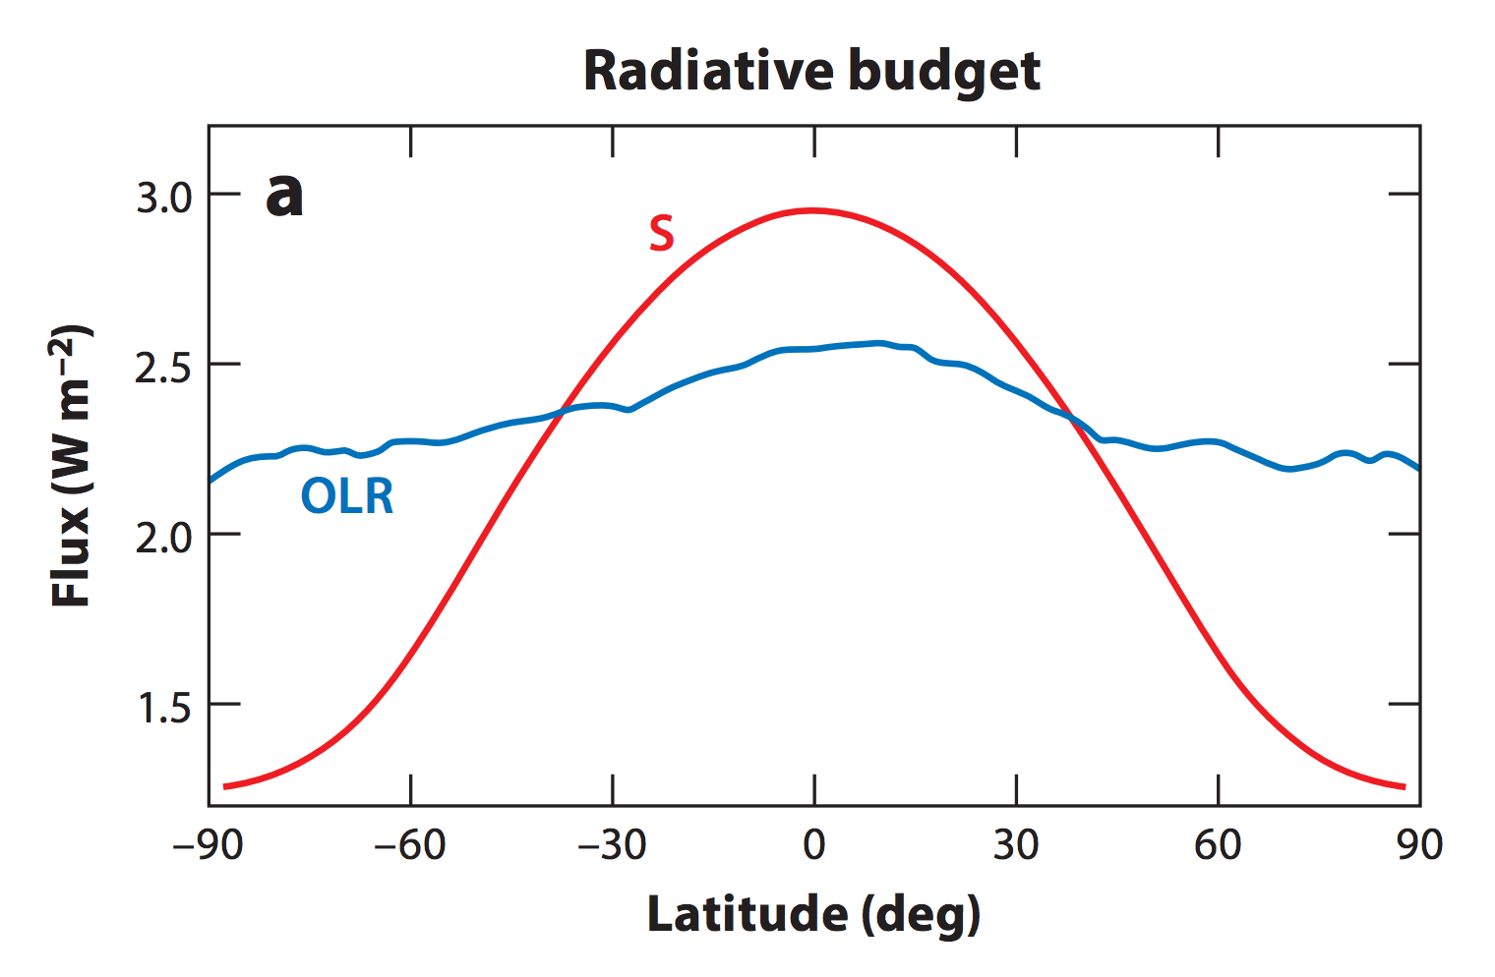
Because Titan is small and spins slowly, its atmospheric circulation has weak horizontal temperature gradients (Coriolis force is less important than on Earth).
Annual
mean:
S = Sunlight
OLR = Outgoing
Longwave
Radiation
CH4 humidity
100% between
40 km and 8 km
altitude; below
saturation closer to
the ground.
Mitchell & Lora 2016

Slide 38
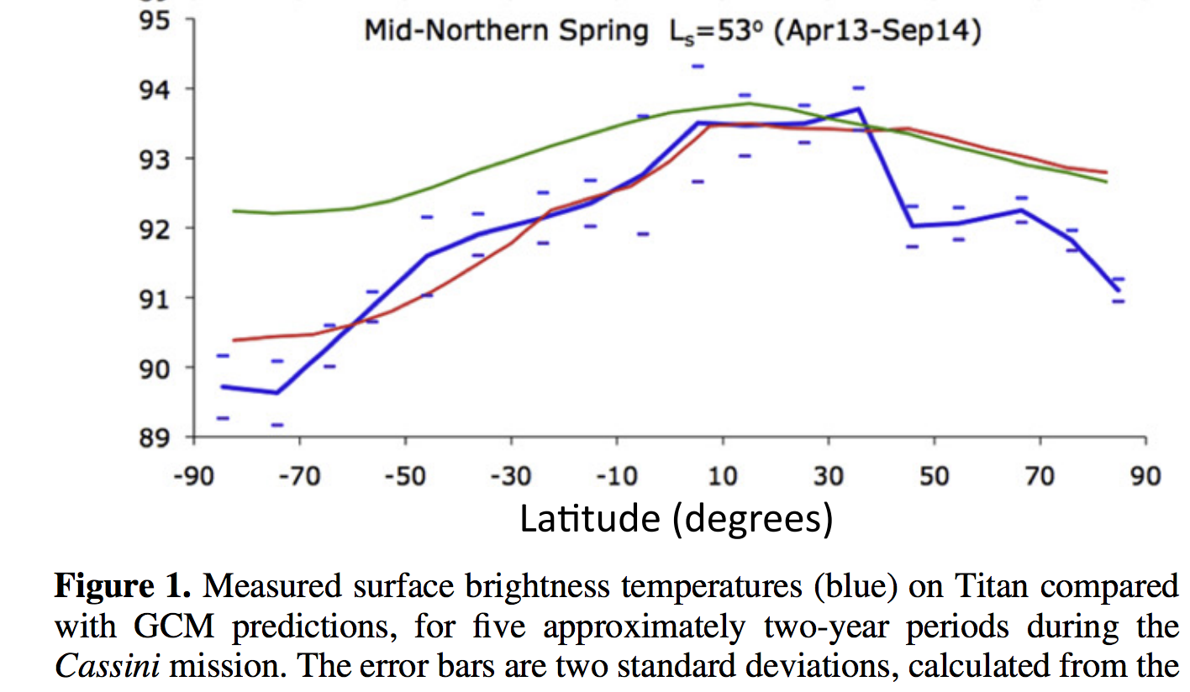
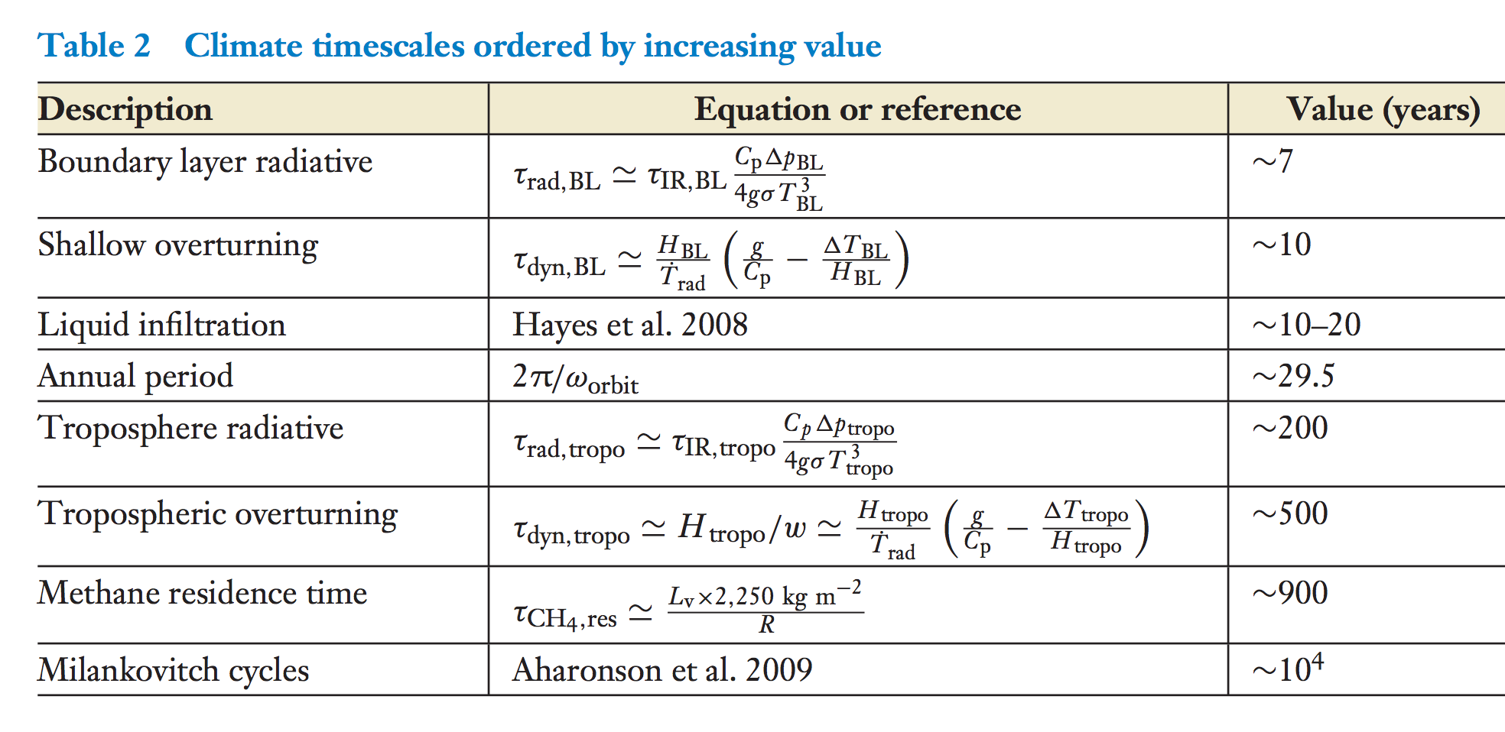
Titan’s thick atmosphere (high column heat capacity) and weak insolation allow winds to
cause a weak equator-pole gradient in surface temperature
Jennings et al.
Astrophysical Journal 2016
Mitchell & Lora 2016

Slide 39
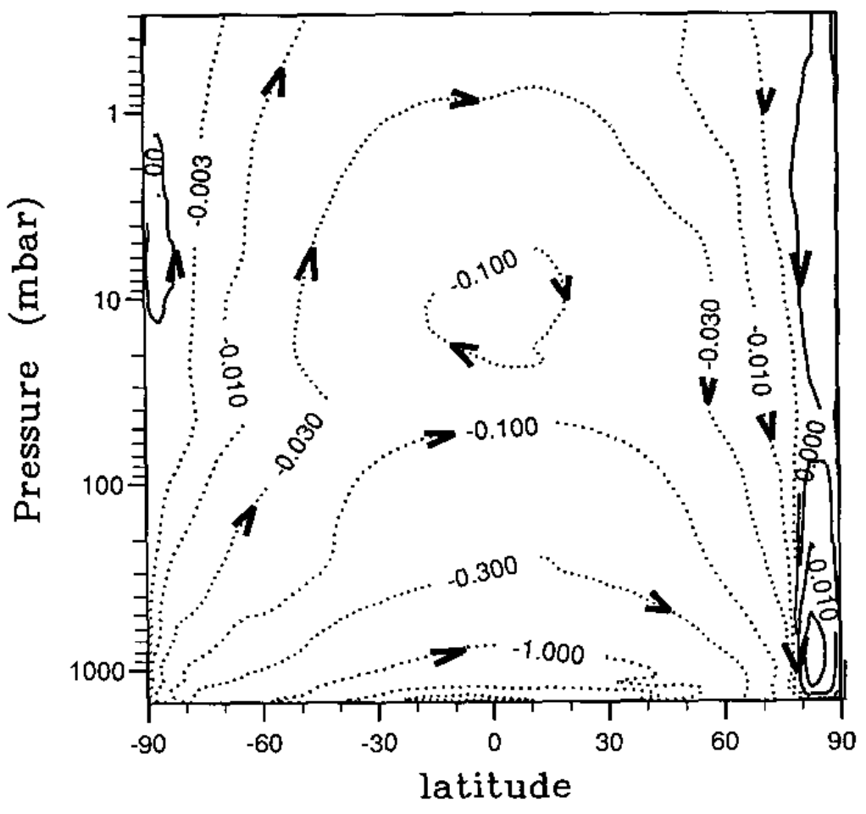
Strong seasonal cycle in winds (“single Hadley cell”)
Streamfunction (kg/sec)
Hourdin 1995

Slide 40
Strong seasonal cycle in clouds (and precipitation)
CH4 swamp
dry surface
CH4 swamp

Slide 41
Orbital cycles of Saturn (→ orbital cycles in insolation on Titan) may explain why lakes are mostly in the N Hemisphere
pCH₄
T
Nonlinear
(Clasius-
Clapeyron)
increase in
pCH4 with T
Aharonson et al., Nature Geoscience 2009

Slide 42
Surface processes as a record of climate: Titan
EXPLORATION OF TITAN
CLIMATE DRIVERS
SURFACE PROCESS RESPONSE

Slide 43
Questions about Titan’s valleys:
Mechanical or chemical erosion?
Incision of channelized surface flows, or erosion driven by sapping?
Catastrophic flows, or sustained/repeated flows of smaller magnitude?
Is fluvial erosion due to observed valleys superficial relative to total relief (like Mars’ highland valley networks), or the dominant process that controls relief (like on Earth)?
Bedrock channels or self-formed alluvial channels?

Slide 44
Mechanical or chemical erosion?
Ice is insoluble in liquid hydrocarbons
Titan’s valleys form continuous networks
that span hundreds of km
Burr et al. GSA Bulletin 2013

Slide 45
(2) Incision of channelized surface flows, or erosion driven by sapping?
Junction angles of 72 degrees observed for
groundwater sapping (Abrams et al., 2009)
Burr et al. 2013
Open question: bedrock channels or alluvial channels?

Slide 46
(3) Catastrophic flows, or sustained/repeated flows of smaller magnitude?
Uniform width, single-thread morphology, large length-to-width ratio

Slide 47
(4) Is fluvial erosion due to observed valleys superficial relative to total relief (like Mars’ highland valley networks), or the dominant process that controls relief (like on Earth)?
Drainage network morphology
suggests modest fluvial exhumation
(more similar to Mars than to Earth).
Why?
Black et al. 2012
Relatively recent climate change;
Image resolution limits detection of river channels;
Competing process resets landscape (cryovolcanism)?

Slide 48
Analysis of river widths on Titan (following Perron et al. 2006)
steady, uniform flow
of Newtonian fluid
R =

Slide 49
Seas are up to 200m deep and mostly CH₄ → 7x10⁴ km³ (15x Lake Michigan, 55x oil reserves on Earth)
Radar altimetry
→ time after radar pulse transmitted →
Hayes 2016

Slide 50
Titan karst: is groundwater flow important in setting lake levels?
raised rims?
Malaska et al., 2nd International Planetary Caves Workshop, 2015

Slide 51
Lunine 1990

Slide 52
Unsolved:
Long term CH₄ cycle – resupply of CH₄?
(Lunine & Atreya, Nature Geoscience 2008)
existence of
clathrates on
Titan is unproven

Slide 53
Key points
Lines of evidence for a “hydrological” cycle on Titan
Differences between climates of Titan and Earth and how these are reflected in surface geomorphology
List and explain similarities and differences between the hydrological cycle of Earth and the methanological cycle of Titan

Slide 54
Backup slides

Slide 55
Transient
hillslope
evolution
Pelletier,
2008, ch. 2; also Pelletier, 2013

