Slide 1
GEOS 28600
The science of landscapes:
Earth & Planetary Surface Processes
Lecture 15
Monday 26 Feb 2020

Slide 2
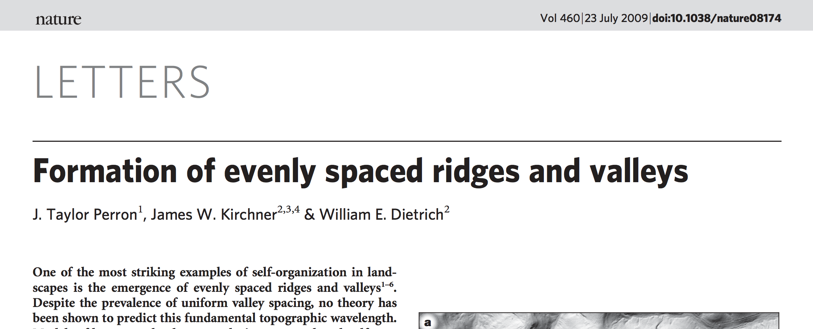

Slide 3
Drainage density is set by a competition between diffusive (hillslope) and advective (channelizing) processes
hillslope
processes
fluvial
erosion
eroding
part of
the landscape
k₀
contributing
area
tectonic uplift
diffusivity
n=1
For large A (and +ve m), 2nd term >> 1st term: fluvial erosion control → concave profile.
For small A (and +ve m), 1st term >> 2nd term: hillslope processes → convex profile.

Slide 4
Fluvial sediment transport vs. hillslope processes: what controls the spacing of rivers?
SETTING THE SPACING OF STREAMS
HILLSLOPE EROSION PROCESSES SOIL PRODUCTION FUNCTION
SYNTHESIS: PERRON ET AL. 2009

Slide 5
The path of water dictates the process that erodes the landscape: Hillslope Hydrology
z
HOF (precip. rate > infiltration rate)
soil
SSSF
x
DPSA
RF
vadose zone
bedrock
SOF
phreatic zone
GF
valley floor
HOF – Horton Overland Flow
SSSF – Shallow Subsurface Storm Flow (usually at soil-bedrock boundary)
DPSA – Direct Precipitation on Saturated Areas
RF – Return Flow
GF Groundwater Flow
SOF – Saturated Overland Flow
Seasonal variation in flow mechanism may occur –
e.g. some tuffs form clays when wet and deep

Slide 6
HOF – Horton Overland Flow
Badlands – fine-grained material
Australia – mature landscape – silcretes, gypcrete, calcrete.
Dirt roads
Cattle grazing
SOF – Saturated Overland Flow
Favored in poorly-drained valleys
SSSF – Shallow Subsurface Storm Flow (usually at soil-bedrock boundary)
Oregon - Coastal Oregon – Holes due to tree roots and mountain beaver. Steep,
relatively straight slopes. Low-density (porous) soil.
(DPSA – Direct Precipitation on Saturated Areas)
GF Groundwater Flow
(Hawaii: fractured, permeable lavas Localised SSSF. No HOF).
.
HYPOTHETICAL HYDROGRAPHS:
Q
HOF
SOF
SSSF
GF
t

Slide 7
Hydrologic processes can be related to hydrograph shape
HYPOTHETICAL HYDROGRAPHS:
Q
HOF
SOF
SSSF
GF
t
peak lag, L_{p}
P,Q
SSSF
log₁₀(L_{p} / hours)
SOF
centroid
lag, L_{c}
HOF
t
HOF: L_{p} = 0.42 A^{0.2}
log₁₀(drainage area A / km²)
SOF: L_{p} = 1.0 A^{0.42}
SSSF: L_{p} = 18 A^{0.26}
compilation by Tom Dunne (UCSB)

Slide 8
thin soils
gentle concave footslopes;
wide valley bottoms
Hillslope hydrology:
SOF
variable
source
concept
HOF
topography & soils
SSSF
deep permeable soil
steep straight/convex hillslope
narrow valley bottoms
climate, vegetation, land use
arid→subhumid
thin veg.; disturbed
by land use
humid climate,
dense veg.
ideas by Tom Dunne (UCSB)

Slide 9
thin soils
gentle concave footslopes;
wide valley bottoms
L
Hillslope
erosion processes:
Biogenic transport
(gophers, treethrow)
Sheetwash,
rainsplash,
rilling, &
(where slope >30 deg)
dry ravel
Creep
topography & soils
Landsliding
deep permeable soil
steep straight/convex hillslope
narrow valley bottoms
climate, vegetation, land use
arid→subhumid
thin veg.; disturbed
by land use
humid climate,
dense veg.
ideas by Tom Dunne (UCSB)

Slide 10
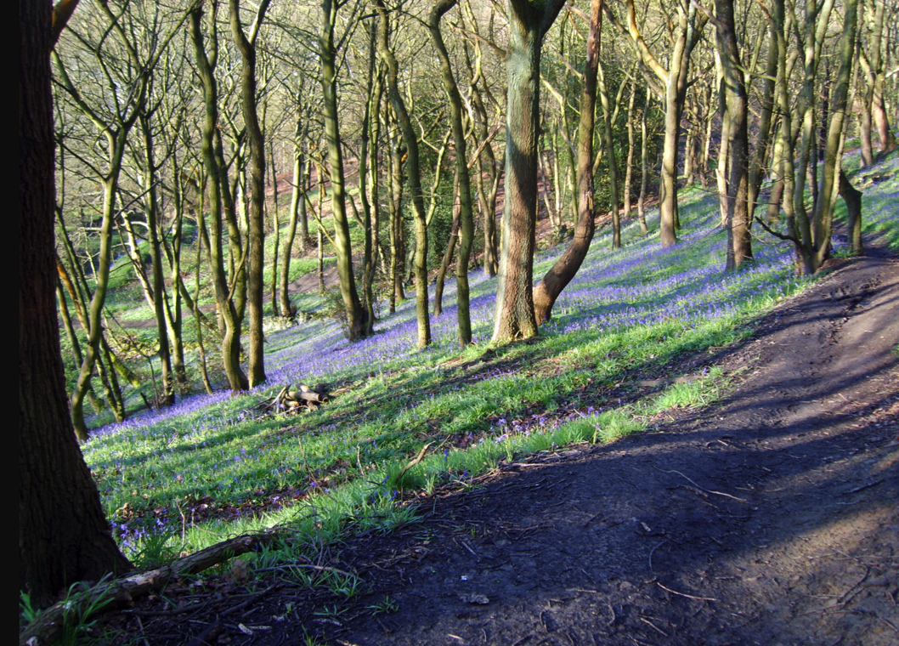
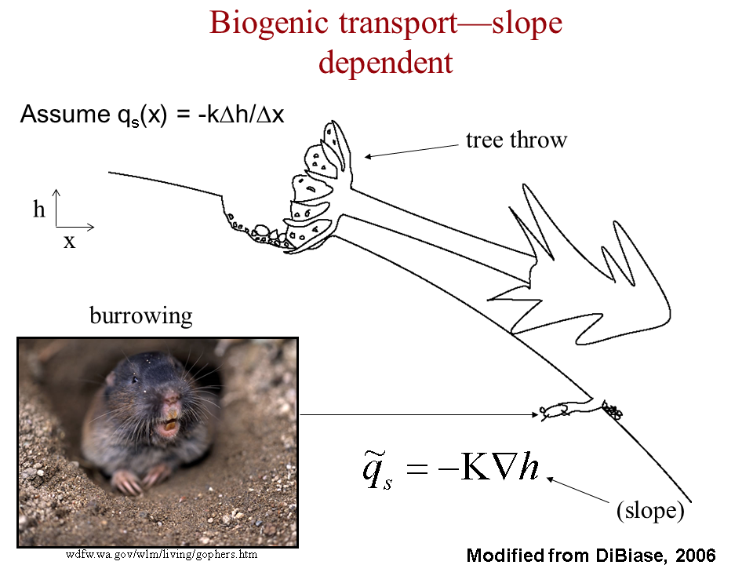
Biogenic transport: gophers + treethrow
Treethrow soil velocity of
~2 mm/yr for
Pacific NW, Appalachians,
Europe.
Soil thickness ~0.5 m,
drainage density 6 km⁻¹
→ 20 tons / km² / yr
Ramon Arrowsmith
Global average erosion rate ~ global average uplift rate U = 0.05 mm/yr

Slide 11
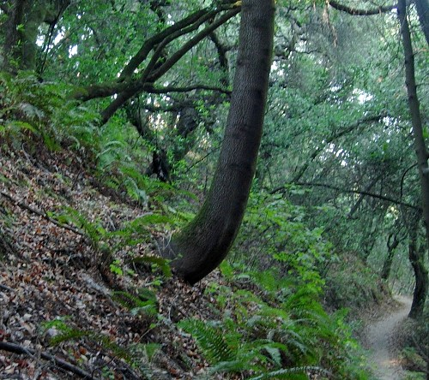
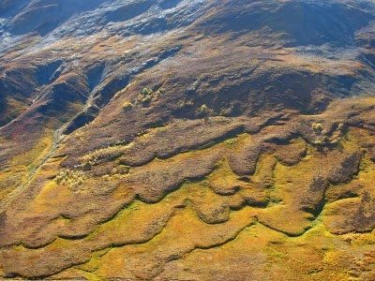
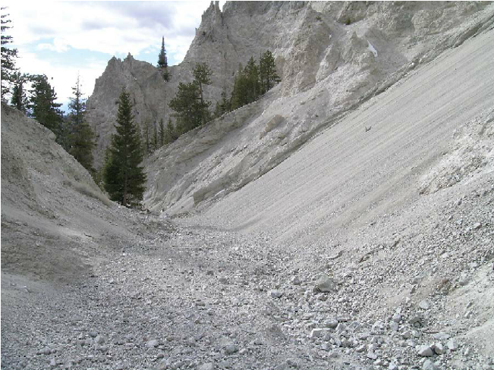
Soil creep
Wetting/drying cycles
Clays expand perpendicular to slope;
contract parallel to gravity.
Solifluction
Granular flow (dry ravel)

Slide 12
Fluvial sediment transport vs. hillslope processes: what controls the spacing of rivers?
SETTING THE SPACING OF STREAMS
HILLSLOPE EROSION PROCESSES SOIL PRODUCTION FUNCTION
SYNTHESIS: PERRON ET AL. 2009

Slide 13
Weathering
=“alteration of rocks and minerals by processes acting near or at the Earth’s surface.”
→ Changes in factors such as surface strength, permeability, particle size – which in turn
affect the rate of mass removal.

Slide 14
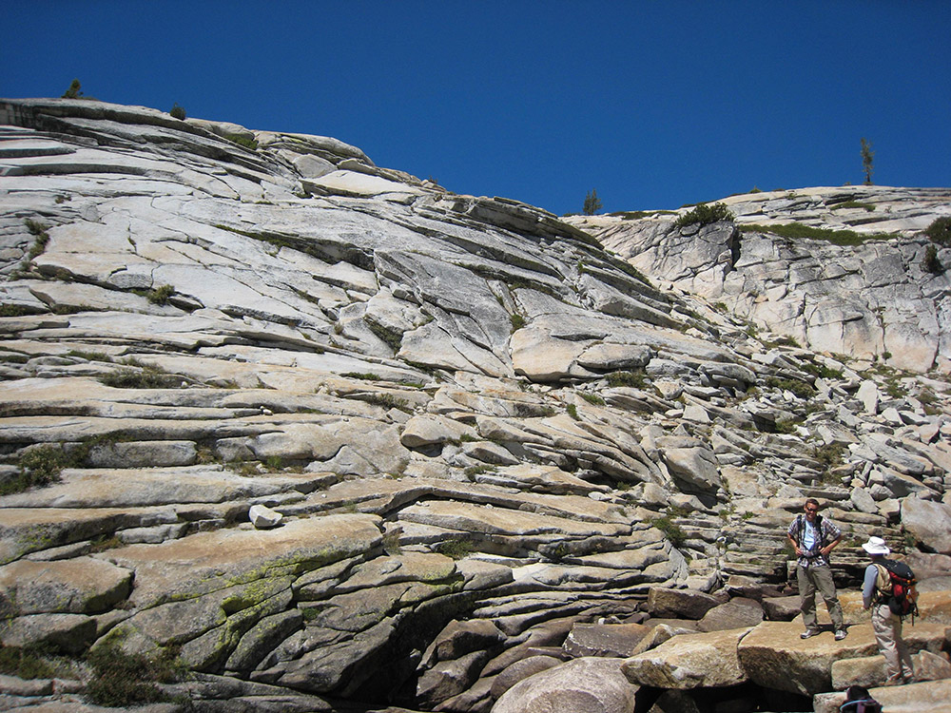
Physical weathering processes: (1) stress release in rocks subject to high tectonic or overburden pressure
“curvature fracturing”(?) – Martel GRL 2006
Valley-bottom fracturing
Tensile secondary unloading joints
St. Clair et al. Science 2015

Slide 15
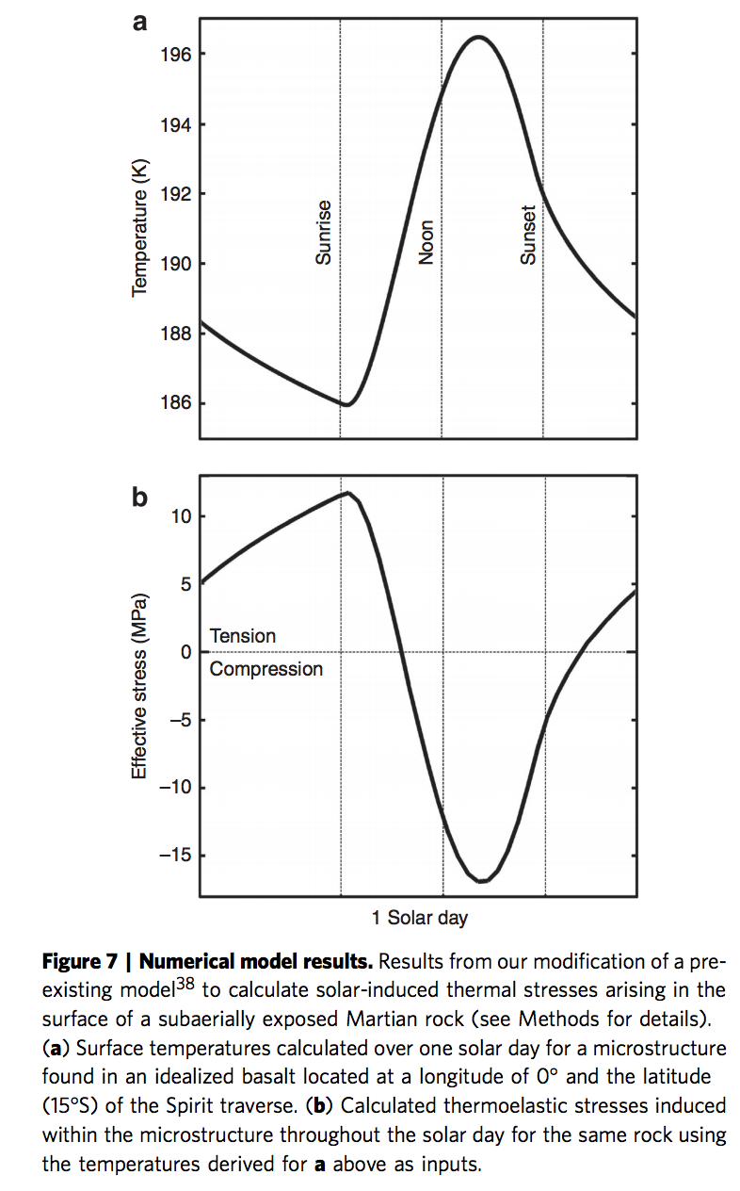
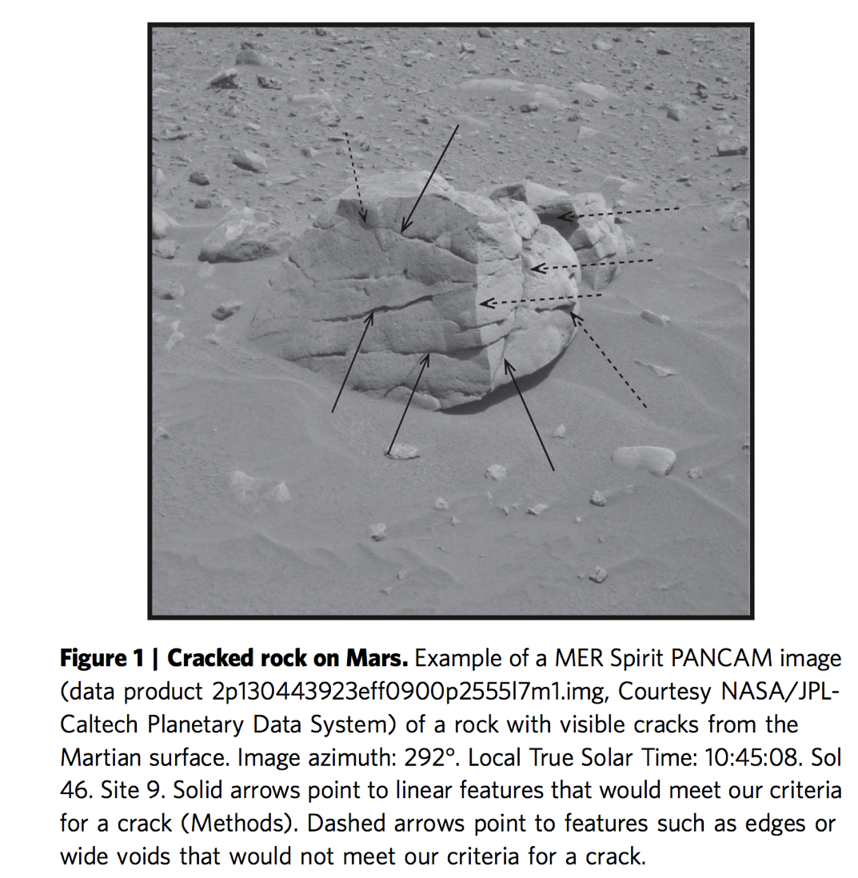
Physical weathering processes: (2) thermal cycling (hot day, cold night → stress gradient)
Eppes et al. Nature Communications 2015

Slide 16
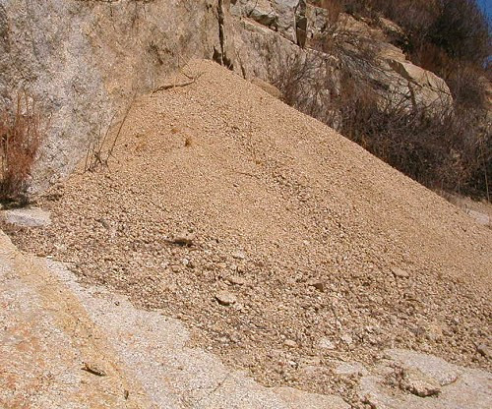
Physical weathering processes: (3) hydration (wetting and drying)
Swelling of micas → gruss on granites
Swelling of mudstones → clay
(4) growth in voids (frost, salt)
Hydrofracturing: thermochemical process at frost tip, not volume change
(5) Physical breakdown due to biota
Root growth, tree throw, burrowing
(6) Abrasion and comminution during transport
Discussed in previous lectures.

Slide 17
Chemical weathering processes: (1) solution Partial or complete dissolution of a mineral in a solvent; NaCl → Na⁺ + Cl⁻ (2) hydration Hydrolysis: addition of H2O to mineral; CaSO4 + nH2O → CaSO4.nH2O (3) hydrolysis
Chemical reaction due to H+ or OH- ions in water; i.e., water is reactant not just a solvent. E.g. albite NaAlSi₃O₈ + nH₂O → Na⁺ + OH⁻ + 2H₄SiO₄ + (1/2)Al₂Si₂O₅(OH)₄ kaolinite.
(4) chelation
Organic process by which metallic cations are incorporated into hydrocarbon molecules. (5) oxidation/reduction e.g. reddening of soils (ferrous → ferric)
(6) carbonation generation of bicarbonate ion and carbonic acid and its reaction with minerals.
Also: microbially mediated processes; pH due to respiration can be as low as pH 4.5
(this accelerates silicate weathering).

Slide 18
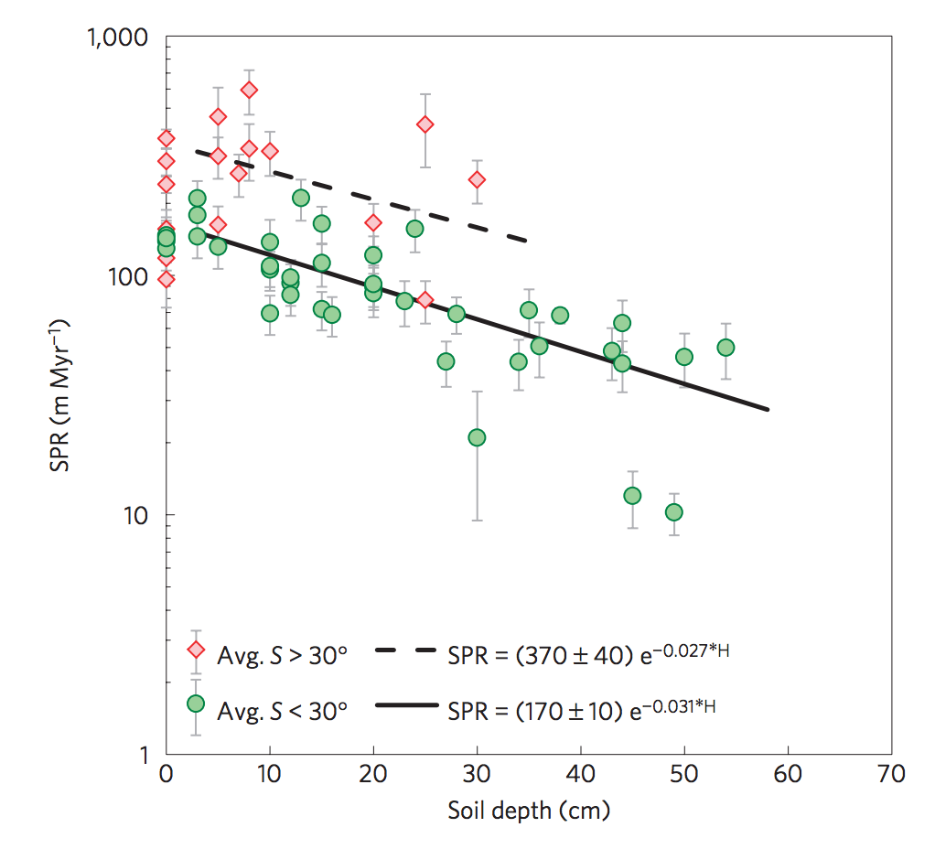
Soil Production Rate (SPR)
Heimsath et al., Nature Geoscience 2012
(bedrock exposed when erosion>max. SPR)
Soil production rates
quantified using
cosmogenic ¹⁰Be
(5 atoms/g/yr at sea level)
Earlier “humped” SPR
functions now considered
dubious
Transport-limited hillslope evolution
is well understood;
Weathering-limited hillslopes (e.g.,
Sierra Nevada) not well understood.
but see Larsen et al. Science 2014 for the claim that there is no speed limit on soil production

Slide 19
Fluvial sediment transport vs. hillslope processes: what controls the spacing of rivers?
SETTING THE SPACING OF STREAMS
HILLSLOPE EROSION PROCESSES SOIL PRODUCTION FUNCTION
SYNTHESIS: PERRON ET AL. 2009

Slide 20
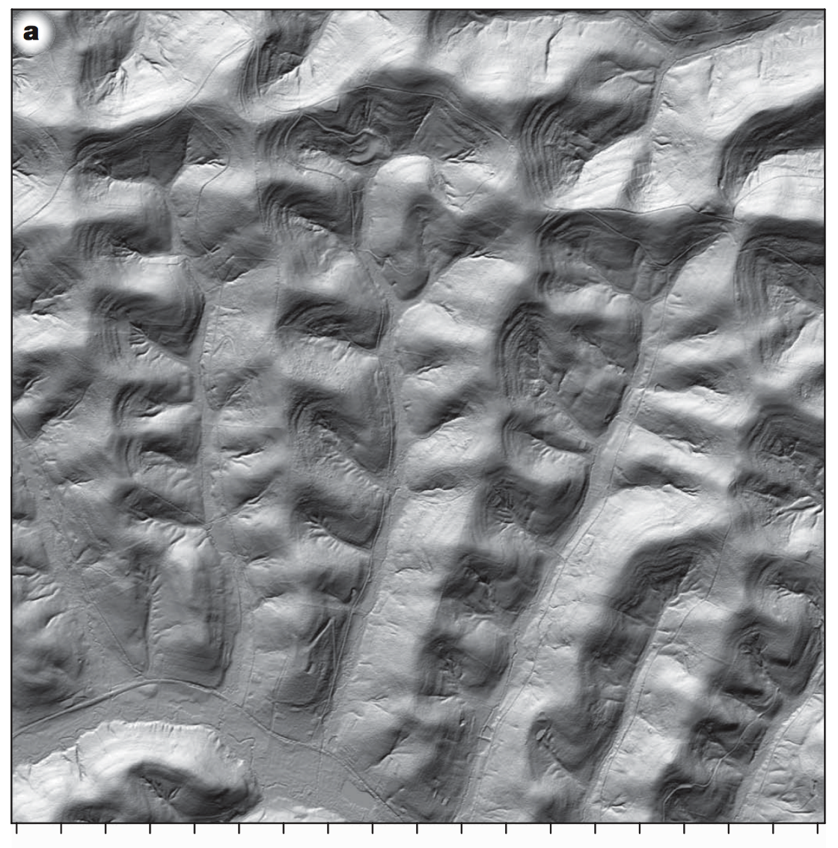
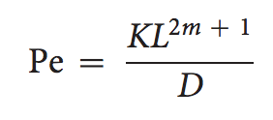
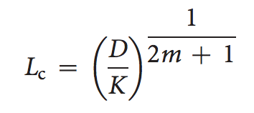
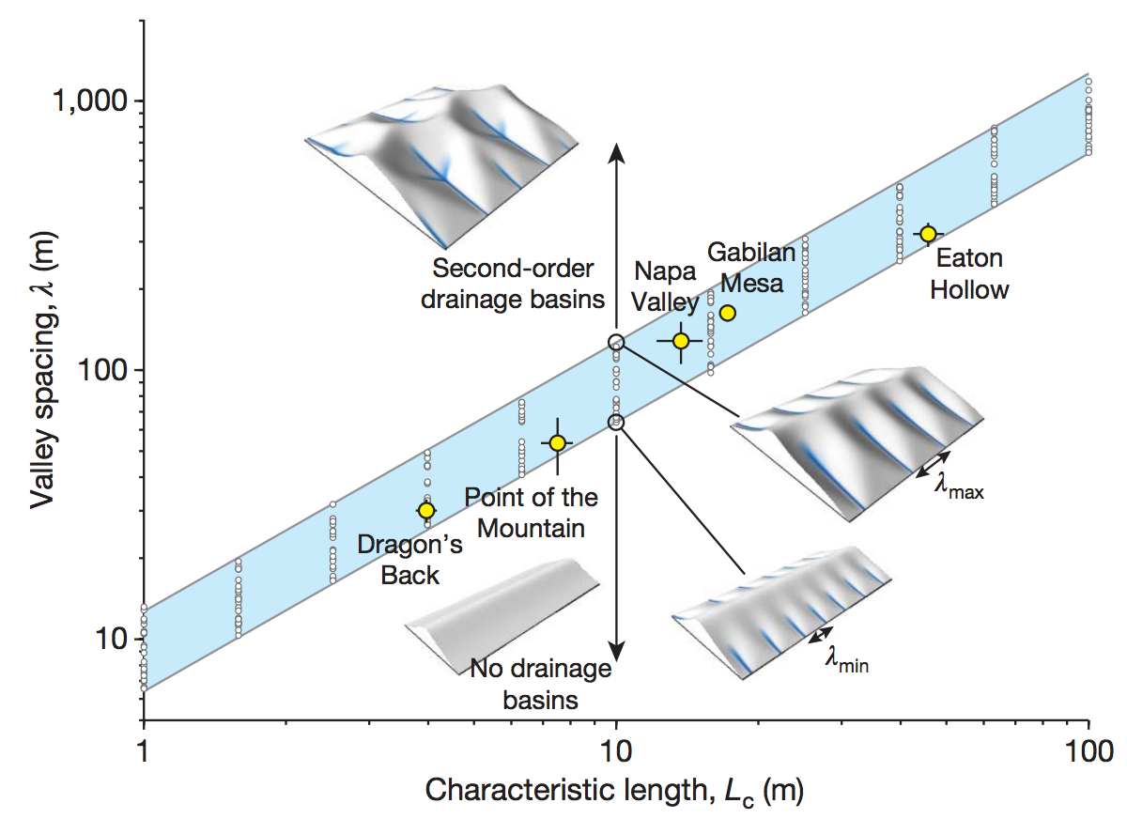
Set Pe = 1, solve for L:

Slide 21
Key points from today’s lecture
Explain mechanistically how streampower landscapes can act as a tectonic tape-recorder Explain why steady-state hillslopes are convex.
Explain 2 or more hillslope transport processes.
Know 2 or more physical and 2 or more chemical weathering processes.
Understand how Peclet number can quantify competition between hillslope processes and fluvial channelization (see also required reading).

Slide 22
Landscape evolution: sources of data
SOME MAJOR LANDSCAPE EVOLUTION PROBLEMS
DATE/RATE DATA ON EARTH
DATE/RATE DATA ON OTHER PLANETS
In the next lecture, you will be presented dates and rates as facts.
In this lecture, you will be shown the methods that generate these dates and
rates: their strengths, weaknesses, and ranges of validity.

Slide 23
Key points
For each Earth-based dating method, know the principle, advantages, disadvantages, example application, age range of application, for each technique.
Explain the evidence for and against a Pleistocene uptick in global erosion on Earth (two arguments for and two arguments against, plus geographic context)

Slide 24
Landscape evolution: sources of data
SOME MAJOR LANDSCAPE EVOLUTION PROBLEMS
DATE/RATE DATA ON EARTH
DATE/RATE DATA ON OTHER PLANETS

Slide 25
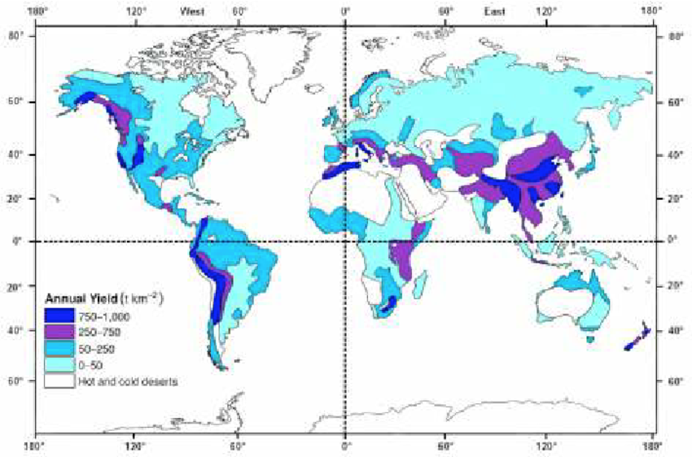
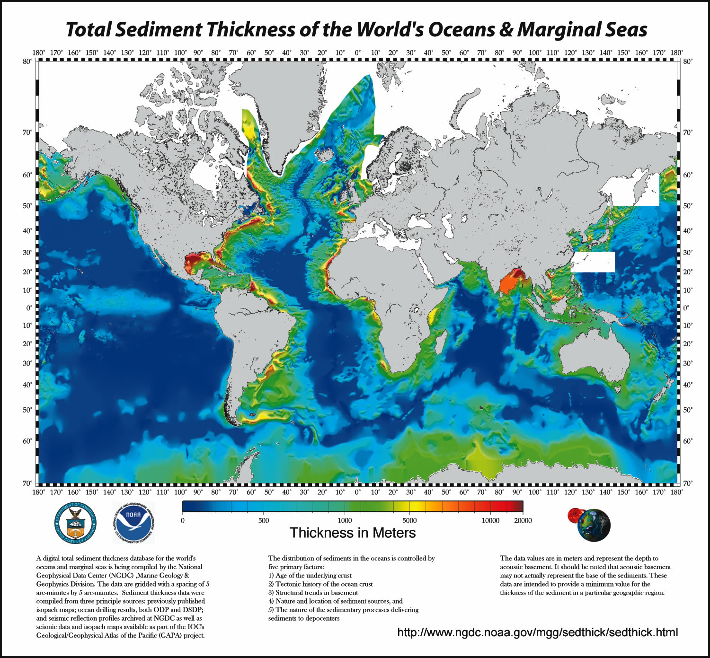
8 km³ of sediment were eroded from Earth’s continents each year (pre-dam), almost all by fluvial processes, mostly from Asia

Slide 26
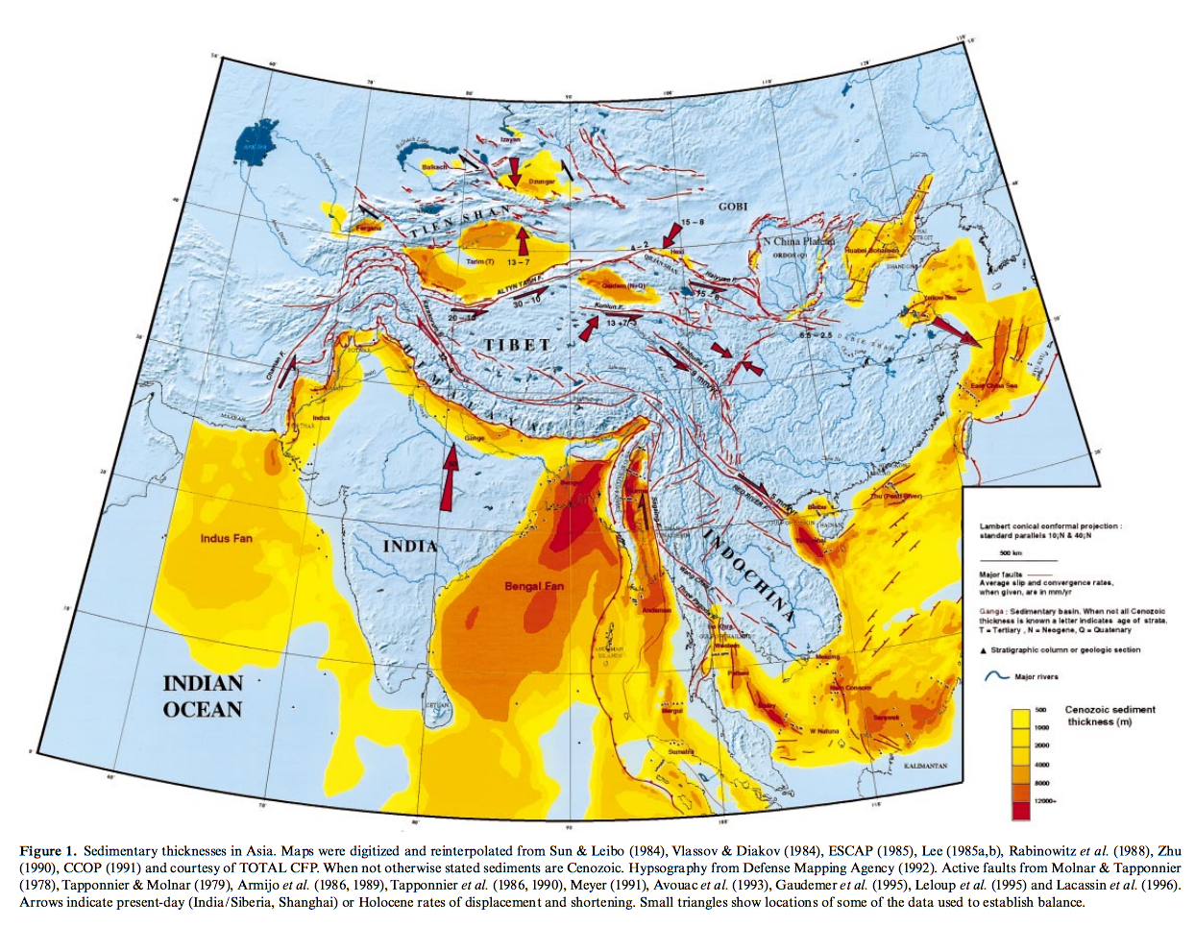
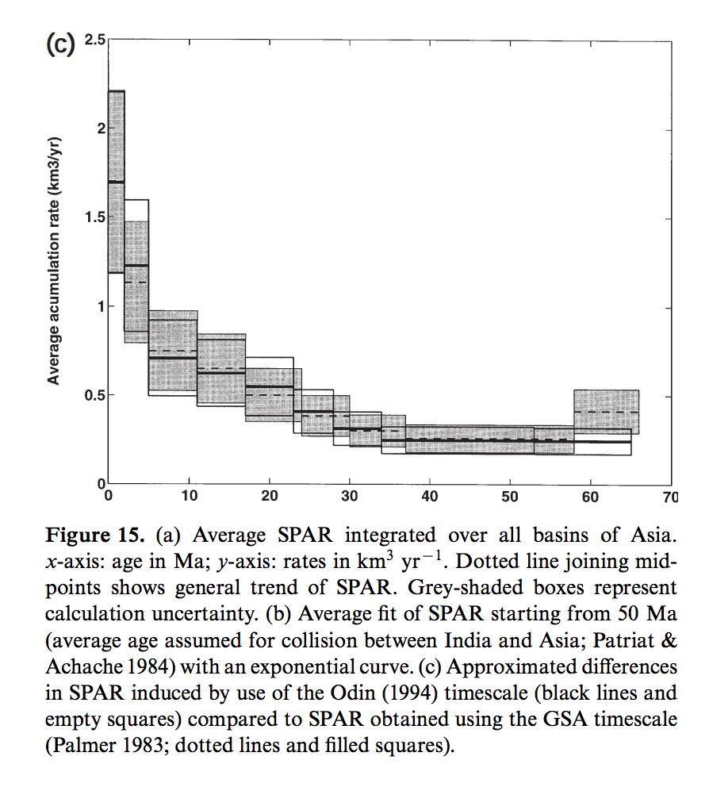
Offshore sediment accumulation rates indicate increase in erosion rates from Asia <2 Mya
Metivier et al. 1999 J. Geophys. Int.

Slide 27
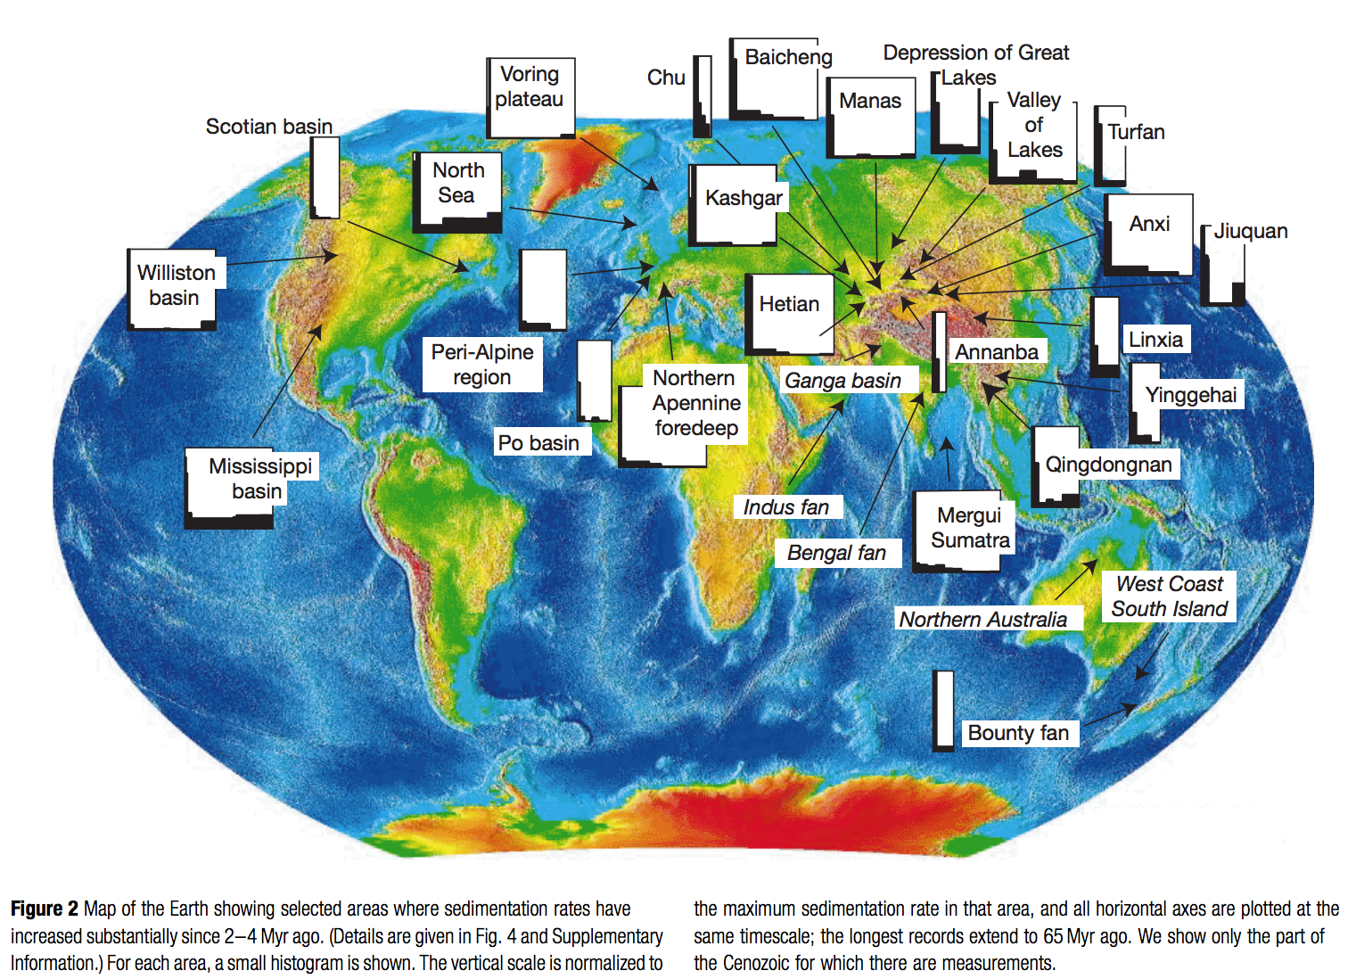
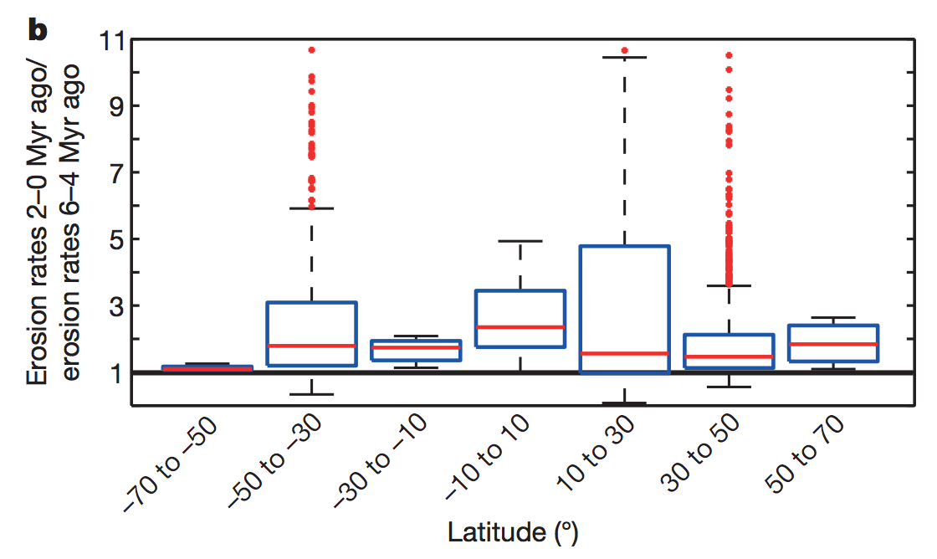
This increase has been reported from onshore Asia basins, and globally
Peizhen et al. Nature 2001
consistent with fission-track data from mountain belts:
Herman et al., Nature 2013

Slide 28
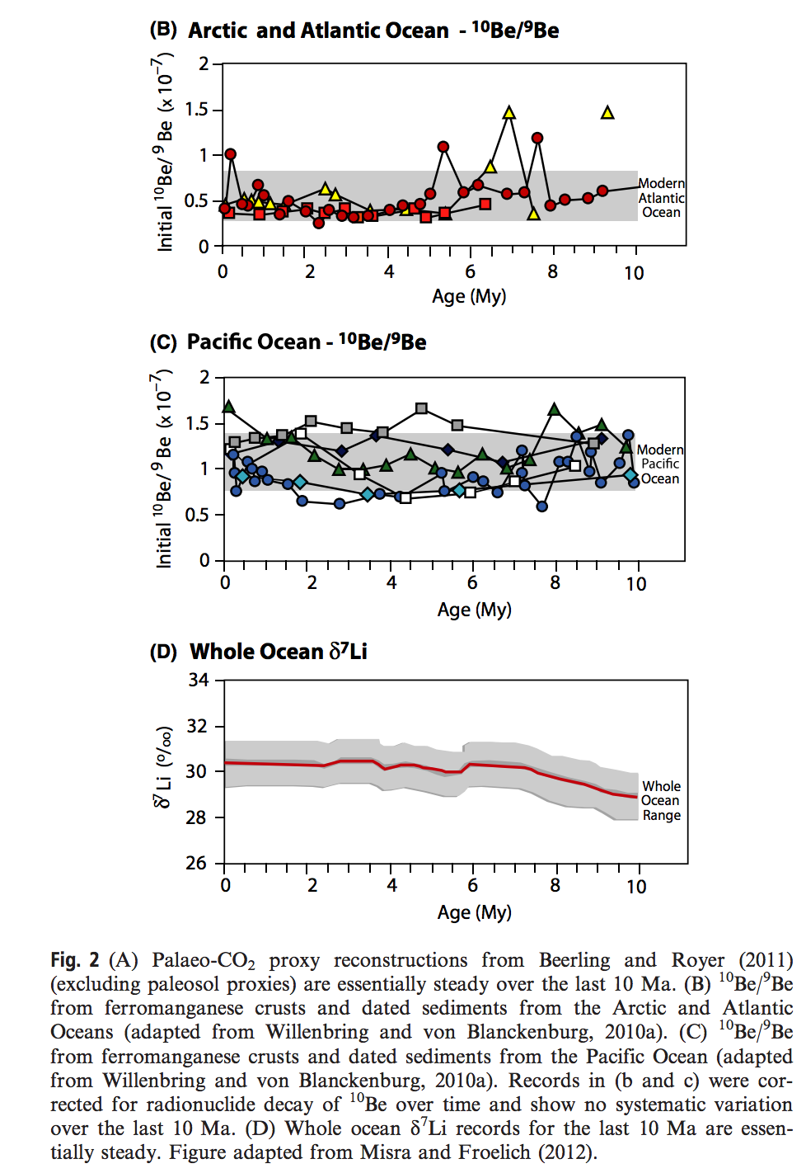
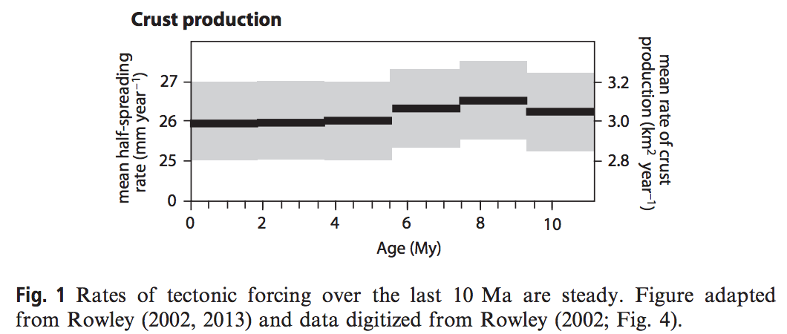
However, records of weathering & global tectonics are steady over the last 10 Ma.
Willenbring & Jerolmack, Terra Nova, 2016

Slide 29
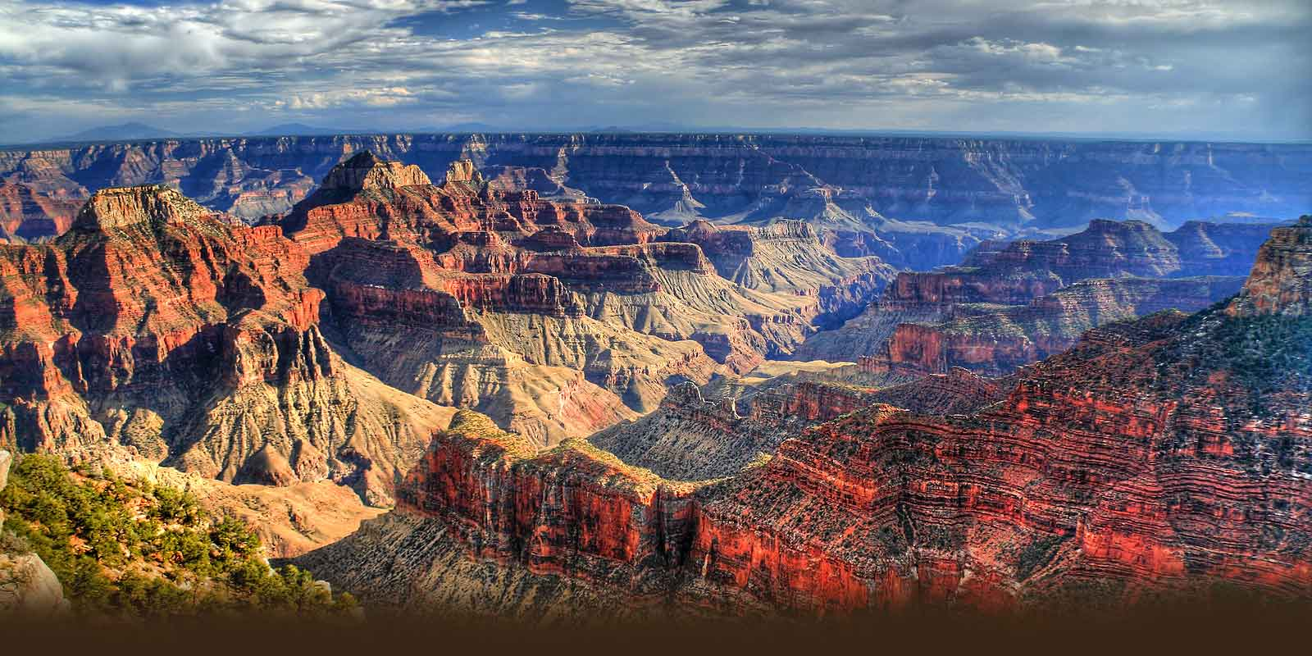
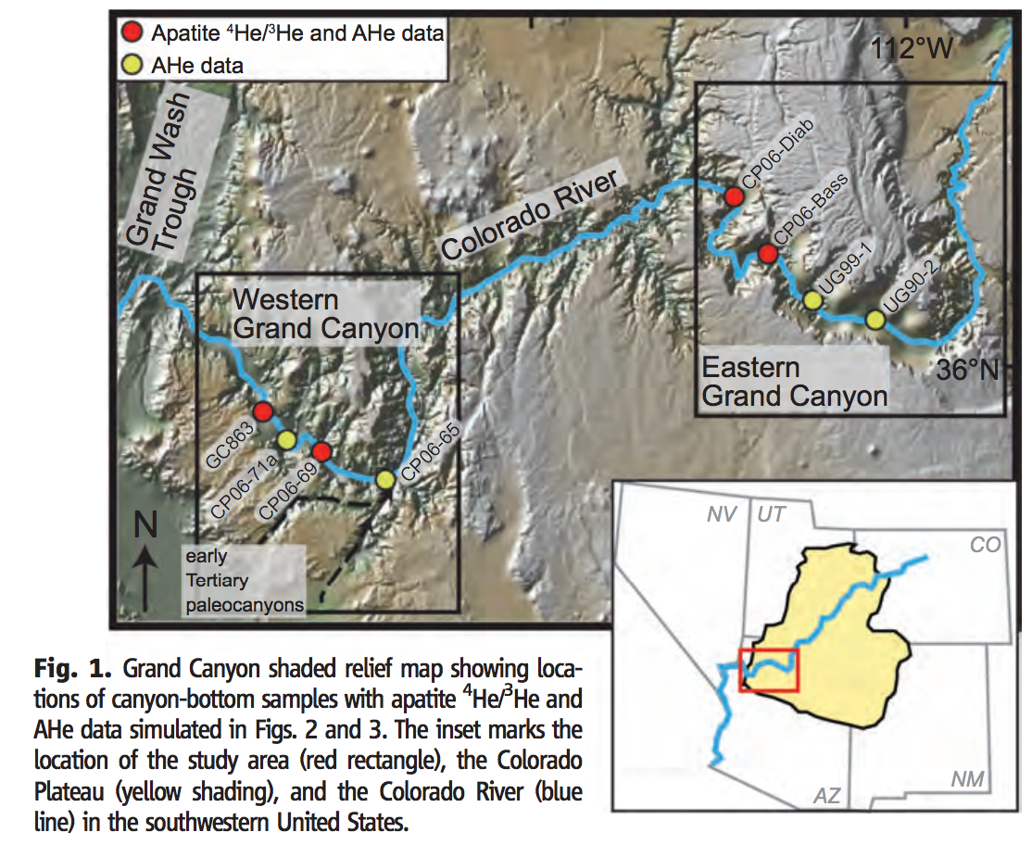
70 Ma formation of the modern Grand Canyon?

Slide 30
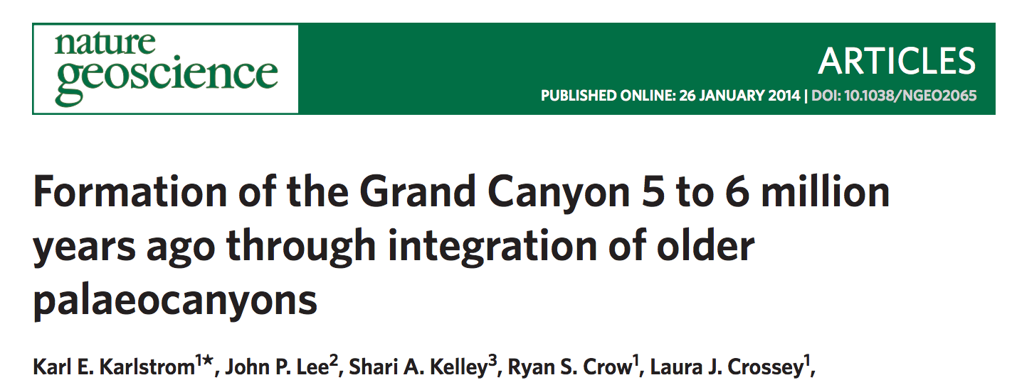
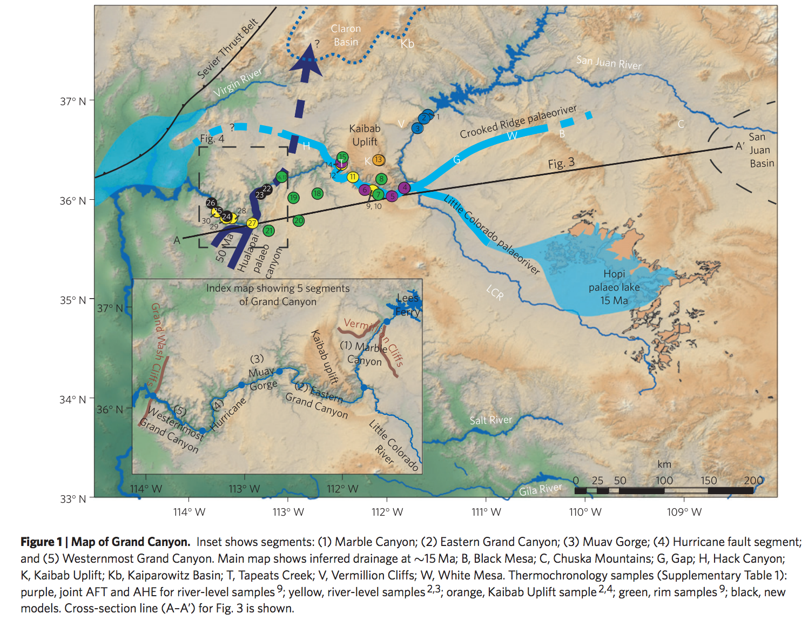
Alternative Grand Canyon formation
scenario: geologically recent drainage
reorganization.
Hindu Fanglomerate,
on S rim of W Grand
Canyon, 50 Ma,
derived from source
to Nwards.
Muddy Creek
Formation at distal
end of Grand Canyon:
no deposition before
6 Ma

Slide 31
Landscape evolution: sources of data
SOME MAJOR LANDSCAPE EVOLUTION PROBLEMS
DATE/RATE DATA ON EARTH
DATE/RATE DATA ON OTHER PLANETS

Slide 32
Count layers (tree rings, varves).
Optically stimulated luminescence.
Radiocarbon - ¹⁴C.
Spike of radioactive elements (e.g. tritium) associated with atmospheric nuclear testing.
Cosmogenic dating.
Fission track.
(U-Th)/He & other exhumation methods.
Shared event of known age.
The sedimentary record.

Slide 33
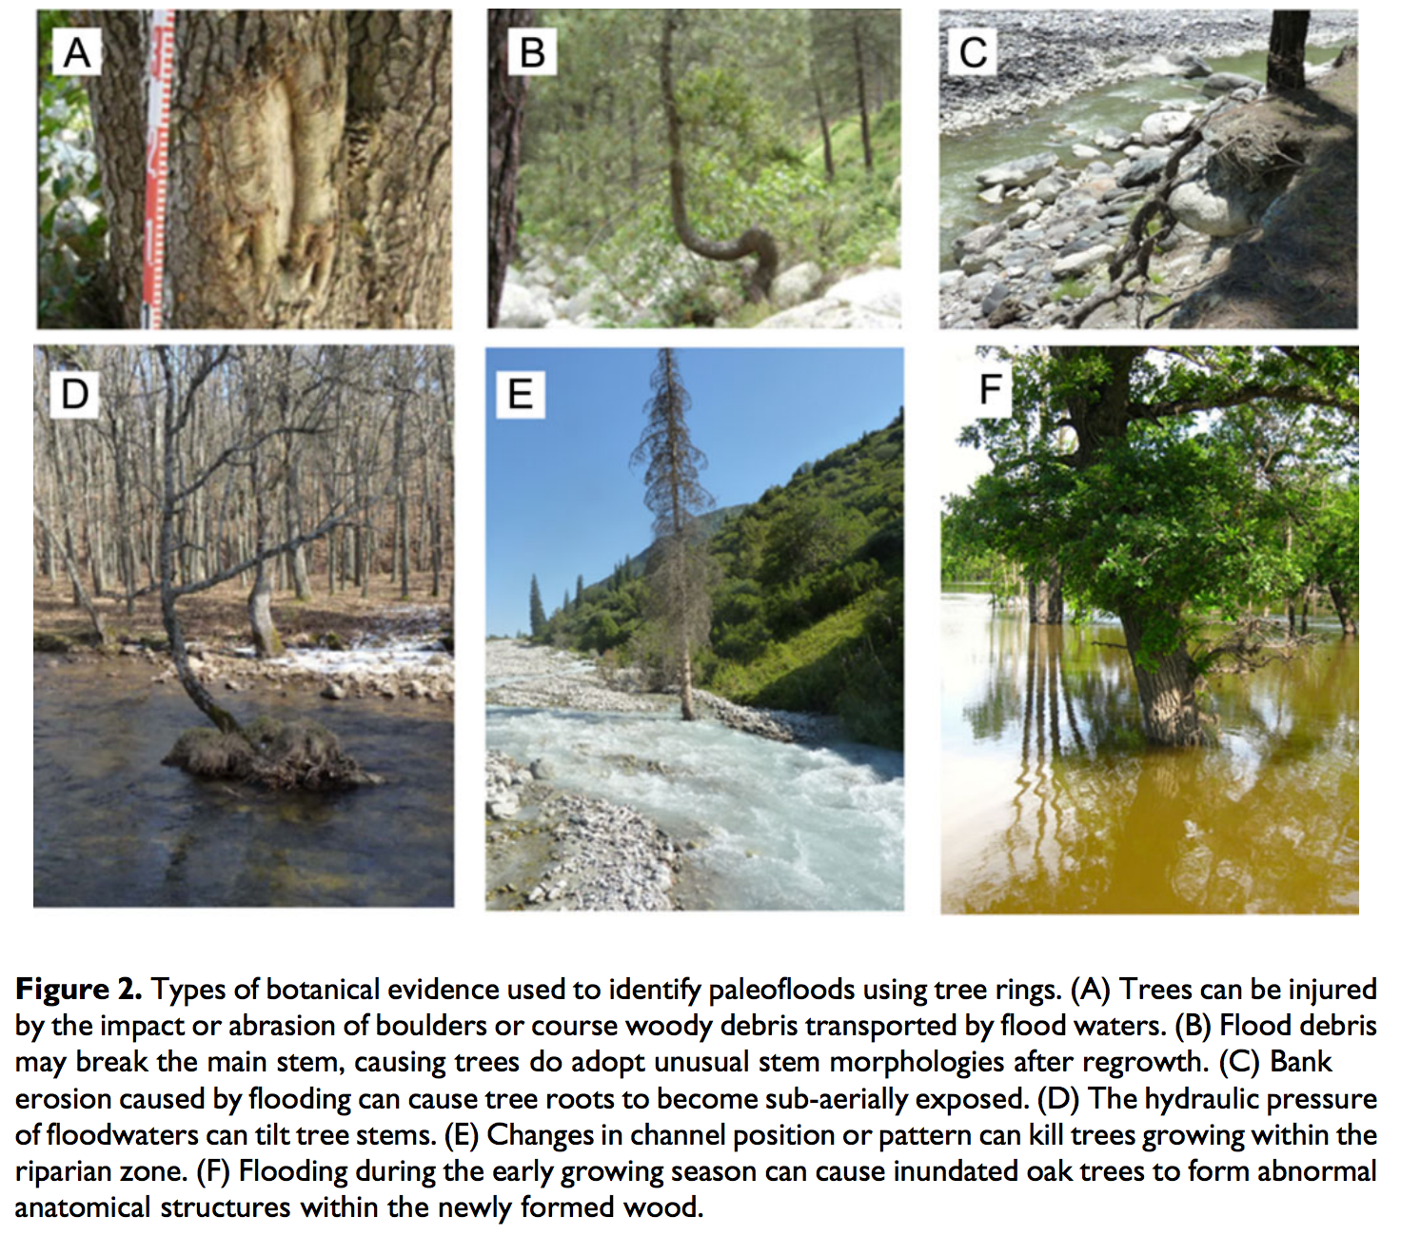
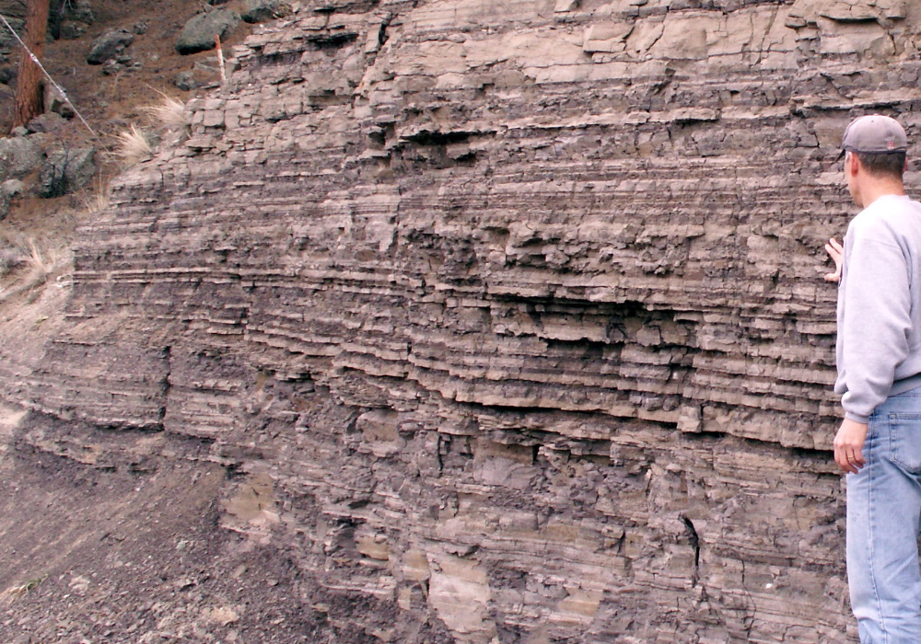
(1) Count layers (tree rings, varves)
Varves: annual layers, most
commonly in strongly-seasonal lakes
Tree rings – when found embedded in e.g.
flood deposits
Ballesteros-Cavenos, Prog. Phys. Geogr. 2015

Slide 34
Example application: mass movements and debris flows → tree death in Southern Alps
Strengths: Well-established, interlocked chronologies for most continents.
Weaknesses: Requires wood preservation (for tree rings). Rarely, tree ring years are “missing” in individual trees.
Time range of application: to 15 Kyr (tree rings); to ~14 Kyr (Cariaco varves); out to 30 Kyr
(“floating” varve chronologies, e.g. Lake Suigetsu)

Slide 35
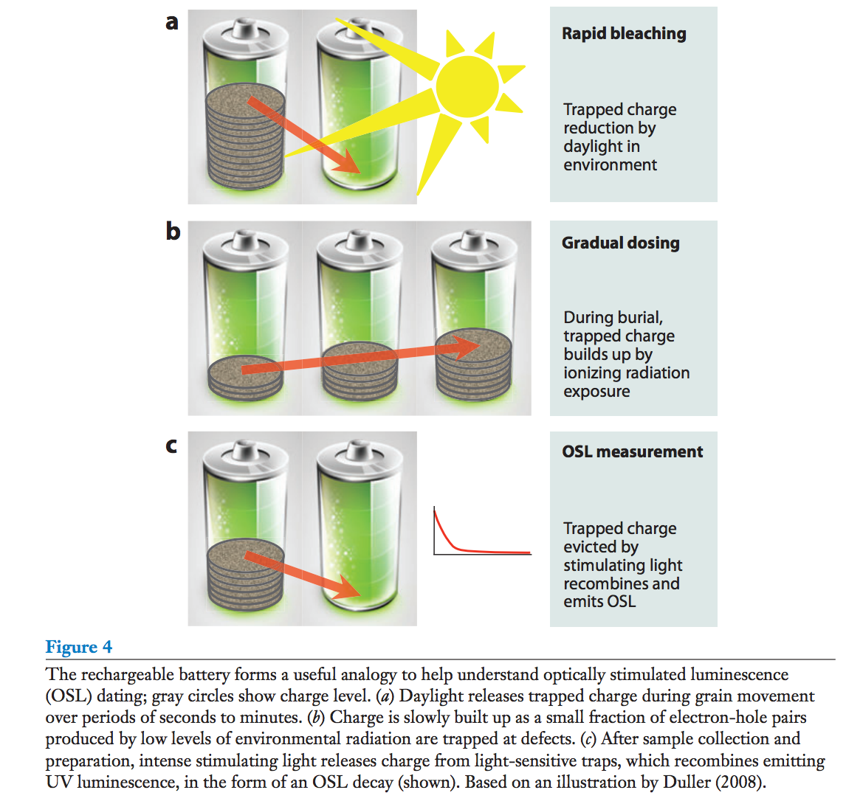
(2) Optically Stimulated Luminescence (OSL)
Rhodes et al. Annual Reviews
2011
Strengths: date sand dune overturn, beach sands …
Weaknesses: 5-10% uncertainty; usually requires quartz; collection can be difficult (age reset by 1s of light).
Age range of validity: 0.1-350 Kyr with quartz (out to 1 Myr with feldspar)

Slide 36
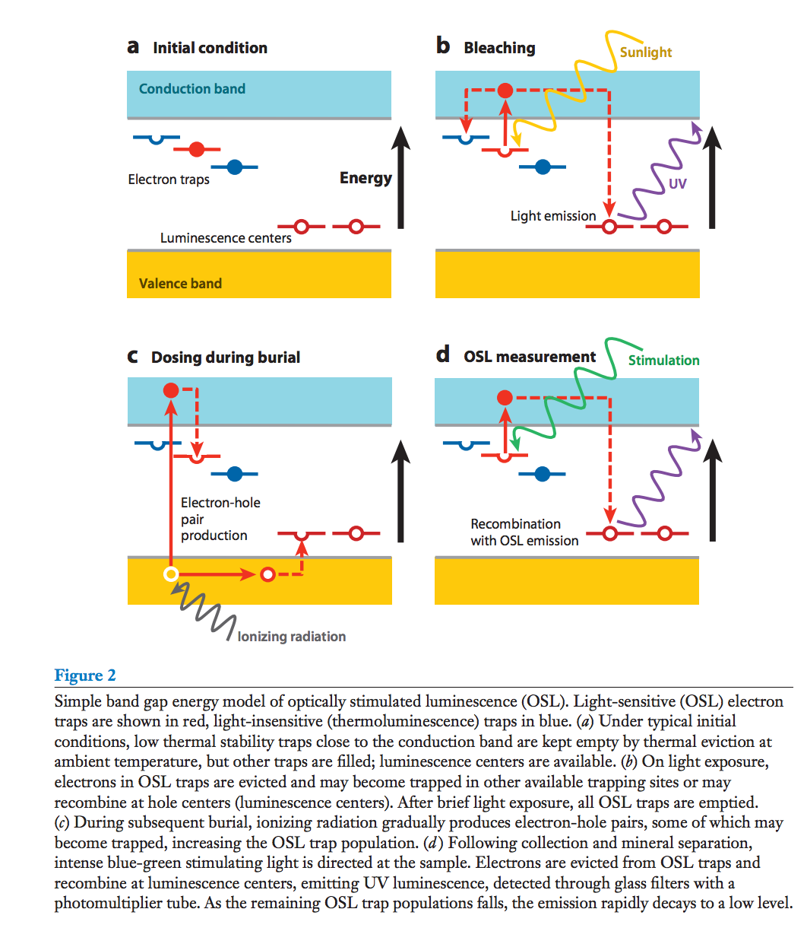
Mechanism of OSL:

Slide 37
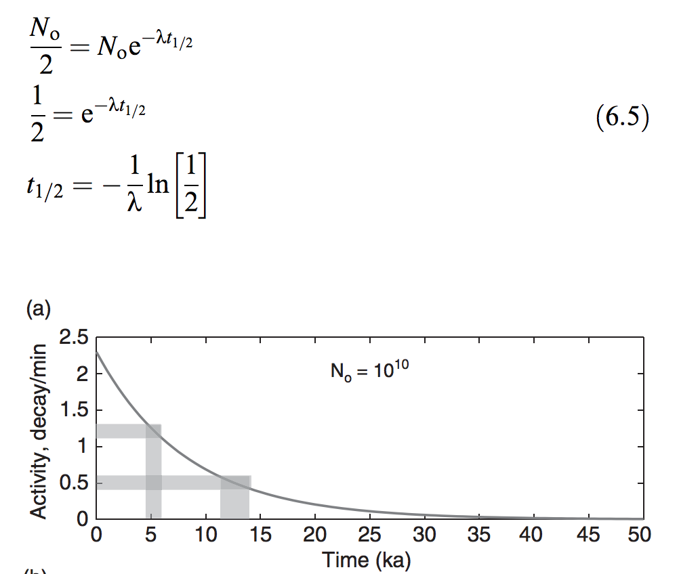
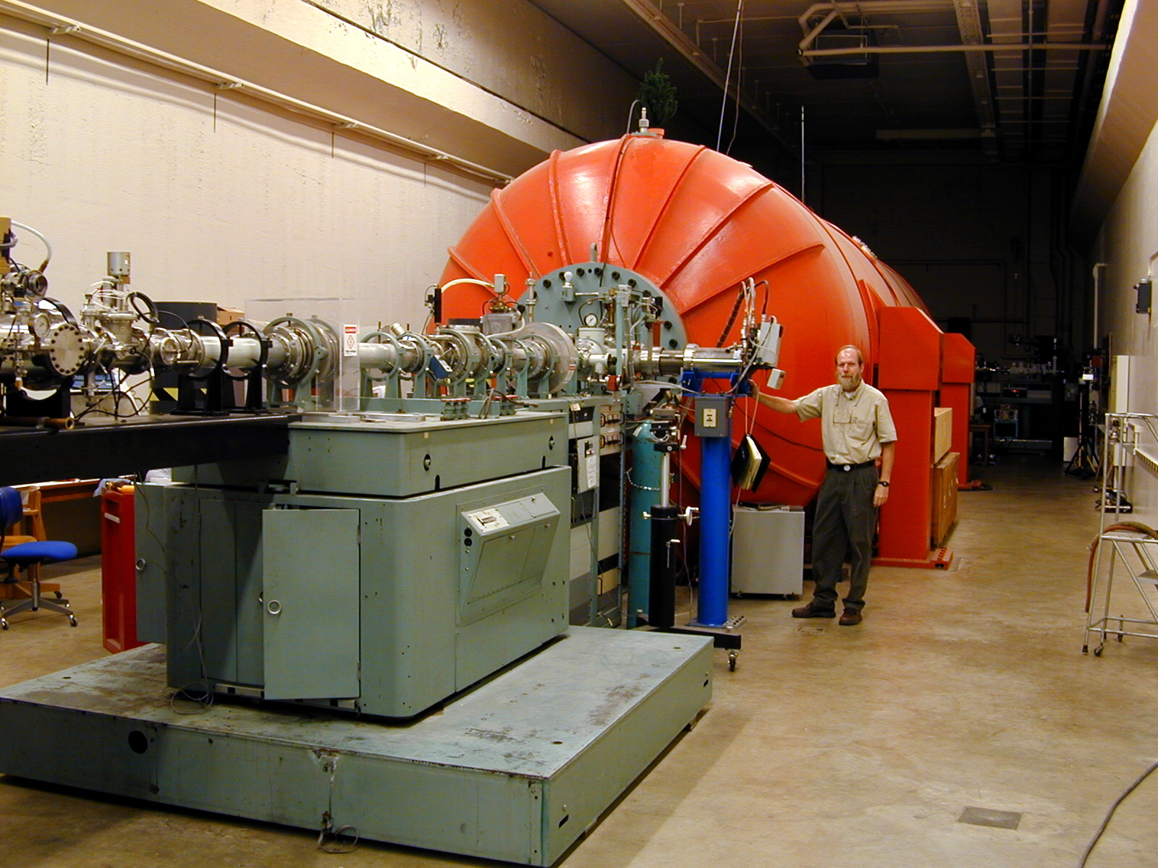
(3) Radiocarbon - ¹⁴C.
Atmosphere contains ¹⁴C (half-life 6 Kyr) due to cosmic-ray bombardment
Plants/soil organisms take up ¹⁴C from atmosphere and isolate it upon burial
Isolation date can be constrained by measuring present-day ¹⁴C concentration.
New method: Accelerator Mass Spectroscopy
Eliminates molecular isobars (e.g. ¹³CH) by
accelerating sample to >>KeV and passing
through a thin graphite foil.
Strengths: Precise, widely used,
can date soil profiles & fluvial deposits.
Example weaknesses: Reworking of old wood,
decay of ancient organic matter.
Time range of validity: 50+ Kyr
Mark Chaffee (Purdue)

Slide 38
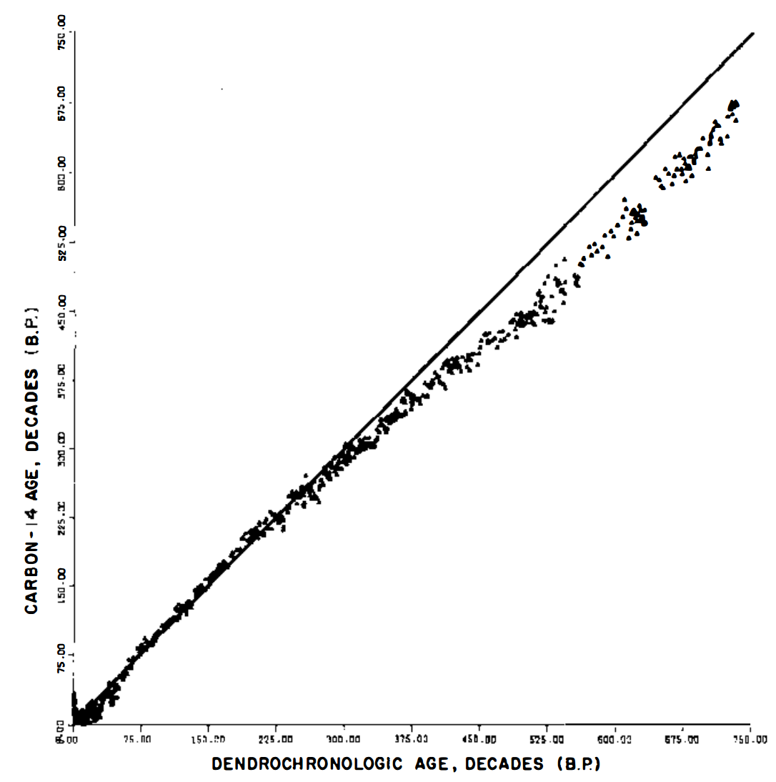
¹⁴C measurements are very precise, but are affected by several systematic biases. “¹⁴C age” is not equal to actual age. Ages are reported this way to allow for future improvements in ¹⁴C de-biasing.
Past atmosphere contained
more radiocarbon
Damon et al. Annual Reviews 1978

Slide 39
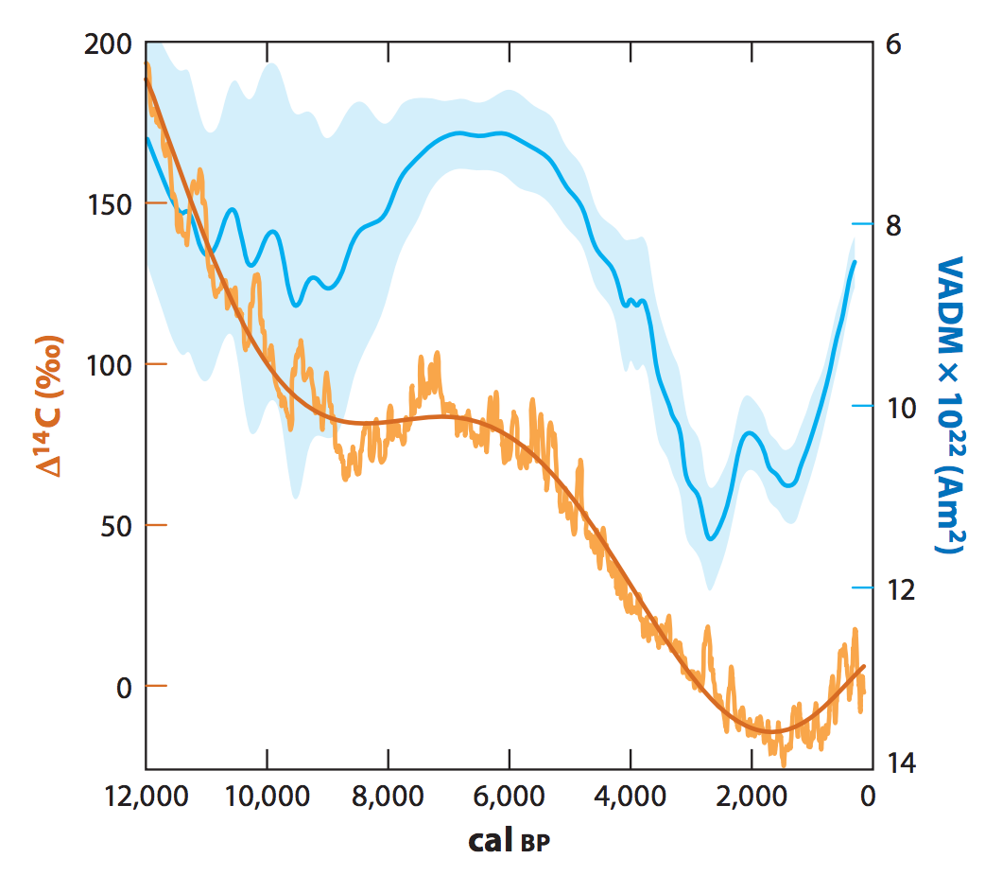
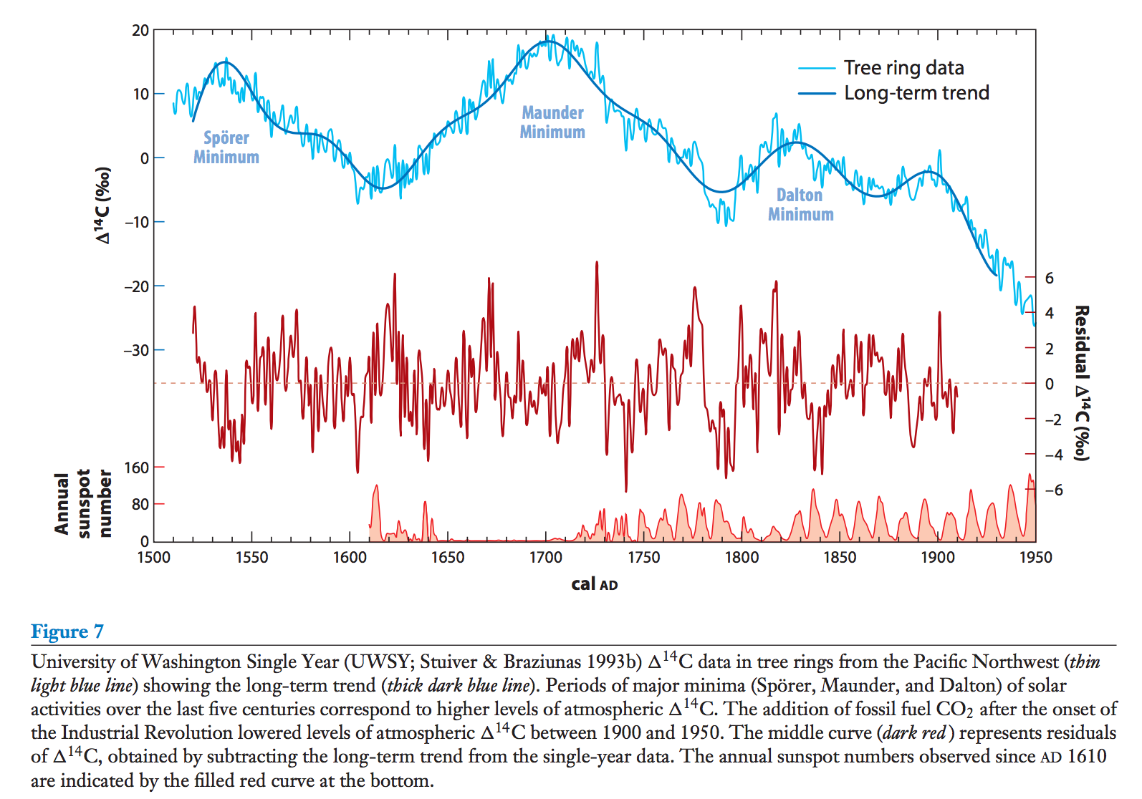
¹⁴C uncertainty is affected by variations in the rate of production (& atmospheric content) of ¹⁴C.
Varying magnetic field on Earth:
Varying solar activity (De Vries effect):
VADM = Virtual Axial Dipole Moment
(Strength of Earth’s magnetic field)
Also: Varying rates of atmosphere-ocean exchange.

Slide 40
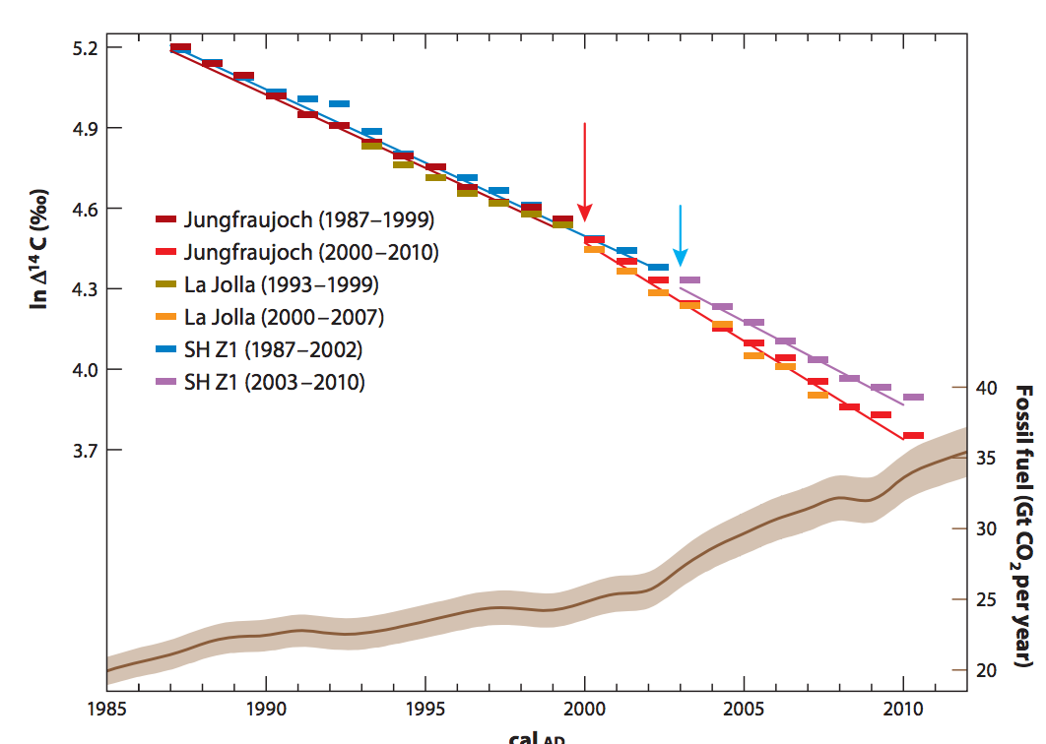
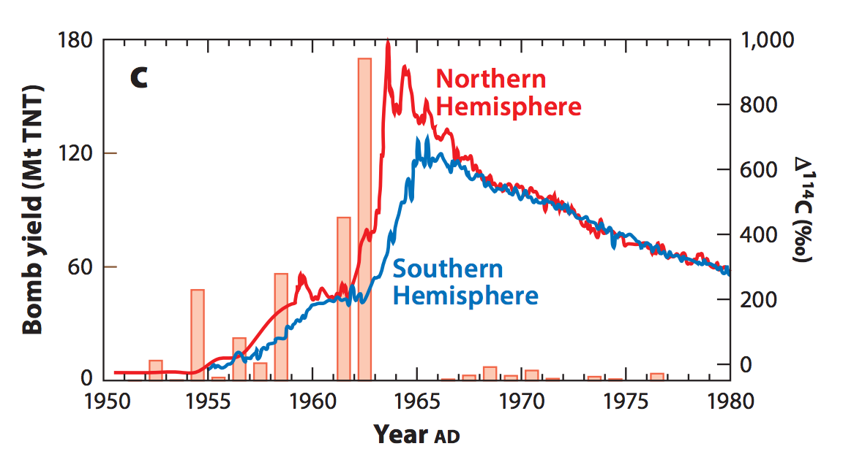
(4) Spike of radioactive elements (e.g. tritium) associated with atmospheric nuclear testing
Also: fossil-fuel burning dilutes
atmopsheric C with radioactively-inert
C
Dutta, Annual Reviews, 2016

Slide 41
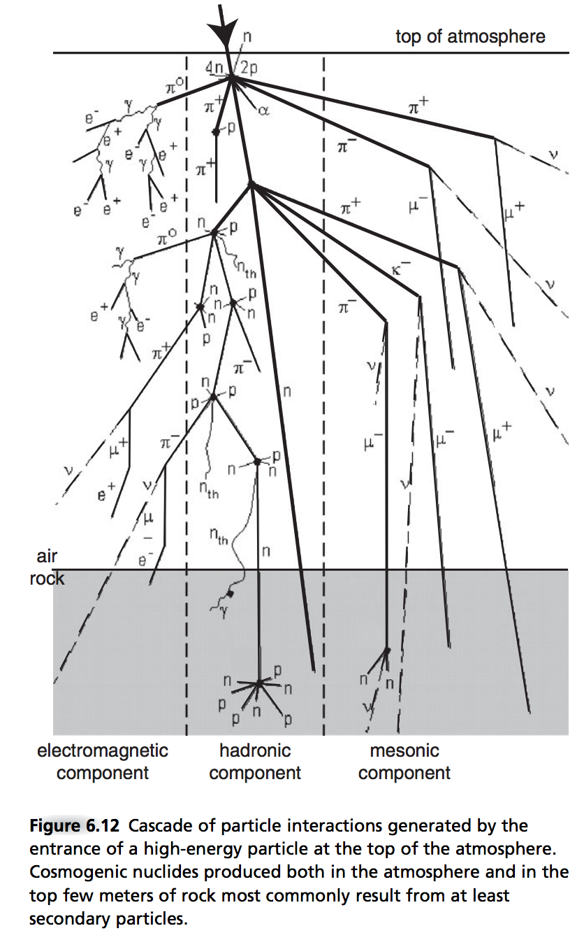
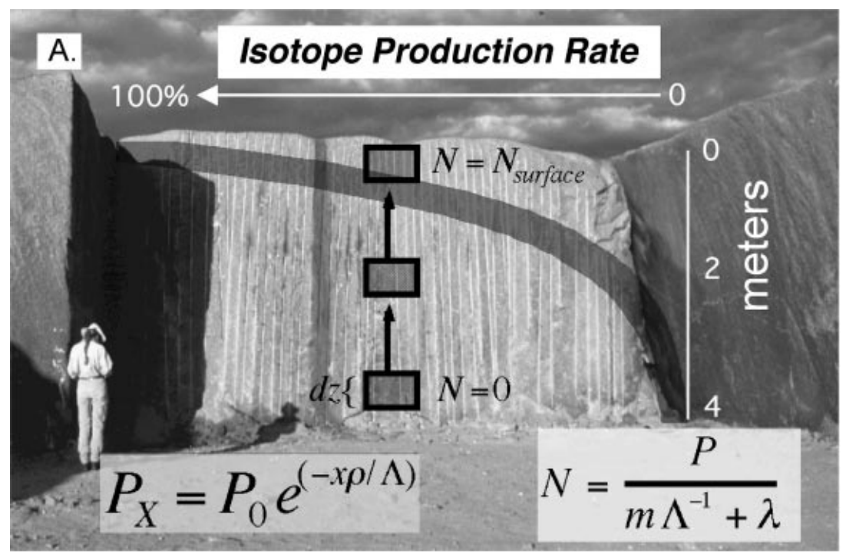
(5) Cosmogenic dating
Alongside LIDAR, one of the
two most important innovations
in geomorphology in the last 20
years
Produced within rock (not absorbed from atm.),
mostly by neutrons
10Be, 26Al, 36Cl are radioactive
Depth profiles allow correction for inheritance
Bierman & Nichols Annual Reviews 2004
Anderson & Anderson, ch. 6

Slide 42
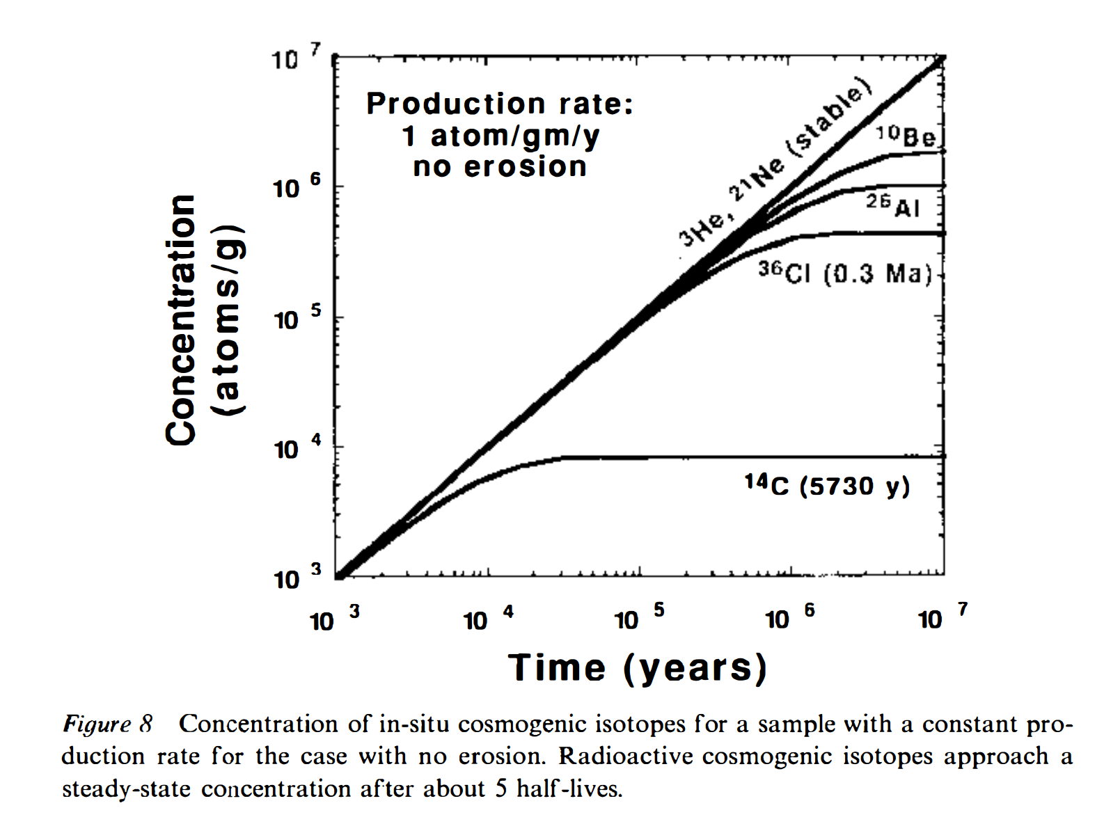
Equilibrium between production and decay for cosmogenic radionuclides with no erosion

Slide 43
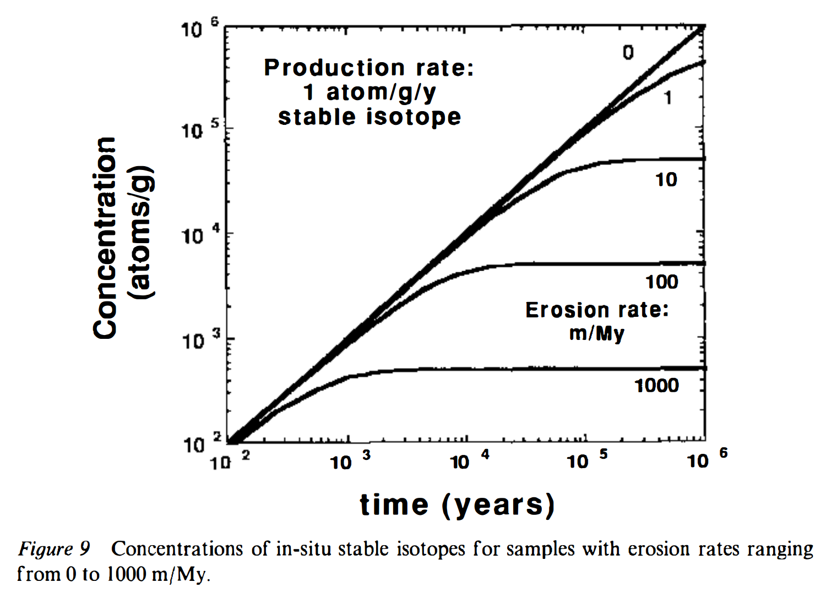
Equilibrium between production and erosion for a stable cosmogenic isotope (e.g., 3He)

Slide 44
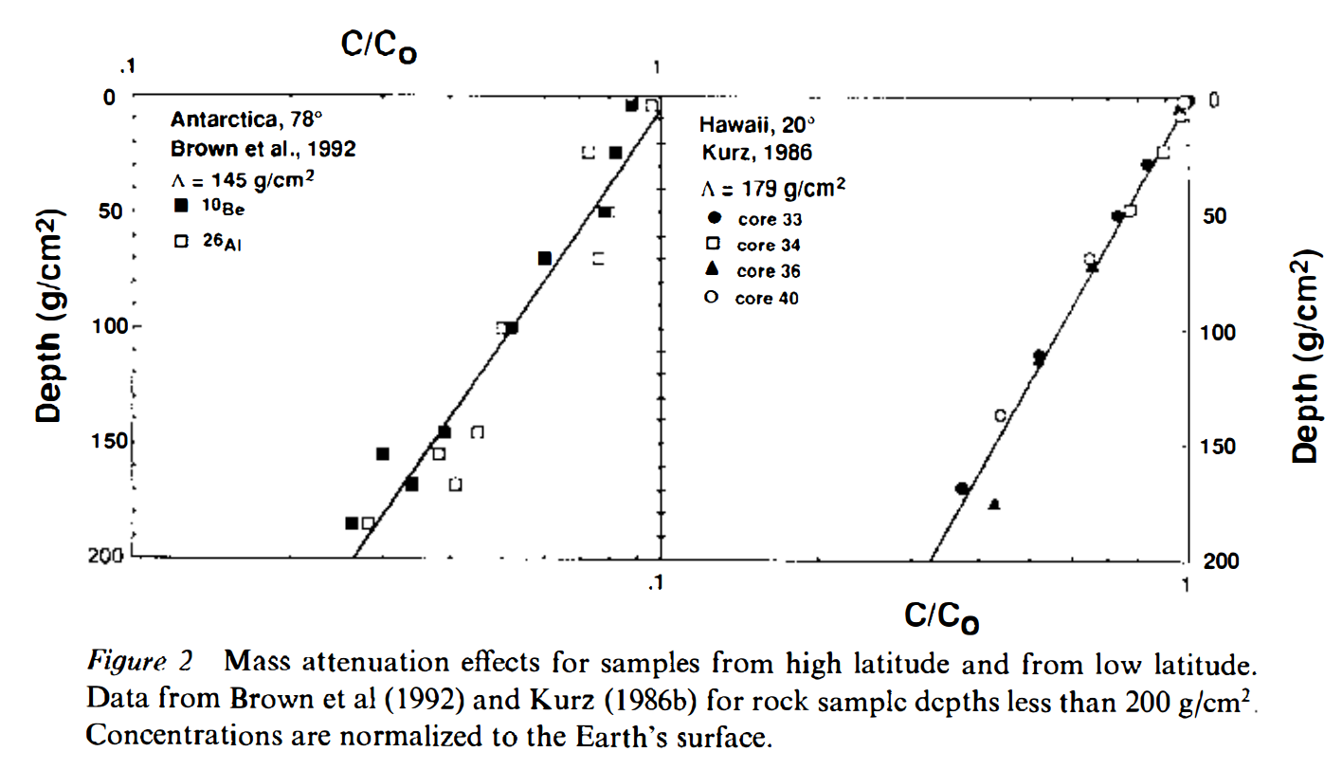
Softer cosmic ray energy spectrum
at high latitudes (due to Earth’s magnetic field)
Cerling & Craig,
Annual Reviews 1994

Slide 45
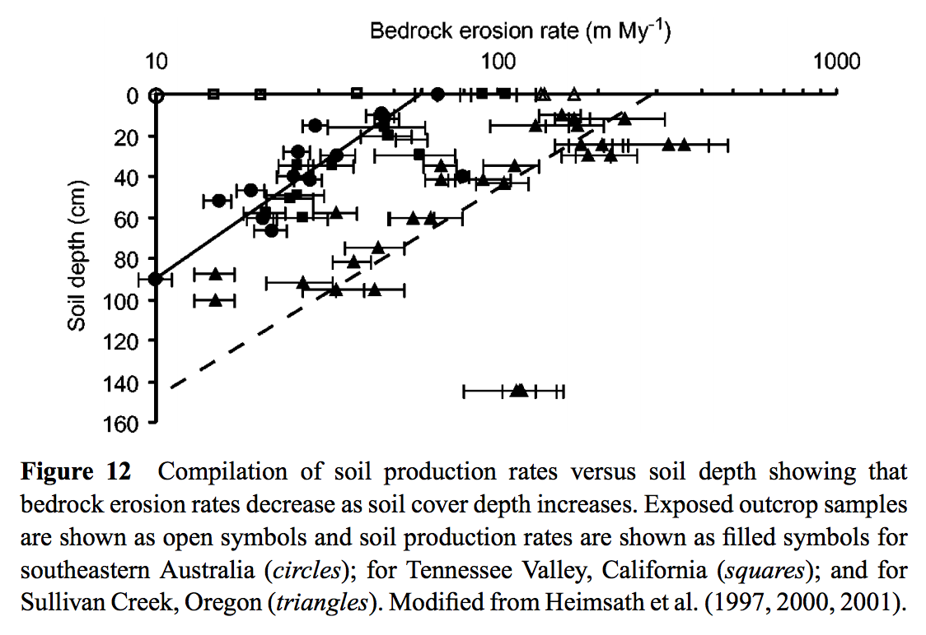
Bierman et al. Annual Reviews 2012

Slide 46
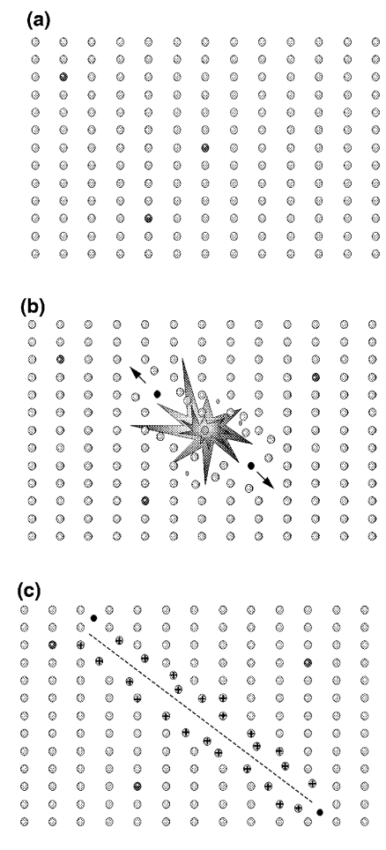
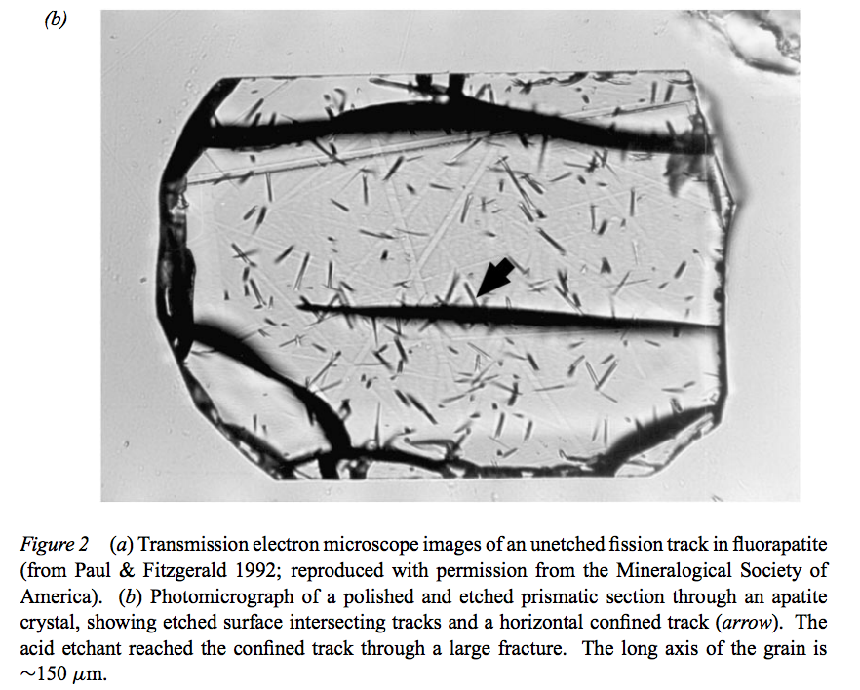
(6) Fission track dating
Gallagher et al. Annual Reviews 1998

Slide 47
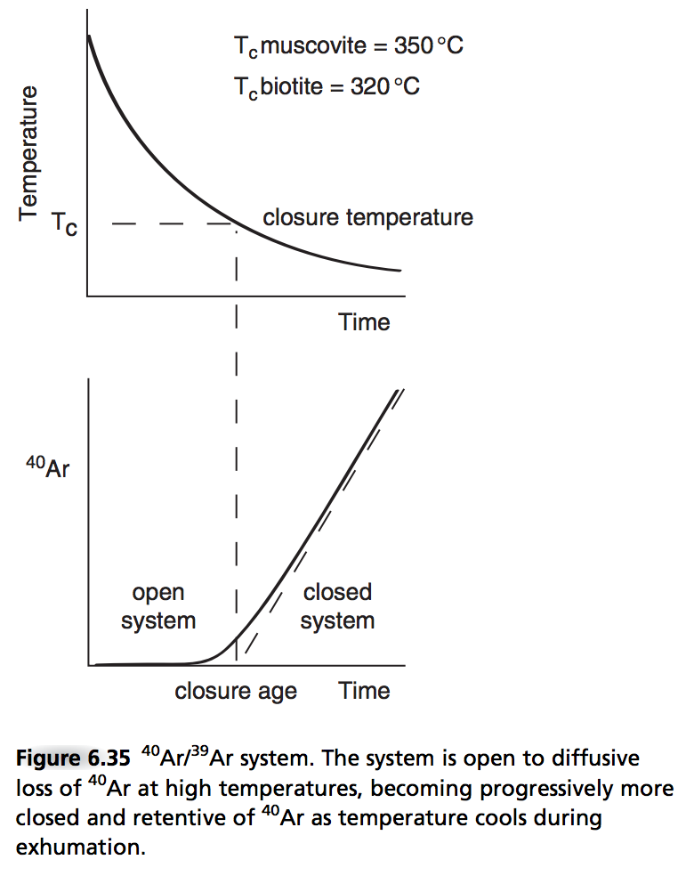
The meaning of “closure temperature”
Closure temperature varies
depending on what’s escaping,
and on what mineral it’s escaping
from.

Slide 48
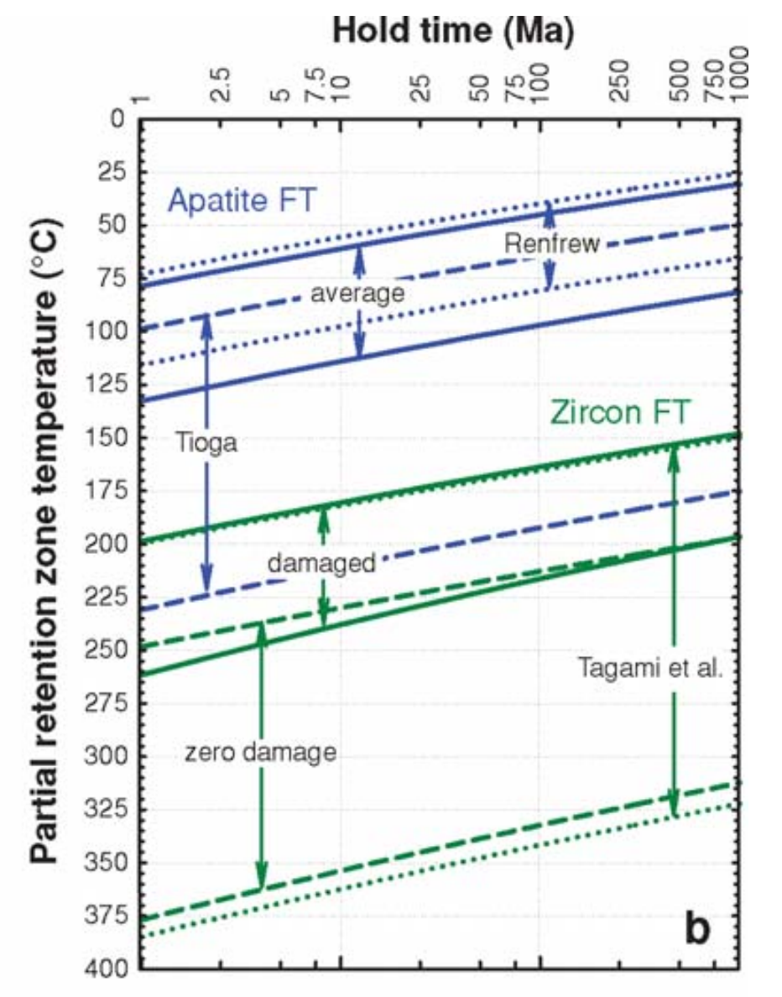
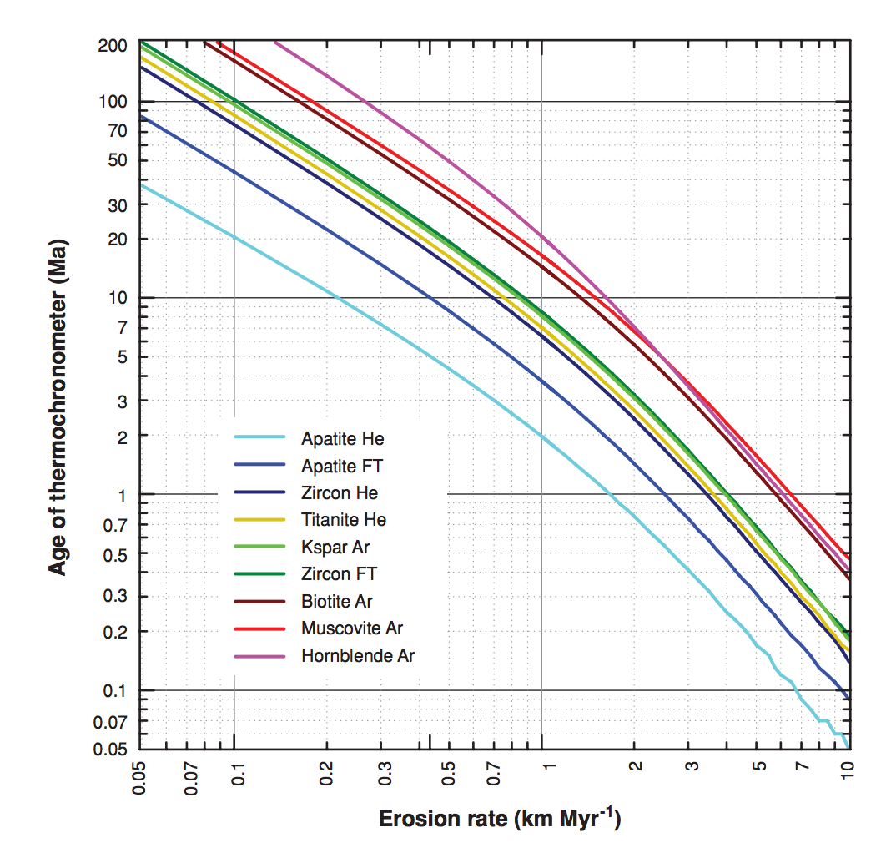
(6) Fission track.
why are these
not straight lines?
Mountain belt uplift:
Pe = L*u/kappa ~ 30 km*(1 mm/yr)/10⁻⁶ m²s⁻¹ ~ 1
Reiners & Brandon,
Annual Reviews 2006

Slide 49
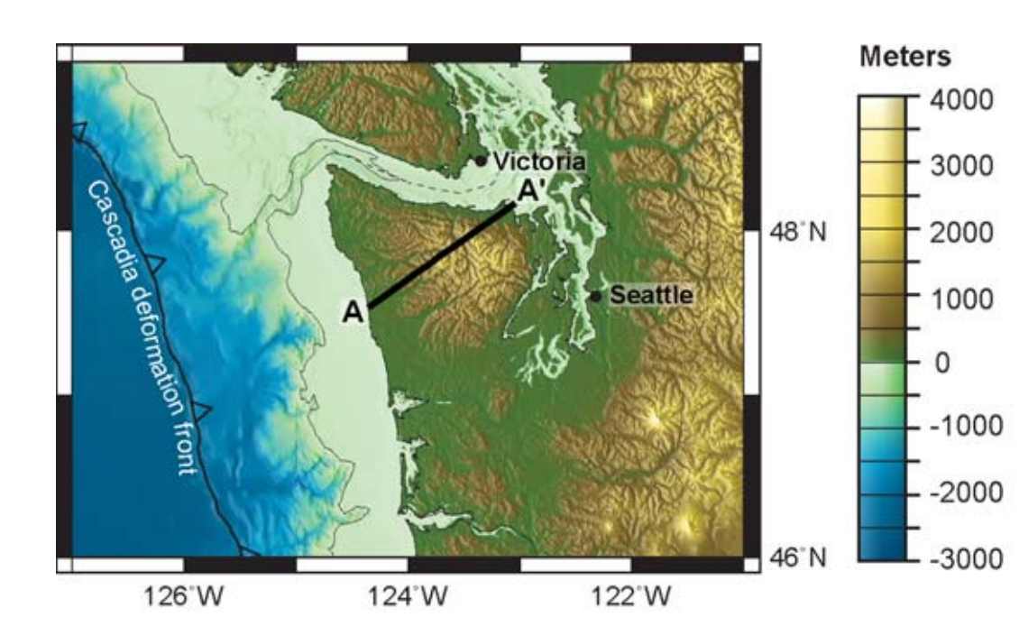
Example application: Olympic Peninsula
“strath” rates: uplift
of dated marine terraces

Slide 50
(7) (U-Th)/He & other exhumation methods.
Thermally activated
diffusive loss of
radiogenic ⁴He

Slide 51
(7) - Detrital thermochronology
Enabling technology: ⁴⁰Ar/³⁹Ar ages of individual grains

Slide 52
(8) Shared event of known age.
Berlin et al. JGR-Earth Surface, 2007
Example: Roan Plateau, NW Colorado:
8 Ma incision
by Colorado River
Test of streampower incision
model
See also Crosby & Whipple
JGR 2006.
Strengths: Natural experiment.
Weaknesses: Relative, not absolute method (though can be calibrated by other methods)
Age range of applicability: Unrestricted in principle; in practice, post-180 Ma
(for which ~complete plate reconstructions are available).

Slide 53
Gondwana rifting

Slide 54
(8) Shared event of known age
Other example: Gondwana Scarp,
known as “Great Escarpment” in S. Africa
South Africa: rifting ~160 Ma
(plate tectonic reconstruction)
Scarp retreat rate: ~1 km/Myr

Slide 55
Scarp retreat following continental break-up is constrained by apatite fission-track data

Slide 56
(9) The sedimentary record.
Foreman et al. Nature 2012
method with great
promise for the future;
see required reading
Allen 2008
4-6 deg C increase in
global T accompanied
by 2x-4x increase in
pCO₂
Strengths: Records information about fully-vanished landscapes.
Weaknesses: Changes in grain size + channel dimensions have multiple possible explanations.
Age range of application: < 3.5 Ga on Earth; <4.1 Ga on Mars (for orbiter methods)

Slide 57
Example (idealized model):
Armitage et al. Nature Geoscience 2011

Slide 58
Integration and cross-checking of methods.
Anderson &
Anderson, ch. 6
University of Innsbruck

Slide 59
Landscape evolution: sources of data
SOME MAJOR LANDSCAPE EVOLUTION PROBLEMS
DATE/RATE DATA ON EARTH
DATE/RATE DATA ON OTHER PLANETS

Slide 60
(P1) Crater-density constraints on burial and exhumation.
CONCEPT:
DATA:
Kite & Mayer 2017
Strengths: Can be applied anywhere on Mars;
Can give past sedimentation rates.
Weaknesses: Difficult to date steep slopes (small area, distorted craters)
Age range of validity: In principle, applies to all timescales.
In practice, restricted to 1-100 Myr for erosion rates

Slide 61
(P2) Statistical approaches (e.g. crater modification)
Fassett & Thomson, JGR-Planets, 2014 – Goal:measure crater degradation on the moon vs. time.
Plot the diffusional degradation of individual craters as a function of the crater density of the
terrains that host them. Map the crater density to absolute age using Apollo radiometric dates.

Slide 62
Key points
For each Earth-based dating method, know the principle, advantages, disadvantages, example application, age range of application, for each technique.
Explain the evidence for and against a Pleistocene uptick in global erosion on Earth (two arguments for and two arguments against, plus geographic context)

Slide 64
Backup slides

Slide 65
Transient
hillslope
evolution
Pelletier,
2008, ch. 2; also Pelletier, 2013

