Slide 1
GEOS 28600
The science of landscapes:
Earth & Planetary Surface Processes
Lecture 12
Monday 17 Feb 2020

Slide 2
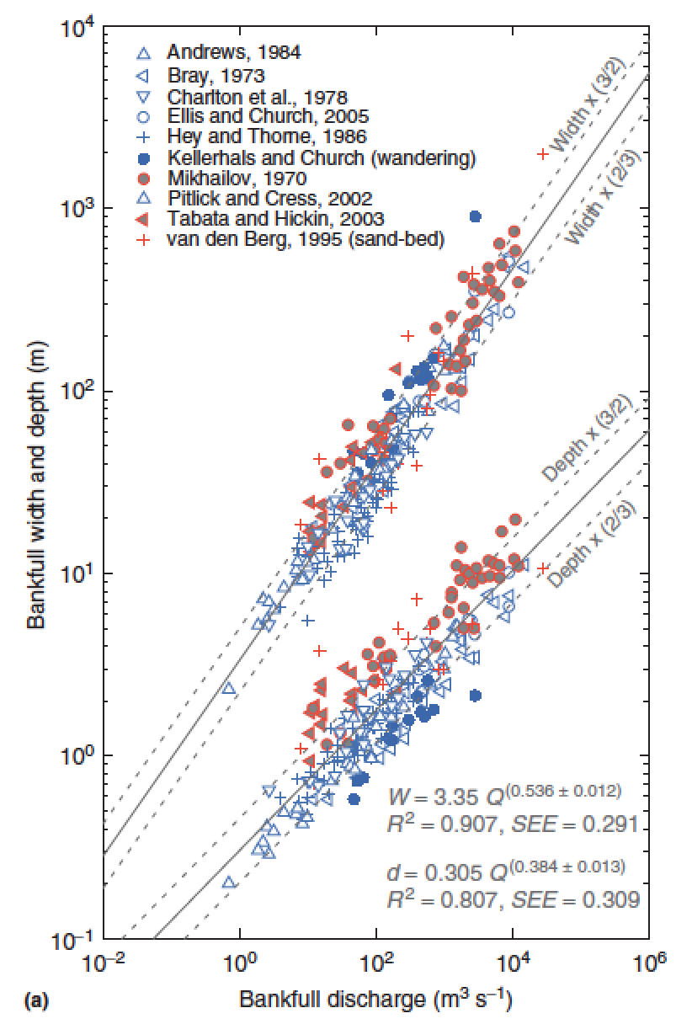
What sets river channel width?
Q = wd<u>
w = aQ^{b}
d = cQ^{f}
<u> = kQ^{m}
b+f+m = 1
Comparing
different points
downstream
b = 0.5
m = 0.1
f = 0.4
Eaton, Treatise on
Geomorphology, 2013

Slide 3
What sets width? Three approaches to this unsolved question:
(1) Posit empirical relationships between hydraulics, sediment supply, and form (Parker et al. 2008 in suggested reading; Ikeda et al. 1988 Water Resources Research).
(2) Extremal hypotheses; posit an optimum channel, minimizing energy (Examples: minimum streampower per unit length; maximum friction; maximum sediment transport rate; minimum total streampower; minimize Froude number)
(3) What is the actual mechanism? What controls what sediment does, how high the bank is, & c.?

Slide 4
Rivers and landscape evolution

Slide 5
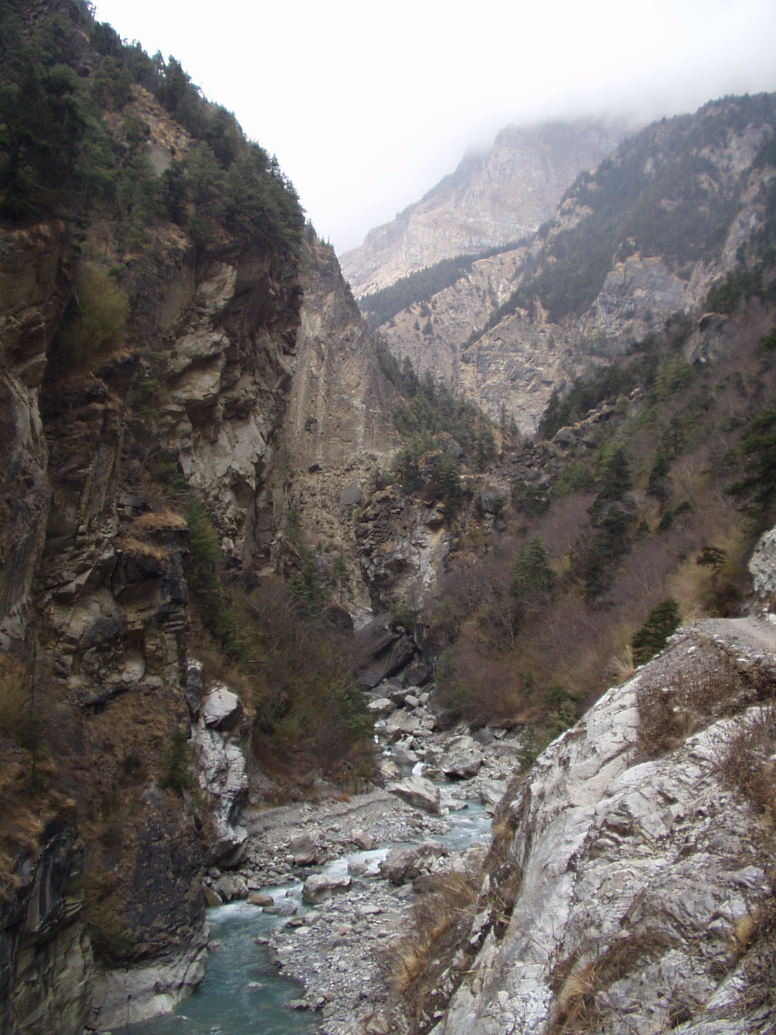
Bedrock rivers
Rivers that cut into bedrock
(“rock is everywhere close to the
surface and may be frequently
exposed during flood events or
on decadal to centennial
timescales”, Whipple et al. 2013)
Detachment-limited landscape
evolution (dz/dt ~ k dz/dx )
Clasts transported mainly by
bedload
Knickpoints can propagate
gm
What controls the rate of
downcutting?
What controls the height/
width/shape of mountain belts on
Earth?
Neil Humphrey, UWYO

Slide 6
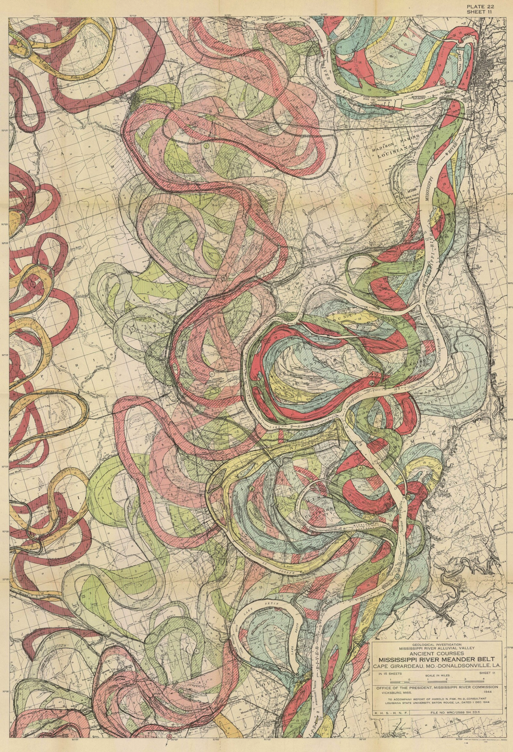
Alluvial rivers
Transport-limited
landscape evolution
(dz/dt ~ k d²z/dx² )
A large percentage of clast transport in suspension
When does meandering
occur?
US Army Corps of Engineers
(Lower Mississippi / Fisk 1944)

Slide 7
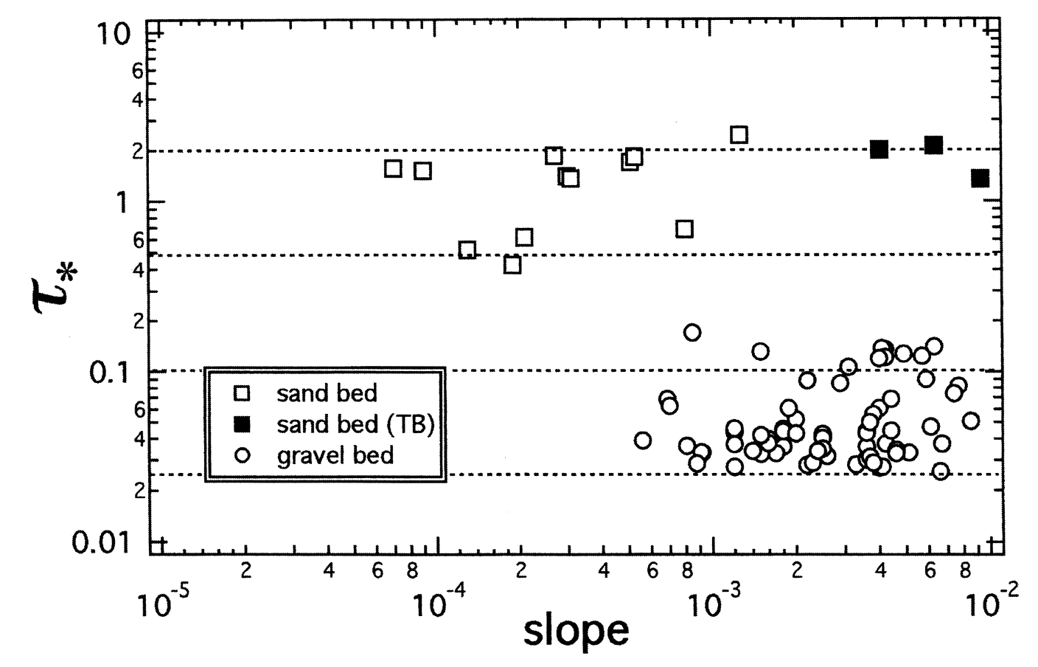
Usually (not always), Bedrock rivers ←→ gravel bed. Alluvial rivers can be sand or gravel bed.
suspended
load
bedload
τ_{*c}
Marr et al., Basin Research, 2000

Slide 8
Key points from “rivers and landscape evolution”
Advective vs. diffusive channel profile evolution
Hypotheses for controls on concavity
Know the streampower equation
Know bedrock erosion processes
In the required reading, don’t omit the section on transient evolution (bridge to next lecture)
Next lecture: Landscape-scale responses to forcing

Slide 9
Fluvial sediment transport: what controls the shape of rivers?
BASIC EQUATIONS GOVERNING BED ELEVATION
WHAT SETS RIVER PLANFORM?
WHAT SETS RIVER LONG PROFILE?
BEDROCK RIVER EROSION

Slide 10
Fluvial sediment transport: what controls the shape of rivers?
EXNER EQUATION
WHAT SETS RIVER PLANFORM?
WHAT SETS RIVER LONG PROFILE?
BEDROCK RIVER EROSION

Slide 11
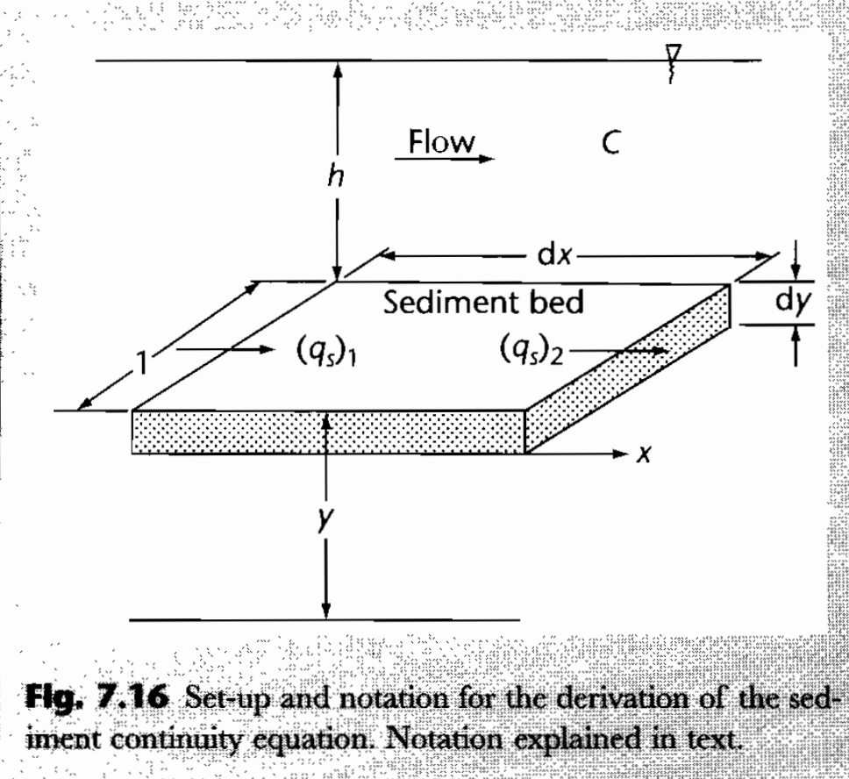
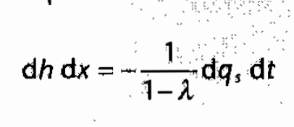
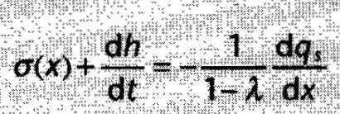
Mass balance for alluvial rivers (Exner equation)
Emphasizes suspended sediment
Steady sediment supply:
C = sediment concentration per unit volume
q_{s}= sediment flux
λ = porosity in bed material
Usually, gross transport >> net accumulation
Allen & Allen, Basin Analysis 2nd edn (2005), box 7.1

Slide 12
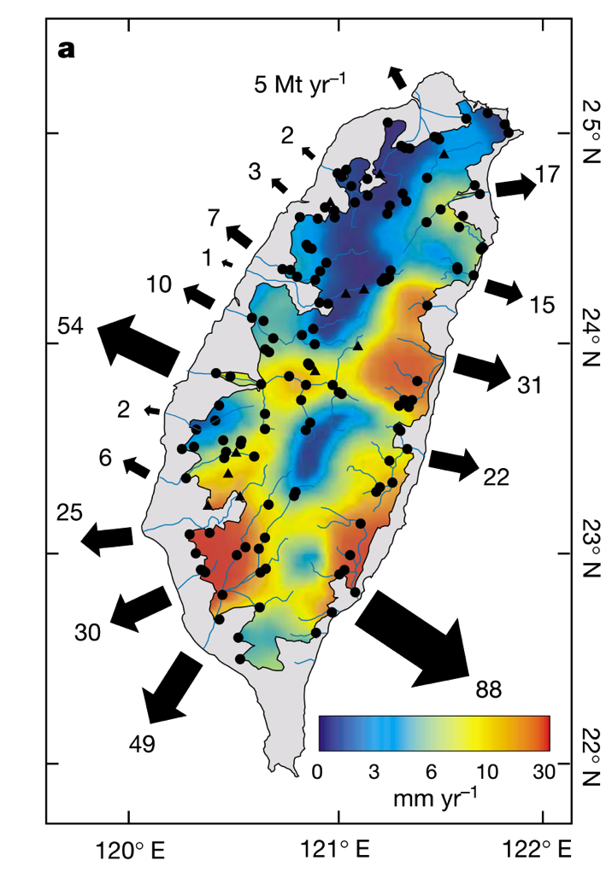
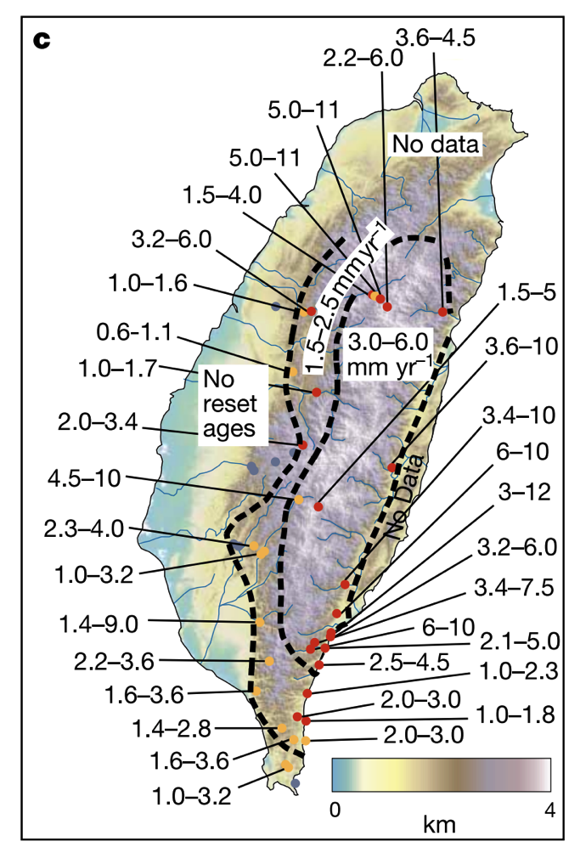
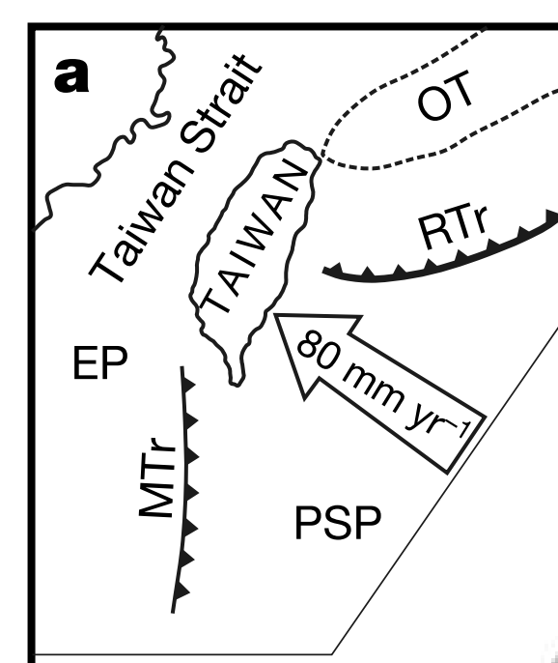
Natural laboratory: Taiwan
High mass fluxes forced by tectonics (uplift 2-5 mm/yr)
Do steady state landscapes exist on Earth?
Dadson et al.
Nature 2003
Exhumation (“unroofing”)
rate from apatite fission-track
data
Erosion rate from sediment
traps

Slide 13
Fluvial sediment transport: what controls the shape of rivers?
BASIC EQUATIONS GOVERNING BED ELEVATION
WHAT SETS RIVER PLANFORM?
WHAT SETS RIVER LONG PROFILE?
BEDROCK RIVER EROSION

Slide 14
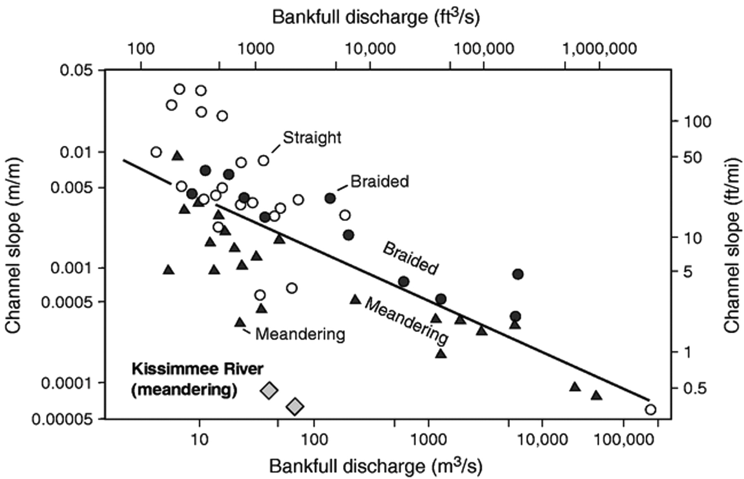
Meandering outcompetes braiding when banks are strong
Possible causes:
A grainsize effect?
Due to weak channel banks?s
S_{crit} = 0.012 Q ^{-0.44}
Warne et al.
GSA Bulletin 1999
“1.5 year flood”

Slide 15
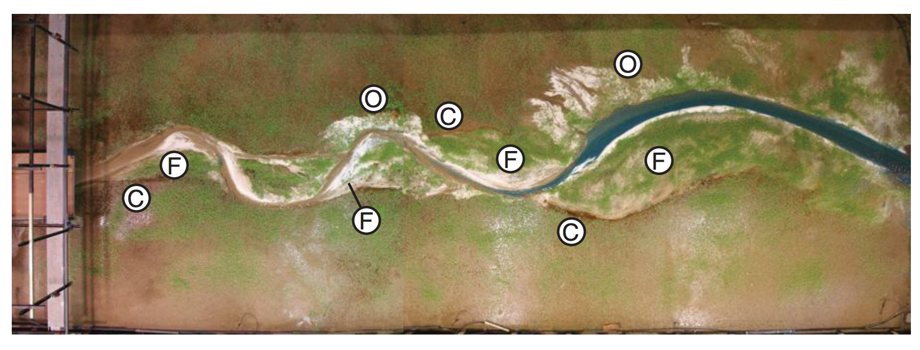
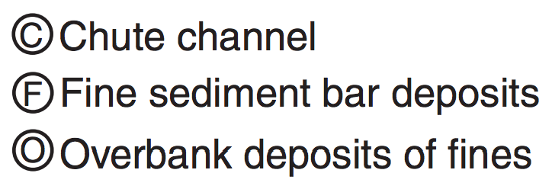
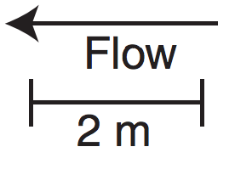
Laboratory replication of meandering is hard: vegetation matters
On Earth, most meandering-river deposits postdate the Devonian (evolution of roots)
Braudrick et al. PNAS 2009

Slide 16
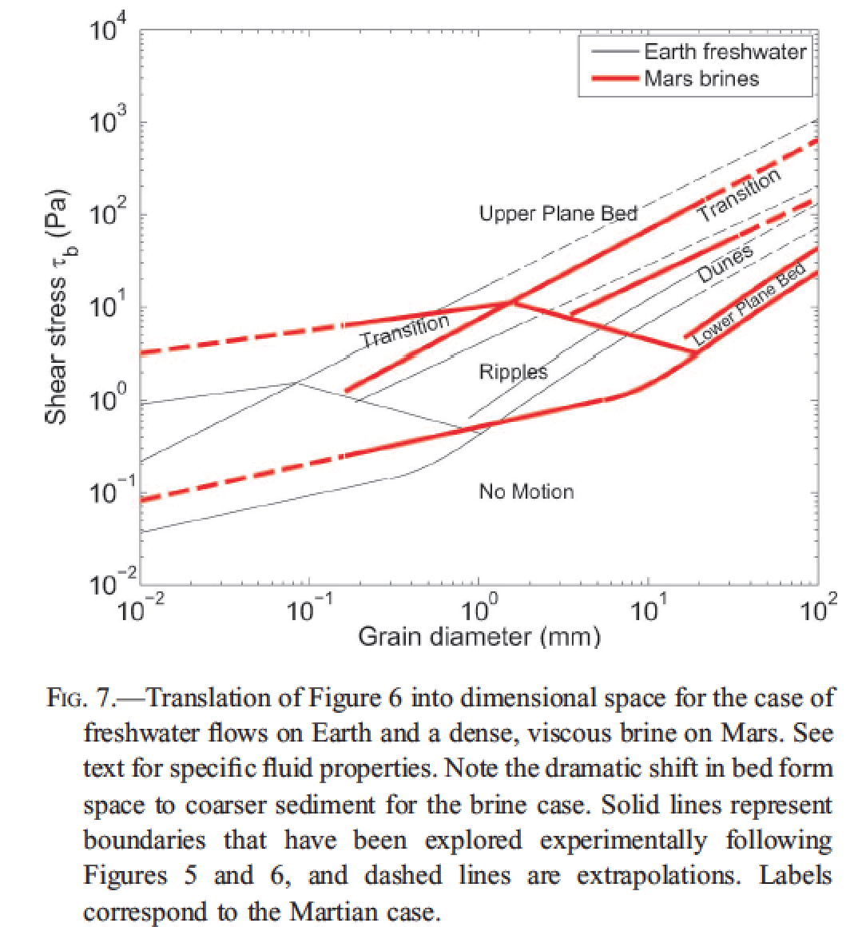
Fluvial bedforms constrain paleo-depth of flow
(uncommon) antidunes
Lamb et al. 2012, in
“Sedimentary Geology of Mars,”
Grotzinger & Milliken, eds.
Useful on other planets,
for Precambrian Earth,
and in rock outcrops where
full depth of river channel
is not always preserved

Slide 17
Fluvial sediment transport: what controls the shape of rivers?
BASIC EQUATIONS GOVERNING BED ELEVATION
WHAT SETS RIVER PLANFORM?
WHAT SETS RIVER LONG PROFILE?
BEDROCK RIVER EROSION

Slide 18
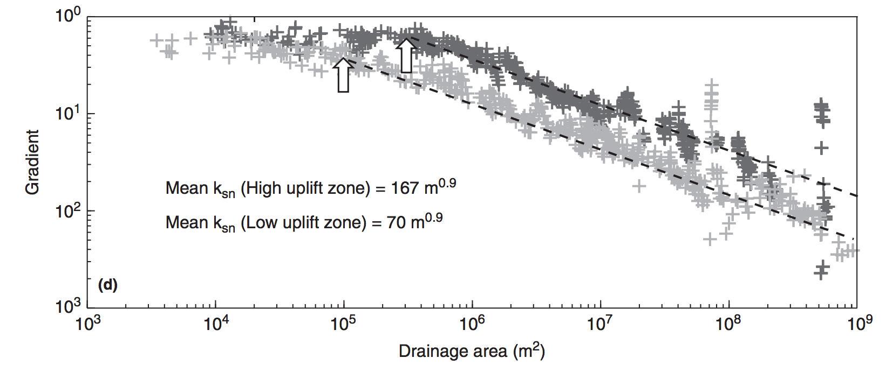
Debris flows and hillslopes
Fluvial processes

Slide 19
The broadest possible view (hypothesis 1):
z
lowland
floodplain
fans
delta
UPLIFT
SUBSIDENCE
x
However, we find that concavity is found within the bedrock-cutting and sediment-
transporting parts of the system. So what causes this concavity – if not the grand-scale
tectonics?
First, assume τ_{b} = τ_{c} everywhere on the profile (just moving “indestructible balls”).
Then, ρghS = τ_{c}. And τ_{c} / (ρ_{s} – ρ)gD₅₀ = τ_{*c} = “k” ~ constant (~0.045 for gravel, 0.03 for sand).
S = k(ρ_{s} – ρ)gD₅₀ / ρgh
S = k₁h⁻¹
(hypothesis 2 …)

Slide 20
From hydraulic geometry, h = cQ^{f} , f ~ 0.4. (Definition: Q = Q_{bf} = bankfull discharge)
last lecture …
Q is proportional to A (for small catchments)
S = k₂A^{-0.4}D₅₀
(hypothesis 2)
Prediction: A river’s slope is to some extent controlled by the grainsize it receives.
What if D₅₀ changes (change in hillslope or tributuary input, clast abrasion/dissolution)?
Downstream fining - e.g. , breakdown of sediment along the stream path?
Experimentally, D(x) = D₀ e^{-βx}
x is distance along flowpath
“Sternberg’s law”
with β = (10⁻⁵ – 10⁻¹) km⁻¹ (function of lithology)
Set L_{1/2} = travel distance at which grainsize is reduced by ½
L_{1/2} = ln(2)/β = (7 – 70,000) km
Set L_{D}* = travel distance at which grain goes into suspension.
Then L_{D}* = (1/β) ln (D₀/D_{min}), where D_{min} = size at suspension.

Slide 21
Amplitude of concavity depends on sediment supply (and sediment abrasion)
Transported sediment:
q_{s} = kτ_{b}^{n} per unit width (neglect τ_{c})
Q_{s} = q_{s}w = kτ_{b}^{n}w; τ_{b} = ρghS, where h = cA^{γ} ; w = dA^{b}
Input sediment: Q_{s} = aA^{α}
= k₁(ρgcA^{γ}S)^{n}dA^{b}
Conservation of mass:
aA^{α} = k₁(ρgc)^{n}A^{γn}S^{n}dA^{b}
S = k₂A^{(α – γn -} ^{b)/n}
(hypothesis 3)
Examples:
α = 1.0, γ = 0.4, n = 1.5, b = 0.5:
S = k₂A^{-0.07} → straight profile.
But, if α = 0,
S = k₂A^{-0.73} → large concavity.
(downstream fining control = hypothesis 4)

Slide 22
For rivers that cut through bedrock, how does this erosion affect the long profile?
neglect threshold
dz/dt = U – E. Hypothesis: E = k(streampower)^{n}
“Streampower”:power = force x distance / time
power/(bed area) = F x d
A x t
river
speed
τ_{b}
hypothesis:
widely used &
physically reasonable,
but not tested enough
to be trusted
ω = τ_{b}v
Q_{w} = hvw (Q_{w} = water flux)
ω = ρghVS =ρgQ_{w}S/w
E = k (ρgQ_{w}S/w)^{n}
Streampower erosion law

Slide 23
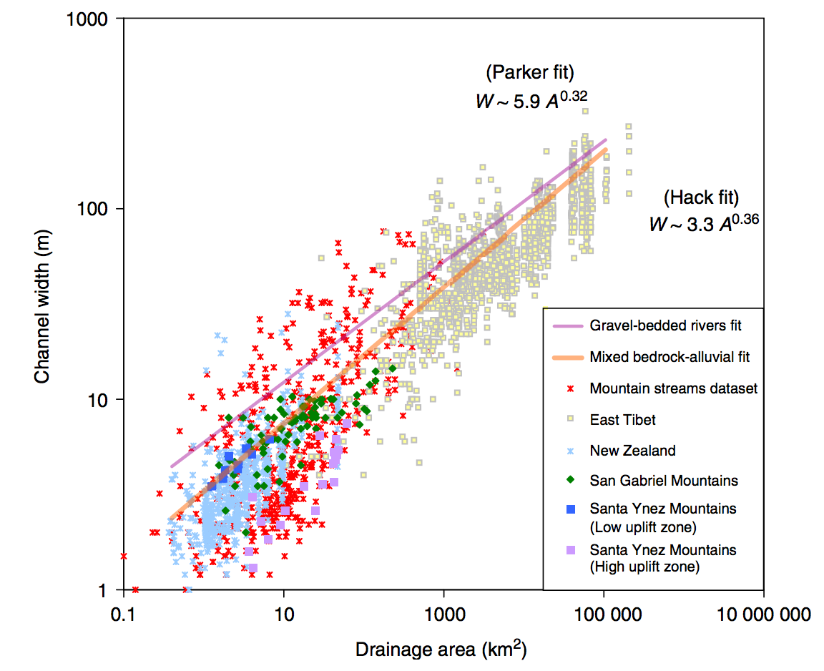

Slide 24
Streampower - topographic steady state:
Q = k_{q}A^{c}
w = k_{w}Q^{b}
Q = vhW τ_{b} = ρghS ω = τ_{b}v
E = (ρg)^{n}(k₃^{(1-b)}k₄⁻¹)^{n}A^{en(1-b)}S^{n}
Following Whipple and Tucker
JGR 1999
define this as “m”
E = k₅A^{m}S^{n}
The streampower hypothesis leads to E = kA^{m}S^{n}
“m” contains channel geometry information.
slope: m/n
log S
Steady state:
dz/dt = U - E = 0
Concavity
S = (U/k₅)^{1/n} A^{-m/n}
log A
(“Whipple’s”) steepness
index
Increasing uplift or harder rock
Decreasing uplift or softer rock

Slide 25
Summing up controls on longitudinal profiles: hypotheses
Gross topography (set by tectonics)
Threshold rivers (intent: gravel-bed rivers)
Power-law relation between sediment transport flux and basal shear stress (intent: sand-bed rivers)
Selective transport
Bedrock incision in canyons:
(5a) Streampower
(5b) Tools-and-cover (Leonard Sklar)
Large boulders: effectively
rough pieces of bedrock
(abraded in pace)
Sourcing may change from
coarse to fine downstream.

Slide 26
Fluvial sediment transport: what controls the shape of rivers?
BASIC EQUATIONS GOVERNING BED ELEVATION
WHAT SETS RIVER PLANFORM?
WHAT SETS RIVER LONG PROFILE?
BEDROCK RIVER EROSION

Slide 27
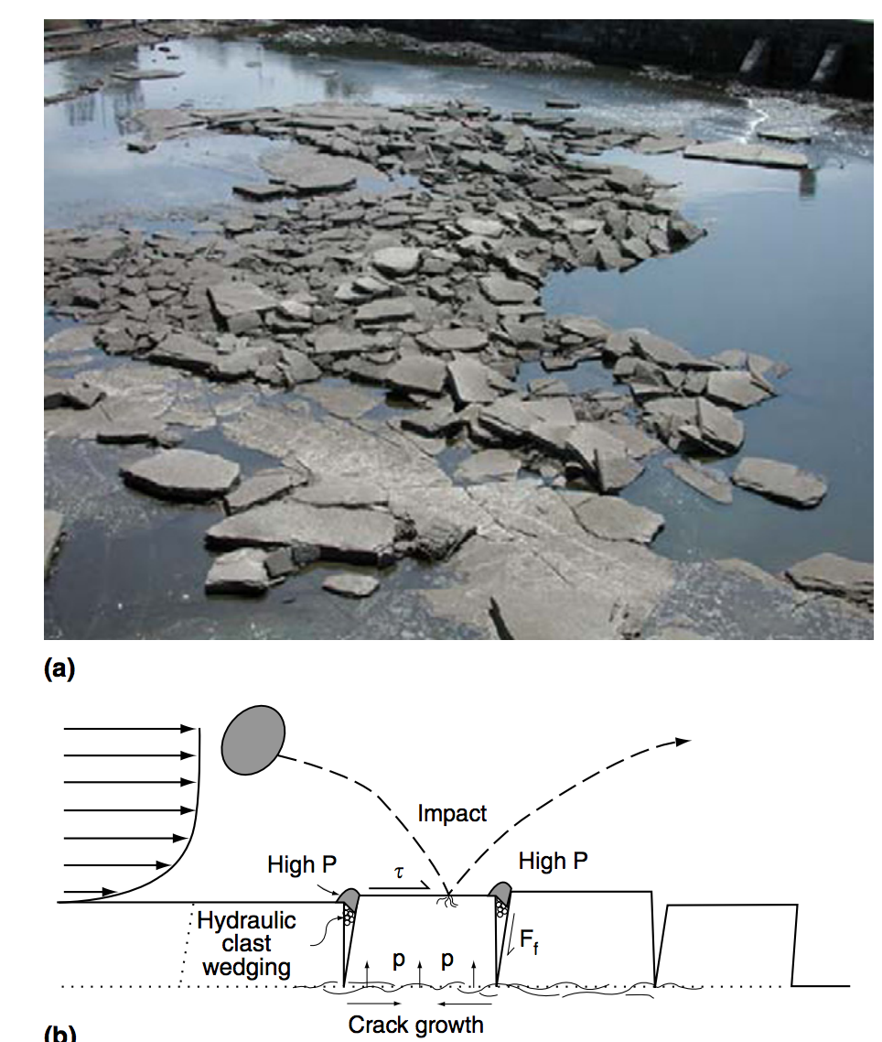
Mechanisms of bedrock erosion: plucking
Whipple et al., Treatise on Geomorphology 2013

Slide 28
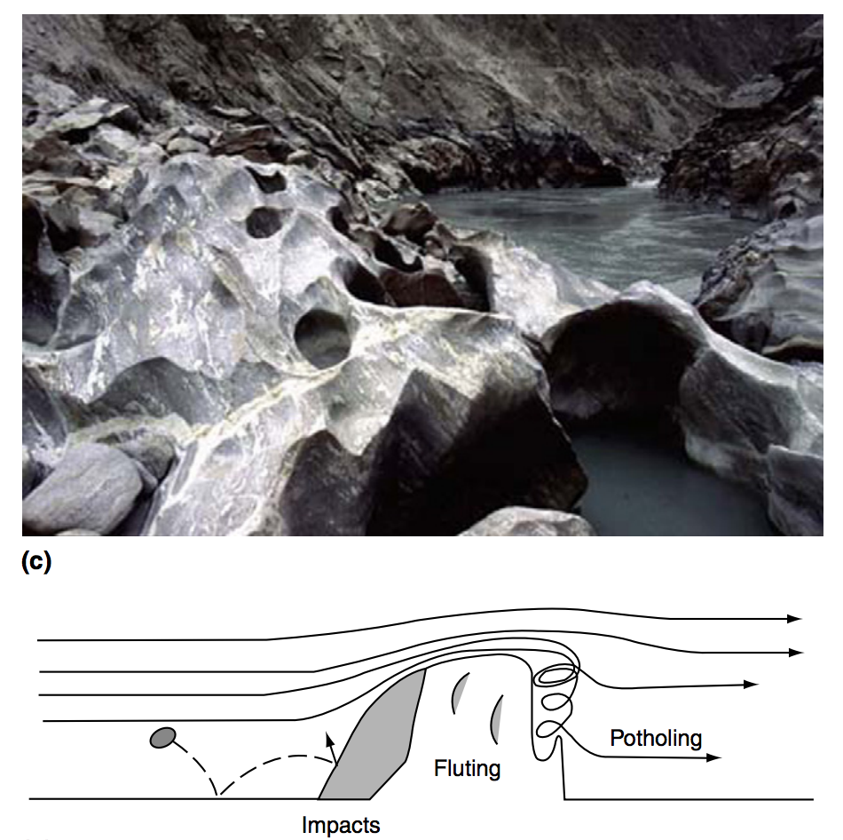
Mechanisms of bedrock erosion: abrasion
Whipple et al., Treatise on Geomorphology 2013

Slide 29
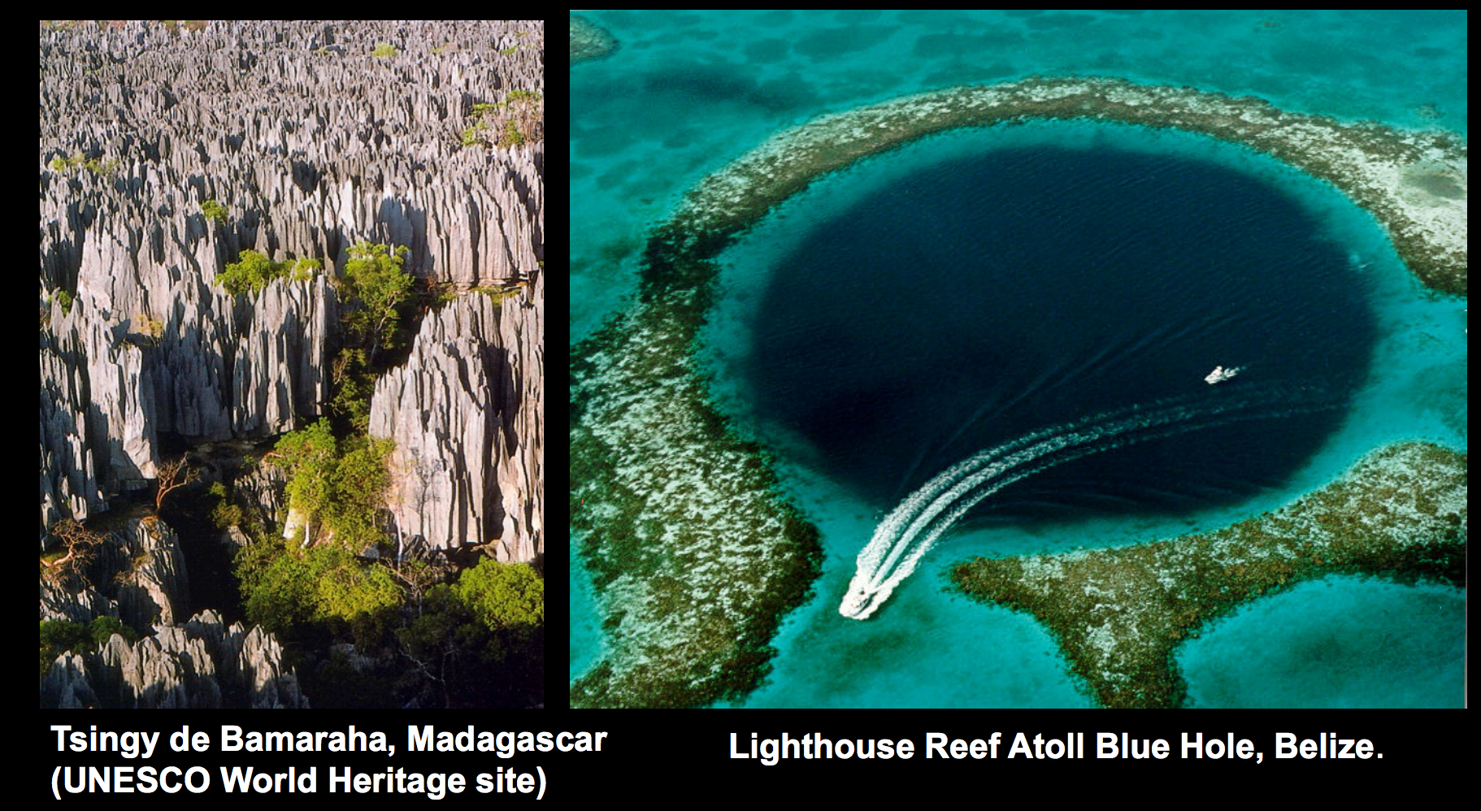
Mechanisms of bedrock erosion: corrosion (= weathering + dissolution)
Mike Malaska (JPL)

Slide 30
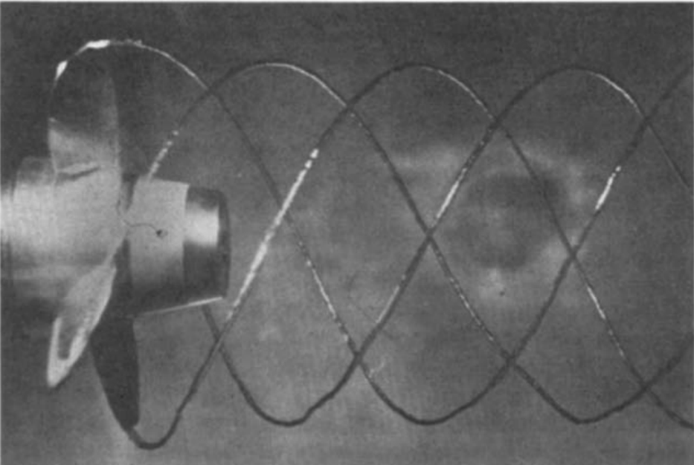
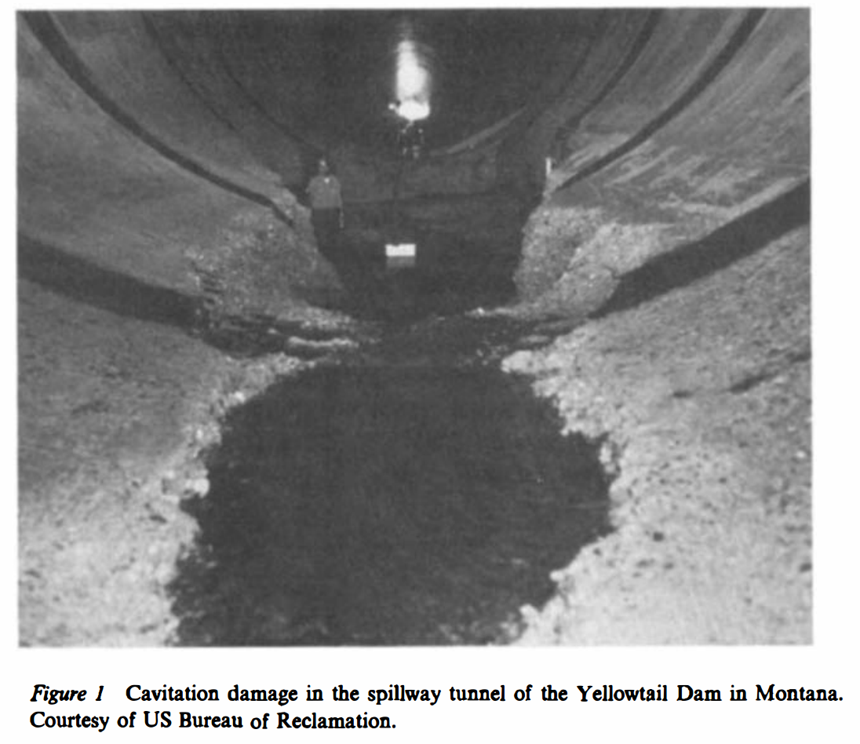
Mechanisms of bedrock erosion (?): cavitation?
Arndt, Annual Reviews of Fluid Mechanics, 1981

Slide 31
Points to remember for lab:
(Greg Tucker)

Slide 32
Key points from ‘intro. to rivers and landscape evolution’
Advective vs. diffusive channel profile evolution
Hypotheses for controls on concavity
Know the streampower equation
Know bedrock erosion processes
Next lecture: Landscape-scale responses to forcing

Slide 33
Fluvial sediment transport vs. hillslope processes: what controls the spacing of rivers?
SETTING THE SPACING OF STREAMS
HILLSLOPE EROSION PROCESSES SOIL PRODUCTION FUNCTION
SYNTHESIS: PERRON ET AL. 2009
Focus on
gently-uplifting
landscapes
(no landslides)
on Earth

Slide 34
Key points from today’s lecture
Explain mechanistically how streampower landscapes can act as a tectonic tape-recorder (from Lab 4).
Explain why steady-state hillslopes are convex.
Explain 2 or more hillslope transport processes.
Know 2 or more physical and 2 or more chemical weathering processes.
Understand how Peclet number can quantify competition between hillslope processes and fluvial channelization (see also required reading).

Slide 35
Fluvial sediment transport vs. hillslope processes: what controls the spacing of rivers?
REVIEW OF LAB 4
SETTING THE SPACING OF STREAMS
HILLSLOPE EROSION PROCESSES SOIL PRODUCTION FUNCTION
SYNTHESIS: PERRON ET AL. 2009

Slide 36
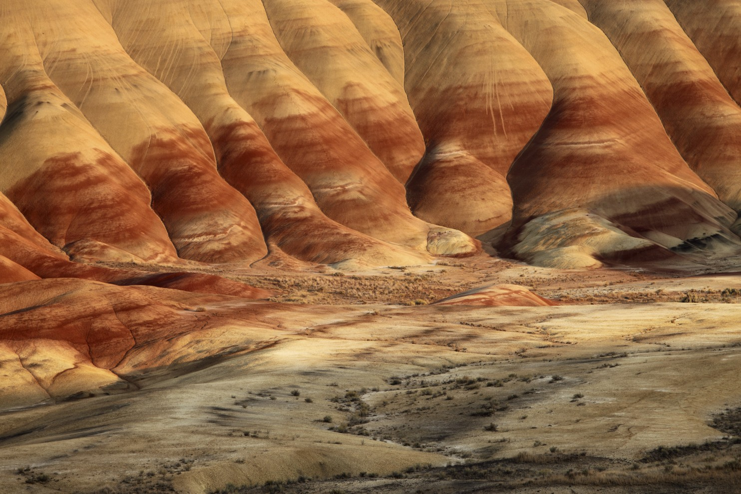
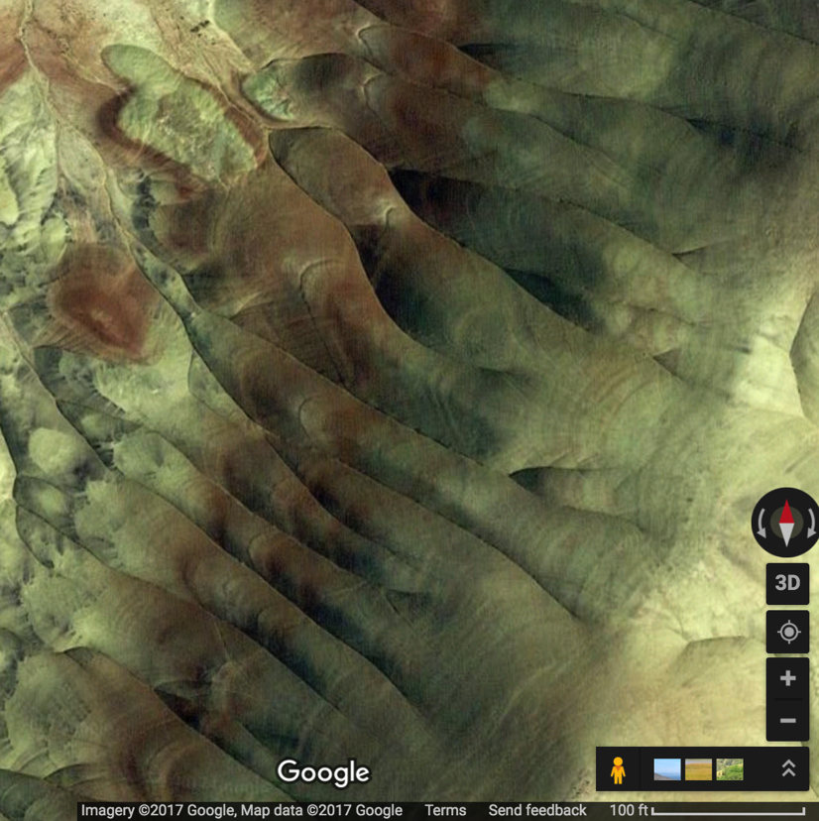
Painted Hills, Oregon: badlands, fine-grained material, micro-channeling, rilling
drainage density,
D_{d} = L/A (dimensions m⁻¹)

Slide 37
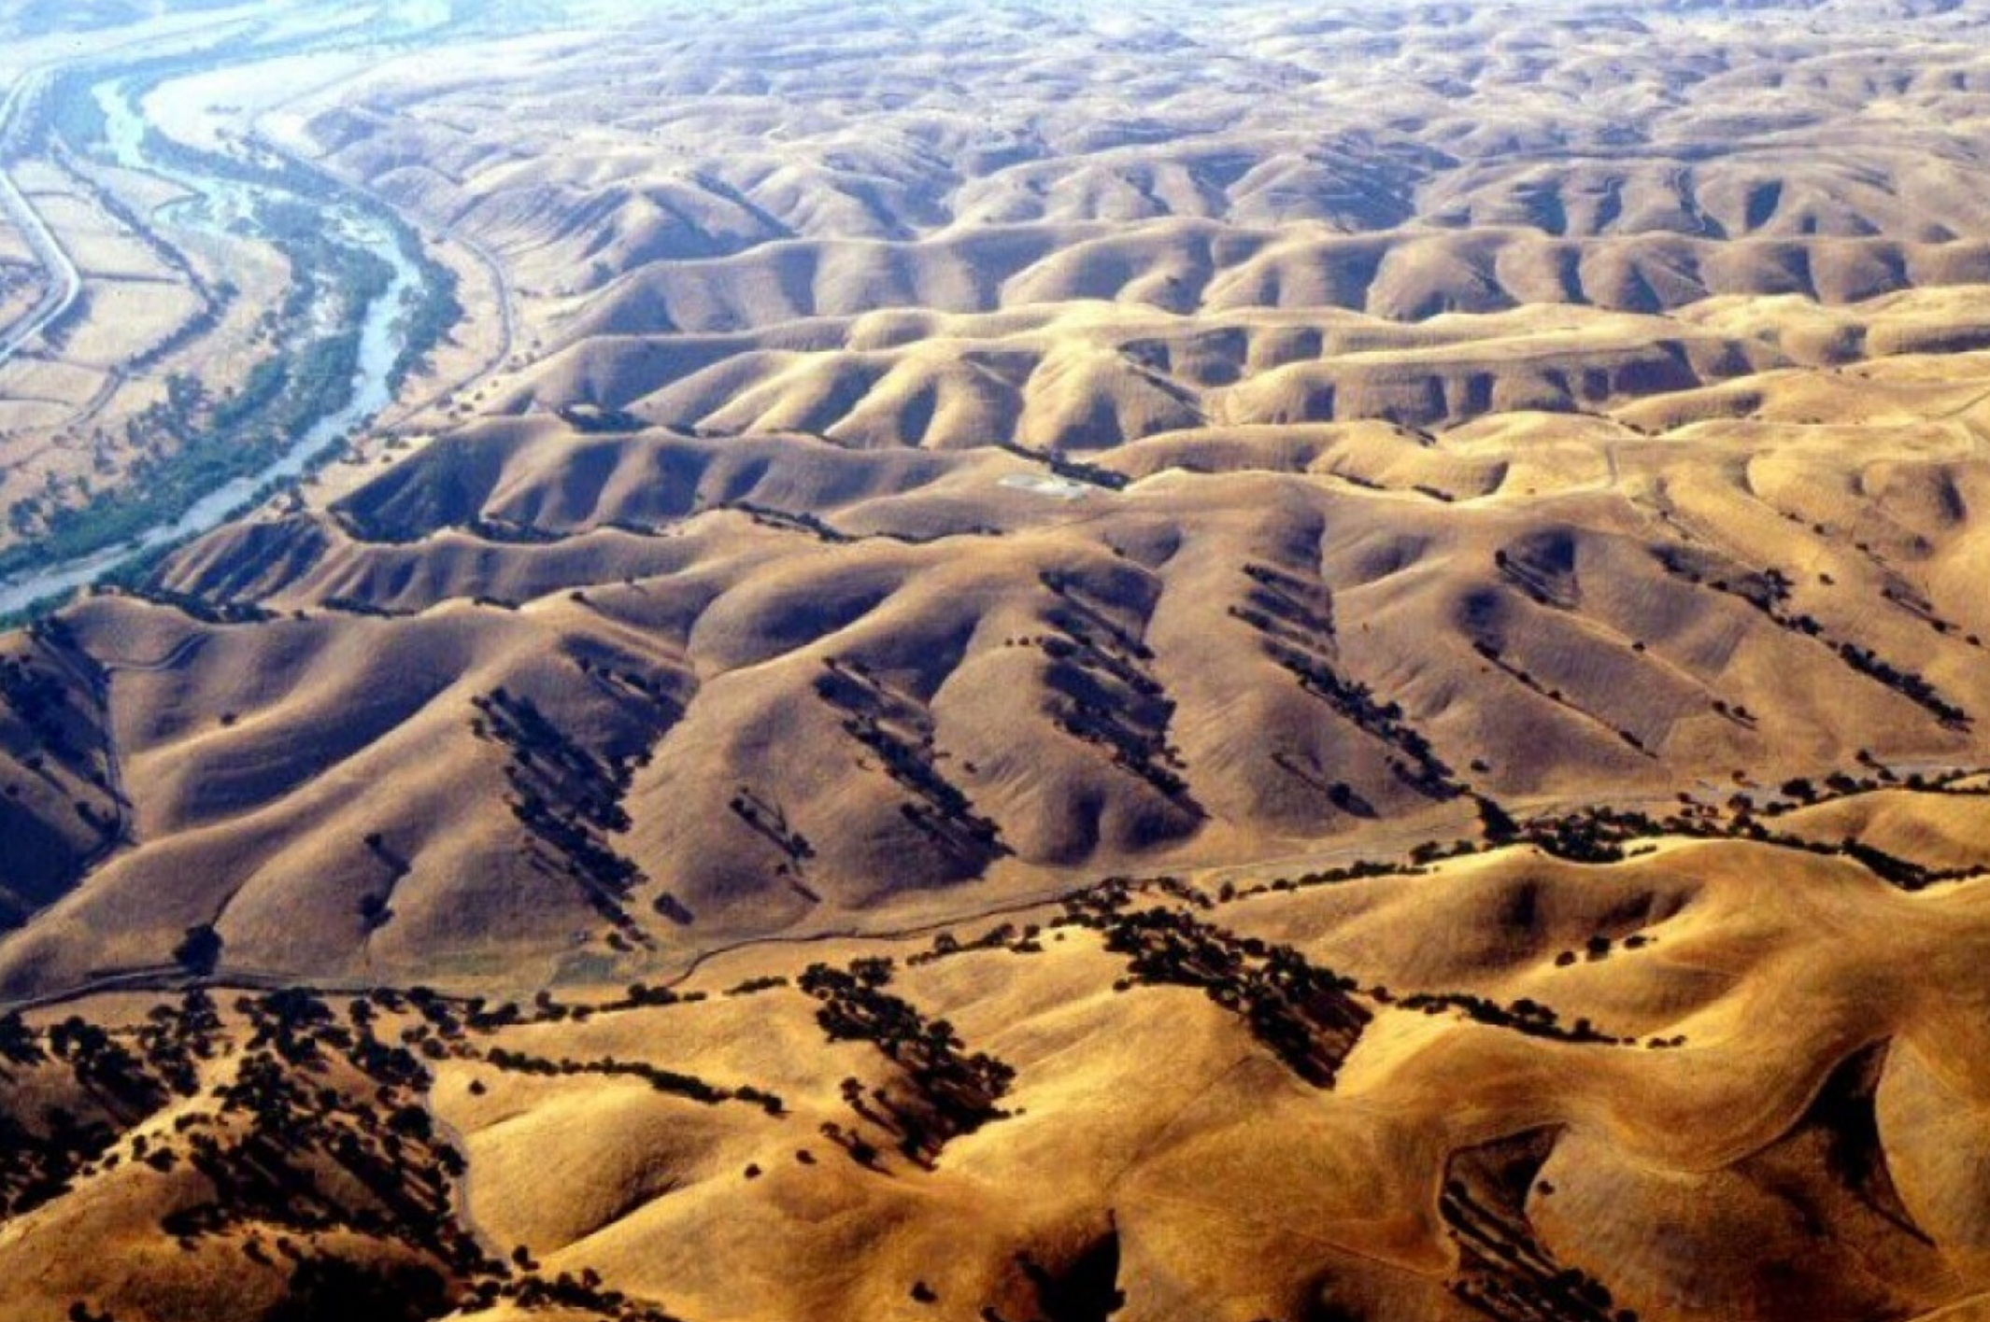
Central California: uniform lithology; saturation overland flow
Perron et al. Nature 2009 (required reading)

Slide 38
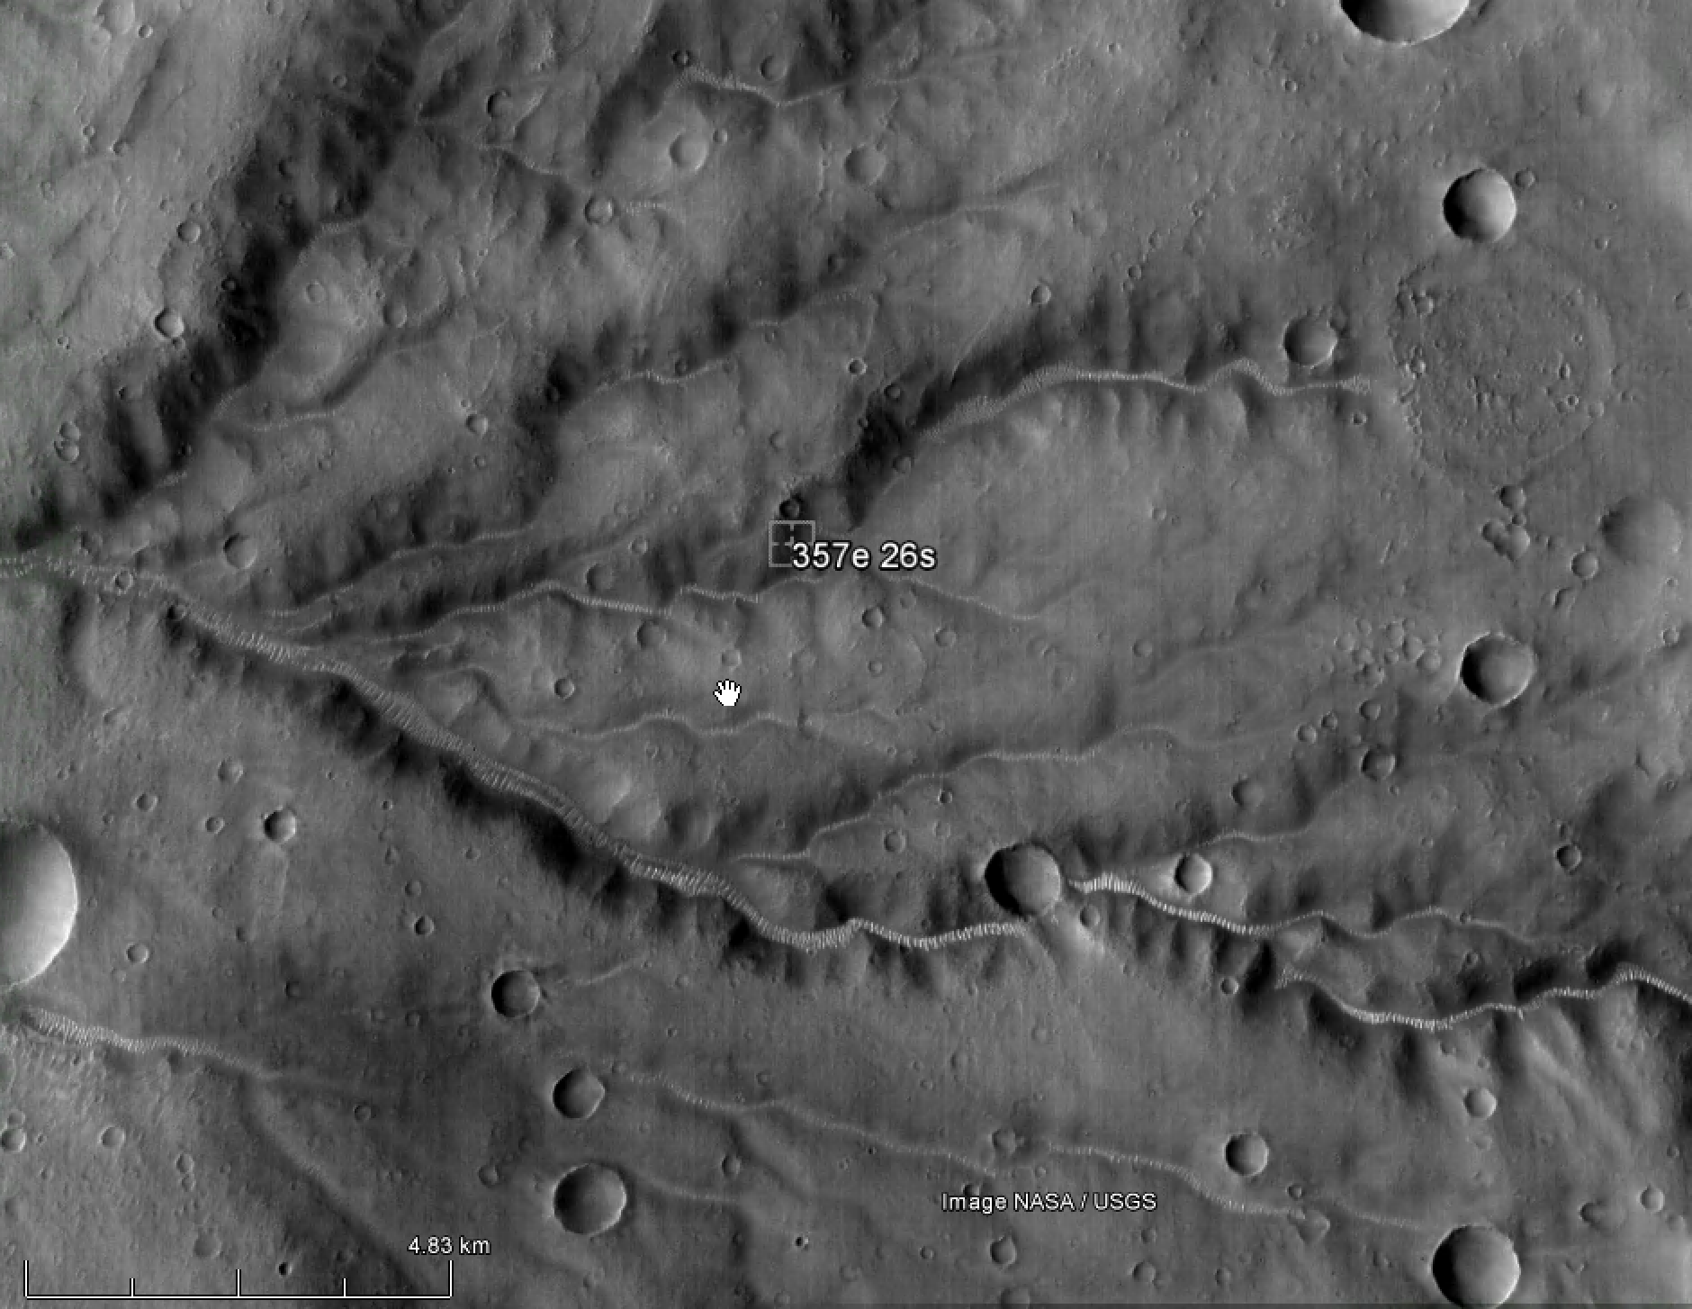
Mars: hillslope processes = ?

Slide 39
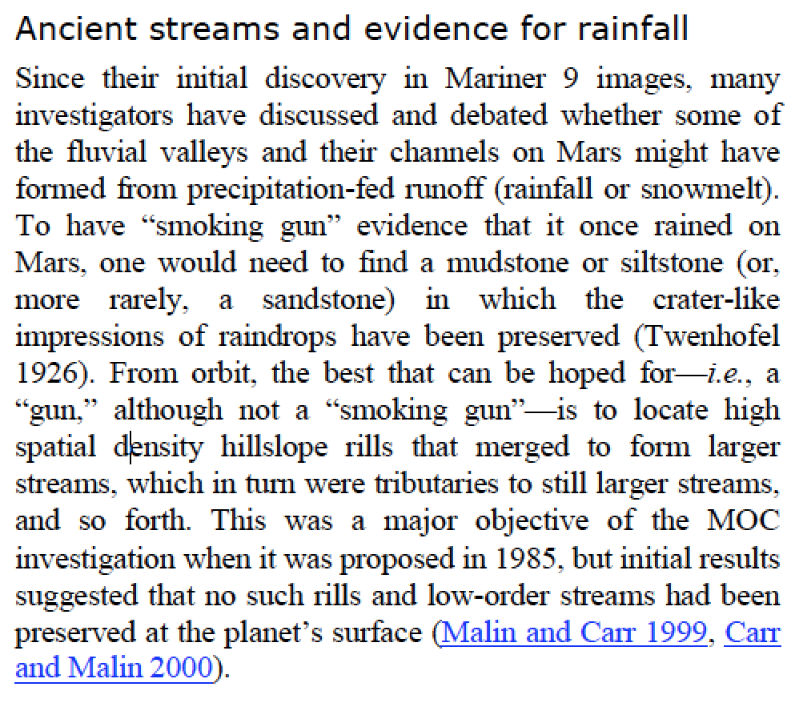
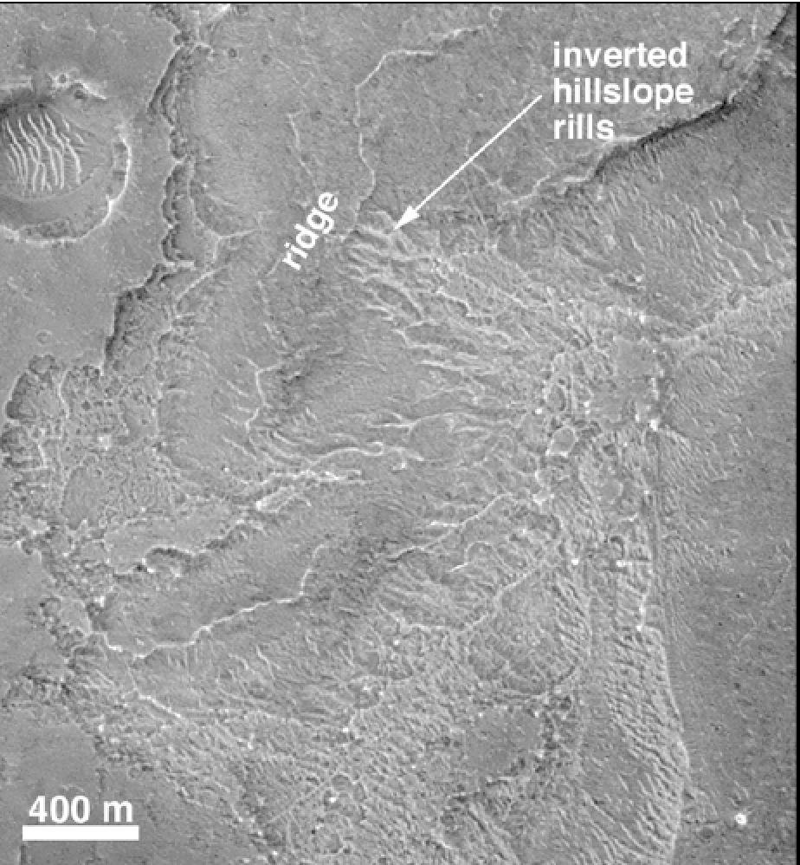
Drainage density D_{d} as a Mars process indicator?
Malin et al. 2010 Mars Journal

Slide 40
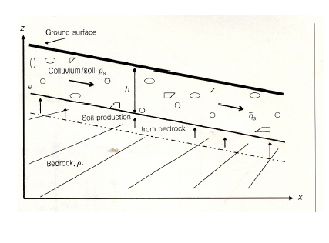
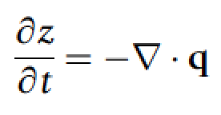
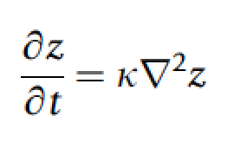
Steady state hillslope
What is soil? → Horizontally mobile layer
→ practical: No relict bedrock texture visible
Q_{soil} = c S
dz/dt = k₁*(Q_{in}-Q_{out})
dz/dt = k₂*(c S_{up} – c S_{down})
Topographic change is
proportional to curvature.
All the interesting
processes are buried in
k₀!
Nonlinear hillslope diffusion can occur
(not emphasized in this course.)
k₀

Slide 41
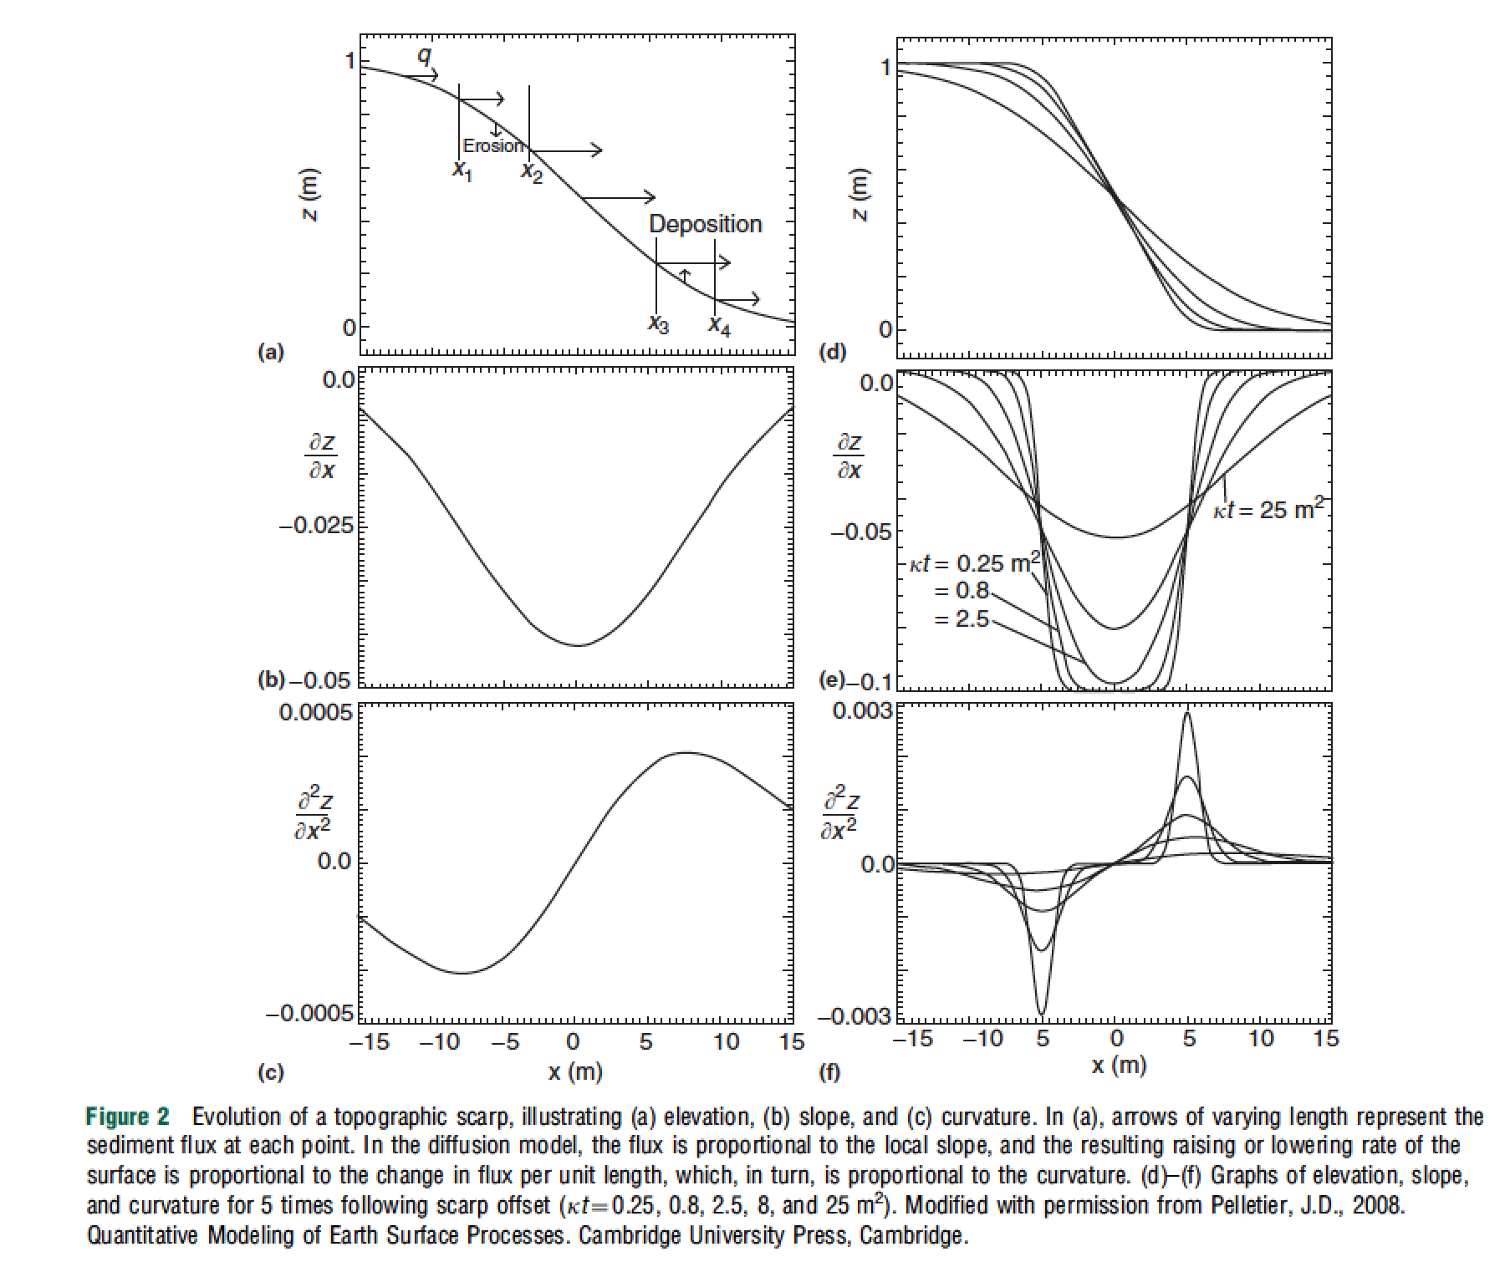
Transient
hillslope
evolution
Pelletier,
2008, ch. 2; also Pelletier, 2013

Slide 42
Steady state hillslopes are convex
x = 2
x = 1
Q = k * dz/dx
In steady state, Q at x =2
is 2 x Q at x = 1.
Slope is proportional to
distance from drainage divide.
drainage divide
z
x
uniform uplift rate, U
channel

Slide 43
Drainage density is set by a competition between diffusive (hillslope) and advective (channelizing) processes
hillslope
processes
fluvial
erosion
eroding
part of
the landscape
k₀
contributing
area
tectonic uplift
diffusivity
n=1
For large A (and +ve m), 2nd term >> 1st term: fluvial erosion control → concave profile.
For small A (and +ve m), 1st term >> 2nd term: hillslope processes → convex profile.

Slide 44
Fluvial sediment transport vs. hillslope processes: what controls the spacing of rivers?
REVIEW OF LAB 4
SETTING THE SPACING OF STREAMS
HILLSLOPE EROSION PROCESSES SOIL PRODUCTION FUNCTION
SYNTHESIS: PERRON ET AL. 2009

Slide 45
The path of water dictates the process that erodes the landscape: Hillslope Hydrology
z
HOF (precip. rate > infiltration rate)
soil
SSSF
x
DPSA
RF
vadose zone
bedrock
SOF
phreatic zone
GF
valley floor
HOF – Horton Overland Flow
SSSF – Shallow Subsurface Storm Flow (usually at soil-bedrock boundary)
DPSA – Direct Precipitation on Saturated Areas
RF – Return Flow
GF Groundwater Flow
SOF – Saturated Overland Flow
Seasonal variation in flow mechanism may occur –
e.g. some tuffs form clays when wet and deep

Slide 46
HOF – Horton Overland Flow
Badlands – fine-grained material
Australia – mature landscape – silcretes, gypcrete, calcrete.
Dirt roads
Cattle grazing
SOF – Saturated Overland Flow
Favored in poorly-drained valleys
SSSF – Shallow Subsurface Storm Flow (usually at soil-bedrock boundary)
Oregon - Coastal Oregon – Holes due to tree roots and mountain beaver. Steep,
relatively straight slopes. Low-density (porous) soil.
(DPSA – Direct Precipitation on Saturated Areas)
GF Groundwater Flow
(Hawaii: fractured, permeable lavas Localised SSSF. No HOF).
.
HYPOTHETICAL HYDROGRAPHS:
Q
HOF
SOF
SSSF
GF
t

Slide 47
Hydrologic processes can be related to hydrograph shape
HYPOTHETICAL HYDROGRAPHS:
Q
HOF
SOF
SSSF
GF
t
peak lag, L_{p}
P,Q
SSSF
log₁₀(L_{p} / hours)
SOF
centroid
lag, L_{c}
HOF
t
HOF: L_{p} = 0.42 A^{0.2}
log₁₀(drainage area A / km²)
SOF: L_{p} = 1.0 A^{0.42}
SSSF: L_{p} = 18 A^{0.26}
compilation by Tom Dunne (UCSB)

Slide 48
thin soils
gentle concave footslopes;
wide valley bottoms
Hillslope hydrology:
SOF
variable
source
concept
HOF
topography & soils
SSSF
deep permeable soil
steep straight/convex hillslope
narrow valley bottoms
climate, vegetation, land use
arid→subhumid
thin veg.; disturbed
by land use
humid climate,
dense veg.
ideas by Tom Dunne (UCSB)

Slide 49
thin soils
gentle concave footslopes;
wide valley bottoms
L
Hillslope
erosion processes:
Biogenic transport
(gophers, treethrow)
Sheetwash,
rainsplash,
rilling, &
(where slope >30 deg)
dry ravel
Creep
topography & soils
Landsliding
deep permeable soil
steep straight/convex hillslope
narrow valley bottoms
climate, vegetation, land use
arid→subhumid
thin veg.; disturbed
by land use
humid climate,
dense veg.
ideas by Tom Dunne (UCSB)

Slide 50
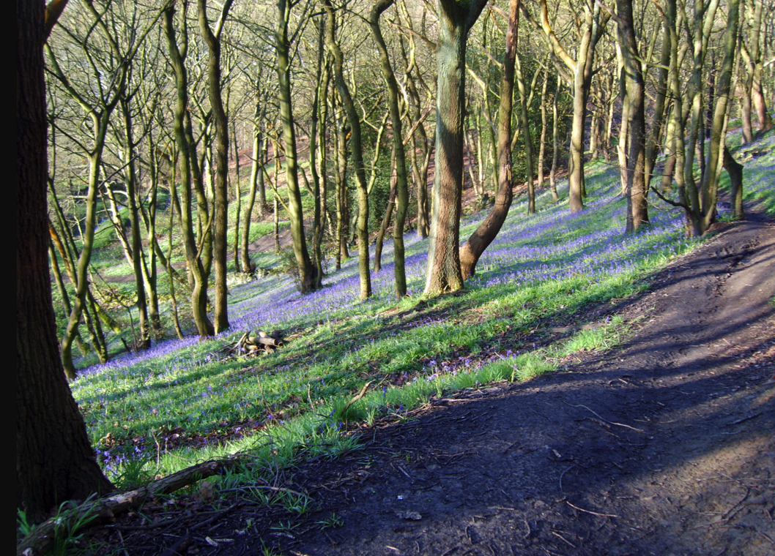
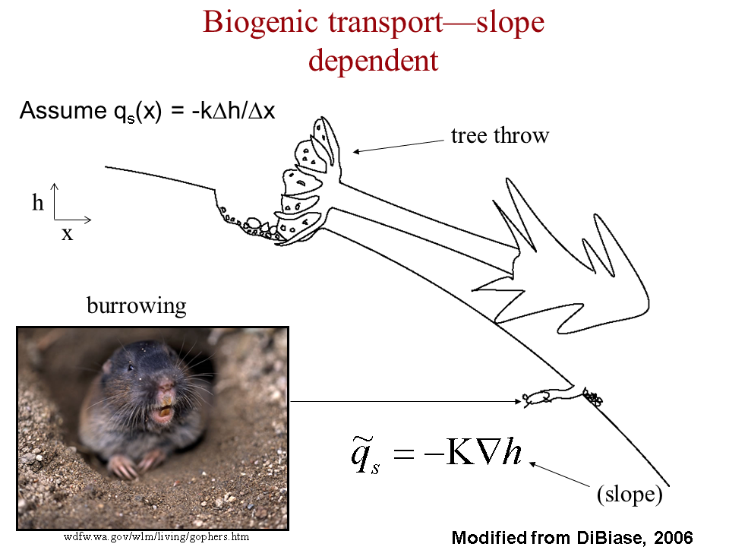
Biogenic transport: gophers + treethrow
Treethrow soil velocity of
~2 mm/yr for
Pacific NW, Appalachians,
Europe.
Soil thickness ~0.5 m,
drainage density 6 km⁻¹
→ 20 tons / km² / yr
Ramon Arrowsmith
Global average erosion rate ~ global average uplift rate U = 0.05 mm/yr

Slide 51
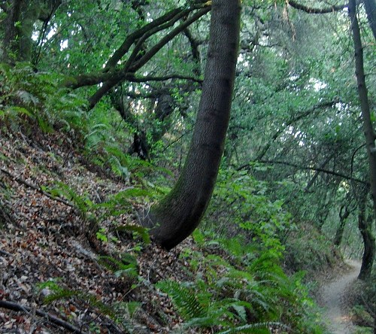
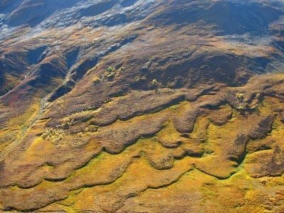
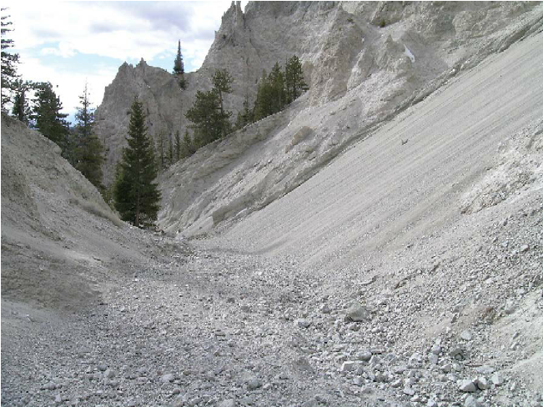
Soil creep
Wetting/drying cycles
Clays expand perpendicular to slope;
contract parallel to gravity.
Solifluction
Granular flow (dry ravel)

Slide 52
Fluvial sediment transport vs. hillslope processes: what controls the spacing of rivers?
REVIEW OF LAB 4
SETTING THE SPACING OF STREAMS
HILLSLOPE EROSION PROCESSES SOIL PRODUCTION FUNCTION
SYNTHESIS: PERRON ET AL. 2009

Slide 53
Weathering
=“alteration of rocks and minerals by processes acting near or at the Earth’s surface.”
→ Changes in factors such as surface strength, permeability, particle size – which in turn
affect the rate of mass removal.

Slide 54
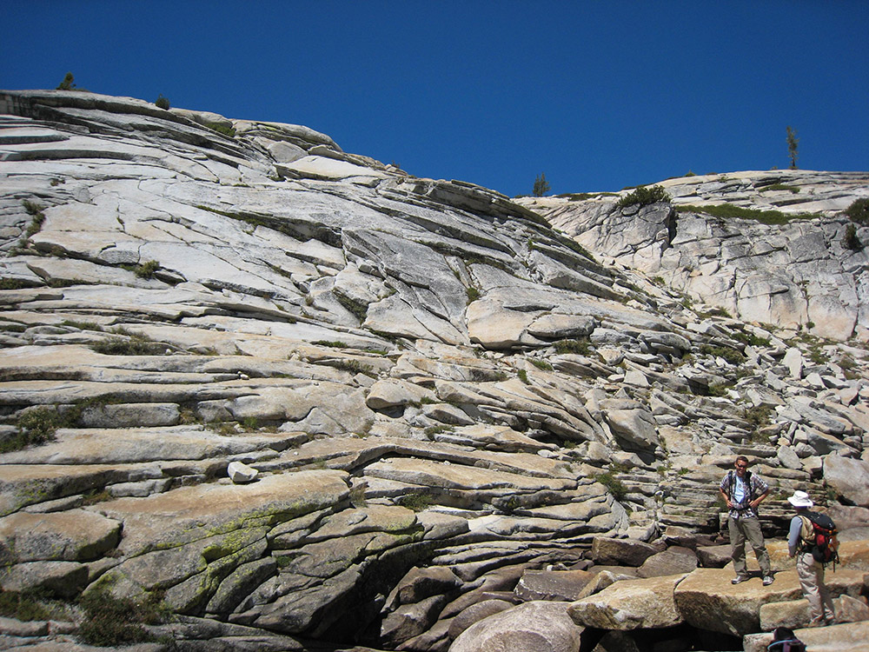
Physical weathering processes: (1) stress release in rocks subject to high tectonic or overburden pressure
“curvature fracturing”(?) – Martel GRL 2006
Valley-bottom fracturing
Tensile secondary unloading joints
St. Clair et al. Science 2015

Slide 55
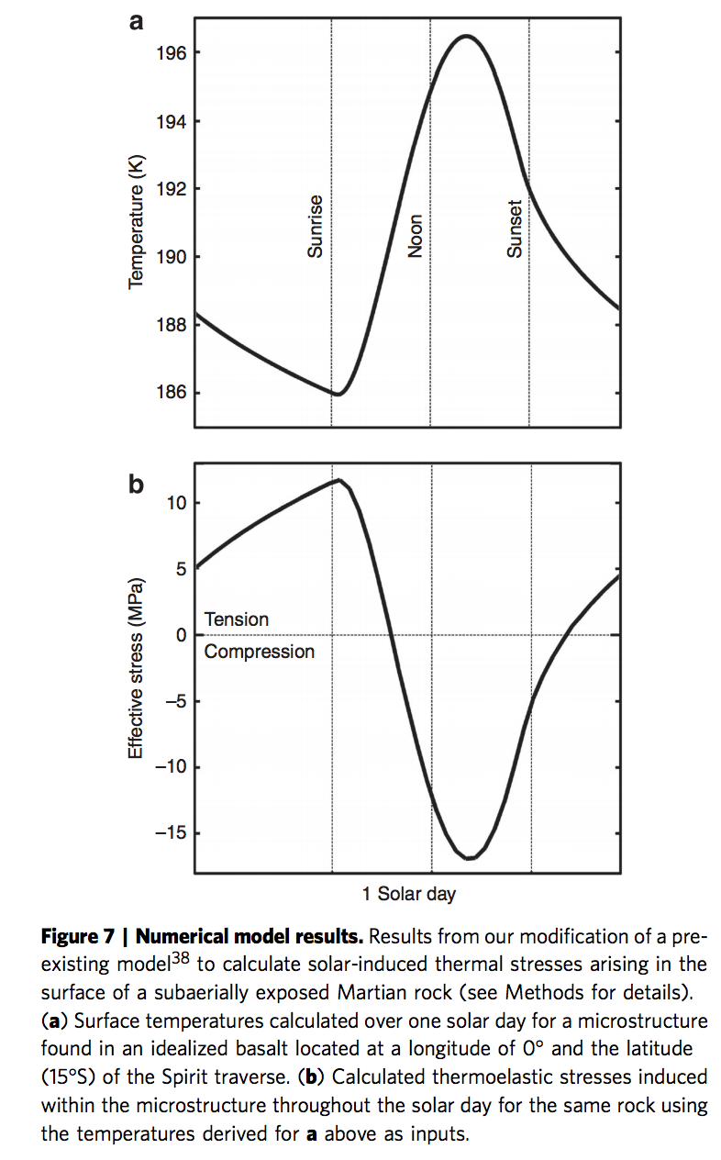
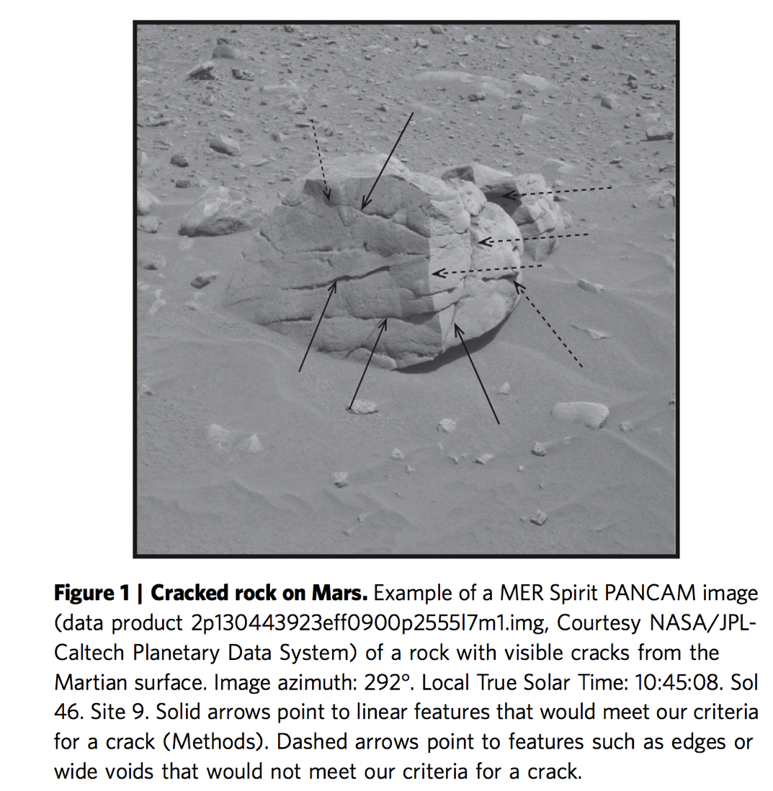
Physical weathering processes: (2) thermal cycling (hot day, cold night → stress gradient)
Eppes et al. Nature Communications 2015

Slide 56
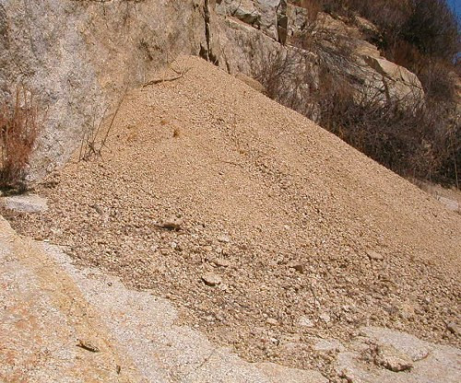
Physical weathering processes: (3) hydration (wetting and drying)
Swelling of micas → gruss on granites
Swelling of mudstones → clay
(4) growth in voids (frost, salt)
Hydrofracturing: thermochemical process at frost tip, not volume change
(5) Physical breakdown due to biota
Root growth, tree throw, burrowing
(6) Abrasion and comminution during transport
Discussed in previous lectures.

Slide 57
Chemical weathering processes: (1) solution Partial or complete dissolution of a mineral in a solvent; NaCl → Na⁺ + Cl⁻ (2) hydration Hydrolysis: addition of H2O to mineral; CaSO4 + nH2O → CaSO4.nH2O (3) hydrolysis
Chemical reaction due to H+ or OH- ions in water; i.e., water is reactant not just a solvent. E.g. albite NaAlSi₃O₈ + nH₂O → Na⁺ + OH⁻ + 2H₄SiO₄ + (1/2)Al₂Si₂O₅(OH)₄ kaolinite.
(4) chelation
Organic process by which metallic cations are incorporated into hydrocarbon molecules. (5) oxidation/reduction e.g. reddening of soils (ferrous → ferric)
(6) carbonation generation of bicarbonate ion and carbonic acid and its reaction with minerals.
Also: microbially mediated processes; pH due to respiration can be as low as pH 4.5
(this accelerates silicate weathering).

Slide 58
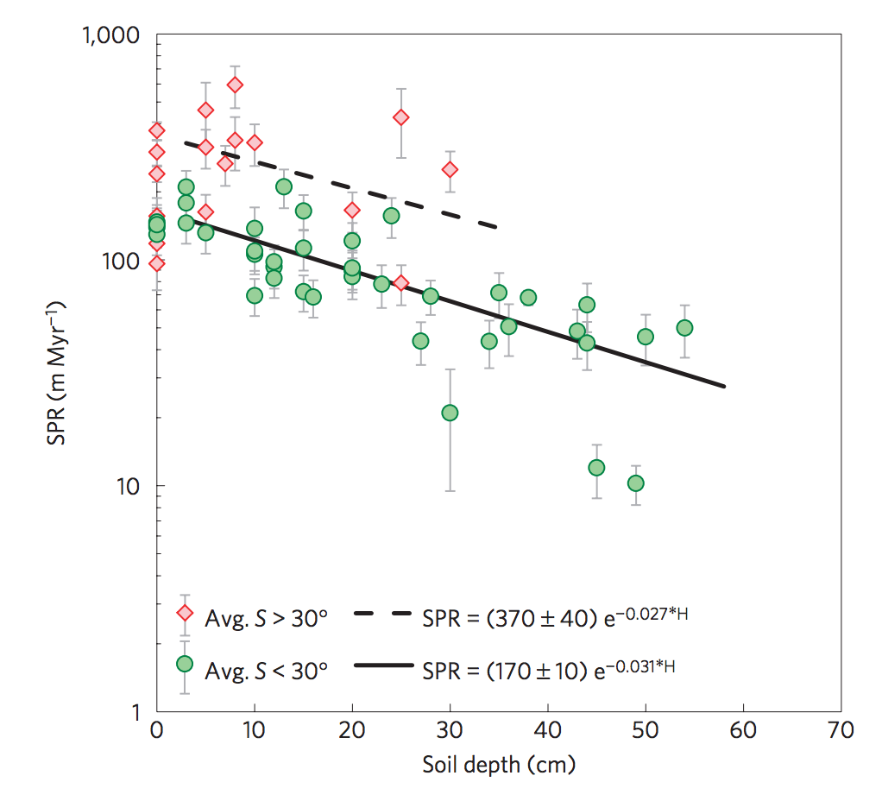
Soil Production Rate (SPR)
Heimsath et al., Nature Geoscience 2012
(bedrock exposed when erosion>max. SPR)
Soil production rates
quantified using
cosmogenic ¹⁰Be
(5 atoms/g/yr at sea level)
Earlier “humped” SPR
functions now considered
dubious
Transport-limited hillslope evolution
is well understood;
Weathering-limited hillslopes (e.g.,
Sierra Nevada) not well understood.

Slide 59
Fluvial sediment transport vs. hillslope processes: what controls the spacing of rivers?
REVIEW OF LAB 4
SETTING THE SPACING OF STREAMS
HILLSLOPE EROSION PROCESSES SOIL PRODUCTION FUNCTION
SYNTHESIS: PERRON ET AL. 2009

Slide 60
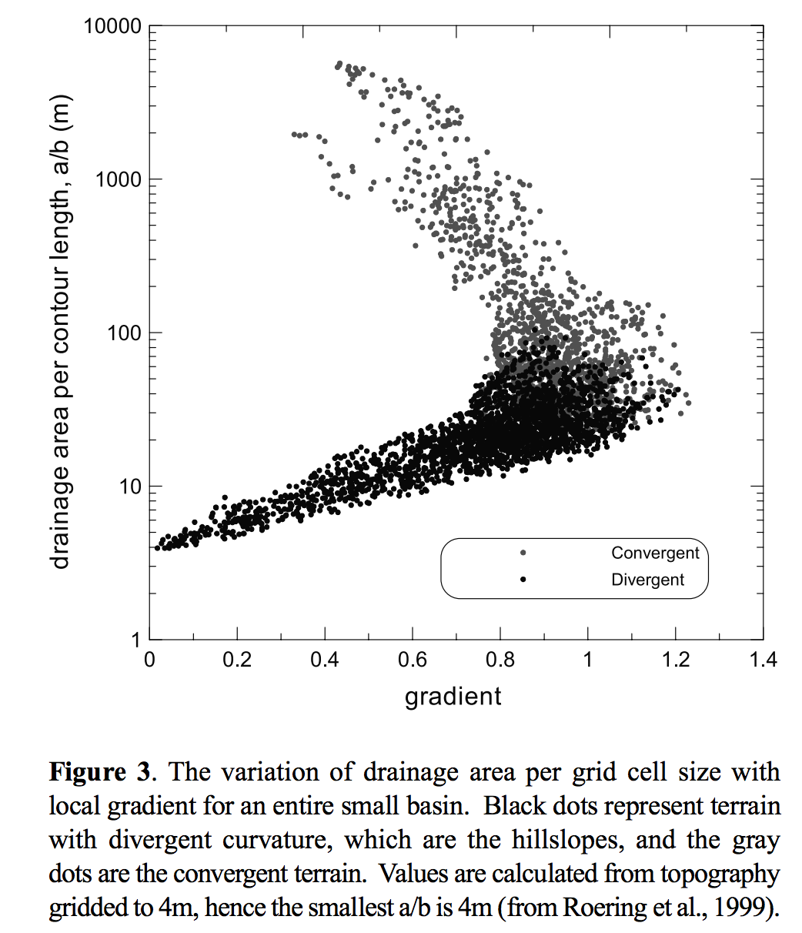
concave
convex
Dietrich et al. 2003
(supplementary reading)

Slide 61
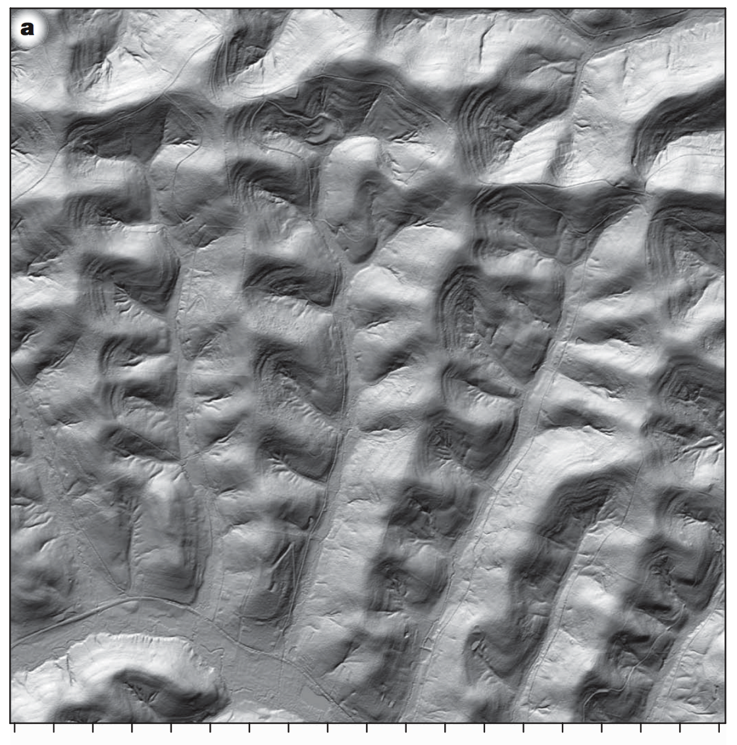
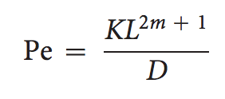
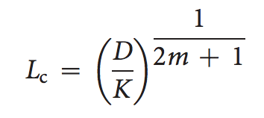
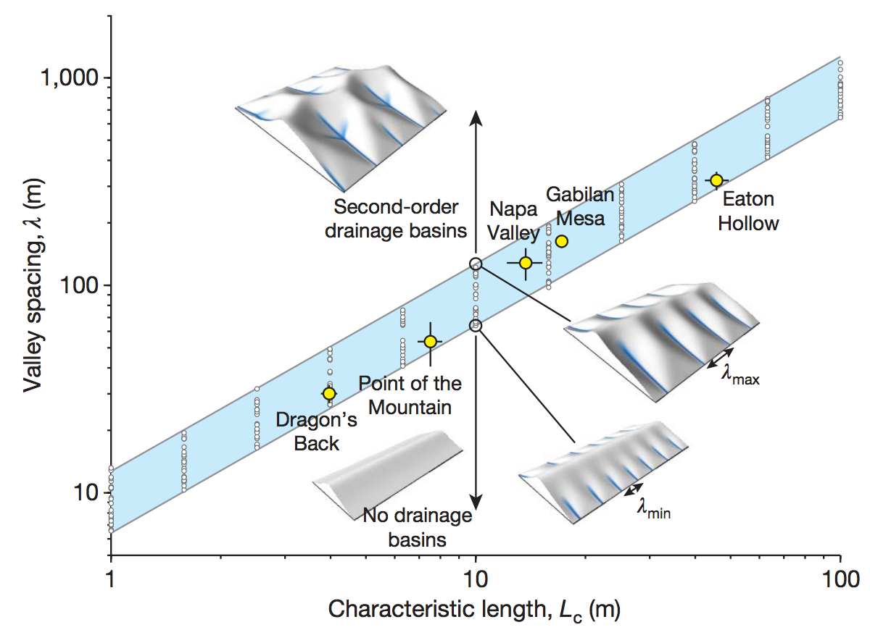
Set Pe = 1, solve for L:

Slide 62
Key points from today’s lecture
Explain mechanistically how streampower landscapes can act as a tectonic tape-recorder (from Lab 4).
Explain why steady-state hillslopes are convex.
Explain 2 or more hillslope transport processes.
Know 2 or more physical and 2 or more chemical weathering processes.
Understand how Peclet number can quantify competition between hillslope processes and fluvial channelization (see also required reading).

Slide 63
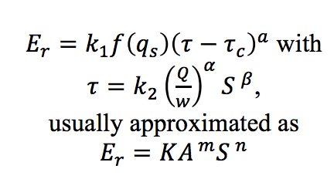
Perron, in press (on class website)

